Slide 1
Data warehouses in Hungarian state treasury
PEmpal

Slide 2
Contents
Different data warehouses
Technology
Integration or collaboration
Depersonalization
Reports assessment

Slide 3
Data warehouses in Hungarian state treasury
Agriculture and rural development
Social security and family support
Local government
Central government

Slide 4
Agriculture and rural development
Hungarian Paying Agency
EU and domestic support
Statistical reports
Fraud detection
Process monitoring
When, Whom, How much, Why

Slide 5
Social security and family support
Family supports
Pension
Cash benefits
Social supports
Rehabilitation supports
Permission / Statement / Payment
Life path from birth to death
When, Whom, How much, Why

Slide 6
Local government
Local taxes
Accommodation data
Company site authorization data
Municipal management
Document management

Slide 7
Central government
Payroll for the entire public sector
Appropriations
Payment transactions
Fulfillment
Subsidy
Institutional budget reports

Slide 8
Technology variegation
Agriculture and rural development
Social security and family support
Local government
Central government

Slide 9
Status
Live
Ongoing
Agriculture and rural development
Social security and family support
Procurement
Just before golive
Local government
Central government

Slide 10
Integration or collaboration
Agriculture and rural development
Social security and family support
Local government
Central government

Slide 11
The key to collaboration
Linking elementary data
Depersonalization
MDM
(Master Data Management)
S–ID + M–ID
P–ID + S–ID
Source systems
Forrás-rendszer
S–ID + M–ID
Data + S–ID
Data
Warehouse 1
Data Warehouse 2
M–ID

Slide 12
traditional data warehouse features
Consolidated
Historical
Business focus
Optimized for analysis
Itemized
Authentic
Automated

Slide 13
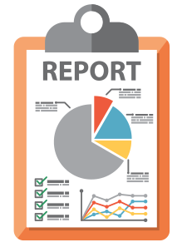
Public finance reports assessment
148 Reports
489 Queries or sheets
392 Different queries
322 Subjects

Slide 14
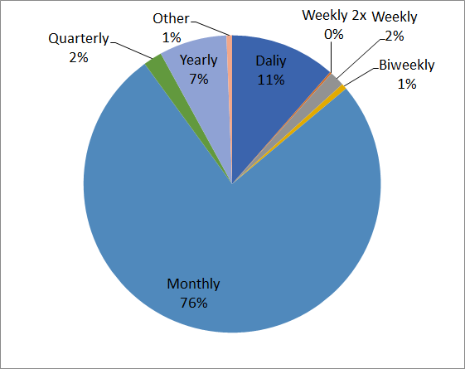
Report frequency

Slide 15
dimensions
Entity | Number of subjects
Economic Classification | 22
Administrative Classification | 30
Functional Classification | 5
Institution | 39
Bank account | 24
Appropriations | 30
Transactions | 29
Special hierarchy | 13

Slide 16
IFMIS project
The main objective of the project is the improvement of information processes in public finances, the rationalization of public data and information flow, the development of a data warehouse and the development of decision support functions supporting modern budget implementation tasks and the increase of transparency.
This project is part of a large, strategic-level program plan, other elements of which are the development of a Treasury Data Warehouse, the creation of a central master data management system and the development of a new account management - banking system.

Slide 17
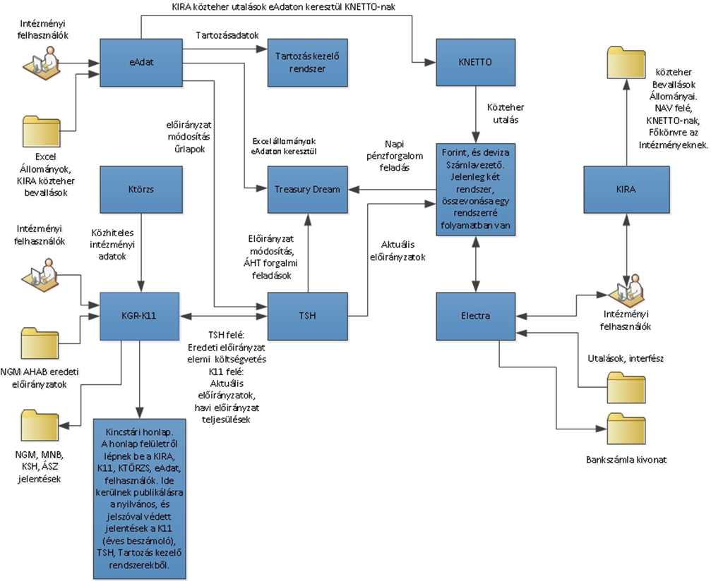
Present system

Slide 18
Components of the IFMIS
3 Components:
Budget Module: Budget Management, Commitment Management, Payments and Revenue Management, Liquidity Management, Budget Monitoring.
Integrated Accounting Application: Accounting application for centrally managed appropriations.
Institutional accounting system: new accounting system for spending units.

Slide 19
Main systems in cooperation
Budgetary Planning:
Ministry of Finance
(Not part of the IFMIS)
Budget implementation:
Account management system
Data Warehouse
MDM
Payroll and HR (KIRA)
Public purchase
Reporting
KGR-K11 will not be replaced

Slide 20
Systems’ transformation
Pensions
Wages
Family subsidies
K11
IFMIS
Bank accounts management system
TSA
Spending units

Slide 21
Planned technological background
Central Module and Integrated Accounting Application: SAP Platform
Data Warehouse: SAP HANA
Supply Systems, EER Project: SAP Platform
Institutional accounting system: not SAP
New Account Management System: Not SAP

Slide 22
Scheduling of the IFMIS project
Preparatory phase from 2016
Public purchasing processes: 2018-2019Q1
Detailed Design: Starts in 2019Q2
First phase of implementation: Functional design of the central module without integration points, establishment of institutional frontends, development of MDM integration. Deadline: 31 December 2019
Phase 2: Integration with the new Account Management System, Integration with the Integrated Accounting Application and Institutional Accounting System. Deadline: 30 June 2020
Testing, migration, go-live: 01 January 2021

Slide 23
Thank you for your attention!

