Slide 1
PEM PAL Budget Community of Practice (BCoP) “The Role of Austria's Parliament in Budgeting” The Austrian Parliamentary Budget Office Vienna, 30th January 2014
Helmut Berger
Parliamentary Budget Office

Slide 2
Content
Parliamentary Budget Offices as Part of Fiscal Governance
Establishment of the Austrian Parliamentary Budget Office
Products and Services
Leading Principles and Strategic Approach
Input in the Parliamentary Discussions
Relations with other Institutions
Challenges

Slide 3
Parliamentary Budget Offices as Part of Fiscal Governance

Slide 4
Rationale for Parliamentary Budget Offices and Independent Fiscal Institutions (I)
Improvement of the political decision process
Government independent analysis and assessment of budget drafts, broader fiscal and economic issues, budget related documents and reports or more generally of the fiscal policy of the Government
Raise quality of debate and scrutiny: “challenge” function
Reduction of information asymmetries between Government und Parliament
Provision of a strong professional resource and government independent expertise for Parliaments (and public discourse more generally)
Promotion of fiscal transparency
Promotion of government accountability

Slide 5
Rationale for Parliamentary Budget Offices and Independent Fiscal Institutions (II)
Support of a sustainable and anti-cyclical budget policy and more generally enhancement of fiscal discipline
Preparation or endorsement of budget forecasts
Preparation or endorsement of costings and impact assessment in the legislative process
Illustration of alternative decisions and possible consequences and government independent advise: “consulting” function
Integration of underrepresented political interests in the political debate (e.g. future generations, gender equality, social and political diversity)

Slide 6
Issues to Consider
Definition and scope of the mandate
Institutional framework to assure independence and competence
Staffing and necessary resources in respect of the mandate
Relationship to Parliament and to Government
Communication to Parliament, parliamentary committees and individual members of Parliament
Access to government information
Assuring transparency in operations and published reports
Attention and acceptance by stakeholders
Access to the public, media and other stakeholders
Split of functions and competences across different bodies
Establishing relations to other relevant fiscal institutions and a professional network to assure quality

Slide 7
Establishment of the Austrian Parliamentary Budget Office

Slide 8
Establishment of the new Parliamentary Budget Office
Longstanding efforts to provide Parliament with immediate and government-independent budgetary expertise and to strengthen its position in relation to government
New budget law confers former Parliament’s rights in budgetary matters to a higher level of aggregation (70 global budgets instead of more than 1100 individual budget lines) and requires additional technical knowledge
Strengthening of the parliamentary budgetary control:
Additional reporting requirements for the Minister of Finance
Establishment of the new independent Parliamentary Budget Office as a pilot project to
=> provide government-independent and objective analysis
=> support Parliament, in particular the Budget Committee in budgetary matters

Slide 9
Basic Documents
Political agreement between the all political parties represented in the Austrian national assembly
Statement of the Budget Committee of the Austrian Parliament, 10th November 2011 (1510 d.B. XXIV. GP)
Establishment without specific legal basis, based on the following principles:
PBO shall
Work independently and ensure high-quality expertise
Submit analysis to all political parties
Ensure transparency and publish results on parliament’s homepage

Slide 10
Resources and Organization
Planned staffing: in total 8 employees (6 academic experts, 2 assistants)
Recruitment procedures require public competition
Recruitment status end of January 2014:
Head of PBO (appointed in July 2012)
4 academic experts (primarily economists)
2 assistants
1 position open
PBO is a unit of the Parliamentary Administration, within the Department of Legal, Legislative and Research Services, however the PBO has a specific mandate to support and consult Parliamentarians and especially the Budget Committee directly

Slide 11
Mandate
To support Parliament in the budgetary process, in consulting and enacting budget laws and exercising its oversight role.
Key tasks:
(1) To support the Budget Committee in form of written expertise, analysis and short studies on budgetary matters presented by the government according to Federal Organic Budget Act (e.g. draft fiscal framework and budget, reports)
(2) To prepare brief information upon request of members of the Budget Committee
(3) To support other parliamentary committees regarding impact assessment of new legislation
(4) To consult the Parliament on performance budgeting and the effective equality of women and men (gender budgeting)

Slide 12
Leading Principles and Strategic Approach

Slide 13
Leading Principles of the PBO
Independence and objectivity
Support in substantive matters of budget approval and budget control
Direct access to Members of Parliament
Customer focus
Equal treatment and equal distance to all political parties
High quality performance through competent staff
Enhancement of transparency
Publication of results on the website of Parliament

Slide 14
Strategic Approach
Main objective is to support parliamentary work in budget matters an so further strengthen Parliamentarism
Contribution to increase the accountability of Government towards Parliament and the Public
PBO as service provider especially to the Budget Committee and in some cases to other Parliamentary Committees
Products and services are orientated on the tasks and needs of the Budget Committee
Recipients of products and services are primarily members of Parliament, their parliamentary groups and their staff involved in budgetary issues
All products and services are also available to the public and published on the website of the Parliament
PBO takes part in meetings of the Budget Committee and the head of the PBO may be heard from members of the Committee in his expert role

Slide 15
Products and Services

Slide 16
Catalogue of Products & Services
Developing products and services
Basic statement of the Budget Committee
Asks Head of PBO to elaborate a catalogue of deliverables and related services to be agreed upon with the budget speakers of the parliamentary groups
Specifies examples for expected products and services
PBO submitted a draft to the budget speakers of the parliamentary groups in the last legislative period
As the current legislative period only started recently, agreement with the new budget speakers is envisaged in the coming months

Slide 17
Catalogue of Products & Services (Draft)
Ongoing analysis:
Written expertise, analysis and short studies on all budget-relevant draft documents presented by Government, in particular
Medium Term Expenditure Framework (MTEF)
Annual Federal Finance Act
Draft documents in connection with the European Semester (e.g. Annual Growth Survey, Austrian Stability Programme, National Reform Programme)
Austrian Stability Pact
Fiscal Equalization Law

Slide 18
Catalogue of Products & Services (Draft)
Ongoing analysis:
Support the Budget Committee to control budget execution. This includes analysis of
Reports on budget controlling and of monthly reports on budget execution
Reports on investment and financial controlling
Reports on outcome controlling
Subsidy reports
Reports on borrowing, assumption of liabilities, financial debt and currency swap agreements

Slide 19
Catalogue of Products & Services (Draft)
Analysis upon request:
Responses to budget related questions of the Budget Committee or its members
Statements or short studies
Response in order of arrival of the request and depending on personnel capacity
Analysis out of own initiative:
Analysis on certain budget relevant topics
Comments on impact assessements, in particular of financial consequences of new legislation

Slide 20
Catalogue of Products & Services (Draft)
Recommendations on the improvement of budget reports and documents and on development of budget laws
Participate in the evaluation and further development of the Federal Organic Budget Act
Provide suggestions to the Budget Committee on how to further improve budget documents and reports
Consultation services on performance and gender budgeting
Consultation regarding impact assessment of new legislation as requested by committees

Slide 21
Catalogue of Products & Services (Draft)
Information and knowledge transfer:
Information services for the Budget Committee on economic and fiscal data
Presentations on new technical budgetary instruments or formats
Information exchange with relevant stakeholders
Ministries
Austrian Court of Audit
Austrian Fiscal Council
Statistics Austria
Establishment of networks with scientific institutions (e.g.Austrian Institute for Economic Research, Institute of Advanced Studies)
Exchange of expertise in different forums
Publications
Provision of budgetary and economic information on the website
Link Budgetdienst

Slide 22
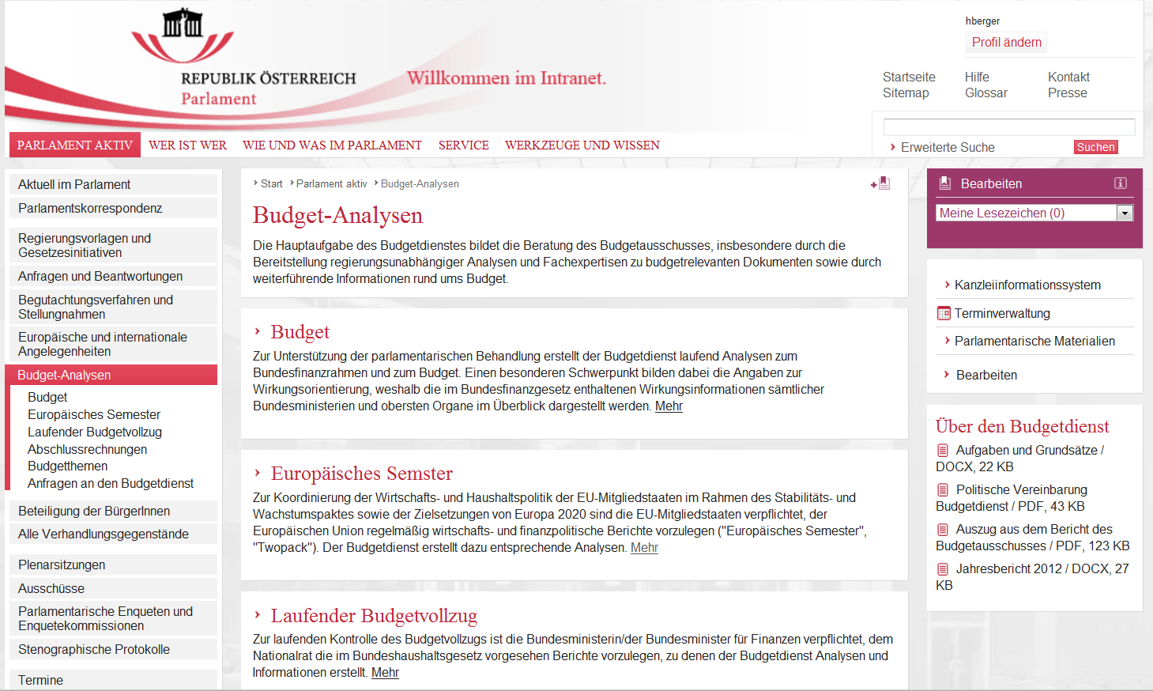
Budget-Analysen - Budgetdienst

Slide 23
Catalogue of Products & Services (Draft)
Establish international networks and represent the Parliamentary Administraion in budgetary matters
Collaborate with international partners (Worldbank, OECD Parliamentary Budget Officials Network, EU Institutions)
Information exchange with the European Centre for Parliamentary Research and Documentation (ECPRD)
Assistance in the organization of international events on budget-relevant issues

Slide 24
Relations with other Institutions

Slide 25
Relations with the Government
Ministry of Finance
Permanent contact on presented documents
Mutual presentations on budgetary issues or developments
Federal Performance Management Office (Federal Chancellery)
Participation in jour fixe meetings with the line ministries
Line Ministries
Participation in networking meetings of senior budget officials
Consultation on budgetary issues
Mutual exchange of information

Slide 26
Relations with Independent Institutions and the Scientific Community
National Statistical Institution (Statistics Austria)
Member of the Advisory Board for Economics
International Monetary Fund (IMF)
Information point for Article IV Consultations
Court of Auditors
Austrian Institute for Economic Research (WIFO) and Institute for Advanced Studies (IHS)
Presentations on interesting developments
Regular but informal exchange of information

Slide 27
Relations with Independent Institutions and the Scientific Community
Fiscal Council
According to requirements of the European Union the Compliance with country-specific numerical fiscal rules shall be monitored and supported by national independent institutions
The existing (established already in 1970) Government Debt Committee will act as independent fiscal institution and be renamed “Fiskalrat” (Fiscal Council)
The Fiscal Council analyses public finances and presents recommendations on the fiscal policy
The Austrian National Bank and Parliamentary Budget Office will participate in an advisory function without a vote
PBO will feed Fiscal Coucil recommendations into Parliamentary Debate

Slide 28
Input in Parliamentary Debate

Slide 29
Input by the PBO (I)
Raising awareness of all stakeholders and consulting services for the Budget Committee especially regarding
Analyses of macroeconomic developments and fiscal sustainability (e.g. implementation risks for the expenditure framework)
Analyses of changes in the expenditure and income structure
Analyses of changes in the taxation structure
Analyses on outcome orientation (e.g. stronger harmonisation of targets between different line ministries)
Analyses on gender budgeting and gender equality (e.g. missing gender-disaggregated data, ambitious targets)
Input for further development – e.g. transparent budget with regard to diversity (considering people with migration background, generations, disabled people)

Slide 30
Input by the PBO (II)
Raising awareness of all stakeholders and consulting services for the Budget Committee especially regarding
Propose improvements of the budgetary document´s setup
Create of maps giving an overview on performance information ( objectives, measures and indicators) to improve transparency
Recommend enhancement and improvement of reports presented by Government (e.g. subsidy report)
Knowledge and information transfer (e.g. presentations, expert hearings) within and outside Parliament
Publication of results on Parliament’s website

Slide 31
Budget Analysis 2013
Changes of the Medium-Term Expenditure Framework
Implementation of the new budget law
Budgetary focuses
Macroeconomic framework
Recommendations of ECO-Fin, IMF, OECD
Trends in expenditures and revenues
Taxes and duties
Debt and interests
Development of reserves
Gender Budgeting

Slide 32
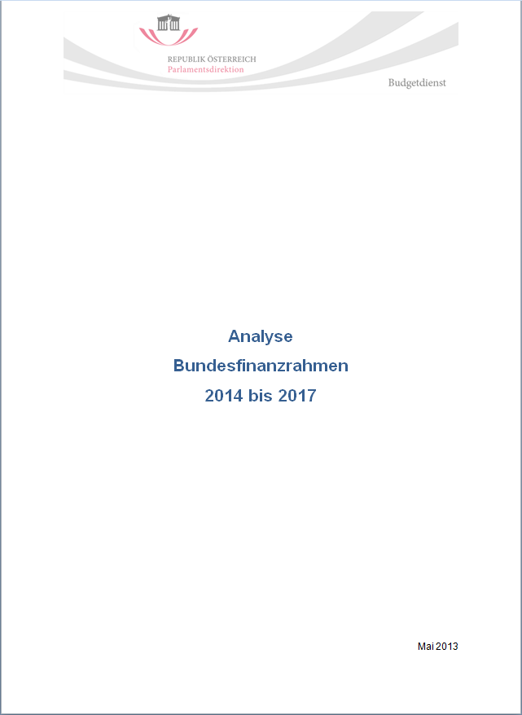
Analysis of Medium-Term Expenditure Framework 2014 - 2017
Focus of the MTEF
Analyses of the expenditure and income development
Expected macroeconomic environment
Reaction in the MTEF to new challenges
Risks for the implementation of the MTEF
Reflection of other government strategies
Improvement of the strategy report

Slide 33
Challenges

Slide 34
Challenges 2014
Finalization of the catalogue of products and services in coordination with the Budget Committee
Development of working relations and procedures with the Budget Committee and other committees (regarding impact assessment on new legislation)
Development of working relations and working procedures with governmental units
Further clarification of the access to budgetary information held by the government
Knowledge transfer in both directions
Creating a data base on fiscal and economic issues
Integrating new staff members

Slide 35
Thank you for your Attention
Contacts:
Helmut Berger
Head of Parliamentary Budget Office
Parliament, A-1017 Wien, Dr. Karl Renner-Ring 3
Tel. +0043 1 40 110-2889; +0043 676 8900-2889
E-mail: helmut.berger@parlament.gv.at

