Slide 1
UNIFIED INFORMATION SYSTEM FOR INTERNAL AUDIT

Slide 2
USERS
• Head on Internal Audit Division
• Group Leaders
• Auditors
• Entity’s Head
• Authorized Body
• Administrator

Slide 3
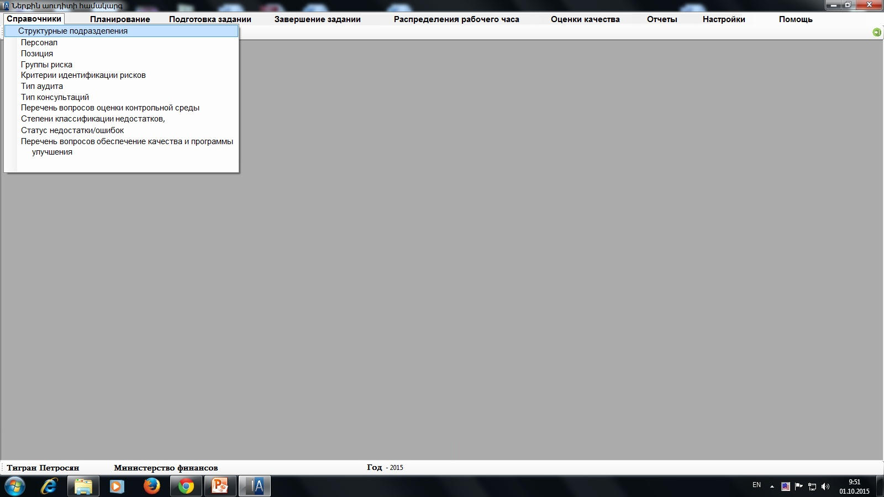

Slide 4
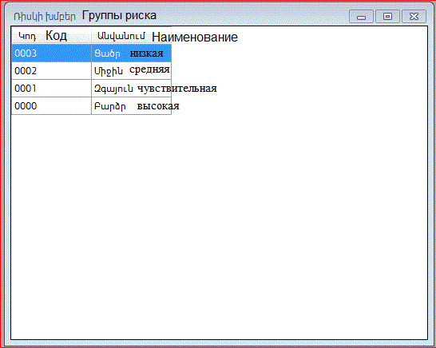

Slide 5
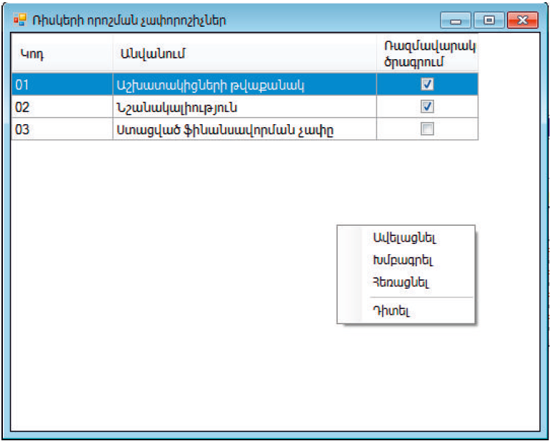
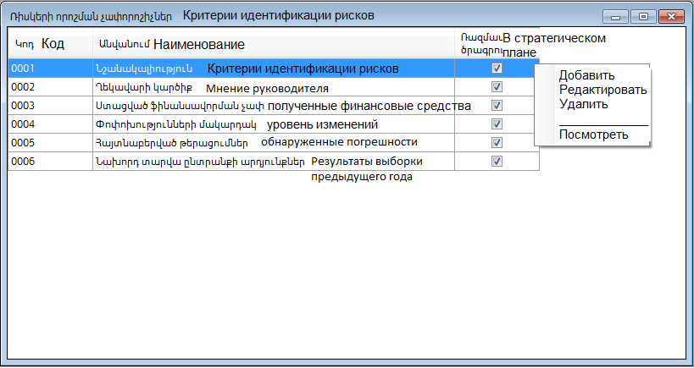

Slide 6
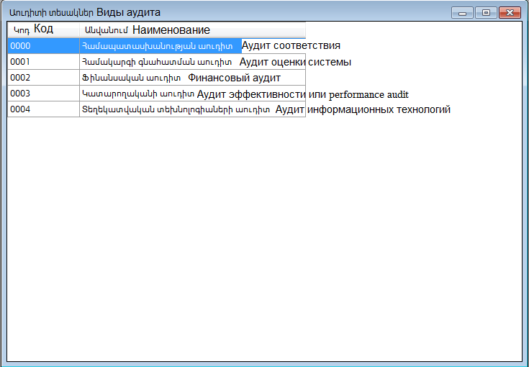

Slide 7
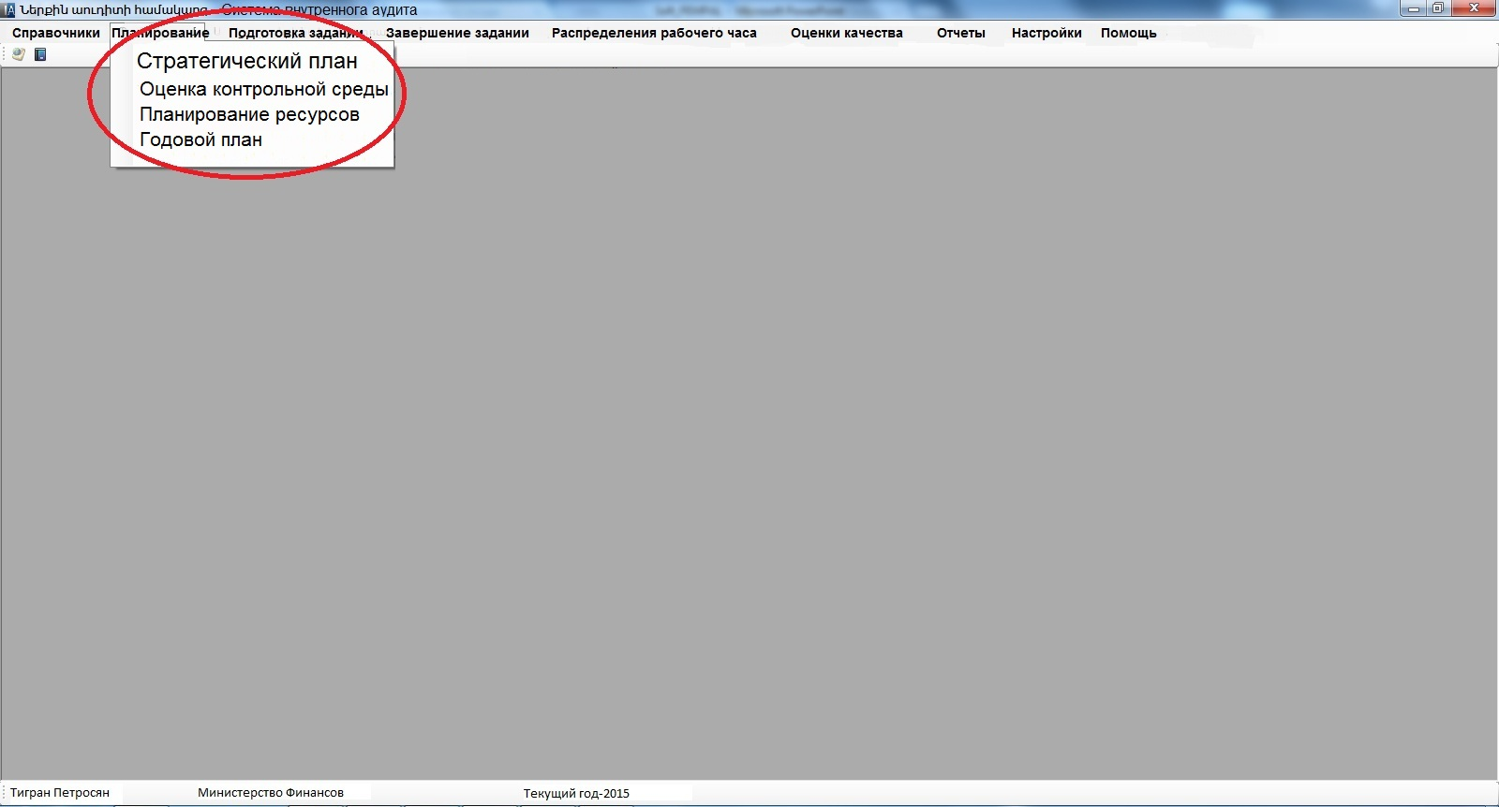

Slide 8
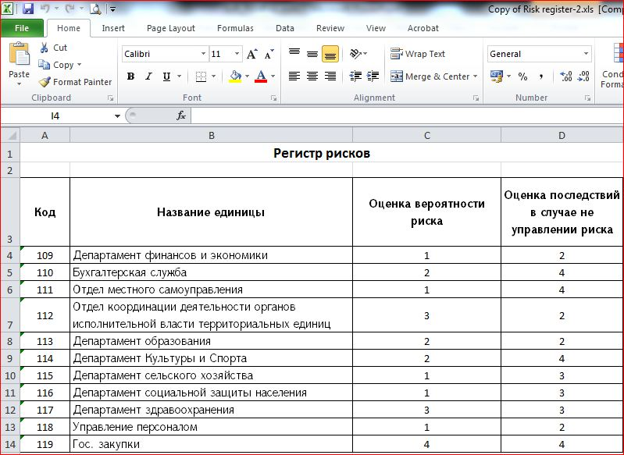

Slide 9
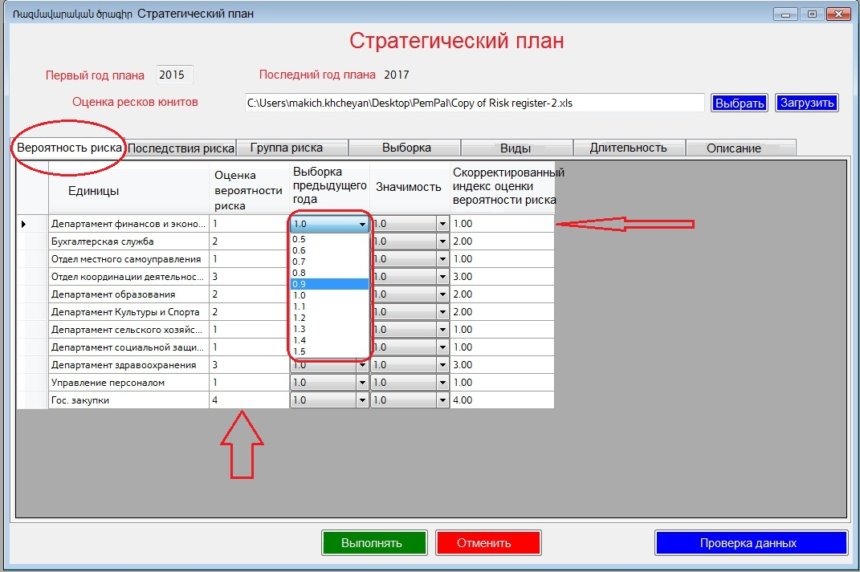

Slide 10
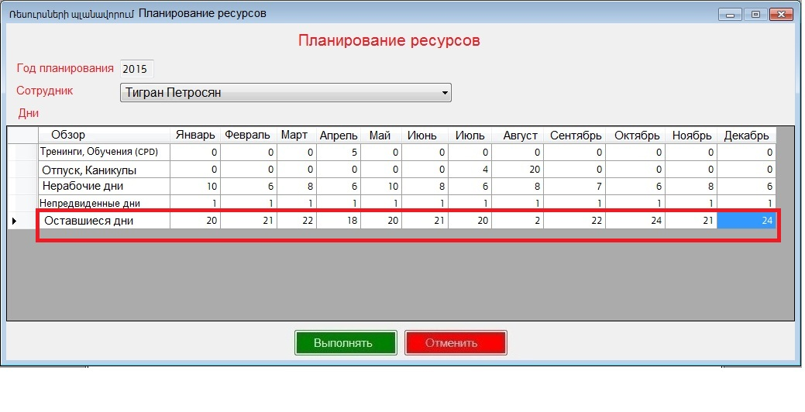

Slide 11
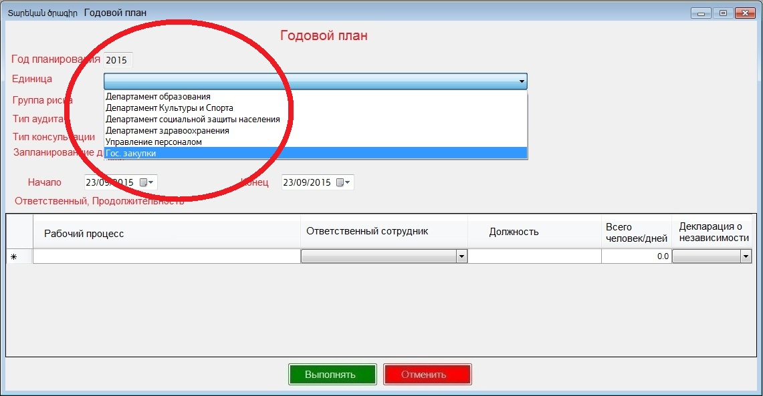

Slide 12
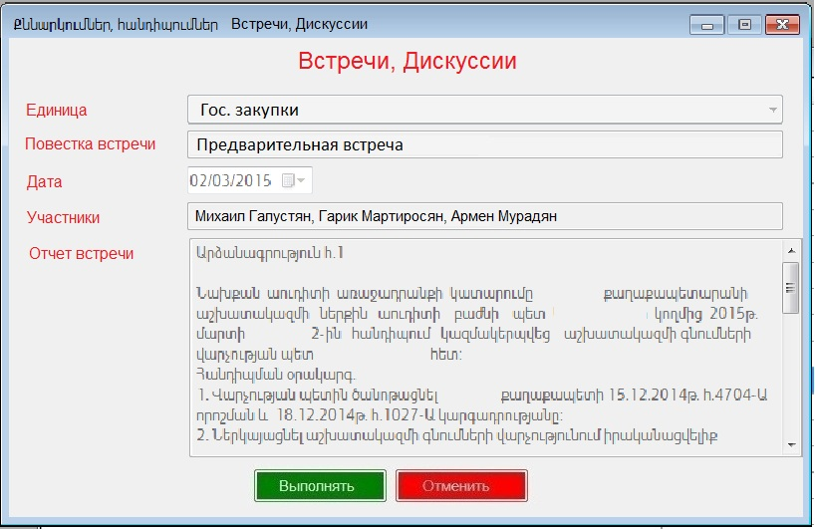

Slide 13
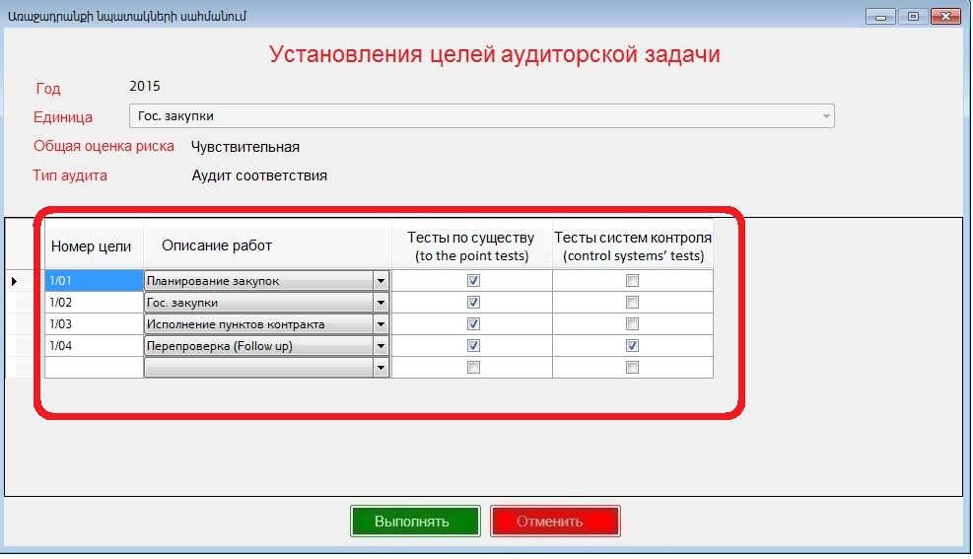

Slide 14
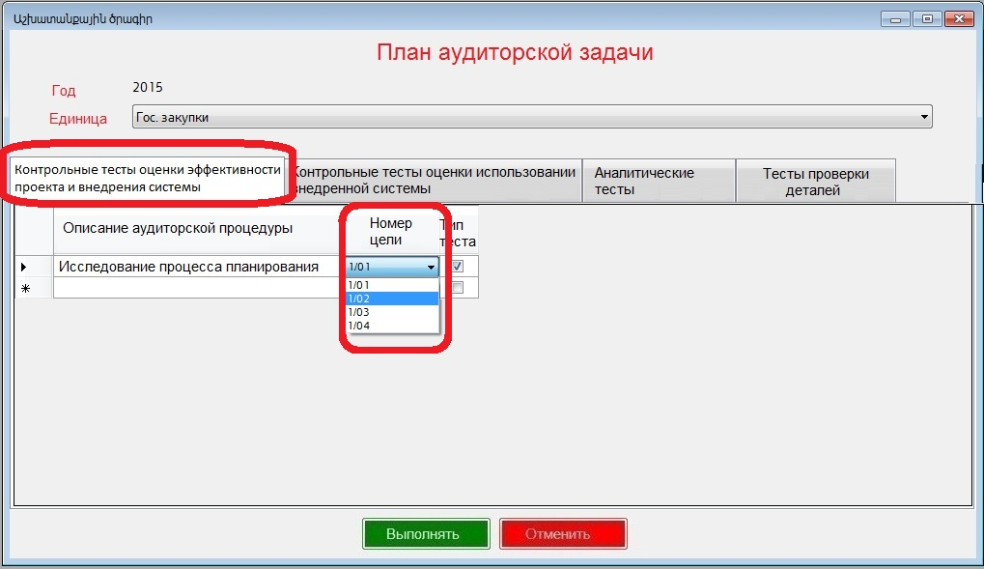

Slide 15
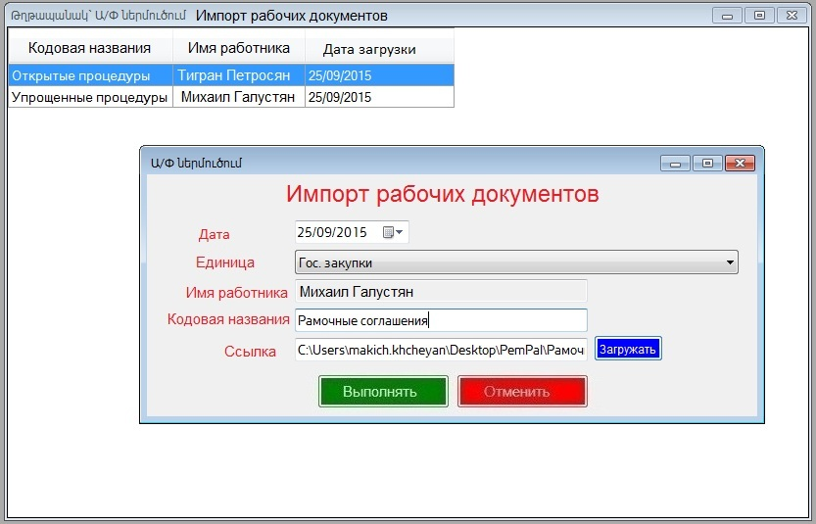

Slide 16
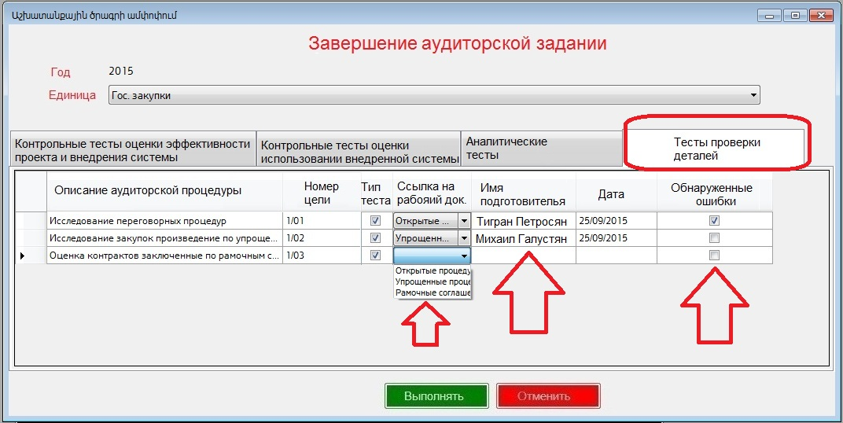

Slide 17
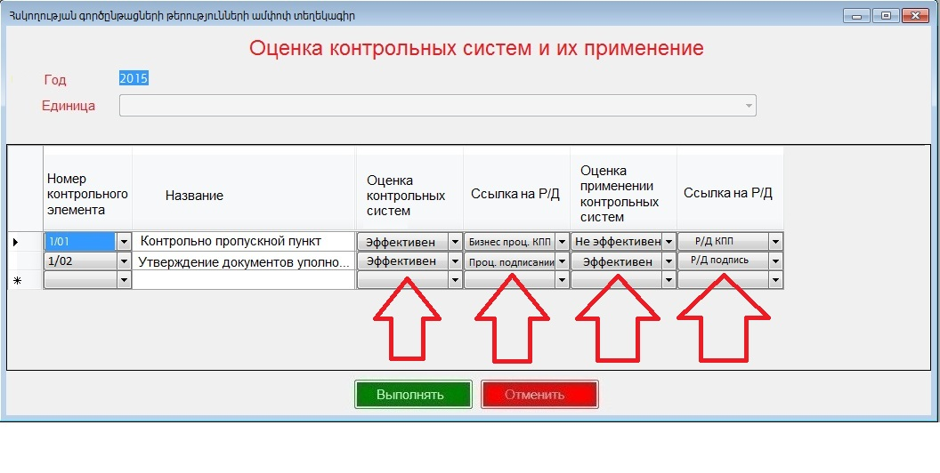

Slide 18
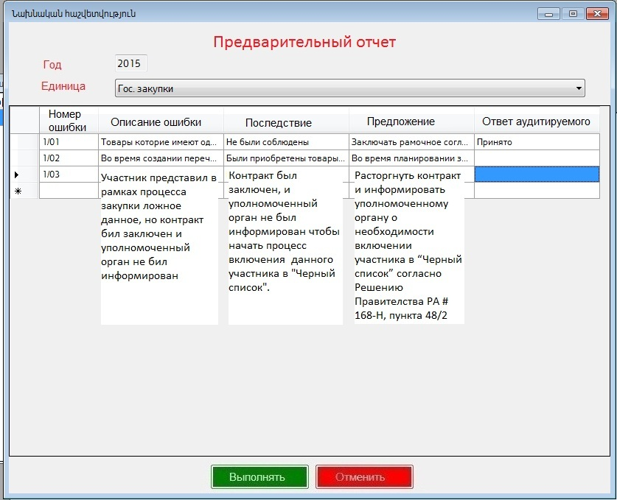

Slide 19
THANK YOU FOR YOUR ATTENTION!
Karen Sedrakyan
Head of Internal Audit Department
Email: Karen_Sedrakyan@taxservice.am
Tel. +374-60-544-789

