Slide 1
Treasury Reference Model
Key Treasury Reform Priorities
Implementation Pointers
and Sequencing
Ali Hashim
Consultant Treasury Systems
World Bank

Slide 2
Treasury Reference Model –TRM*
TRM was developed to:
  Assist Bank and IMF member countries in implementing Treasury Reforms
  Inform manufacturers of COTS Package software of key Treasury functional requirements to enable them to incorporate these requirements in products that had been primarily designed for the private sector.
Describes essential aspects of Treasury Reform, core Treasury Functional processes and key activities involved in setting up Treasury Systems.
Shows how Treasury processes fit in the overall set of processes and systems for Government Fiscal Management- GFM

Slide 3
Presentation outline
Part I: Re-visits some of the topics covered in the TRM including:
  Rationale/Objectives for Treasury Systems
  Policy Pre-Requisites
  Scope and Functionality of Treasury systems
  Technological Considerations
Part II: Summarizes some implementation experiences
Part III: Gives some implementation pointers
Part IV: Discusses some sequencing issues involved in extending the scope of Treasury systems to cover broader GFM processes

Slide 4
Part I: Treasury Systems
Basic Concepts

Slide 5
Define the correct rationale for setting up Treasury systems – what is the problem that we are trying to solve.
Pre-Reform situation I
In transition economies there was a lack of a legal framework, institutional structures and accompanying systems required for management of Government finances:
    Spending units were allowed to open up Bank accounts outside the control of the MOF and the MOF transferred money to these accounts periodically.
    As a result sizable idle balances could build up in spending unit bank accounts while the MOF was in deficit in overall terms
    MOF had no means to exercise control to ensure that expenditures are in accordance with budget appropriations
    Other resultant problems, like lack of timely information on expenditures and revenues required for economic management, statutory reporting, base line data for budget preparation

Slide 6
Pre-Reform situation II
  In other countries the legal and institutional structures for management of Government finances did exist but were /are in need of repair since they are frequently bypassed
    Erosion of controls (e.g. appropriation control)
    Blurring of the roles and responsibilities of participants (SU- Treasury)
    Multiplication of bank accounts outside the control of the Treasury – e.g. personal ledger account
    This resulted in essentially the same situation as that in transition economies with regard to lack of MOF control over government finances, expenditures and availability of timely information for economic management.

Slide 7
The Solution is defined by the problem -
Two part solution
  A- Set up /repair policies and institutional structures required for management of government finances
    Transition economies- There was a need for building the legal framework and institutional structures ab-initio to enable the MOF to regain control over the financial resources and ensure that expenditures are in accordance with budget appropriations
    In other countries – There is need to build on and repair the existing policies, structures and systems- to plug the leaks

Slide 8
B - Set up systems that ensure that these policies are implemented without exception
Systems should enable
Better Fiscal control:
    By ensuring that expenditures are in accordance with budget appropriations, commitments and cash allocations
    Close monitoring of outstanding bills, cash in Government bank accounts, arrears and fiscal deficits
Better cash management
    By bringing all government accounts under the control of Treasury and consolidation in a Treasury Single Account (TSA)
    By reducing idle balances in Government Accounts and improved planning for cash
Timely and accurate reporting for Economic management and in Preparation of statutory financial statements
Improved quality of baseline data for budget preparation

Slide 9
Implementing the solution requires - Legal and Institutional Reforms
A budget management law for management of public funds and property provides the legal basis for Budget Execution Systems
  Specifies the roles and responsibilities of the MOF, Treasury and Line Agencies;
  Specifies the authorities and responsibilities for:
    Receipt and custody of public funds
    Public expenditure management control processes,
    Management of Public Debt, Accounting, Financial Reporting and Audit

Slide 10
Policy Pre-Requisites - Institutional Setting
May require changes in Institutional arrangements for banking Government funds and processing payment transactions
  Consolidation of bank accounts in a Treasury Single Account (TSA) held at the central bank
  Setting up a Treasury organization with a network of offices located country wide. (or locating Treasury staff with SUs)
  Re-engineering payment processes and routing all payment transactions through the Treasury/ out posted Treasury staff
  Re-engineering all receipt processes to ensure revenues are directly deposited in the Government account

Slide 12
Policy Prerequisites - Budget Classification System
Adoption of a budget classification system consistent with the IMF’s GFS
  Design of a chart of accounts embodying this classification
  Budget classification structure would need, as a minimum, segments for function, organization and economic classification.
  The function and economic classification structures need to be consistent with IMF’s GFS.
  Additional segment may be used to classify and monitor budgets and expenditures by Level of Government, Source of Funds, Programs, Projects and Activities.
  Note: Additional segments will entail additional work by transaction processors while recording actual transactions.

Slide 13
Treasury systems- Scope
Systems provide support for:
Budget Execution
  Budget Management
    Budget Apportionment, Budget Allotment,
    Budget Releases, Budget Transfers
  Commitment Management – Recording all commitments relating to intended government expenditures
  Payment Management- Processing all government expenditures relating to:
    Procurement of goods and services from current/capital budgets
    Salary and Pension Payments
    Debt servicing payments
    Subsidies/Fiscal transfers to sub-national levels or SOEs
  Receipts Management - Recording revenues and other receipts
Accounting (posting all transactions as they occur)
Cash Management
Fiscal Reporting

Slide 14
Treasury systems- Functionality
  Systems Record
    Initial budgets, budget revisions, budget releases
    Commitments
    Purchase orders, Contract details
    Receipt of goods and services
    Vendor Invoices
  Authorize payments after checking for controls
  Give payment instructions to Bank
  Record revenues and other receipts paid into Government accounts
  Reconcile with bank records
  Enable monitoring of balances in Government accounts
  Enable posting of all transactions, enforcement of controls, accounting and comprehensive reporting
Ensure that these functions are performed by authorized staff only

Slide 15
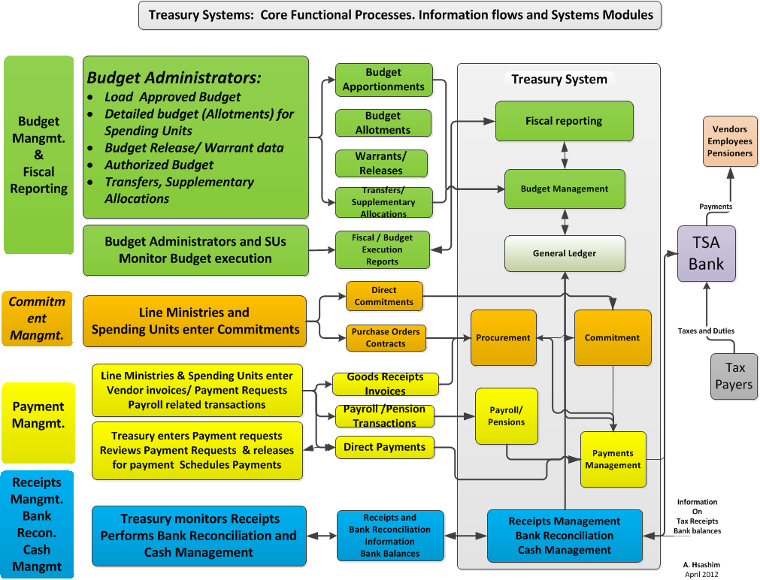

Slide 16
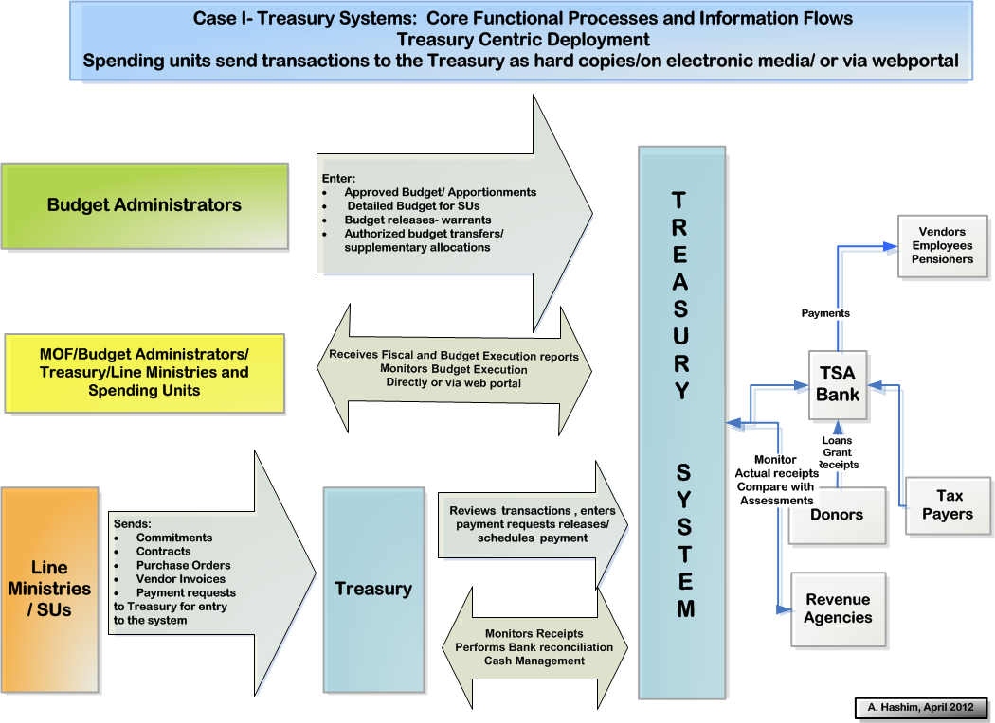

Slide 17
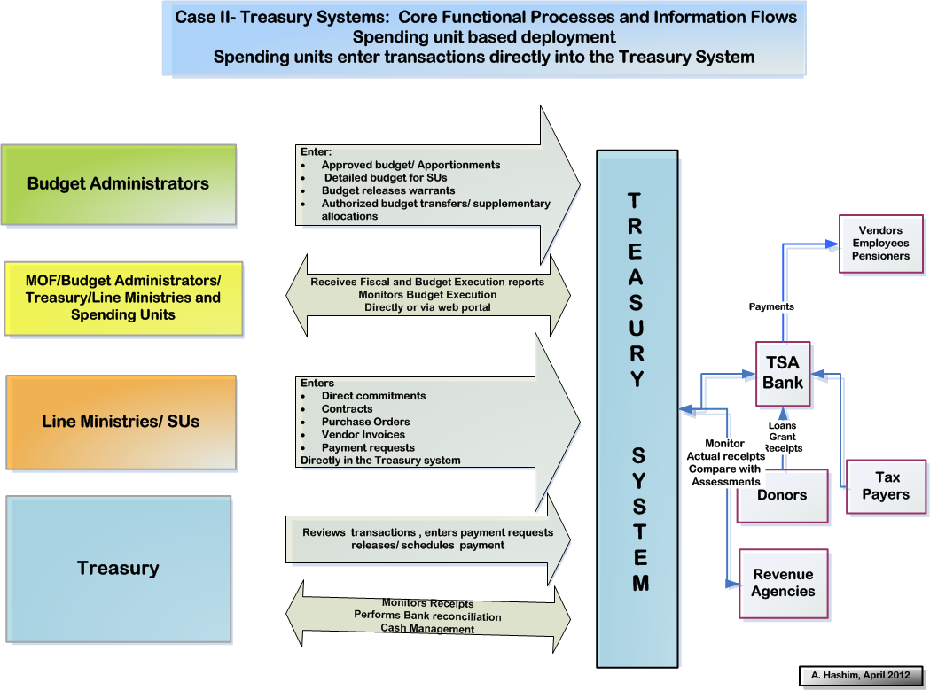

Slide 18
Treasury Single Account
Basic Requirements
All government financial resources should be under the control of the Treasury;
The Treasury should be in a position to determine the magnitude of these resources at any given point- i.e. the balances in Government accounts;
All expenditures from the TSA should be subject to budgetary controls;
All government receipts should be deposited in the TSA.
TSA is normally located at the Central Bank
However, often the Central Bank uses commercial banks as its fiscal agents to collect revenues and pay government creditors.

Slide 19
Technology Requirements : Design, procure and implement appropriate technology to support systems
Application Software – to support functional processes;
Hardware- Servers located at various processing centers
Work stations, peripheral hardware
Middle ware- Operating systems, DBMSs, Application development tools, systems management tools
Telecommunications Infra structure
  WAN-Links between various Treasury offices via telecommunications network- public switched network, leased lines, dial up lines;
  LANs- connections between work stations at a particular site
  Network management systems
Back up / Disaster Recovery arrangements
  Business Continuity Strategy
  Power back up systems
  Information security systems

Slide 20
Part II
Some Implementation Experiences

Slide 21
Some Recently Financed IFMIS / Treasury Projects
Name and Country | Number of main Sites | Approx. Cost US $ million | status | Remarks
Europe and Central Asia
Ukraine Treasury Systems Project (TS) I Ukraine PFMP (II) | 700 | 26.9 (16.5+10.4) 55.0 | Completed 7.0 yrs Ongoing Started 2005 | Custom S/W Follow on project ongoing; plans for COTS software
Kazakhstan Treasury Modernization Project (TS) | 250 | 17.7(15.7+2.0) | Completed 8.9 yrs | Oracle Financials
Hungary Public Finance Management Project (TS) | 20 | 10.4(7.3+3.1) | Completed 7.1 yrs | Custom S/W
Turkey PFMP (TS) | 1500 | 15.9(15.9 + 0.0) | Completed 8.5 yrs | Custom S/W
Albania (TS) | 35 | 9.0(8.5+0.5) | Completed 6.8 yrs | Oracle Financials
Russia Treasury Development Project ( TS) | 2200 | 613(231.0+382.) | Completed started 2002 | Oracle Financials
Moldova PFMP (IFMS) | 35 | 15.3(8.5+6.8) | Ongoing started 2005 | SAP
Azerbaijan (TS) | 90 | 13.4(9.5+3.9) | Ongoing started 2004 | SAP
Kyrgyz Republic (TS) | 65 | 10.2(6.7+3.5) | Ongoing started 2005 | Selected Free balance
Tajikistan (IFMS) | 75 | 10.0(5.0+5.0) | Under Preparation | COTS planned
Team: Ali Hashim (1994-2004); Dominique de Roquefeul (2000-2004); Cem Dener (2004-todate)

Slide 22
Some observations
Scope: Initial Projects focused on the implementation of Core Treasury Reform and Functionality. As new institutional structures and reform measures have stabilized newer projects have a wider scope
Software Choices: The major COTS packages had not incorporated Public Sector requirements. There was a need to develop core functionality so that the reform could start yielding results. Many countries therefore started out with the implementation of interim custom developed systems. These were used as a means of firming up requirements, - a first step of a two step transition. These have been or are now being replaced by COTS applications. New projects are starting off with COTS software. Open source Software opens up additional opportunities . Currently widely available as middle ware but not fully tested in the application area.
Telecommunications infra - structure was not well developed in the early nineties. Interim systems were first implemented on a distributed architecture. Migrated to centralized architecture as telecommunications infra-structure improved. All new systems are being implemented on a centralized architecture.
New systems use web-based versions of the Application S/W

Slide 23
Some Metrics
Implementation Cost of Systems based on COTS packages has been approximately $13-15000 per licensed user.
Projects have taken 7-10 years to finish (from Board approval to completion). Many ongoing projects are expected to take similar times for completion
Obtaining consensus on and implementing the policy reforms has been a major factor contributing to long implementation times (Specially at Green field sites)
Systems procurement using Bank procedures has also contributed to long completion periods
The actual implementation time of the COTS solution from contract award to completion is between 3-6 years, depending on scale size

Slide 24
Part III
Some Implementation Pointers

Slide 25
Hierarchy of Requirements
      Political will to implement sound PFM policies and procedures and support within government (the MOF and others) for reform measures
  Realistic Budget Formulation
  Institutional arrangements to implement Fiscal Control
    Control of Treasury over all Government Financial Resources - Consolidation of Bank Accounts in a TSA
    Routing of Transactions through a Treasury office/ Treasury staff
  HR Capacity within implementing agencies to implement reform measures and associated systems
  Appropriate Technology to support transaction processing and data management
        Application Software which reflects functional processes
        Technology Platform to implement Software (H/W, Networking, Middleware)
.
5/4/2012

Slide 26
Government Commitment and support of the MOF has been a Critical Success Factor for Treasury Reform Projects
  Can be achieved better if projects are framed as public expenditure management (PEM) systems reform initiatives rather than just accounting systems reform
  Senior level policy makers in MOF and donor organizations relate to this better
  Linkages can then be established between project and requirements under policy based lending
  The MOF then starts taking an active interest in ensuring that project milestones are met.

Slide 27
Systems Design
Systems should be designed along functional and not organizational lines
  Define the contours of the system clearly to avoid duplicative investments
  Budget Department, Treasury, and Line Ministries should use the same system to process their transactions and should share databases
Budget Preparation and Budget Execution should use the same chart of Accounts.

Slide 28
Online Transaction entry- Ex-ante controls
Transactions should be captured in real time as they occur
Financial controls should be applied in ex-ante mode to all transactions processed by the system. (e.g. funds availability checking on budgeted expenditures prior to committing funds or making payment).
Ex-post transaction posting should be avoided

Slide 29
Comprehensive Transaction processing
No expenditure transaction should be processed outside the system. Data captured only once as an accounting transaction progresses through the system.
  Budget Funds- Payroll, Debt, Subsidies, Fiscal transfers
  EBFs
  Donor Funds
  Technical revenues
The IFMIS databases should be treated as the primary source for financial reporting within Government- no second set of books

Slide 30
Project Management and Interagency Coordination
  Project Manager – Senior official from FUNCTIONAL SIDE with stature within bureaucracy, adequate financial and administrative powers.
    This has been the case in many successful projects
  Core Team –
    Group of trained professionals from core functions, who can act as change agents.
    Representatives of major stake holders need to be represented on the team to manage the interface with their agencies.
  Project Secretariat - should have specialist staff with experience in the installation of large scale IT systems and IT procurement
    The Familiarity with IT projects and good contract management capacity has been an advantage in ECA

Slide 31
Orientation and Training
Large numbers - can appear overwhelming.
  However, most Governments have training institutions which could be used to impart training.
Program needs to be matched to requirements.
  Most staff need to know only specific features of the system
Should be coordinated closely with implementation plans
  focused to specific requirements of a given site
  should be imparted just before site implementation;
  help desk,
  hand holding clinics
  Computer based learning courses
Train the Trainers

Slide 32
Management of Change
Need to overcome opposition from vested interests who perceive the reform measures as a threat
  advantages of new system need to be recognized by MOF management and opposition resisted
  perception of the system being a threat has to be removed
Lack of incentives for change in a civil service setting
  Bureaucracies are normally risk averse
  Give examples where this has been done successfully
  Show case results internationally

Slide 33
Realistic time frames for reform program
  The whole process of setting up the legal and institutional framework, systems design, procurement and implementation can easily take 8-10 years
  Sustaining management support over long periods has been a problem. Linkage to IMF program and/ or SAL operations has often been used to reinforce commitment
  Some times interim technical solutions have been implemented to support the reforms followed by full function systems. This has proved useful.

Slide 34
Part IV
From Core Treasury Systems to a Broader IFMIS
Some Sequencing Considerations

Slide 35
The current situation and the way forward
The basic elements of Treasury Reform are in place with a functioning Treasury Organization, a TSA and at least a basic interim Treasury System that enables the MOF to exercise some degree to control
In some countries these arrangements are comprehensive and in others their coverage is not complete and the degree of fiscal control inadequate.
In some countries the interim system are proving inadequate both in terms of capacity and functionality. They provide basic transaction control for part of the transaction cycle but but lack the full functionality required for budget execution and are also not able to provide overall government wide information that is required for economic management
The scope and coverage of the systems needs to be is extended to upstream and down stream areas of the GFM cycle such as Budget Preparation, Payroll and Position management, Debt Management, Auditing
There is a need for introducing performance criteria in budgeting and more advanced standards for accounting. This will entail significant changes in the systems.
We discuss possible sequencing options for further reform and related issues in this section.

Slide 36
How do the Treasury Processes fit in the functional processes of Government fiscal management
The main functional processes involved in Government Financial Management are:
  Macro Economic Forecasting
  Budget Preparation
  Budget Execution, Cash Management, Accounting and Fiscal Reporting
  Position, Payroll and Benefits management
  Debt Management
  Revenue Administration (Customs and Tax)
  Auditing
  Each of these require specific information systems support. The systems modules required are illustrated in the attached diagram

Slide 37
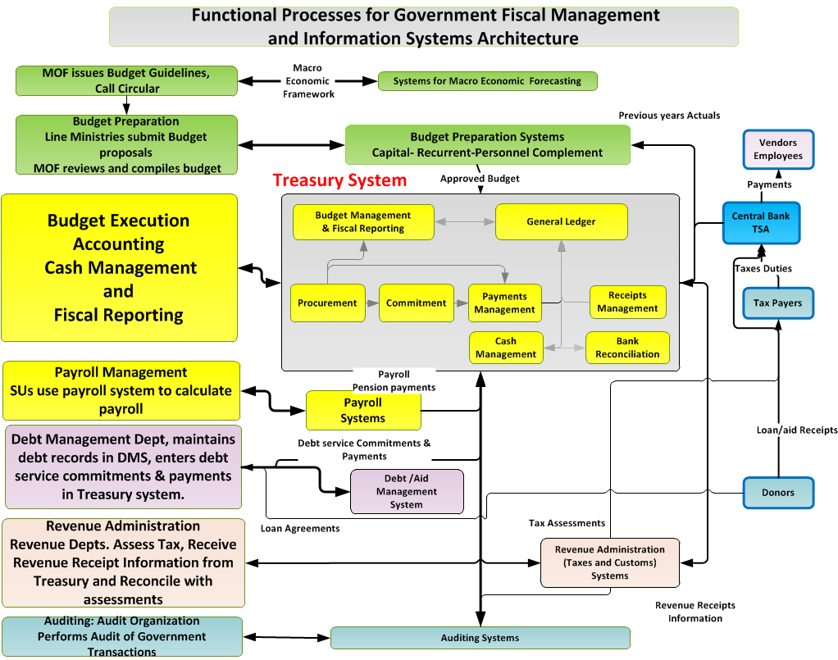

Slide 38
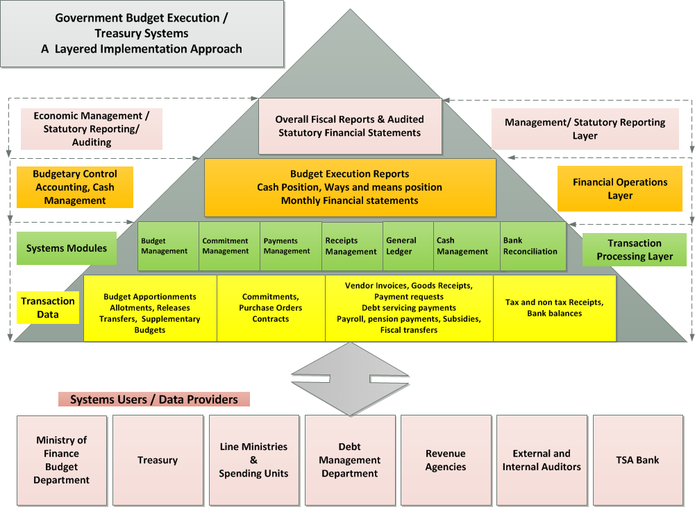

Slide 39
Sequencing I
First set up the transaction processing layer of the systems. This is the most difficult and time consuming
It is necessary to have this layer in place to get good and credible information to be used for financial operations and for management reporting. Other layers would be built on top of this layer
In Russia the Government has only now developed a reporting and monitoring system that provides information on Key performance Indicators (KPIs) to enable the MOF and all budget participants monitor and control the budget execution process.

Slide 40
Sequencing II
First Implement modules to cater to Core Budget Execution Processes, payments and receipts transactions, across government before going on to other non-core elements, like fixed assets management, HR management
First implement Treasury Centric System then De-Centralize to spending Units - An attempt should be made to first capture payment / receipt transactions at Treasury offices then de-centralize to Spending units – if necessary/possible.
To start with, budget preparation can be done outside the system or by another system, and the final approved budget can then be loaded in the system and used to control expenditure - However, all subsequent in year budget transactions, like budget releases, transfers etc. should then be done in the Treasury system.

Slide 41
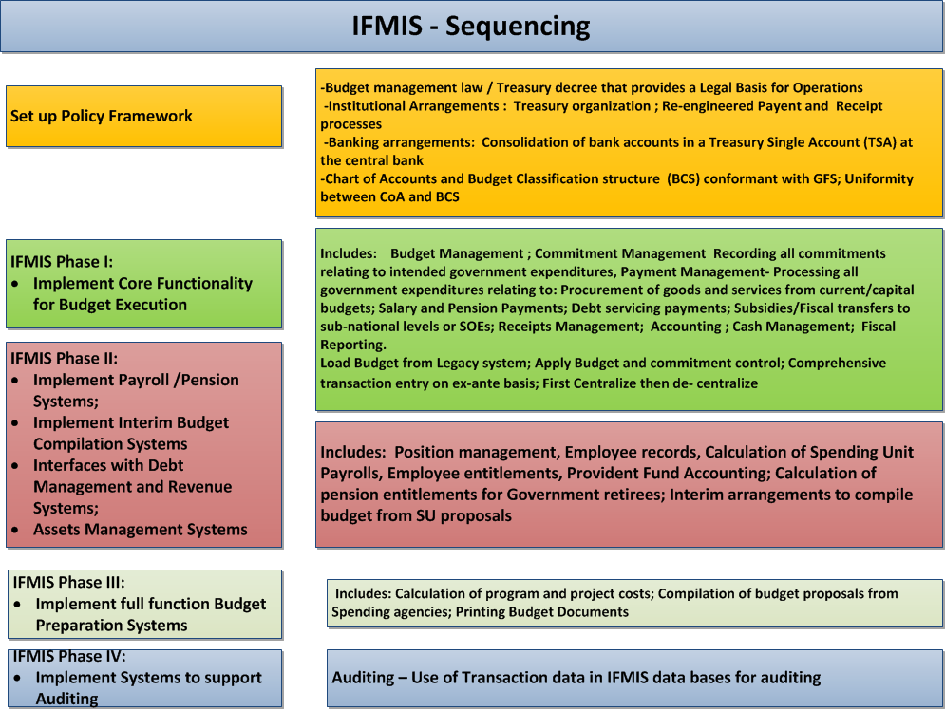

Slide 42
Hierarchy of reforms- Jack Diamond
If we look at advanced countries we see a progression:
First financial compliance= emphasis on inputs
Second aggregate fiscal discipline= emphasis on fiscal aggregates over time
Third efficiency/effectiveness = emphasis on outputs and outcomes
Each new objective was added, it did not replace
AND the reform process took time

Slide 43
Hierarchy of Reforms Contd:
(Jack Diamond)
First priority is to create a PFM system that delivers financial compliance/fiscal discipline
e.g. Comprehensive input based budget, delivered as approved, a TSA, commitment control, regular calendar, timely year-end accts etc.
Once achieved, the PFM system is developed to adjust fiscal aggregates to ensure macroeconomic stability/sustainability
e.g. ability to macroeconomic forecast, monitor and adjust fiscal aggregates, set fiscal policy in medium term budget framework, etc
A list of what not to do in the early stages (no program budgeting, no accrual accounting, no decentralization) according to Allen Schick.
Once this is achieved move to getting better value for money spent
e.g. Strategic planning, program budgeting, performance indicators to monitor and evaluate, more decentralized management

Slide 44
Some Closing Words
“It is the political economy stupid!”
Political economy and institutional issues are more difficult to resolve than technical issues
Setting up PFM information systems is a necessary pre-requisite, even essential, for improving Governance, but not sufficient
44

