Slide 1



Treasury of Russia
            INTERACTION BETWEEN INFORMATION SYSTEMS USED IN PUBLIC PROCUREMENT AND PUBLIC FINANCE MANAGEMENT –
            THE CASE OF RUSSIA.
    Alexandr Albychev,
    Deputy Head of the Federal Treasury
    www.roskazna.ru
    June 2019

Slide 2




Public procurement and PFM information systems
in the Russian Federation
Treasury of Russia
  Ministry of Finance
State Integrated Information System (SIIS) “E-Budget”
Federal Treasury
Integrated system for procurement
Federal
Treasury
Operators of electronic
trading platforms
Electronic trading platforms

Slide 3
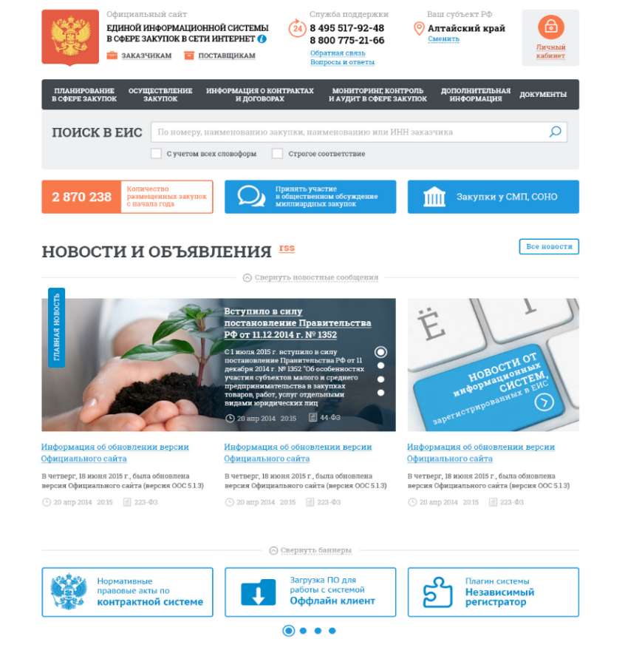

The role of FT in procurement information support development
Treasury of Russia
  Official PP site - www.zakupki.gov.ru
  Integrated Information System (IIS) for procurement
  RF Ministry of Finance
  Statutory regulation of procurement
Federal Treasury
  IIS development and maintenance
  Services to IIS users
  E-signature key certificates issuance
  Some control functions
over
2 million
IIS users:
Audit and control bodies
  Procurement procedures control

Slide 4
Treasury of Russia
IIS functional capabilities
Integrated Information System (IIS) for Procurement
Maintenance and use of the Goods, Works and Services Catalogue (GWSC)
Development, maintenance of GWSC; applying GWSC items during procurement
Generation of procurement information
Develop procurement plans and schedules, procurement information (invitations, bidding documents, protocols)
Рublication of information
Making information and documents public (IIS official website). Information and documents search and viewing
Integration and routing
Communication and information exchange between IIS an d other IS
Procurement control and audit
Maintaining a Registry of complaints, scheduled and unscheduled inspections, their outcomes and issued improvement notices, maintaining a blacklist of suppliers
Administration
General IIS functions settings;
maintenance of organisations’ and users catalogues, access rights control, event logging
Procurement monitoring
Statistical processing of information and generation of information reports with different breakdowns
Ensuring information security
Measures to ensure information integrity, accessibility and confidentiality
Maintaining reference data
Maintain, accept and disseminate IIS guides and classifiers

Slide 5
Interactions between procurement system and budget process management in Russia
Treasury of Russia
Procurement plan
(procurement plan amendments)
Notice of procurement
Contract information
Contract execution information
Contract execution information (payment)
IIS for procurement
Information on budget commitments “to be” assumed
Information on budget commitments (“actual”)
Information on cash liabilities (certificates, invoices etc.)
Information on execution of cash liabilities
Draft procurement plan (PP)
Checking PP against budget commitments limits
E-Budget
Recording of the budget commitments limits
Registration of the budget commitments “to be assumed”
Registration of the “actual” budget commitments
Registration of cash liabilities
Payment liabilities
Justification of budget appropriations
Procurement planning
Procurement
Public contract establishment
Contract execution

Slide 6



Treasury of Russia
Procurement planning
“E-Budget”
IIS for procurement
Justification of budget appropriations
Draft procurement
plan
Procurement plan (procurement plan amendments)
Checking PP against budget commitments limits
Appropriations and budget commitments limits
Data on information system development activities
Federal SIS to Coordinate Information System Development
Procurement plan publication
Information system development plan preparation and approval

Slide 7
Treasury of Russia
Procurement
IIS for Procurement
“E-Budget”
Procurement Plan
Checking for compliance
with limits
Information on budget commitments “to be assumed”
Notice of Procurement
Registration of commitments “to be assumed”, posting it on client’s account
Notice of Procurement publication
Uncommitted balance
Bidding

Slide 8
Treasury of Russia
Public contract establishment
IIS for procurement
“E-Budget”
Bidding
Information on assumed commitments
Recording the “assumed” commitment
Public contract establishment
Publication in the contracts registry
Making entries in institutions’ records and on client’s account
Information on public contract

Slide 9




Treasury of Russia
Contract execution
IIS for procurement
“E-Budget”
Supplier
Customer
E-certificate of acceptance
Recording cash liabilities
Making entries in institutions’ records and on client’s account
Generation and signing of e-certificate of acceptance
Signing e-certificate of acceptance
Creating request for cash expenditures
Information on public contract execution
Commitments settled are recording and reflected on client’s account
Payment
against commitment
Publishing information in the contracts registry
- e-signature

Slide 10


A fast-track procedure for opening client accounts when contracts are established
Treasury of Russia
ЕИС
ГИИС «Электронный бюджет»
IIS for procurement
“E-Budget”
Request to book client account number
Booking a number in the client accounts registration file
Adding it to Consolidated Register of Organizations
Customer (winning bidder)
Confirmation of client account number booking
Registration
with the “E-Budget”
Establishment of public contract
Request to open client account
Opening account with the client accounts registration file
Information on client account opened
- E-signature

Slide 11
Treasury of Russia
            THANK YOU!
    www.roskazna.ru

