Slide 1

Client Connection API: Automating Data Exchange Between WBG and Country Systems
May 2019
Simon Lango
Balamurugan Sivaprakasam
Ramraj Rangarajan
Yuanjun Jenny Yin
Cem Dener

Slide 2

Transition to Web Services/APIs
Contents
Transition to Web Services/APIs
New Client Connection API
Contents
Transition to Web Services/APIs
New Client Connection API

Slide 3
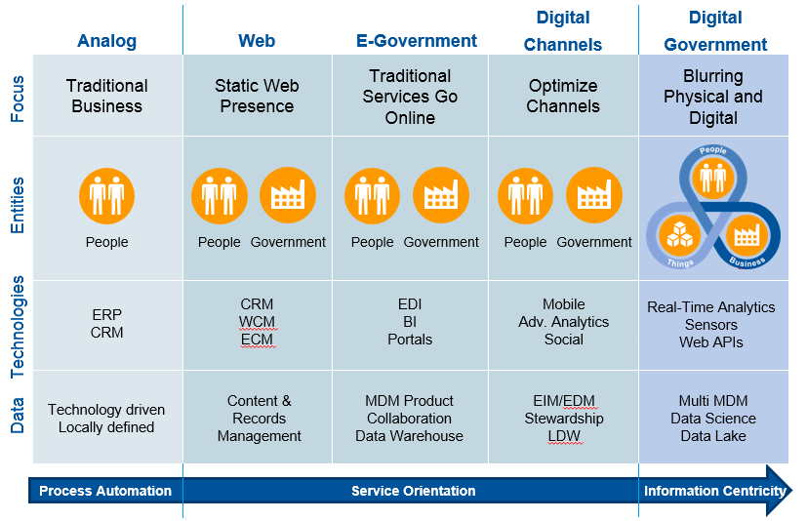
Evolving Technologies in Digital Government
ERP: Enterprise Resource Planning; CRM: Citizen Relationship Management; WCM: Web Content Management; ECM: Enterprise Content Management;
EDI: Electronic Data Interchange; BI: Business Intelligence; EIM/EDM: Enterprise Information/Data Management; LDW: Logical Data warehouse;
MDM: Mobile Data Management; API: Application Program Interface Source: EU Joinup July 2017 https://joinup.ec.europa.eu/document/recommendation-10
Notes:
Reliable and sustainable Digital Government (DG) systems and e-Services are crucial to improve public resource mobilization and management, institutional capacity, integrity, openness, and service delivery.
There is a tendency among practitioners to differentiate between the terms “e-Government” and “Digital Government”.
This figure is presenting the evolving focus, scope, technology applications, and data handling while moving to more sophisticated digital government platforms from the EU perspective. Please note that the web APIs are included as an integral part of the technology layers to improve the collection and consolidation of open data, together with mobile data management and real-time analytics.
e-Government (e-Gov) is often described as technology driven improvements in practices and public services for transition to digital culture.
Digital Governance (DG) includes the improvement of regulations, policy-making capabilities, and institutional capacity, and use of advanced digital technologies in collaboration with all stakeholders, to define a sustainable governance and operation model for e-Government.
The essence of Digital Government is to interact with the beneficiary, and ensure the effective delivery of services to citizens (G2C), businesses (G2B), public employees (G2E) and government entities (G2G).

Slide 4

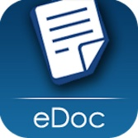
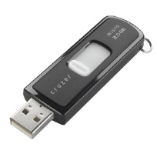

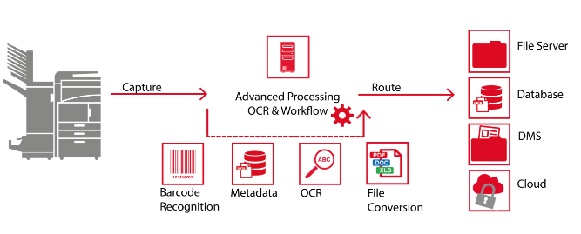
Transition to Web Services/APIs
CC API
Future
Trend > Transmission and consolidation of data by using “electronic documents” and “automated transfer of data/files through web APIs”
Present
3
Web Services / APIs
Effectiveness
2
Reports generated from FMIS.
Machine-readable files (DOC/XLS/XML/JSON/other).
Application Program Interfaces (APIs) for secure auto exchange of data/eDocs between two systems.
Web Portal
1
Reports generated from FMIS.
Machine-readable files (DOC/XLS).
Secure semi-automated transmission of files via portal.
Manual upload or download of eDocs.
Electronic Docs
Digitization (of Archives)
eDoc
0
Reports usually generated from information systems (e.g. FMIS).
Machine-readable files (DOC/XLS).
Manual (or file transfer) transmission of electronic docs.
Manual
Reports manually prepared (PDF, DOC/XLS) & printed.
Manual transfer and consolidation
Paper
Resources
Notes:
There is a growing interest in using secure Application Program Interfaces or APIs, for reducing the cost and complexity of data exchange in our client countries. This slide presents the path in transition to web services. In most of our client countries, transmission and consolidation of budget data or financial statements are manual or semi-automated through file transfer or portal upload options, despite the generation of most of these reports from an information system, as electronic documents. Transmission of data and electronic documents can be improved rapidly and cost effectively, by using web APIs.

Slide 5
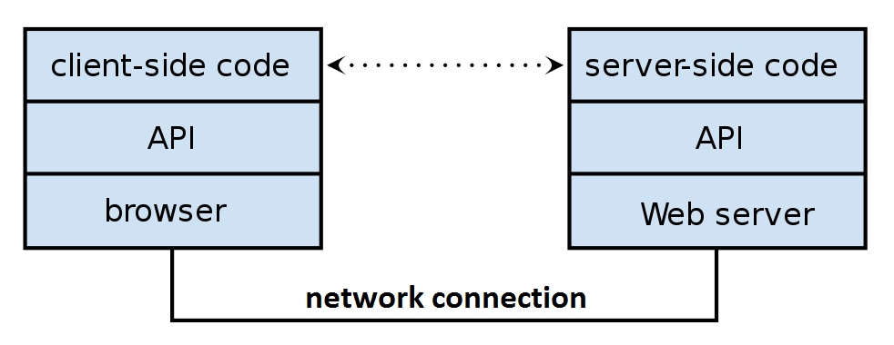
API Basics
What is an API?
A web Application Program Interface (API) is a link established between two systems (over Internet or intranet) to automate data transfer from one portal to another, based on a well-defined secure data exchange protocol.
Database
Database
Why are APIs important to the World Bank and our Clients?
APIs contribute significantly to the improvement of public services and seamless end-to-end interactions among government, citizens and businesses, by eliminating manual interactions on data exchanges. Web APIs can be developed in a relatively short time with a modest budget, and result in substantial cost savings due to secure automated data transfer and updates.
Notes:
Let’s first clarify what an API is, and why it is important for the World Bank and our clients.
A web Application Program Interface is a link established between two systems (over Internet or intranet) to automate data transfer from one portal to another, based on a well-defined secure data exchange protocol.
APIs contribute significantly to the improvement of public services and seamless end-to-end interactions among government, citizens and businesses, by eliminating manual interactions on data exchanges. Web APIs can be developed in a relatively short time (in several months) with a modest budget (around $10k-$20k for each side of the interface), and result in substantial cost savings due to automated system-to-system transfer and updates.

Slide 6
Transition to Web Services/APIs
Contents
Transition to Web Services/APIs
New Client Connection API

Slide 7
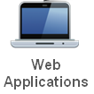

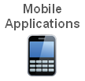
New Client Connection API
New
Client Connection
API
URL
World Bank Databases
Existing
Internet
JSON
Dev. Indicators
API
Project
API
XML
Finance
API
New Client Connection (CC) portal was rolled to over 180 countries between March 2018-Sept 2018
As a part of this upgrade, a secure CC web API was developed (Mar-Oct 2018) to automate data exchange between Client Country Systems & CC databases (e.g., Project/Loan details, Commitments/Disbursements, Contract Awards).
New CC API was tested in Albania EAMIS until January 2019, and is expected to go live in March 2019.
Notes:
As you know, Client Connection is an existing secure web portal that offers government officials and project implementation units quicker access to information about their portfolio. Clients can submit requests for disbursements and track the status of transactions, loans and projects.
The data available in Client Connection is at granular level, and is updated near real-time.
There are currently more than 20,000 external users of the Client Connection spread across 4,500 organizations and 180 countries. Disbursement transactions in excess of 18 billion USD per year are securely submitted and processed through the e-disbursement feature of this online banking portal.
New Client Connection portal will be launched in July 2018.
As a part of this upgrade, new secure CC API will be available to automate data exchange between Client Country Systems and the World Bank operational databases for project and loan details, commitments, disbursements, contract awards, and more. You may wish to inform your counterparts in client countries about new CC API, and promote the use of these new capabilities for possible operational efficiency improvements and cost savings.

Slide 8
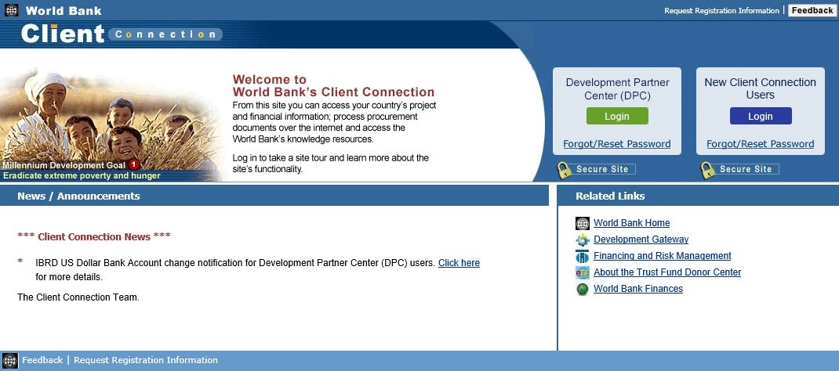
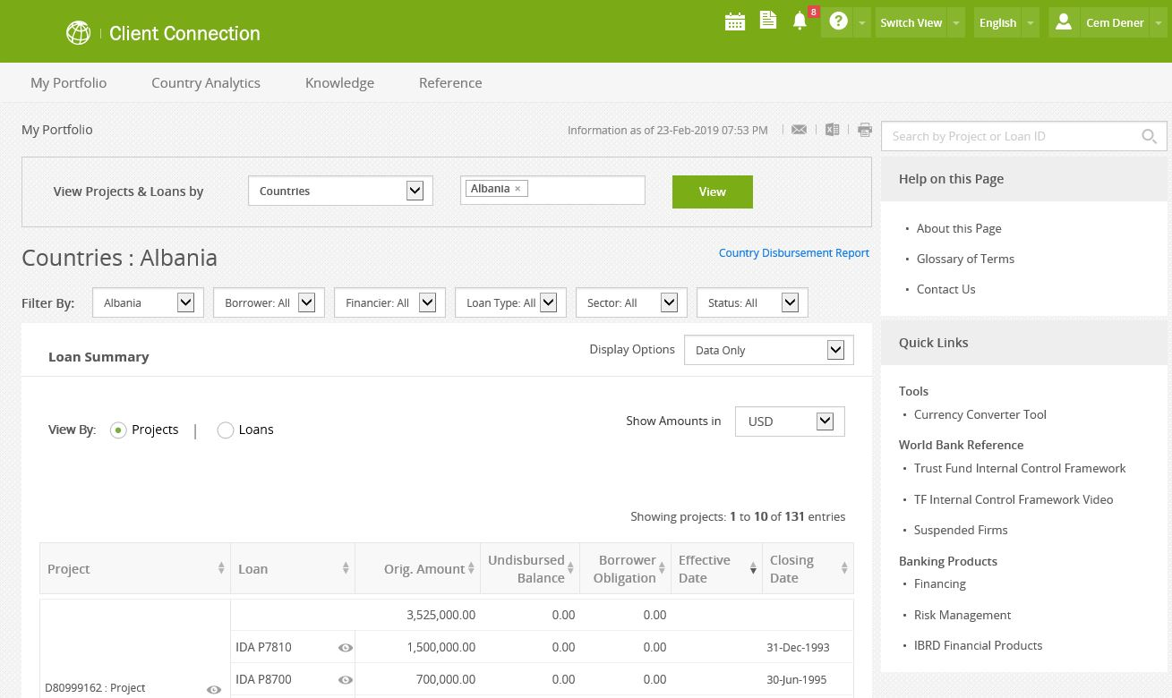
CC > Present Manual Data Transfer
1
Register (one time)
2
Login
View and
Filter
3
4
Download (XLS)
5
Manual Data Transfer
to Country Systems
Notes:
Reliable and sustainable Digital Government (DG) systems and e-Services are crucial to improve public resource mobilization and management, institutional capacity, integrity, openness, and service delivery.
There is a tendency among practitioners to differentiate between the terms “e-Government” and “Digital Government”.
This figure is presenting the evolving focus, scope, technology applications, and data handling while moving to more sophisticated digital government platforms from the EU perspective. Please note that the web APIs are included as an integral part of the technology layers to improve the collection and consolidation of open data, together with mobile data management and real-time analytics.
e-Government (e-Gov) is often described as technology driven improvements in practices and public services for transition to digital culture.
Digital Governance (DG) includes the improvement of regulations, policy-making capabilities, and institutional capacity, and use of advanced digital technologies in collaboration with all stakeholders, to define a sustainable governance and operation model for e-Government.
The essence of Digital Government is to interact with the beneficiary, and ensure the effective delivery of services to citizens (G2C), businesses (G2B), public employees (G2E) and government entities (G2G).

Slide 9


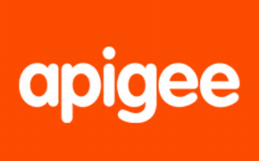



CC > API for Automated Data Transfer
1
Register (one time)
Get Client ID & Client Secret
Secure Data Exchange between Client Connection & Country System
2
Get Access Token
Using Client ID & Client Secret
3
Request > Invoke CC API
4
Get Projects / Loans / Disbursements
Projects / Loans / Disbursements
After successful Authorization
PDMZ
WBG Firewall
APIGEE
Oauth
Azure
Oauth
Client Connection
ESB
Client Application
Azure Oauth
5
Receive data in
JSON / XML format
Project Data
Apigee Oauth Authentication
SAP Service Account
Azure Oauth Authentication
Open Access
Notes:
Reliable and sustainable Digital Government (DG) systems and e-Services are crucial to improve public resource mobilization and management, institutional capacity, integrity, openness, and service delivery.
There is a tendency among practitioners to differentiate between the terms “e-Government” and “Digital Government”.
This figure is presenting the evolving focus, scope, technology applications, and data handling while moving to more sophisticated digital government platforms from the EU perspective. Please note that the web APIs are included as an integral part of the technology layers to improve the collection and consolidation of open data, together with mobile data management and real-time analytics.
e-Government (e-Gov) is often described as technology driven improvements in practices and public services for transition to digital culture.
Digital Governance (DG) includes the improvement of regulations, policy-making capabilities, and institutional capacity, and use of advanced digital technologies in collaboration with all stakeholders, to define a sustainable governance and operation model for e-Government.
The essence of Digital Government is to interact with the beneficiary, and ensure the effective delivery of services to citizens (G2C), businesses (G2B), public employees (G2E) and government entities (G2G).

Slide 10
Client Connection API Data
Request URL https://api.clientconnection.org/project/getProjects
Request Parameters
Data Format: XML or JSON
Criteria
Country: Country name (“Albania”)
Project ID: Comma separated “Project ID” values or “ALL”
Status: "Active", "Pipeline", "Closed", "Dropped"
Service: 1 = Project details
2 = Loan details (for all selected Projects)
3 = Disbursement transactions (for all Loans selected)
4 = Contract awards (prior review) in all selected Projects
5 = Status of Procurement activities in all selected Projects
6 = Procurement Notices in all selected Projects

Slide 11
Client Connection API Benefits
Benefits
Increased efficiency for World Bank Clients due to automation of existing manual processes of exchanging and consolidating data, and substantial cost savings.
Response to increasing Client demands for automated data exchange between Client Connection and Country Systems (e.g., Albania, Bhutan, Brazil, Rwanda, Kenya, Lesotho, Jamaica, Mexico, India).
WB would be the first development partner pioneering the use of APIs to connect operational databases with Client Country Systems.
Contribution towards promoting efficiency and reliable reporting through external aid management information systems worldwide.
The Client Connection API can be presented as a fine example of “disruptive innovation” during April 2019 Spring Meetings.
Notes:
As you know, Client Connection is an existing secure web portal that offers government officials and project implementation units quicker access to information about their portfolio. Clients can submit requests for disbursements and track the status of transactions, loans and projects.
The data available in Client Connection is at granular level, and is updated near real-time.
There are currently more than 20,000 external users of the Client Connection spread across 4,500 organizations and 180 countries. Disbursement transactions in excess of 18 billion USD per year are securely submitted and processed through the e-disbursement feature of this online banking portal.
New Client Connection portal was rolled out to over 180 countries between Mar 2018-Sept 2018.
As a part of this upgrade, new secure CC API will be available to automate data exchange between Client Country Systems and the World Bank operational databases for project and loan details, commitments, disbursements, contract awards, and more. You may wish to inform your counterparts in client countries about new CC API, and promote the use of these new capabilities for possible operational efficiency improvements and cost savings.

Slide 12
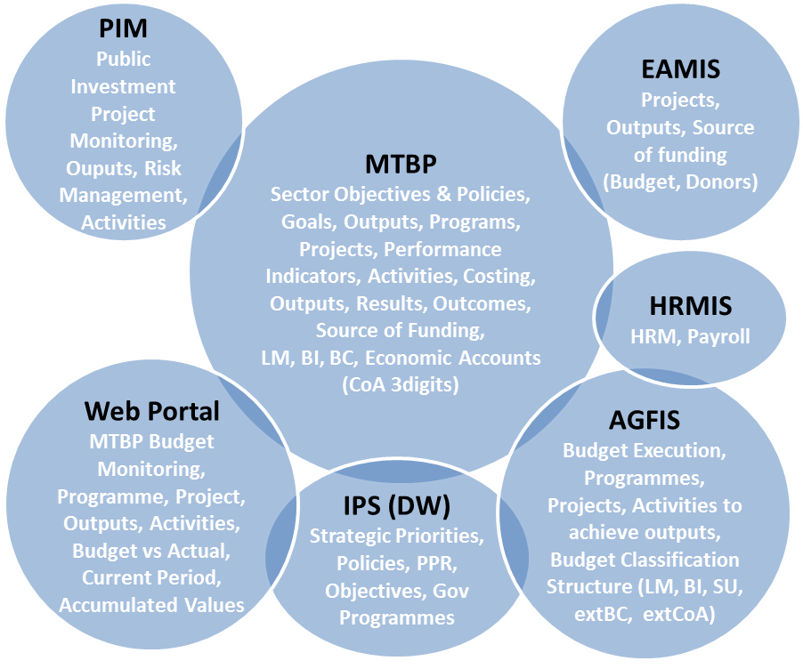
Albania – Integrated Planning System
EAMIS
API
Internet
WB Databases
CC API
API
AGFIS
In Albania, Integrated Planning System-2 Project (P129332) is supporting the development of External Assistance Management Information System (EAMIS) to monitor all donor and government funded projects. New system will go live in April 2019. Albania will be the first pilot to use new CC API in upcoming months.
Notes:
One of the important country cases regarding the effective use of web APIs to connect government systems, as well as the CC portal is presented in this slide.
In Albania, Integrated Planning System-2 Project (P129332) is supporting the development of External Assistance Management Information System (or EAMIS) to monitor all projects funded by the government and development partners. New system is expected to go live in 2018. The Bank is currently assisting the Ministry of Finance for the development of web services to connect EAMIS with new CC portal using APIs. Albania EAMIS platform will be the first pilot to test new CC API in upcoming months.

Slide 13
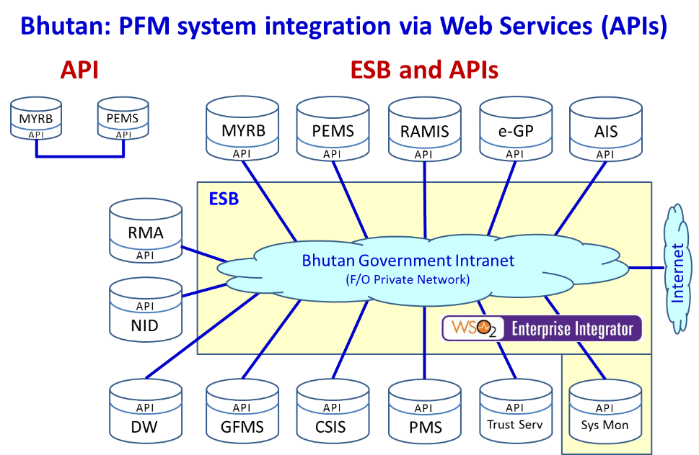
Bhutan > Integrated PFM Systems
WB Databases
CC API
In Bhutan, the MoF is using an open source government service bus (WSO₂), and low cost web APIs are being developed rapidly to connect all critical government systems. This platform can be linked to new CC API to automate secure data exchange between Country Systems and WB (no manual intervention), and enforce system based approach (all transactions captured with audit trails).
Notes:
In Bhutan, the MoF has already invested on an open source government service bus (called WSO2), and low cost new web APIs are being developed rapidly to connect all critical government systems in 2018. Budget planning and execution systems are already connected through APIs developed by the ICT units in-house. This platform can be easily linked to new CC API to automate and regulate data exchange between country systems and the WB (to avoid manual interventions), and enforce system-based approach (to avoid parallel processes and capture all transactions with secure audit trails).

Slide 14
Thank You

