Slide 1
Austrian Fiscal Advisory Council
Federal Law on the Establishment of the Fiscal Advisory Council
Federal Law Gazette I No. 149/2013 of 31. July 2013
(www.fiskalrat.at)
(former Government Debt Committee)
Jarmila Urvova
Office of the Fiscal Advisory Council
PEM PAL Budget Community of Practice (BCoP) Seminar
“The Role of Austria's Parliament in Budgeting”
Vienna, 31st January 2014

Slide 2
Outline
Fiscal Councils (FCs)
FCs within the new EU fiscal framework
Austrian Fiscal Advisory Council (FISK)
FISK output

Slide 3
The case for fiscal councils
Deficit-bias of fiscal policy,
due to/manifested by:
Possible remedies:
Political business cycles
Short-sightedness,
pro-cyclicality in good times
Time inconsistency
Moral hazard/free riders
Informational asymmetry/lack of transparency/fiscal illusion
Biased official forecasts
Fiscal rules
Improving policymakers’ incentives by raising reputational and electoral costs of unsound policies
Raising public awareness to address fiscal illusion and contribute to a stability culture
Independent forecasts/assessment and analyses
Closing technical loopholes through independent expertise
Fiscal Council = independent public institution informing the public debate on fiscal policy (IMF, 2013)

Slide 4
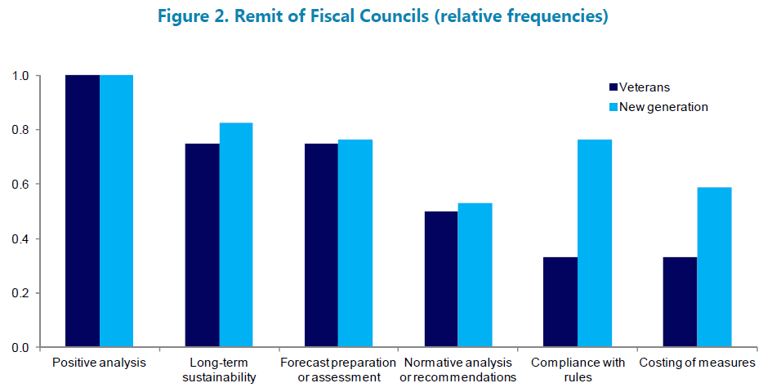
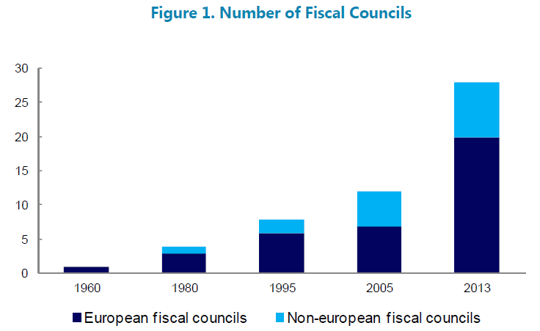
Fiscal Councils: the Experience So Far I.
Source: IMF: The functions and impact of fiscal councils. 2013.

Slide 5
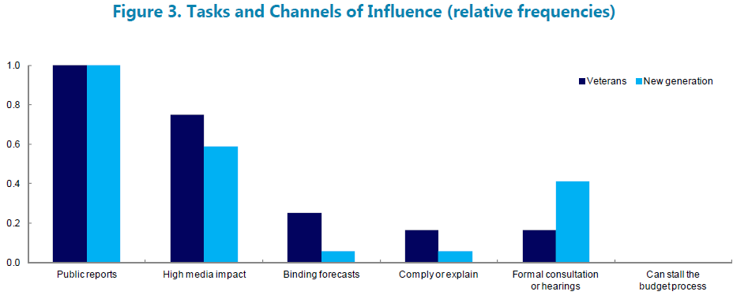
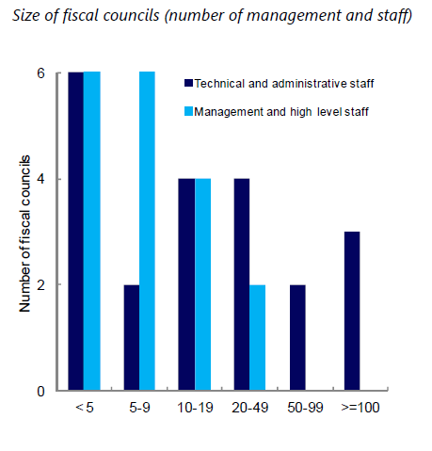
Fiscal Councils: the Experience So Far II.
Source: IMF: The functions and impact of fiscal councils. 2013.

Slide 6
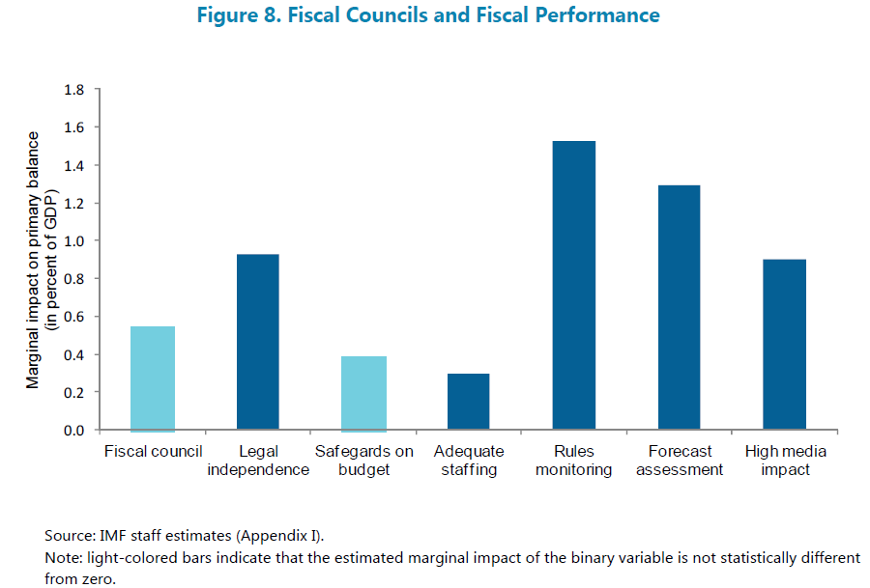
Fiscal Councils: the Experience So Far III.
Source: IMF: The functions and impact of fiscal councils. 2013.

Slide 7
EU-Governance Response to Crisis
Fiscal Policy
Structural Policies
Crisis Resolution
Stability and Growth Pact “3.0” (Six-pack)
strenghtening of fiscal rules
strenghtening of surveillance
Europe 2020 Strategy & Compact for Growth and Jobs
EFSF (European Financial Stability Facility)
EFSM (European Financial Stabilisation Mechanism)
Bilateral Loans
Permanent ESM (European Stability Mechanism)
Minimum standards for national fiscal frameworks (Six-pack)
Macroeconomic Imbalance Procedure (Scoreboard) (Six-pack)
Two-pack:
fiscal surveillance i.a. via national independent fiscal institutions
Euro-Plus Pact (enhanced co-ordination of economic policies)
Other measures, e.g.:
non-standard measures of ECB
EU supervisory authorities
regulation of financial markets
Treaty on Stability, Coordination and Governance (incl. Fiscal Compact)
Two-pack: enhanced surveillance of EA MS (threatened) with financial difficulties
European Semester
Jan
Feb
Mar
Apr
May
Jun
Jul
Autumn
EC’s Annual Growth Survey
Stability and Convergence Programmes, National Reform Programmes
Council endorses
Country-specific Recommendations
National Semester:
Draft Budgetary Plans submitted by countries and assessed by EC
*Selected measures
Source: European Commission, own graphical representation.

Slide 8
EU-Governance Response to Crisis: FCs
Independent Fiscal Institutions in the EU fiscal framework:
  Six-pack (2nd update of the Stability and Growth Pact, „3.0“)
    entered into force on 13th December 2011
    applies to all EU MS + stricter provisions for EA MS
  Fiscal Compact (Articles 3-8 of the Treaty on Stability, Coordination and Governance; transposition of SGP into national rules)
    entered into force on 1st January 2013
    signed by 25 EU MS (excluding CZ and UK), binding for EA MS
  Two-pack (even stronger surveillance for EA MS)
    entered into force on 30th May 2013
    applies to EA MS

Slide 9
According to Two-pack – forecasts:
Regulation 473/2013 of the European Parliament and of the Council on common provisions for monitoring and assessing draft budgetary plans and ensuring the correction of excessive deficit of the MS in the EA:
  Article 4:
  “National medium-term fiscal plans and draft budgets … shall be based on independent macroeconomic forecasts, and shall indicate whether the budgetary forecasts have been produced or endorsed by an independent body.”
  Two-pack Code of Conduct:
  “…Member States may decide to involve the independent body in the preparation of the budgetary forecasts (either by production or endorsement), or on the contrary, assign the development of these budgetary forecasts to another institution with no further involvement of the independent body…”

Slide 10
According to Two-pack – monitoring:
Regulation 473/2013 of the European Parliament and of the Council on common provisions for monitoring and assessing draft budgetary plans and ensuring the correction of excessive deficit of the MS in the EA:
  Article 5:
  Member States shall have in place independent bodies for monitoring compliance with numerical fiscal rules [debt, deficit, MTO]. Those bodies shall, where appropriate, provide public assessments…, inter alia relating to:
    the occurrence of circumstances leading to the activation of the correction mechanism,
    whether the budgetary correction is proceeding in accordance with national rules and plans,
    any occurrence or cessation of circumstances which may allow a temporary deviation from the MTO

Slide 11
Requirements: Two-pack vs. National law:
Two-pack definition of
“independent bodies”:
AT Federal Law on the Establishment of the Fiscal Advisory Council:
(Fed. Law Gazette No. 149/2013 of 31. July 2013)
Statutory regime grounded in national law | Federal law establishing the Fiscal Advisory Council
Not taking instructions from the budgetary authorities or others | Members are not permitted to request or take instructions; office period ≠ legislation period
The capacity to communicate publicly in a timely manner | Public assessments; shaping public opinion, informational events
Procedures for nominating members on the basis of their experience and competence | Members must be experts; balanced view due to diversity of nominators reflecting the Austrian culture of social partnership
Adequate resources and appropriate access to information to carry out their mandate | funding by OeNB; legally based data provision from administrative authorities and Statistics Austria

Slide 12
AT Fiscal Advisory Council: Tasks
FISK as a national co-ordination and advisory body (the „old“ tasks):
Assessing the current fiscal situation, incl. an outlook for the future
Analyzing the sustainability and the quality of fiscal policies
Analyzing the economic effects of public debt
Providing written recommendations on fiscal policies
Preparing an annual report
Contributing to shaping public opinion [in fiscal matters]
FISK as part of the EU fiscal framework („new“ tasks, as of 1.11.2013):
i.a. timely monitoring of compliance with nationally transposed EU fiscal rules, as well as providing recommendations on medium-term budget objectives

Slide 13
Key elements of EU fiscal rules (simplified)
SGP: a preventive and a corrective arm
Main elements:
Medium-Term Objective (MTO):
budget balance, adjusted for the effect of the business cycle („cyclically adjusted balance“) and excluding one-off measures („structural balance“)
  level: min. -0.5% of GDP for EA MS
  adjustment path towards it: min. 0.5% of GDP p.a.
Budget balance: min. -3% of GDP
Public debt: max. 60% of GDP, or diminishing at a satisfactory pace
Expenditure benchmark:
real growth rate of public expenditure* < medium-term potential GDP growth
*(excluding interest payments and unemployment related expenditure and expenditure offset by discretionary revenue measures)

Slide 14
Austrian Fiscal Institutional Framework
Austrian Treasury
Fiscal Advisory Council
Court of Audit
Operational Debt Management
Advice and recommendations to
the Ministry of Finance and National Council
(with respect to/based on):
Fiscal monitoring (sustainability and quality
of public finance): current situation and outlook
Assessment of compliance with EU fiscal rules
Ex-post audit of the finances of the federation, the states, certain municipalities and certain legal entities
Ex-post opinion on non-compliance with national fiscal rules and consequent sanctions (Austrian Stability Pact 2012)
Ministry of Finance
(+ Governing Bodies of the States and Municipalities)
Planning and execution of fiscal policy
National Council
(Parliament)
Approval and oversight of fiscal policy
Ex-post data provision, necessary for the calculation and assessment of compliance with national fiscal rules (ASP 2012)
(GDP, budget balances, debt, etc.)
Macroeconomic forecasts for
the Ministry of Finance
Research
Analytical support to the National Council in fiscal matters
Austrian Institute of
Economic Research (WIFO)
Statistics Austria
Parliamentary
Budget Office

Slide 15
AT Fiscal Advisory Council: Organisation I.
15 members, independent fiscal experts appointed for 6 years by:
Federal government: 6 members (1st nominee = FISK President)
Austrian Federal Economic Chamber in agreement with the Presidential Conference of the Chambers of Agriculture: 3 members (1st = Vice-President)
Austrian Federal Chamber of Labour: 3 members (1st = Vice-President)
Austrian Association of Municipalities, Association of Austrian Towns and Cities and Conference of Provincial Governors: 1 member each, with no voting rights
A substitute member for each member in case they are temporarily unavailable
The Oesterreichische Nationalbank (OeNB) and the Parliamentary Budget Office are entitled to participate in the meetings in an advisory capacity
Further experts may be consulted
Resolutions are passed with simple majority, the President has the casting vote in case of a tie

Slide 16
AT Fiscal Advisory Council: Organisation II.
Office of the Fiscal Advisory Council
Provides analytical and administrative support to FISK
5 economists,
1 research assistant/statistician,
½ secretary
Staff provided by and costs borne by the Oesterreichische Nationalbank

Slide 17
Main FISK Outputs (preliminary list)
Medium-term fiscal outlook: based on AT Stability Programme with own calculations regarding compliance with fiscal rules and assessments based on own forecasts
Assessment of the Draft Budgetary Plan of the Government with own calculations regarding compliance with fiscal rules and assessments based on own forecasts
FISK Annual Report: main indicators of fiscal developments (deficit, debt, their structure, etc.), including extra-budgetary liabilities
Recommendations (including macro outlook): bi-annually
Regional fiscal developments: analyses on compliance with national fiscal rules
Quality of public finance: analyses on medium- and long-term developments of public revenues and expenditures, as well as their structure
Other (ad-hoc) analyses and position documents

Slide 18
Fiscal performance: budget balance

Slide 19
Fiscal performance: public debt

Slide 20
December 2013 FISK Assessment – Summary
The sustainability of AT public finances needs to be
supported by structural reforms
für die Einhaltung der EU-Fiskalregeln
Expenditure-side structural measures i.a.
  Simplify public granting schemes and reform public governance,
  Close efficiency gaps in health-care system, enhance co-operation of municipalities and within the welfare system
  Strengthen the long-term sustainability of the pension system
Growth-enhancing structural reforms of the tax system to relieve the tax burden on labor
Offensive measures (to promote growth and employment) should be financed by expenditure-side structural reforms
For 2014, AT has not yet ensured full compliance with the EU fiscal rules

Slide 21
December 2013 FISK-Assessment – EU Rules
Source: European Commission, own calculations.

Slide 22
Thank you for your attention!
Contact:
Useful links:
Büro des Fiskalrates / Office of the Fiscal Advisory Council
c/o Oesterreichische Nationalbank
Otto-Wagner-Platz 3 |1090 Vienna
P.O. Box 61|A-1011 Vienna, Austria
Phone: +43-1-40420/7473
Email: fiskalrat@oenb.at
www.fiskalrat.at
www.oenb.at
http://ec.europa.eu/economy_finance/
economic_governance/index_en.htm

