Slide 1
































Internal audit
Community of practice
Results and Way Forward

Slide 2
Our Mission
IA COP offers support to its member countries
in establishing modern and effective Internal Audit system that
meets international standards and best practices and
is a key for good governance and accountability in the public sector
Our Core Values
Professionalism, dedication to reforms, commitment to sharing knowledge
and experience with the community (as professional family of peers),
trust, unity and respect to diversity of 23 member countries
IACOP Motto
unityINdiversity

Slide 3
IACOP Balanced Scorecard
Internal Processes
To maintain and develop a
volunteer network of internal audit professionals through ‘peer’ learning,
knowledge management
with range of activities
Customer
To serve our
governments
Financial
Accomplish donors’ needs and make best value for money of PEMPAL with the help of Secretariat
Learning and Growth
Develop the volunteering, Executive Committee leadership, self sustainability
of IACOP Working Groups, coordination with Steering Committee and other COPs

Slide 4
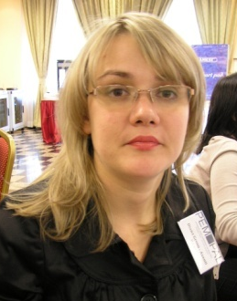
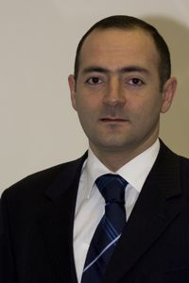
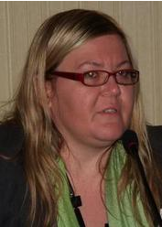
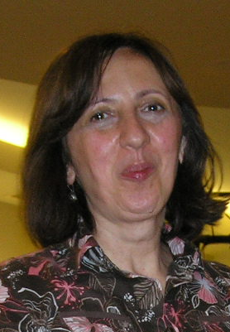
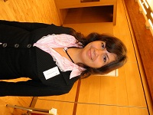
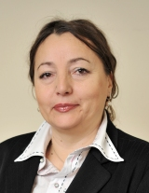
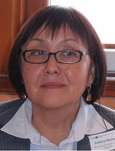
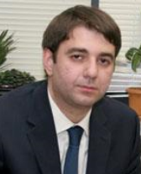
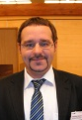
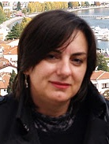
Strong leadership team-
IACOP ExCom
Diana
Grosu–Axenti
Resource team
member
Arman Vatyan
WB, Lead
Edit Nemeth
Chair
Hungary
Cristina
Scerbina
Vice Chair on
Operations
Moldova
Ljerka
Crnković
Vice-Chair
On Substance
Croatia
Zamira
Omorova
Kyrgyzstan
Svilena
Simeonova
Bulgaria
Karen
Sedrakyan
Armenia
Stanislav
Bychkov
Russia
Amela Muftić
Bosnia and Herzegovina

Slide 5
PEM-PAL Internal Audit COP
PEMPAL
Steering Committee
Bank TL (Elena)
SC member (Marius)
Guidance/Fiduciary
Lead of the
Community (Arman)
Executive Committee
led by Chair (Edit)
Internal Audit Community of Practice
(23 member countries)
Leadership+ Funding
Quality
Assurance
Risk
Assessment
Audit in
Practice
(AiP)
logistical support
RIFIX
Internal
Control
Secretariat
World Bank (WB)
Funding, professional support
Information
Professional support
Information
SECO, Russia, Dutch Academy and others
Organizations and professional associations (the IIA, CIPFA, etc.) and resource people

Slide 6
Strategic Priorities for 2016/17 and beyond
Priority themes in FY 2016-2017 and within the next five years:
Public Internal Control - FMC implementation with emphasize on accountability and transparency (new ICWG)
RIFIX WG - Relationship of Internal Audit with Financial Inspection and External Audit (continuing working group to be closed in FY 2017)
Audit in Practice - Practical implementation of audit cycle, different type and models of audits, including IT solutions (AiP - new WG)
Central Harmonization Units: challenges at different stages of reform
Promotion of IACOP, including the existing knowledge products and experience gained in ongoing and previous working groups: T&C, CPD, RA, QA, Body of knowledge
The format of events proposed:
Plenary, working group, thematic meetings, ExCom members and leaders’ meeting, study visit
Promotion activities, including distribution and of existing knowledge products
IACOP peers’ advisory missions and reverse study visit (type of thematic meeting)
Videoconferences, webinars (for thematic meetings)

Slide 7
Cross-COP Collaboration
Some thinking is needed to make this collaboration effective, as it is challenging
The challenge is that the COPs are getting move involved in specific topics, which could be narrow for cross-COP interest
It may be conducted with one day maximum allocated to the Cross-COP topics in the area of broader PFM reforms (similar to the one conducted on Transparency and Accountability)
Those Cross-COP events should not take the whole time of the event with sufficient time to be reserved for COP specific topic
This is further jeopardized by the limited funds available for COP priority activities
Public Internal Control is considered as a potential area for COP collaboration

Slide 8
IACOP Strategy Development Steps
Regularly solicitation of the possible priorities of the member countries during the Plenary meetings – getting reassurance that the IACOP is addressing right priorities of the governments
ExCom preparing the priority list and survey to seek views directly from the member countries
Collecting member country priorities via survey to confirm the completeness of those and priorities
Meeting on ExCom for 1.5 day to develop the Strategy based on the priorities established
Critical Friends and Agenda Activists Enabling Group lead this task

Slide 9
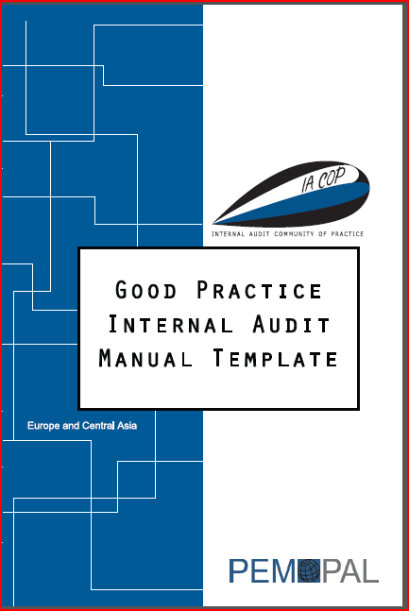

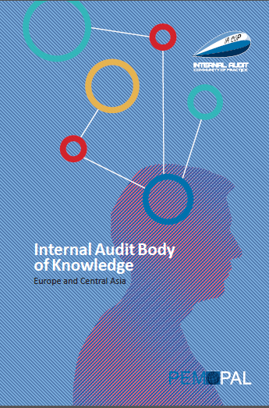
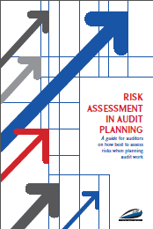
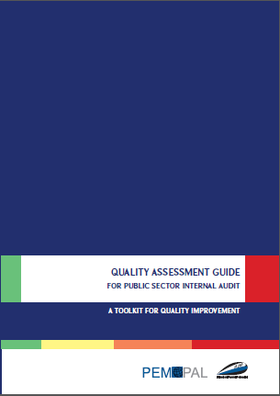
IACOP Good Practice Products
Good Practice IA Manual Template (completed and published)
Good Practice CPD Manual Template (completed and published)
Internal Audit Body of Knowledge (completed and published)
Risk Assessment in Audit Planning (completed and published)
Quality Assessment Guide (completed and published)
Concept Note on RIFIX (Relationship of Internal Audit with Financial Inspection and External Audit) (draft available)
Communiqués and 100+ other knowledge products
Concept Note on RIFIX

Slide 10

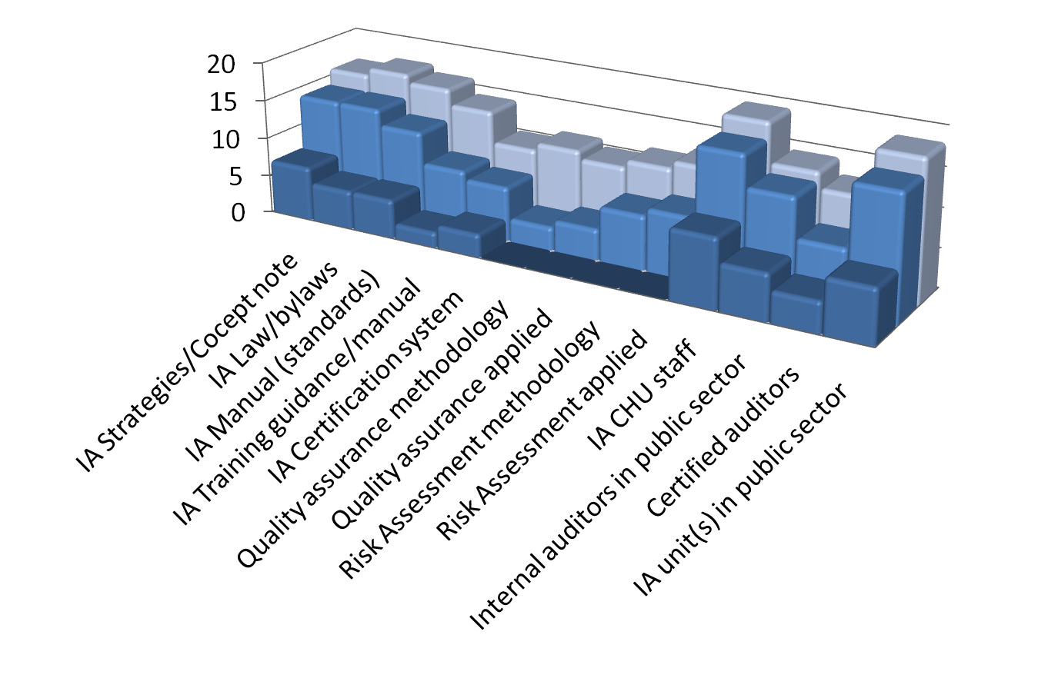
Results: Impact of IACOP by Theme
2014
2011
2007

Slide 11
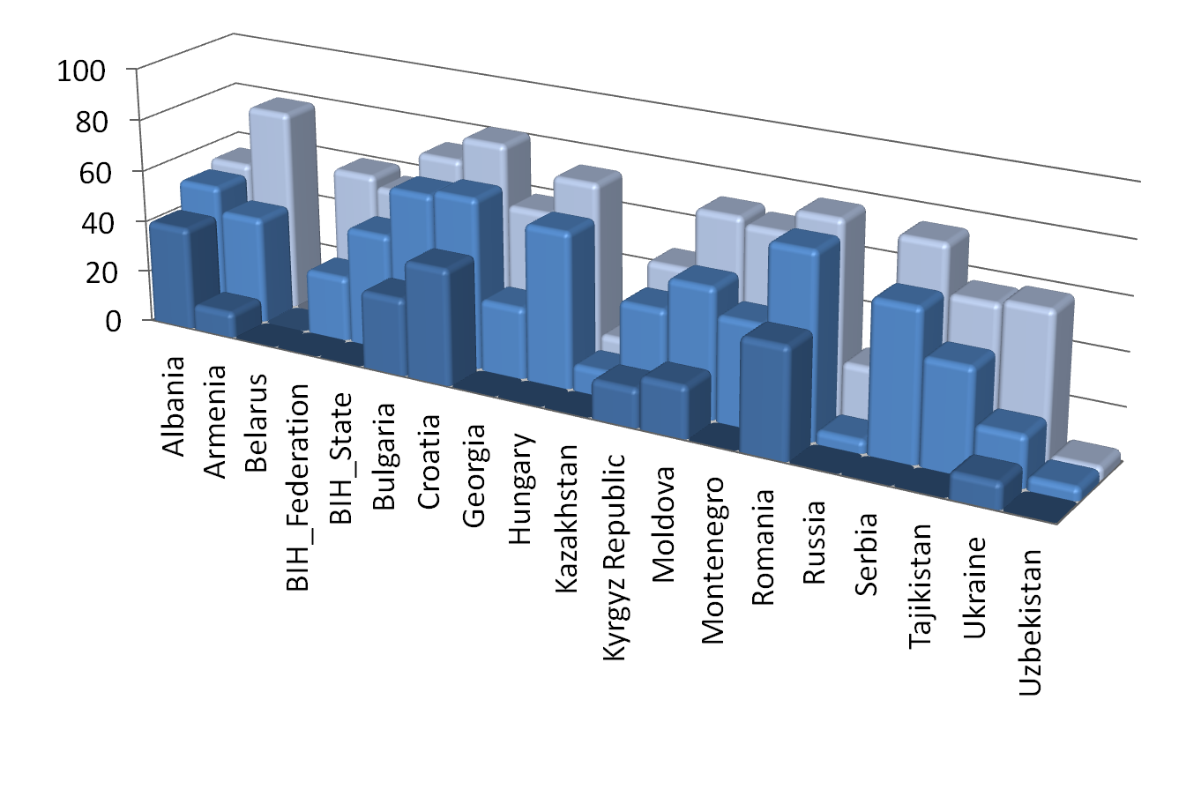
Results: Impact of IACOP by Country
2014
2011
2007

Slide 12
Thank you

