Slide 1

Budget
Community of Practice (BCOP)
Results Achieved 2012-17
Future PFM Priorities and Plans 2017-22
Cross-COP ExCom Meeting, Berne Switzerland, July 2016

Slide 2






















BCOP has 21 member countries
Notes:
NOTE there is 22 flags in this slide, remove two flags for Hungary and Czech Republic for B/TCOPs

Slide 3
BCOP Mission
The BCOP aims to strengthen budget methodology, planning and transparency in PEMPAL member countries.
Sharpening knowledge for effective fiscal management (through tools such as program budgeting, long term budgeting, management of fiscal risks)
Strengthening fiscal transparency and accountability with a focus on budget literacy, transparency and public participation initiatives.
Facilitating knowledge exchange between:
  budget related Departments of our 21 member country MoFs
  OECD member and accession countries in Europe and Central Asia at annual Senior Budget Officers’ (SBO) meetings.
Expanding internationally available data on PEMPAL countries through benchmarking using pre-meeting thematic surveys and more formal OECD surveys

Slide 4
Strong Leadership Team: BCOP Exec Committee
CHAIR Ms. Anna Belenchuk Ministry of Finance Russian Federation | DEPUTY CHAIRS Ms. Gelardina Prodani Ministry of Finance Albania Mr. Mikhail Prokhorik Ministry of Finance Belarus
Mr. Alija Aljović Federal Ministry of Finance, Bosnia and Herzegovina Ms. Mladenka Karačić Ministry of Finance Croatia Mr. Kanat Asangulov Ministry of Finance Kyrgyz Republic | Ms. Elena Zyunina Ministry of Finance Russian Federation Mr. Nikolay Begchin Ministry of Finance Russian Federation Mr. Hakan Ay Ministry of Finance Turkey Mr. Armen Manukyan Ministry of Finance Armenia

Slide 5
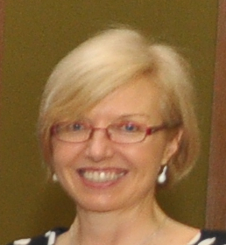

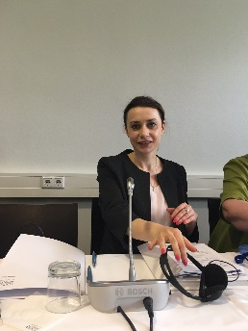
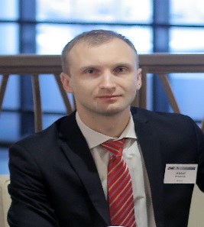
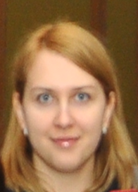
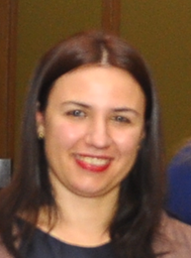
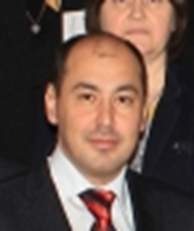
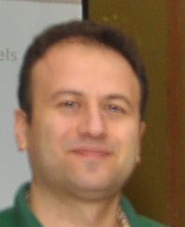
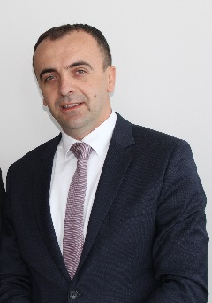
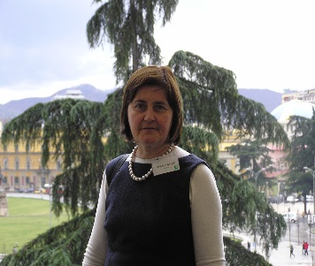
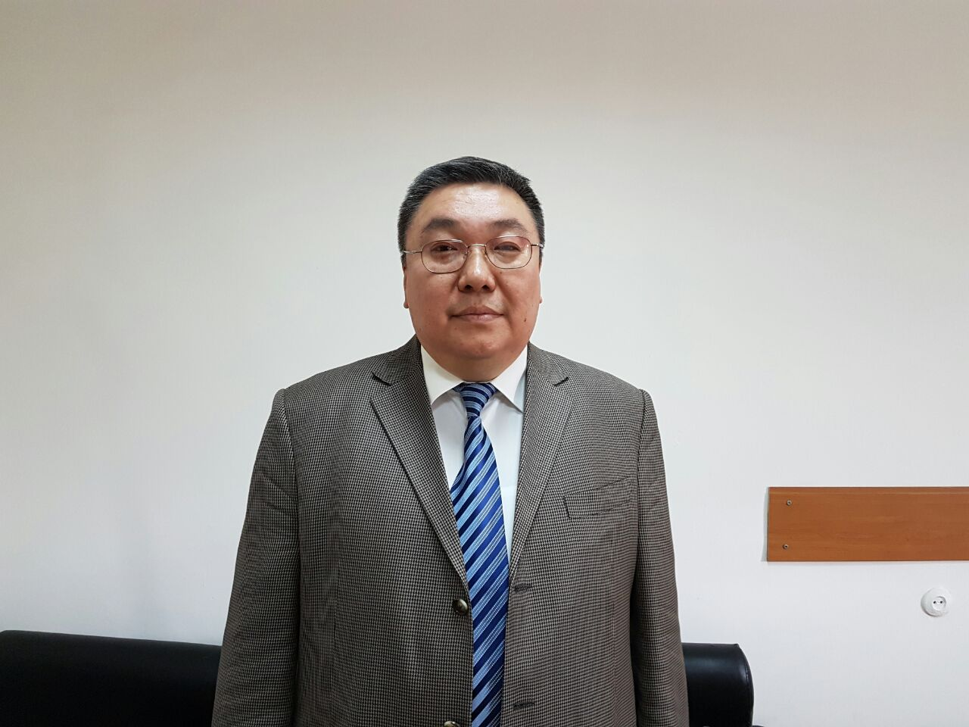

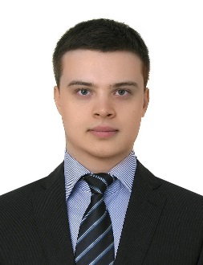
BCOP Resource Team
Maya Gusarova
World Bank
Deanna Aubrey
World bank
Naida Carsimamovic
World Bank
BCOP Executive Committee
Mikhail Prokhorik
Deputy Chair
Belarus
Anna Belenchuk
Chair
Russian Federation
Gelardina Prodani
Deputy Chair
Albania
Armen Manukyan
Armenia
Hakan Ay
Turkey
Alija Aljović
Bosnia and Herzegovina
Maldenka Karačić
Croatia
Kanat Asangulov
Kyrgyz Republic
Elena Zyunina
Russian Federation
Nikolay Begchin
Russian Federation

Slide 6
Activities during 5 years: 2012-17
Plenary
Five plenary meetings attended by 18-21 member countries (held in Albania, Turkey, Armenia, Belarus, Kyrgyz Republic (2017)
Working group
Six working group meetings held (OECD survey (2013), Wage Bill (2014), PEFA (2014), two Budget Literacy workshops (2015) (2016), one OECD PEMPAL performance budgeting survey workshop (2016)
Video conferences
Seven VC meetings held (two in 2014 and five in 2015)
Study visits
Participation in five OECD CESEE SBO meetings and two OECD performance and results network meetings, six thematic surveys conducted on PFM issues, and 21 BCOP Executive Committee meetings held
Nine study visits held: four in 2013, two in 2014, two in 2015, one so far in 2016 attended by up to 15 people each
Other
Notes:
This information should be available in Annual Reports. Make an estimate based on FY17 plans for the last year.

Slide 7
Past Results: Strategic Priorities Addressed for 2012-17
Sharpening knowledge for effective fiscal management:
Program and performance budgeting addressed initially through three annual plenary meetings (2012-2014) and now through new Working Group (2016):
Up to 21 member countries met each year given priority of these reforms
First meeting on program budgeting had to clarify terminology, select technical reference documents for translation, and identify regional and international trends and good practices.
  Subsequent meetings focused on aspects of program and performance budgeting and then concluded with results-based monitoring and evaluation.
Experts from World Bank, OECD, IMF participated in all meetings and thematic pre-meeting surveys were conducted before each meeting to provide status of reforms. (Links to 4. Expanding internationally available data on PEMPAL countries)

Slide 8
Past Results: Strategic Priorities Addressed for 2012-17
Sharpening knowledge for effective fiscal management:
Program and performance budgeting continued:
Country cases examined over three meetings:
  International: France, Australia, Slovenia, Poland, Estonia, Austria, Ireland, Sweden, Netherlands, South Korea
  PEMPAL: Kazakhstan, Russian Federation (3), Armenia, Croatia (2), Bosnia and Herzegovina, Turkey
Study visits also held in 2013: Poland on program budgeting at local levels; to UK to determine how results information was determined in the education sector; and to Ireland to examine approach to spending reviews.

Slide 9
Past Results: Strategic Priorities Addressed for 2012-17
1. Sharpening knowledge for effective fiscal management (continued):
Other tools and issues examined over last strategy period:
IT systems for budget planning (2013 study visit to Georgia by 6 countries)
Budget Planning and the role of Parliament (2014 study visit to Austria by 5 countries)
PEFA Secretariat workshop to discuss PEFA revisions (2014 back-to-back OECD SBO)
Budget planning and management of EU funds (2014 study visit to Slovenia by 6 countries)
Wage bill management – refer to slide on Working Group for Wage Bill Management

Slide 10
Past Results: Strategic Priorities Addressed for 2012-17
Sharpening knowledge for effective fiscal management (continued):
Fiscal consolidation plans (plenary meeting, 2015) and fiscal risks for effective and sustainable budgeting (plenary meeting, 2016) were also chosen by members to discuss given measures and tools being implemented to recover from global economic crisis since 2008.
Country cases examined for a) fiscal consolidation: Armenia, Turkey and Russia; and b) fiscal risks: Sweden, Latvia, Albania, Belarus and Russia
World Bank and IMF also shared insights on key concepts, issues, examples, and the design choices for spending reviews, and how to ensure fiscal sustainability through effective wage bill management.
Pre-meeting thematic surveys conducted to provide information on status of reforms in each country and to inform discussion groups held on common challenges. OECD budget practices and procedures survey for fiscal risks implemented and results compared to 2012 survey.

Slide 11
Past Results: Strategic Priorities Addressed for 2012-17
2. Strengthening fiscal transparency and accountability – cross-COP meeting in 2014 in Moscow led to formation of working group – refer to working group slide
3. Facilitating knowledge exchange between OECD member and accession countries at annual Senior Budget Officers’ (SBO) meetings.
BCOP members have attended the annual OECD SBO meeting for CESEE region and have actively participated including presenting specific issues each year. Small delegations have also attended the annual OECD SBO meeting on performance and results. Cooperation with OECD has led to:
  13 PEMPAL member countries participating in the 2012 OECD Budget Practices and Procedures survey which benchmarked practices against 33 OECD countries while identifying good practices and international trends
  16 PEMPAL member countries participating in the fiscal rules part of the 2016 OECD Budget Practices and Procedures survey to update results
  12 PEMPAL member countries participating in the 2016 OECD Performance Budgeting survey

Slide 12
Past Results: Strategic Priorities Addressed for 2012-17
4. Expanding internationally available data on PEMPAL countries through benchmarking using pre-meeting thematic surveys and more formal OECD surveys
PEMPAL thematic surveys have been conducted on budget transparency; program budgeting practices; fiscal consolidation; wage bill management
Impact: For mid-term review of last strategy, six BCOP member countries provided evidence of significant impact from PEMPAL activities. Country level success stories which included positive impact of BCOP also collected in 2011 and 2016 for:
  Albania
  Belarus
  Russia Federation
  Kyrgyz Republic
Areas of impact included: program budgeting; IT systems budget planning; wage bill management; budget literacy and transparency

Slide 13
Results of BCOP Wage Bill Management Working Group (members involved: 12 countries, finished FY2016)
What has been done from FY2014 to FY 2016
Examined application of a wage bill forecasting model and pay flexibility approaches in the civil service; use of IT systems in wage bill management (Turkey case study); and Latin American experience in improving HRM efficiency
Developed documents and Working Group Results
To learn from international experience and exchange lessons PEMPAL countries learnt on how to address key challenges and vulnerabilities in countries public sector pay systems and wage bill management practices.
Main objective
Expert presentations prepared by country cases addressing the questions raised by the group members
Examined country case studies in pay policy and wage bill management in Kyrgyz Republic, Croatia and Slovenia
Sharing of wage bill policies, procedures and laws
Members gained a deepened knowledge on several critical issues in pay policy and wage bill management which should lead to improved wage bill management and overall strengthened budget sustainability given the wage bill accounts for significant proportion of public expenditures across ECA region
Study visit to Slovenia in 2016 to examine approaches in-depth

Slide 14
Results of BCOP Budget Literacy and Transparency Working Group (members involved: 15 countries)
What has been done from FY2015 to FY 2016
Documentation of member countries practices and status of reforms through an online survey during 2015.
Developed documents and Working Group Results
Through roundtable discussions, the Group identified 10 implementation challenges to developing Citizens Budgets. Developed a knowledge product providing a menu of options to address them based on peer and international advice. Consultations included input by OECD and IBP.
To learn from international experience with raising budget literacy among citizens and budget openness and accessibility.
Main objective
Reviewed international country case studies through a World Bank study on budget literacy practices.
Approaches of engaging citizens in Canada, UK, Russia Federation and Croatia examined through presentations by Canadian NGO; HM Treasury UK, and PEMPAL member countries.
Study visit conducted to Croatia to examine citizens’ budgets and public participation initiatives at state and local levels.
Identification of good practices as identified in IBP’s 2015 Open Budget Index and close examination of practices of Romania, Russian Federation as leaders in PEMPAL region and also Kyrgyz Republic as most improved.
Participated in discussions with other Ministries of Finance in OECD region on budget transparency including providing input to draft OECD toolkit on budget transparency
Study visit to South Africa (2015) by Executive Committee to examine transparency and budget approaches given it rated highly in Open Budget Index

Slide 15
Knowledge Products Produced
  Comparative benchmarking conducted:
  OECD surveys: Budget Practices and Procedures (2012) ; Performance Budgeting (2016) ; Fiscal Rules (2016)
Other benchmarking PEMPAL surveys: fiscal consolidation (2015), program budgeting (2012, 2013, 2014), budget literacy and transparency (2015)
Knowledge product documents developed:
Citizens Budget Knowledge Product – identification of 10 challenges and how to break them (2016)
Collation of key performance indicators by sector (2014)
Results of the OECD PEMPAL Budget Practices and Procedures survey: Report on Strengthening Budget Institutions in PEMPAL countries (2012)

Slide 16
Knowledge Products Produced (cont)
Technical PFM reports by World Bank, OECD, IMF, IBP and GIZ translated and shared.
For each major meeting, concept notes are developed identifying key concepts and international trends and issues (eg program and performance budgeting; results-based monitoring and evaluation; fiscal consolidation; fiscal rules)
Numerous member country laws, policies and guidelines shared eg Guidelines on Citizens Budget from Kyrgyz Republic, Moldova, Russia Federation translated and shared

Slide 17
Future Results: Strategic Priorities planned for 2017-2022
Strategic priorities to be included for next PEMPAL Strategy 2017-22:
Sharpening tools for effective fiscal management with initial focus on performance and program budgeting, while identifying other countries challenges and priorities to address.
Strengthening fiscal transparency and accountability with a focus on budget literacy, transparency and public participation initiatives.
Expanding internationally available data on PEMPAL countries through identification ad sharing of good practices and benchmarking within and outside the PEMPAL.

Slide 18
Future Results: Strategic Priorities planned for 2017-2022
The format of events proposed:
  annual plenary meeting to discuss key fiscal tools;
  study visits to best practice countries for working groups;
  participation at annual OECD SBO meetings with working group meetings held back-to-back;
  videoconference meetings.
Knowledge products will be developed by working groups that will identify member country reform challenges and provide a menu of options to address them from peer and international advice.

Slide 19
Process for Identifying and Prioritizing PFM priorities
During the last strategy, BCOP circulated country priority forms at annual plenary meetings of all members.
  BCOP Executive Committee prioritized topics during meeting making most common ones for plenary meeting and less common the subject of VCs and other meetings.
  These were announced by end of meeting.
  Study visits were assigned to working groups only (adopted in last years of strategy).
Over strategy period, this will be done more formally by pre-meeting surveys providing priority reform options to ensure more formal documentation and to cover all countries (given 1-2 countries did not attend annual meetings).
  Countries will then be informed of selected priorities by Executive Committee through feedback provided in annual presentation on achievement and activities.

Slide 20
Ideas for Cross-COP Collaborations
BCOP would like to suggest:
a joint event for BCOP and TCOP on budget transparency and/or cross-COP event on government budget reporting (ie how to link budget planning and reporting in accordance with GFS, Eurostats, and national statistic agency requirements)
a joint VC with IACOP on how internal audit can strengthen budget preparation, monitoring and evaluation
a cross-COP VC or event on citizen engagement innovations in the budget cycle or/future role and functions of MoFs

Slide 21
Хвала
Спасибо
Thank you
Köszönöm
დიდი მადლობა
Շնորհակալություն

