Slide 1
THE MINISTRY OF FINANCE OF
THE REPULIC OF BELARUS
Providing the information security upon Automated information system of the Ministry of finance

Slide 2
Challenges of the Ministry of Finance
Features
Governmental organization
Critically important ICT objects
Distributed infrastructure
Three levels of confidentiality
Dozens of subsidiary organizations
Hundreds of branches
Thousands of users
Own software developer
Range of complex interconnected systems
Issues
Obligatory legal requirements
Great number of threats, communication channels
CIA balance
Complementary responsibilities
Complementary software testing
Secure communication
Enhanced legal security requirements

Slide 3
Information security concept
is to achieve and substantially maintain:
availability of information, data and services;
data and system integrity;
confidentiality and privacy of information;
compliance with national Laws and Regulations;
normal mode of exploitation information system in accordance with operation rules.

Slide 4
Information security objectives
avoidance or mitigating the risk of unauthorized disclosure and modification of information;
business continuity and disaster recovery planning;
enforcing accountability;
creating information security culture within the Ministry of Finance.
intangible assets management;

Slide 5
Feasible and consistent approach is the main principle of information security framework.
The Ministry of Finance has created Information Security System including specially adapted legal, organization and technical methods and tools in order to support target level of:
integrity,
availability,
confidentiality,
authenticity,
safety
the data, information and services.

Slide 6
Information security arrangements
Legal
Organizational
Technical
Policies, standards and guidelines
Roles and responsibilities
Cryptography
Controls
Public key infrastructure
Audit
Ethics and training
Access control

Slide 7
Information security arrangements
Legal
Domestic legislation
National standards
International standards
Rules of engagements
Confidentiality agreements
Guidelines
Baselines
Roles descriptions

Slide 8
Information security arrangements
Organizational
Information security infrastructure
Assets management
HR management
Mandatory access control at physical and logical layer
Information system life cycle management
Business continuity and disaster recovery planning

Slide 9
Information security arrangements
Technical
Firewalls
Antiviruses
Cryptography tools
Intrusion detection system
Traffic analyzers
Anomaly detection
Audit tools
Data leak prevention system

Slide 10
Public key infrastructure
PKI is a set of hardware, software, people, policies, and procedures needed to create, manage, distribute, use, store, and revoke digital certificates for Belorussian governmental organizations and manage public-key encryption. The purpose of a PKI is to facilitate the secure electronic transfer of financial information.

Slide 11
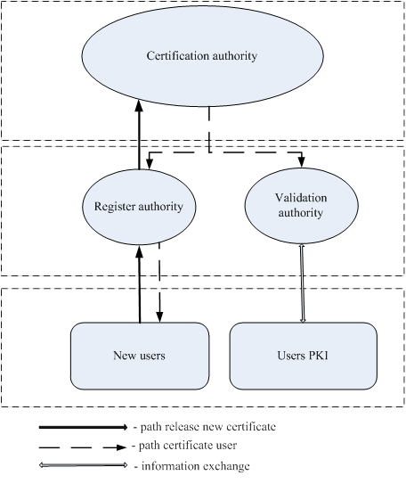
Public key infrastructure diagram

Slide 12
Certificate authority
124 Registration and Validation authorities
Certified software;
Licensed activity;
3000 digital certificates for internal purposes, annual output of 8000 digital certificates;
experienced personnel;
24/7 technical support.

Slide 13
Thank you

