Slide 1
Panel discussions on Accountability
Budapest
30-31 March 2017

Slide 2
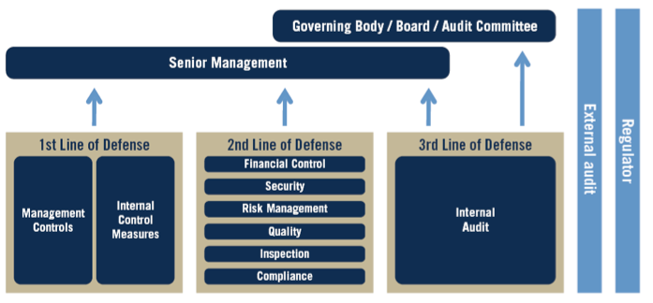
Remember the 3 LoD model

Slide 3
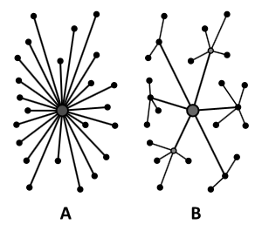
Centralization versus decentralization

Slide 4
The role of Senior Management in establishing Accountability
Budapest
30 March 2017
11h00

Slide 5
Senior Management and Accountability

Slide 6
Senior Management and Accountability
Towards political level
Towards stakeholders
Other...
Setting of agreed upon objectives
Providing tools (budget)
Assurance expected from 3 lines
Other...

Slide 7
The role of the 1st Line of Defense in establishing Accountability
Budapest
30 March 2017
13h45

Slide 8
The 1st Line of Defense and Accountability

Slide 9
The 1st Line of Defense and Accountability
Objectives from the top
Provision of assurance
Other...
Setting of agreed upon objectives
Providing tools (budget support)
Assurance expected from staff
Other...

Slide 10
The role of the 2nd Line of Defense in establishing Accountability
Budapest
30 March 2017
15h30

Slide 11
The 2nd Line of Defense and Accountability

Slide 12
The 2nd Line of Defense and Accountability
Objectives from the top
Provision of assurance
Other...
Consider accountability of 1st line
in a proactive way
in a reactive way
Other...

Slide 13
The role of the 3rd Line of Defense in establishing Accountability
Budapest
31 March 2017
09h00

Slide 14
The 3rd Line of Defense and Accountability

Slide 15
The 3rd Line of Defense and Accountability
Objectives from the top
Provision of assurance
Other...
Consider accountability of 1st line
Consider accountability of 2nd line
Other...

