Slide 1

PEM PAL
IA COP
Audit in Practice Working Group
Human Capital Case
Jean-Pierre Garitte
Skopje
8 April 2019

Slide 2
Human Capital case
From the scenario provided we have identified a number of business objectives:
Obtain the best resources in an as short as possible timeframe (government perspective)
Run the recruitment process in an efficient, cost-effective, correct and transparent way (provider perspective)
Based on the business objectives internal audit can define his/her audit objectives.

Slide 3
Audit objectives (1)
From the business objective:
Run the recruitment process in an efficient, cost-effective, correct and transparent way
We define our audit objectives:
To assure that the recruitment occurs in an efficient, cost-effective, correct and transparent way

Slide 4
Audit objectives (2)
Audit objective:
To assure that the recruitment occurs in an efficient, cost-effective, correct and transparent way.
This audit objective can be broken down in several sub-objectives:
To assure that the needs of the ministries are well captured and translated into correct recruitment criteria.
To assure that the laws and regulations on privacy are respected.
To assure that applicants are notified in a timely manner about the status of their application.
To achieve the various audit objectives the auditor needs to assess the controls in the processes involved.

Slide 5
Processes in scope for audit
Development of vacancy notice
Handling of incoming mails
Handling of incoming applications
Procedure of exam test
Interview process

Slide 6
Reference frameworks
COSO internal control framework
Internal procedures (government)
Internal procedures (provider)
Privacy regulations
Quality handbook

Slide 7
Skills and expertise needed
Data analytics

Slide 8
Inherent risks to the various processes
Incorrect understanding of ministries’ needs
No timely feedback to declined candidates
Applications lost in mail
Good candidates found already a job
Leakage of tests
Bad publicity in press
Incorrect documents submitted remain undetected
Interviews not objective
Ranking of candidates is ‘arranged’
No respect of privacy

Slide 9
Expected mitigating controls (1)
Incorrect understanding of ministries’ needs
  Standard template for identification of needs
  Feedback from ministry once template has been completed

Slide 10
Expected mitigating controls (2)
No timely feedback to declined candidates
  Approved deadlines for providing feedback
  Tracking system for status of application
  Automatic flagging of overdues
  Proper supervision

Slide 11
Expected mitigating controls (3)
Applications lost in mail
  Registration of all incoming mails
  Applications coded according to vacancy
  Only applications to dedicated email address

Slide 12
Expected mitigating controls (4)
Good candidates found already a job
  Approved deadlines for providing feedback
  Tracking system for status of application
  Automatic flagging of overdues
  Proper supervision

Slide 13
Expected mitigating controls (5)
Leakage of tests
  Tests are developed and kept in a secure environment
  Tests can only be accessed on a need-to-know basis
  Compilation of tests can be done at the very last moment

Slide 14
Expected mitigating controls (6)
Bad publicity in press
  This risk can only be managed by mitigating the other risks that may lead to bad publicity.

Slide 15
Expected mitigating controls (7)
Incorrect documents submitted remain undetected
  Have a system in place that easily compares standard documents
  Have a black list of earlier falsified documents

Slide 16
Expected mitigating controls (8)
Interviews not objective
  Members of the interview team should be selected on the basis of specific knowledge and skills
  Usage of a standard script for interviews
  Scoring mechanism to be applied by the interview team
  Having an independent observer attending the interview

Slide 17
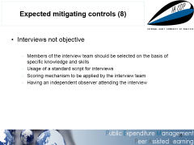
Expected mitigating controls (9)
Ranking of candidates is ‘arranged’
  Ranking of candidates occurs according to their results
  Having an independent observer monitor the ranking of candidates

Slide 18
Expected mitigating controls (10)
No respect of privacy
  Privacy regulations have been integrated into internal procedures and into the entire recruitment process
  An individual has been identified to oversee compliance with regulations

Slide 19
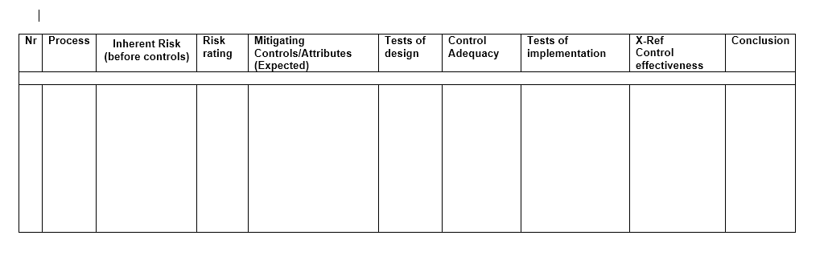
Risk / control matrix

Slide 20
Questions & Answers

