Slide 1
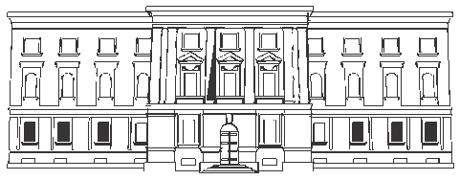
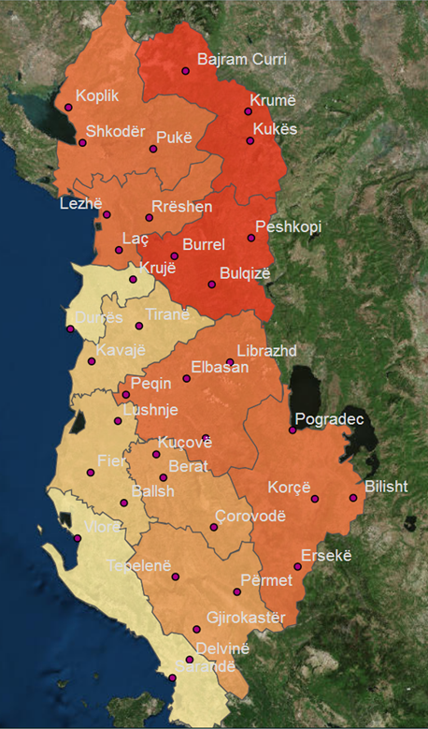
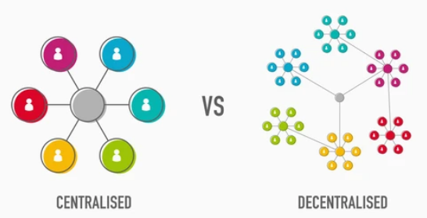
ALBANIAN TREASURY MODEL OF BUDGET EXECUTION
Albania
Treasury Districts Offices (TDOs)
Republic of Albania
Ministry of Finance and Economy
General Directorate of Treasury
2023 TCOP Annual Plenary Meeting
“Almaty - Kazakhstan
We are trying to be as near as possible to our clients to get the effective and efficient service by Treasury functions
Notes:
First of all I want to stress that clearly delineating which is superior CENTRALIZED or DECENTRALIZED model is a difficult task and one that requires careful consideration.
Albania is a small country with the surface of 28 748 km squares and 2.8 million population. Currently the geographical expansion of Treasury Districts Offices (TDOs) is present in this map and the AGFIS-IT treasury System is presented by the diagram in the next slide nr. 2, which is the centralized one, because all transactions of general government are paid centrally from AGFIS to Central Bank as fiscal agent of government, intermediary to commercial bank accounts of beneficiaries.
The debate over a centralized versus decentralized treasury structure is not a new one. It has long been the source of discussion and frustration. Each structural model offers benefits to the global organization for which we are discus in this plenary meeting. So the content of this presentation include (slide nr. 2):

Slide 2
Content
ALBANIAN TREASURY MODEL OF BUDGET EXECUTION
Ministry of Finance and Economy (MFE)
Treasury System
Treasury context
Mix Centralization(CE)/ Decentralization (DE) for:
Authority/Devolution-GDT/TDOs Control of TDOs/MDAs
IT System/Consolidated Reporting
General Directorate of Treasury (GDT)
36 Territorial/District Branches (TDOs) under Prime Authorizing Officer
14 Central government institutions
1 Municipality of Tirana
2
Notes:
Control of transactions and centralized payment through TSA.
The authority to make important decisions for cash management (which is the main function among treasury functions) is maintained by top level manager analyzing the financial position of the general government presented in the daily financial statement generated by the accounting system.(central, local and special funds)
IT system used for treasury operations. As for the Albania specific content, the interesting point about your presentation is that it emphasizes that Albania has centralized its systems through digitization which means controls etc. are decentralized to line ministries, but also centralized to treasury. So for the Albania specific content the model is mix, e.g. a commitment is record in AGFIS from spending unit online, but before get approval from treasury, then is available to be released and match with invoices which will be paid electronically through TSA in Central Bank.
Central automation creates the opportunity to strengthen financial/fiscal discipline and to get the track of audit for controls in the regional treasuries and headquarter of treasury. Both of them as a whole monitor the spending units for consistency with legislation to get the adequate consolidated financial position of government through generates from AGFIS the financial statements set by international standards (PULSAR-IPSAS).
As for the Albania specific content, the interesting point about your presentation is that it emphasizes that Albania has centralized its systems through digitization which means controls etc. are decentralized to line ministries, but also centralized to treasury. So the model is mix, e.g. a commitment is record in AGFIS from spending unit online, but before get approval from treasury, then is available to be released and match with invoices which will be paid electronically through TSA in Central Bank.
The concentration of control of an activity or organization under a single authority.(e.g. the centralization of all financial power in the hands of its leaders)
The transfer of control of an activity or organization to several local offices or authorities rather than one single one. .(e.g. the decentralization of business services)
Automation alone is not sufficient; it requires trained staff to plan, implement and monitor the budget formulation and execution
Key Treasury / IT / Line ministries / Budget staff, including senior officials, need to understand PFM concepts to be able to enter financial information, extract and analyze relevant data, generate and use reports
Develop awarness of the benefits and uses of the automated and integrated FMIS Why? - Enable smooth communication and interoperability (e.g., managing government payroll, revenue administration, external assistance flows, etc.) - Generate new ideas for improvements of the FMIS and decision-making processes - Reduce resistance to change through training, seminars, etc. Challenges - Changing pace of implementation in some components can affect that of the others - Diversity of goals and targets among various components - Managing constant evolution and expansion of the FMIS on one side, and contiuous changes in PFM regulatory framework, on the other
taxes liabilities’ payment system
No payment, for any reason, can not be proceed by the bank, if the taxpayer does not submit payment order generated by the new tax system.
Treasury control and payments
Controls on non-payroll expenditure are primarily ex-ante voucher checking. There is very little internal audit functionality at the ex-post stage as required by international best practices. Other financial controls follow international practice and are generally complied with. • As the budget is being implemented, Treasury monitors the staffing levels with respect to a ceiling of authorized positions. The financial resources and controls in place are based on this ceiling and not on the actual number of staff employed. Inevitable staffing lags result in an underutilized salary budget. • All government expenditure, central as well as local, is executed through the Treasury Single Account system (TSA). The system rejects any spending for which there are inadequate allocations. Controls are exercised by budget program, institution, and economic classification regarding the yearly budget allocations. TDO records and performs an additional ex-ante control before payment. Treasury keeps a strong central control on budget execution.
More than a “managerial accounting issue”, pre-commitments are an integral part of establishing sound internal public financial management controls to ensure there are sufficient funds to cover government commitments. Lack of formal recognition of pre-commitments in the AGFIS could lead to initiating procurement processes for which there might not be sufficient funds to ensure full payment or even to support the contracting process.
Cash overspending cannot occur because each transaction is checked against the appropriations/allocations. If not sufficient cash resources are allocated to the account, the transaction has to be rejected by the Treasury District Office’s expenses specialist. The Treasury executes payment when cash is available, but generally within one month. • The right to make expenditures within the limit of approved funds expires on the last day of the budget year. There is a very strict carry-over regime. All spending is limited to the calendar year unless explicitly allowed by the Parliament in the annual budget law. Borrowing against future appropriations is prohibited. The only exception is that line ministries have the right to carry over the unused funds of multiyear investment contracts, but no longer than three years, provided ex-ante approval by the Assembly. • The Treasury plans generally provide a transparent and reliable framework within which the local governments LG can execute their budget. However, when the government revise downwards the budget ceilings due to over-optimistic projections the LG budget execution is affected because the local governments own revenue is included in the common cash pool – the TSA. This lack of control over the use of their own revenue in the LG is reported to be a source of frustration.
Commitment, accounts payable and arrears controls are Fundamental to effective cash management and budget execution control •Discussions at previous PEMPAL events and internationally indicates that these concepts are understood differently in countries. •This presentation will focus on the “generally accepted definitions” and benchmark PEMPAL practices against those definitions
Step 2 – Recording of commitments for all contracts at the time the contract is agreed with a supplier. This ensures : –funds are set aside to pay the supplier –the Treasury has additional information about likely future cashflows in the accounting system for better cash planning and forecasting –Using a system generated purchase order ensures that suppliers have a guarantee from the Treasury –The purchase order may be issued from a procurement system, however, if it is to be an effective budget and cash control, it must also be recorded in the FMIS system soon after the contract is signed
of 14 countries that responded to the survey indicated that they had commitment controls •10 countries indicated that the given definition of commitments aligned with their country practice. The two remaining countries answered ‘no’, however, the additional explanations provided indicated a strong concurrence •11 countries responded to the question on the types of spending subjected to commitments. All 11 record commitments for utilities, goods and services, projects and capital spending. Four also have commitments for debt •6 of the 11 countries issue a PO for commitments. Of the six, five issue it from the same system that controls appropriations and the budget.
Good practice is to record the commitment when the contract is agreed – this is the legal obligation •Three countries record commitments between 3 and 15 days of the contract being entered into. •One country indicated that commitments are linked to appropriations •One country indicated that commitments are recorded only after payment
In addition to Step 3 many governments require the receipt of a correctly rendered invoice before recognizing the accounts payable.
Most countries have a pre-commitment and commitment stage. Recognition of commitments is however varied •Only half of the countries recognize goods and services delivery. This has implications for accrual accounting •Only half of the countries match invoices to commitments – this presents some challenges for budget control •9 countries recognize accounts payable, however the point of recognition is not consistent •8 countries have a due data and 8 also report on budget arrears •While some consistent themes emerged, there remains significant differences across PEMPAL countries and in comparison to good practice. •Has the degree of integration of all of these processes into a FMIS had an impact? •Has the move to adopting accrual basis IPSAS had an impact?
Why would countries recognize commitments and accounts payable at different stages of the payment process? Are there challenges for budget, cash management and financial reporting for these different points of recognition? 2.Discuss country definitions of due date and budget arrears. Are there issues with recognition of due date and arrears in a country that is experiencing cash shortfalls?

Slide 3
1- Well defined rules and regulation 2- Defined structure by environment 3- Determined objectives and policies 4- Limitation on the activities of the employees 5- Strict observance of the principle of coordination 6- Messages are communicated through vertical chain
Treasury context
The Albanian Treasury is formal organization, a goal-oriented entity that exist to accurate the efforts of employees for carry out the financial services and protect the assets of general government; it refers to the structure of jobs and positions with clearly defined functions, authorities and responsibilities; a system of consciously coordinated activities of budget execution toward a common objective. In detail:
3-
4-
5-
3
Notes:
General government in Albania consists in three level:
-Central government,
-Local government,
-Special funds: Social security, Health care security and Ex-owners compensation.
Mark’s presentations functions:
-The clear core functions in the Treasury:
1.Authorization and processing of payments on behalf of the government
2.Management of government bank accounts (TSA and other)
3.Budget execution reporting
4.Cash forecasting
5.Cash management
6.Consolidated financial reporting
-The majority of treasuries manage the ICT function for the treasury system
7.Management of the treasury information system
8.Training and education
9.IT support
-The less common in the Treasury:
10.Debt management
11.Public sector accounting policy and methodology
12.Management of the whole central financial management information system
13.Management of other government information systems
-By the Albanian point of view to add after nr. 6 above:
7.Risk Management,
8.Banking Relationship enhancement,
9.International Funding Bank Accounts management,
10.Drafting of the strategy for the Treasury within the framework of the sectoral strategy of public finance management,
11. KPIs compilation,
12. Ex-ante control of commitments of central/local government against MTBP in AGFIS.

Slide 4
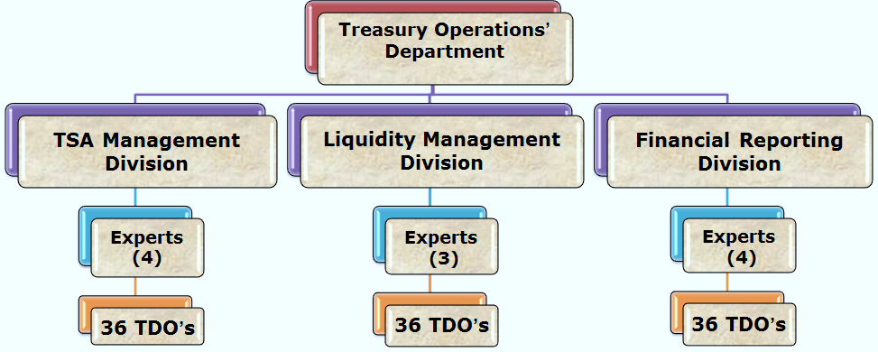
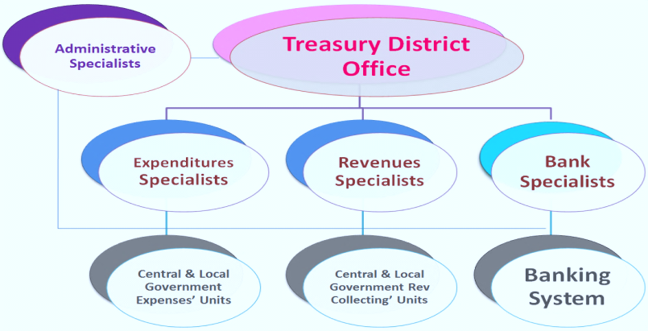
Authority/Devolution – GDT/TDO
Albanian Treasury System
It consists in 36th Treasury Districts Offices (219 employees) and a General Directorate under Ministry of Finance and Economy, composed up as follows:
Treasury Operations’ Department (15 employees),
Business Processing's Department (8 employees),
Department of Indemnity’s Payments (8 employees),
which communicate with 1,300 budgetary units (MDAs-line ministries,
departments and agencies/local government units).
Separated General Directorates of Debt/ Budget/Tax & Customs Authority
Notes:
Bacground
Established Albanian Treasury System on 16th APRIL 1993,
It`s necessary because of:
market economy model,
expenditures control ,
the use of standard documents ,
information,
issuing securities and other debt instruments,
there were no system of cash management,
there were no government accounting system.
Mission Effective management of the process of execution of general government budget, the administration of Treasury Single Account, the financial forecasting and the consolidated financial statements preparation according to international standards in the context of realizing the mission of the Ministry of Finance. Also to secure the necessary financing in accordance with the government's budget requirements through a combination of financial instruments that include foreign project or general budgetary financing, domestic borrowing, and state guarantees. This is to be achieved with the clear objective of minimizing the overall effective cost and risk of the debt portfolio, ensuring timely debt service, and developing the financial instrument base in compliance with the legal and regulatory framework. Development of Albanian Government financial information System- AGFIS (Oracle E-Business Suite) to a modern system for processing of general government transactions based on international standards and practices of the financial reporting, the use of liquidity and general government property with economy, efficiency, effectiveness and transparency.
Functions of TDO’s:
Checking bills from budget institutions and authorizing payments.
Maintained detailed (7 digits code) classified accounts.
Carrying out daily reconciliation with banks
Compiling and submitted monthly classified accounts to Central Treasury
Generating management report by AGFIS
Albania is the unitary parliamentary constitutional Republic.

Slide 5
Control of TDOs/MDAs
The digitalization of processes creates the opportunity to
Control of the destination
Checks if the expenses incurred according to the documents attached to the spending order are expenses of the same nature as the funds approved for this purpose and if they are covered by the unspent funds of the general government unit for each category of expenses (AGFIS reject automatically, Treasury monitors respecting of due date of the payment).
remove the need for controls in the regional treasuries;
focus as Government’s
Accountant/Cash Manager
(IPSAS Trainers)
Controller as:
Formal control
Checks whether the expenditure order is completed in accordance with the approved format in all extremes and fields. Verifies the signatures with the deposited specimens and the accuracy of the seal of the public entity (avoid by implementation of e-spending order; electronic archive ).
Budget executor:
1.Ex-ante controller
2.Recorder
3.Authorizer
Single cash manager:
Documentary control
Checks whether for the expenses listed in the spending order, sufficient original documents have been attached that prove the spending according by legislation, the connection with the commitment of the spending unit previously registered in the system to frozen funds and the references of the spending order (avoid by implementation of e-contract; e-spending order generated by AGFIS).
1.Forecaster of Cash Flows
2.Endorser of Payments
3.Manager of liquidity
Control overspending against monthly cash plans (automated).
Treasury role is to ensure cash is available rather than rationed; exception in rare cases: If the amount of spending orders is greater than available liquidity, then payment is authorized according to the order of priorities determined by the Minister responsible for Finance and emergency payments proposed by the spending unit. (Not “Real time”, one day delay from registration day). Just in time cash management.
Instruction No. 9, dated March 20, 2018
"On Standard Budget Implementation Procedures"
Notes:
Instruction No. 9, dated March 20, 2018 "On Standard Budget Implementation Procedures“ in albanian:
Në proçesin e kryerjes së shpenzimeve publike përfshihen Njësitë e Qeverisjes së Përgjithshme përgjegjëse për menaxhimin e fondeve publike, Sistemi i thesarit – kontrollori financiar përpara pagesës dhe menaxhuesi i likuiditeteve të qeverisjes së përgjithshme, si dhe Sistemi Bankar – për ekzekutimin e pagesave dhe arkëtimin e mjeteve monetare të njësive të qeverisjes së përgjithshme.
158. Struktura përgjegjëse për thesarin rregjistron urdhër shpenzimin në sistemin informatik financiar të qeverisë sapo paraqitet nga njësia shpenzuese. Numri sekuencial që vendoset nga sistemi përbën njëkohësisht numrin e protokollit të depozitimit për njësinë përkatëse. Kontrollet që kryhen gjatë proçesit të rregjistrimit renditen si më poshtë:
Kontrolli formal. Kontrollon nëse urdhër-shpenzimi është plotësuar konform formatit të miratuar në të gjitha ekstremet dhe fushat. Verifikon firmat me specimentet e depozituara dhe saktësinë e vulës së njësisë publike.
Kontrolli dokumentar. Kontrollon nëse për shpenzimet e shënuara në urdhërshpenzim ka bashkëlidhur dokumenta origjinale të mjaftueshme që vërtetojnë kryerjen e shpenzimit sipas paragrafit 157, lidhjen me angazhimin e njësisë së qeverisjes së përgjithshme të rregjistruar më parë në sistem sipas paragrafit 149 dhe referencat e urdhër-shpenzimit.
Kontrolli i destinacionit dhe shumës së fondeve në dispozicion. Kontrollon nëse shpenzimet e kryera sipas dokumentave bashkangjitur urdhër-shpenzimit janë shpenzime të së njëjtës natyrë me fondet e aprovuara për këtë qëllim dhe nëse ato mbulohen me fondet e pashpenzuara të njësisë së qeverisjes së përgjithshme për secilën kategori shpenzimesh.
Kontrolli i ekzistencës së limitit mujor të lejuar për shpenzim (plani mujor i arkës). Ky kontroll realizohet në sistem, sipas zërave agregate të çelur më parë. Në rastet kur shuma e urdhër-shpenzimeve është më e madhe se likuiditetet në dispozicion, atëherë autorizohet pagesa sipas rradhës së prioriteteve të përcaktuara nga Ministri i Financave, të tilla si shpenzimet paralele (kontributet, tatimet, etj.), energjia elektrike, shpenzimet valutore dhe pagesat urgjente të propozuara nga njësia shpenzuese.
157. Pas konstatimit të transaksionit të shpenzimit në kontabilitet nga nëpunësi zbatues i njësisë, dhe marrjes në administrim të aktivit, urdhër-shpenzimi dërgohet menjëherë tek struktura përgjegjëse për thesarin së bashku me:
a. faturën e operatorit ekonomik në rast të blerjeve të mallrave dhe shërbimeve, ose të pagesave të pjesshme apo përfundimtare të lidhura me investimet;
b. listë pagesat për llojet e tjera të shpenzimeve.
c. dokumentin ligjor për pagesa specifike si rastet e pagesave të vendimeve të gjyqit, të shpronësimeve, të të përndjekurve politikë, etj.

Slide 6
CENTRALIZED PLATFORM - INTEGRATED DATA
C@TS
Dashboards Business Intelligence
A set of automation solutions - integrated modules/systems
that will enable government to plan, execute and monitor the budget
Notes:
What is AFMIS?
AFMIS will be a set of automation solutions (integrated modules/systems) that will enable the government to plan, execute and monitor the budget.
AFMIS Portal (in progress)
Human Resource Management (partially live)
Procurement APP (live)
DFMAS (Live)
Other Systems (C@TS: Tax and Customs, etc.)
IPSIS (in progress)
EAMIS (first stage of implementation)
MTBP (in progress)
Budget Program Performance Monitoring-BPPM (Budget project portfolio monitoring )
Budget Portfolio Monitoring (in progress)
AGFIS (live): General Ledger + AGFIS Subledgers
Dashboards Business Intelligence/ DSS/Management Information System (in progress)
Legal bases:
Law on the management of the Budget System (No. 9936 dated 26.06.2008 amended on 2015).
Law on financial management and Internal Control (No. 10296 dated 08.07.2007 amended on 2015).
Public Financial Management Strategy 2014-2020 approved on December 2014.

Slide 7
Main benefits of AFMIS
IT System/Consolidated Reporting
Monitoring performance, products (outputs) and expenditures
Non-Financial Monitoring Information collected via portal from multiple
data sources LM, PMO, DU, EAMIS, HR-DoPA, etc.
Project Monitoring.
Process Tracking & Alerts information for better quality management and audit
Integration with AGFIS insuring final updated version of budget.
Enables monitoring of the progress of the NSDI & MTBP involving all line ministries and BI.
Budget reallocations immediately reflected in both systems MTBP & AGFIS
Provides tools to help analyzing Government data
Create reports for donors
Electronic archive of documentation fostering the internal financial control in budget planning and execution process.
Les time consume on budget execution through treasury (BI’s will send electronically through WP the supporting documents for financial transaction execution in AGFIS and monitor their budget execution through prebuild reports)

Slide 8
Actual benefits of automated public finance systems (AGFIS, PPS, Tax, Customs, DMFAS)
IT System/Consolidated Reporting
PFM rules are technically translated into the Systems, hence ensures that transactions execution and their accounting can only be made in line with the applicable rules.
Transparency throughout budget execution (what, by whom, when).
Almost real time information on budget execution (expense execution, revenue collection, etc.).
Time saved on financial consolidation process and financial reporting preparation of State Budget (prebuild consolidation formulas and FSG reports in AGFIS).
Transparent tendering process of public funds using the information system of Public Procurement (PPS).
Accurate information and time saved on public debt management process- DMFAS (foreign and domestic debt).
Notes:
Albanian Financial Information System (AGFIS) for budget execution and financial reporting (live on 2010), online 36 TDO’s and 15 Budgetary Institutions. AGFIS is systematically improved with new functionalities in recent years (extended to BI’s, multi-year commitments management, added new internal control rules etc.)
Tax Information System (live on 2015)
Custom Information System (live on 2013)
Public Procurement System (live on 2007)
Debt Management Information System- DMFAS (live on 1998)
Week points of actual situation: The information between systems is exchanged manually (mostly excel spreadsheet).
MTBP is used mainly for MTBP preparation till August September – then not used
MTBP do not have final updated version of budget
Not maintained data in MTBP during budget execution
Accessibility problems on MTBP software due to old client server technology
Data for budget monitoring are mainly (only) from Treasury AGFIS
PIM is almost absent, small component of MTBP
PIM is not supported by current system of MTBP
Distributed information in separate IT or non-IT systems
Coherence/ Delays on data exchange between systems
Week Communication / collaboration (mostly manually)
Access to information is problematic / multiple data sources
Difficulties/Delays on budget monitoring and managerial reports (different source and manual elaboration of data).

Slide 9
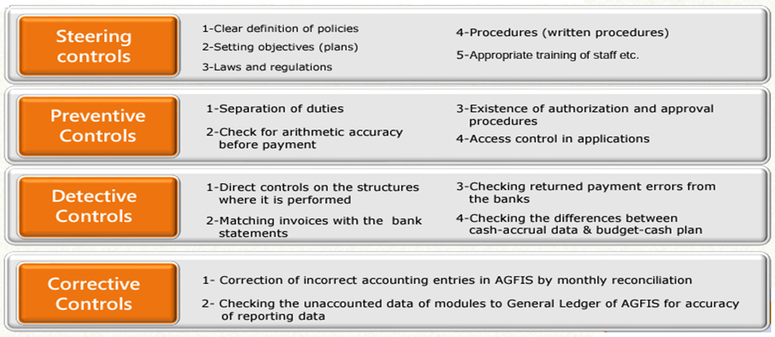
IT System/Consolidated Reporting
General Directorate of Treasury builds the control rules, features and processes
9

Slide 10
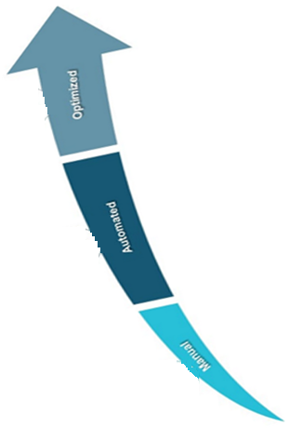
ALBANIAN TREASURY MODEL OF BUDGET EXECUTION
The main factors that encourage the Albanian Treasury towards centralization are:
Automation has resulted in a decentralization of controls to MDAs. The traditional gatekeeper role of TDOs will no longer be required following implementation of reforms. As a result, they will move into a new value-added role in training education, central cash manager and accountant.
Technology
Legislation
Visibility
Centralization of processes across the AGFIS provides better control, efficiency and a consolidated financial position.
Legislation (payment services directives, multiple bank accounts and systems can be consolidated)
Provide Treasury with a view of exposures and ability to manage liquidity. Global financial crisis emphasized a better management of the liquidity/associated risk (counterparty, FX, interest rate)
10
Notes:
Automation has resulted in a decentralization of controls to MDAs. The traditional gatekeeper role of TDOs will be no longer required after implementation of the reforms. As a result they will be moving to a new value added role in training education, government cash manager and accountant.
AGFIS is not fully functional, but is used across most of the general government units, which additionally use local IT accounting systems
The movement toward treasury centralization has been in progress for many years and led by the need for greater:
Control and efficiency
1.1. Centralization of processes across the treasury system provides better control and efficiency
Visibility,
2.1. Provide treasury with a view of exposures and ability to manage liquidity
Cost reduction
3.1. Multiple bank accounts and systems can be consolidated
Ishte:The factors have allowed more Treasurers to continue toward centralization are:
Technology
Globalization of the markets [the global financial crisis emphasized the importance of managing liquidity and risks (counterparty, FX, interest rate)]
Legislation (single euro payment area, payment services directives)

Slide 11
Good spend. Spending with accountability
THANK YOU
Mimoza.Peco@financa.gov.al
Treasury Operations’ Department
Notes:
In recent years, Albania has managed to face three consecutive crises, the 2019 earthquake, the Covid 19 pandemic and the current price crisis. Albania has been able to overcome the successive crises quite well, continuing with the continuous monitoring of the situation, the coordination of policies by the Albanian authorities, taking the necessary measures at the right time. The Albanian government has expressed its determination to continue the initiated reforms, fiscal consolidation and reduction of public debt. Fiscal consolidation is an important factor in the macroeconomic development of the country.

