Slide 1
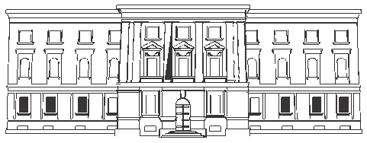
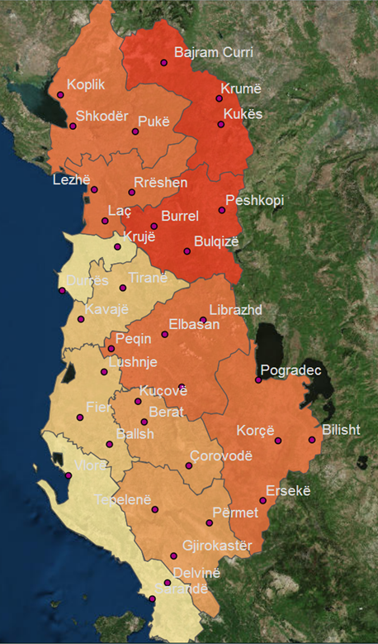
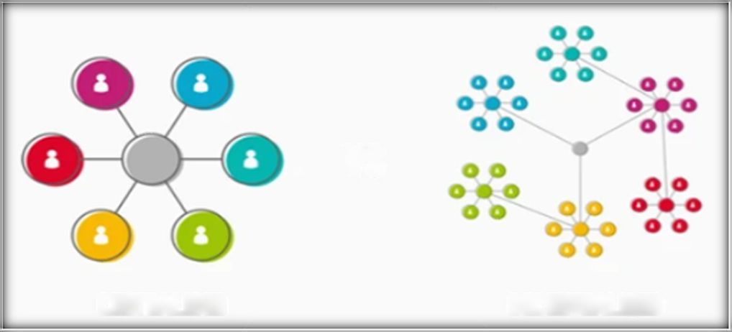
МОДЕЛЬ ИСПОЛНЕНИЯ БЮДЖЕТА, ПРИНЯТАЯ В КАЗНАЧЕЙСТВЕ АЛБАНИИ
Албания
Территориальные отделения Казначейства (ТОК)
Республика Албания
Министерство финансов и экономики
Главное управление казначейства
или
ЦЕНТРАЛИЗАЦИЯ
ДЕЦЕНТРАЛИЗАЦИЯ
Ежегодное пленарное заседание КС - 2023 г.
Алматы - Казахстан
Мы стараемся быть как можно ближе к своим клиентам, чтобы обеспечить эффективное и действенное обслуживание, реализуя функции Казначейства.
Notes:
First of all I want to stress that clearly delineating which is superior CENTRALIZED or DECENTRALIZED model is a difficult task and one that requires careful consideration.
Albania is a small country with the surface of 28 748 km squares and 2.8 million population. Currently the geographical expansion of Treasury Districts Offices (TDOs) is present in this map and the AGFIS-IT treasury System is presented by the diagram in the next slide nr. 2, which is the centralized one, because all transactions of general government are paid centrally from AGFIS to Central Bank as fiscal agent of government, intermediary to commercial bank accounts of beneficiaries.
The debate over a centralized versus decentralized treasury structure is not a new one. It has long been the source of discussion and frustration. Each structural model offers benefits to the global organization for which we are discus in this plenary meeting. So the content of this presentation include (slide nr. 2):

Slide 2
Содержание
МОДЕЛЬ ИСПОЛНЕНИЯ БЮДЖЕТА, ПРИНЯТАЯ В КАЗНАЧЕЙСТВЕ АЛБАНИИ
Министерство финансов и экономики (МФЭ)
Казначейская система
Контекст деятельности казначейства
Сочетание - централизация(Ц)/ децентрализация (Д) в части:
Компетенции/передача полномочий ГУК/ТОК
Контроль ГУК /Mинистерство
ИТ-системы/консолидированная отчетность
Главное управление казначейства (ГУК)
36 территориальных/районных отделений (ТОК) в ведении главного ответственного должностного лица
14 учреждений центрального правительства
1 муниципалитет Тираны
2
Notes:
Control of transactions and centralized payment through TSA.
The authority to make important decisions for cash management (which is the main function among treasury functions) is maintained by top level manager analyzing the financial position of the general government presented in the daily financial statement generated by the accounting system.(central, local and special funds)
IT system used for treasury operations. As for the Albania specific content, the interesting point about your presentation is that it emphasizes that Albania has centralized its systems through digitization which means controls etc. are decentralized to line ministries, but also centralized to treasury. So for the Albania specific content the model is mix, e.g. a commitment is record in AGFIS from spending unit online, but before get approval from treasury, then is available to be released and match with invoices which will be paid electronically through TSA in Central Bank.
Central automation creates the opportunity to strengthen financial/fiscal discipline and to get the track of audit for controls in the regional treasuries and headquarter of treasury. Both of them as a whole monitor the spending units for consistency with legislation to get the adequate consolidated financial position of government through generates from AGFIS the financial statements set by international standards (PULSAR-IPSAS).
As for the Albania specific content, the interesting point about your presentation is that it emphasizes that Albania has centralized its systems through digitization which means controls etc. are decentralized to line ministries, but also centralized to treasury. So the model is mix, e.g. a commitment is record in AGFIS from spending unit online, but before get approval from treasury, then is available to be released and match with invoices which will be paid electronically through TSA in Central Bank.
The concentration of control of an activity or organization under a single authority.(e.g. the centralization of all financial power in the hands of its leaders)
The transfer of control of an activity or organization to several local offices or authorities rather than one single one. .(e.g. the decentralization of business services)
Automation alone is not sufficient; it requires trained staff to plan, implement and monitor the budget formulation and execution
Key Treasury / IT / Line ministries / Budget staff, including senior officials, need to understand PFM concepts to be able to enter financial information, extract and analyze relevant data, generate and use reports
Develop awarness of the benefits and uses of the automated and integrated FMIS Why? - Enable smooth communication and interoperability (e.g., managing government payroll, revenue administration, external assistance flows, etc.) - Generate new ideas for improvements of the FMIS and decision-making processes - Reduce resistance to change through training, seminars, etc. Challenges - Changing pace of implementation in some components can affect that of the others - Diversity of goals and targets among various components - Managing constant evolution and expansion of the FMIS on one side, and contiuous changes in PFM regulatory framework, on the other
taxes liabilities’ payment system
No payment, for any reason, can not be proceed by the bank, if the taxpayer does not submit payment order generated by the new tax system.
Treasury control and payments
Controls on non-payroll expenditure are primarily ex-ante voucher checking. There is very little internal audit functionality at the ex-post stage as required by international best practices. Other financial controls follow international practice and are generally complied with. • As the budget is being implemented, Treasury monitors the staffing levels with respect to a ceiling of authorized positions. The financial resources and controls in place are based on this ceiling and not on the actual number of staff employed. Inevitable staffing lags result in an underutilized salary budget. • All government expenditure, central as well as local, is executed through the Treasury Single Account system (TSA). The system rejects any spending for which there are inadequate allocations. Controls are exercised by budget program, institution, and economic classification regarding the yearly budget allocations. TDO records and performs an additional ex-ante control before payment. Treasury keeps a strong central control on budget execution.
More than a “managerial accounting issue”, pre-commitments are an integral part of establishing sound internal public financial management controls to ensure there are sufficient funds to cover government commitments. Lack of formal recognition of pre-commitments in the AGFIS could lead to initiating procurement processes for which there might not be sufficient funds to ensure full payment or even to support the contracting process.
Cash overspending cannot occur because each transaction is checked against the appropriations/allocations. If not sufficient cash resources are allocated to the account, the transaction has to be rejected by the Treasury District Office’s expenses specialist. The Treasury executes payment when cash is available, but generally within one month. • The right to make expenditures within the limit of approved funds expires on the last day of the budget year. There is a very strict carry-over regime. All spending is limited to the calendar year unless explicitly allowed by the Parliament in the annual budget law. Borrowing against future appropriations is prohibited. The only exception is that line ministries have the right to carry over the unused funds of multiyear investment contracts, but no longer than three years, provided ex-ante approval by the Assembly. • The Treasury plans generally provide a transparent and reliable framework within which the local governments LG can execute their budget. However, when the government revise downwards the budget ceilings due to over-optimistic projections the LG budget execution is affected because the local governments own revenue is included in the common cash pool – the TSA. This lack of control over the use of their own revenue in the LG is reported to be a source of frustration.
Commitment, accounts payable and arrears controls are Fundamental to effective cash management and budget execution control •Discussions at previous PEMPAL events and internationally indicates that these concepts are understood differently in countries. •This presentation will focus on the “generally accepted definitions” and benchmark PEMPAL practices against those definitions
Step 2 – Recording of commitments for all contracts at the time the contract is agreed with a supplier. This ensures : –funds are set aside to pay the supplier –the Treasury has additional information about likely future cashflows in the accounting system for better cash planning and forecasting –Using a system generated purchase order ensures that suppliers have a guarantee from the Treasury –The purchase order may be issued from a procurement system, however, if it is to be an effective budget and cash control, it must also be recorded in the FMIS system soon after the contract is signed
of 14 countries that responded to the survey indicated that they had commitment controls •10 countries indicated that the given definition of commitments aligned with their country practice. The two remaining countries answered ‘no’, however, the additional explanations provided indicated a strong concurrence •11 countries responded to the question on the types of spending subjected to commitments. All 11 record commitments for utilities, goods and services, projects and capital spending. Four also have commitments for debt •6 of the 11 countries issue a PO for commitments. Of the six, five issue it from the same system that controls appropriations and the budget.
Good practice is to record the commitment when the contract is agreed – this is the legal obligation •Three countries record commitments between 3 and 15 days of the contract being entered into. •One country indicated that commitments are linked to appropriations •One country indicated that commitments are recorded only after payment
In addition to Step 3 many governments require the receipt of a correctly rendered invoice before recognizing the accounts payable.
Most countries have a pre-commitment and commitment stage. Recognition of commitments is however varied •Only half of the countries recognize goods and services delivery. This has implications for accrual accounting •Only half of the countries match invoices to commitments – this presents some challenges for budget control •9 countries recognize accounts payable, however the point of recognition is not consistent •8 countries have a due data and 8 also report on budget arrears •While some consistent themes emerged, there remains significant differences across PEMPAL countries and in comparison to good practice. •Has the degree of integration of all of these processes into a FMIS had an impact? •Has the move to adopting accrual basis IPSAS had an impact?
Why would countries recognize commitments and accounts payable at different stages of the payment process? Are there challenges for budget, cash management and financial reporting for these different points of recognition? 2.Discuss country definitions of due date and budget arrears. Are there issues with recognition of due date and arrears in a country that is experiencing cash shortfalls?

Slide 3
1- Четко определенные правила и нормативная база 2- Структура определена условиями 3- Определенные цели и меры политики 4- Ограничения на виды деятельности сотрудников 5- Жесткое соблюдение принципа координации 6- Информация доводится по вертикали
Контекст деятельности казначейства
Казначейство Албании - это официальная организация, ориентированная на достижение целей, существующая для объединения усилий сотрудников по оказанию финансовых услуг и защите активов государства; она подразумевает структуру рабочих мест и должностей с четко определенными функциями, полномочиями и ответственностью; систему тщательно скоординированной деятельности по исполнению бюджета для достижения общей цели. Подробнее:
3-
4-
5-
Исполнение бюджета
1. Превентивный контроль
2. Отражение транзакций
3 Авторизация
Единое управление ликвидностью
1. Прогнозирование движения денежных средств
2. Подготовка платежей
3. Управление ликвидностью
Бухучет в государственном секторе
1. Элиминирование данных
2. Консолидация данных
3. Сверка данных
Распространение данных
Функции Казначейства
1. Формирование финансовых отчетов
Формирование данных государственной
статистики
3
Notes:
General government in Albania consists in three level:
-Central government,
-Local government,
-Special funds: Social security, Health care security and Ex-owners compensation.
Mark’s presentations functions:
-The clear core functions in the Treasury:
1.Authorization and processing of payments on behalf of the government
2.Management of government bank accounts (TSA and other)
3.Budget execution reporting
4.Cash forecasting
5.Cash management
6.Consolidated financial reporting
-The majority of treasuries manage the ICT function for the treasury system
7.Management of the treasury information system
8.Training and education
9.IT support
-The less common in the Treasury:
10.Debt management
11.Public sector accounting policy and methodology
12.Management of the whole central financial management information system
13.Management of other government information systems
-By the Albanian point of view to add after nr. 6 above:
7.Risk Management,
8.Banking Relationship enhancement,
9.International Funding Bank Accounts management,
10.Drafting of the strategy for the Treasury within the framework of the sectoral strategy of public finance management,
11. KPIs compilation,
12. Ex-ante control of commitments of central/local government against MTBP in AGFIS.

Slide 4
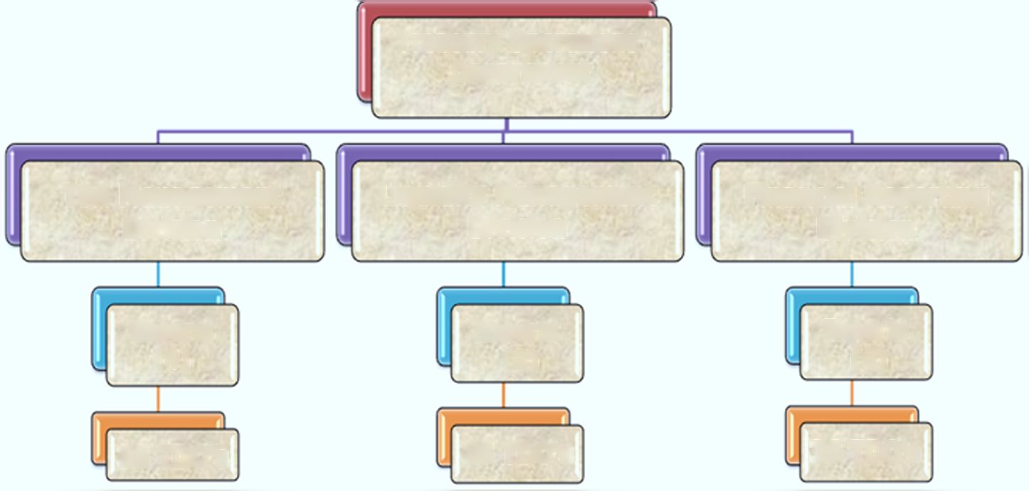
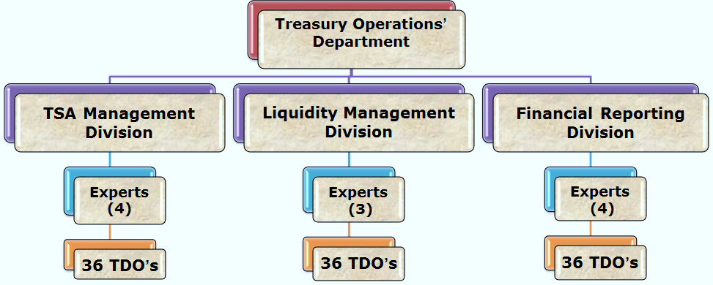
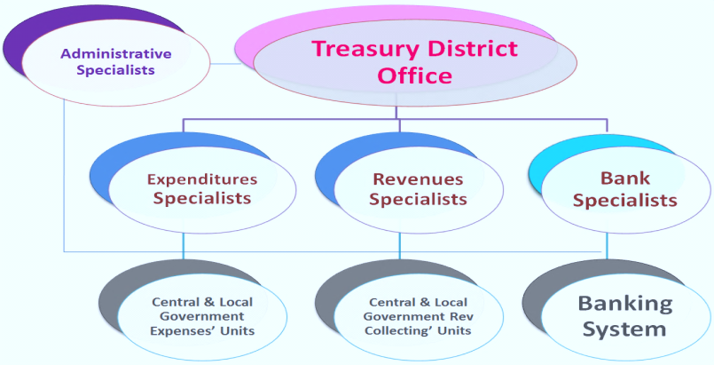
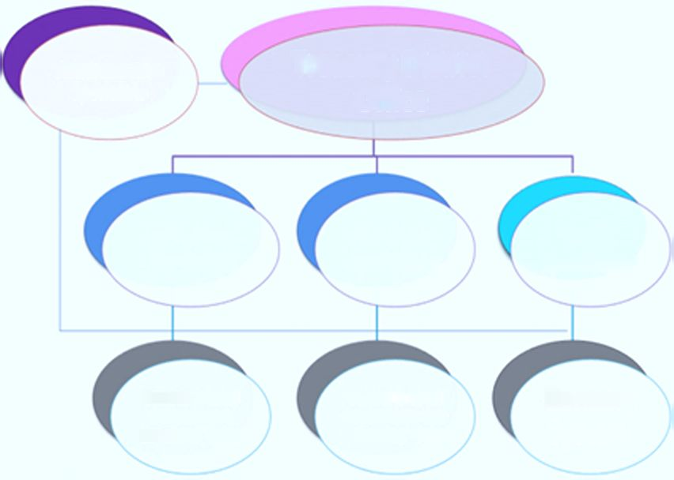
Компетенции/полномочия – ГУК/ТОК
Казначейская система Албании
Включает 36 территориальных отделений казначейства (219 работников) и Главное управление в ведении Министерства финансов и экономики, которое имеет следующую структуру:
Департамент казначейских операций (15 сотрудников),
Департамент по бизнес-процессам (8 сотрудников),
Департамент выплаты возмещений (8 сотрудников);
они взаимодействуют с 1300 РБС (МДВ - отраслевыми министерствами,
департаментами и ведомствами/ОМСУ).
Отдельные генеральные управления по долгу/ бюджету/
налогам и таможне
Департамент казначейских операций
Территориальное отделение Казначейства
Административный персонал
Отдел финансовой отчетности
Отдел управления ЕКС
Отдел управления ликвидностью
Специалисты по расходам
Специалисты по доходам
Специалисты по банковской деятельности
Эксперты
(4)
Эксперты
(3)
Эксперты
(4)
Отделы расходов центральных органов власти и ОМСУ
Отделы сбора доходов центральных органов власти и ОМСУ
Банковская система
36 ТОК
36 ТОК
36 ТОК
Notes:
Bacground
Established Albanian Treasury System on 16th APRIL 1993,
It`s necessary because of:
market economy model,
expenditures control ,
the use of standard documents ,
information,
issuing securities and other debt instruments,
there were no system of cash management,
there were no government accounting system.
Mission Effective management of the process of execution of general government budget, the administration of Treasury Single Account, the financial forecasting and the consolidated financial statements preparation according to international standards in the context of realizing the mission of the Ministry of Finance. Also to secure the necessary financing in accordance with the government's budget requirements through a combination of financial instruments that include foreign project or general budgetary financing, domestic borrowing, and state guarantees. This is to be achieved with the clear objective of minimizing the overall effective cost and risk of the debt portfolio, ensuring timely debt service, and developing the financial instrument base in compliance with the legal and regulatory framework. Development of Albanian Government financial information System- AGFIS (Oracle E-Business Suite) to a modern system for processing of general government transactions based on international standards and practices of the financial reporting, the use of liquidity and general government property with economy, efficiency, effectiveness and transparency.
Functions of TDO’s:
Checking bills from budget institutions and authorizing payments.
Maintained detailed (7 digits code) classified accounts.
Carrying out daily reconciliation with banks
Compiling and submitted monthly classified accounts to Central Treasury
Generating management report by AGFIS
Albania is the unitary parliamentary constitutional Republic.

Slide 5
Контроль ТОК/MДВ
Цифровизация процессов устраняет потребность в средствах контроля в ТОК
Контроль назначения
Проверяется, являются ли расходы, произведенные в соответствии с документами, приложенными к расходному ордеру, расходами того же характера, что и средства, утвержденные на эти цели, и покрываются ли они неизрасходованными средствами органа государственного управления по каждой категории расходов (AGFIS автоматически отклоняет, Казначейство контролирует соблюдение установленных сроков платежа).
Основное направление – бухучет в госсекторе/ управление ликвидностью
(Инструкторы МСУГС)
Контролер в качестве:
Формальный контроль
Проверяется, заполнен ли расходный ордер в соответствии с утвержденным форматом во всех крайних точках и полях. Сверяет подписи с депонированными образцами, а также правильность печати государственного учреждения (устраняется благодаря внедрению электронных расходных ордеров; электронного архива).
Исполнителя
бюджета:
1. Осуществление превентивного контроля
2. Отражение информации
3. Санкционирование
Единого управляющего ликвидностью:
Документальный контроль
Проверяется, приложены ли к расходам, перечисленным в расходном ордере, необходимые оригиналы документов, подтверждающих целевое расходование средств, связь с обязательствами ранее зарегистрированного в системе РБС по замороженным средствам и ссылки расходного ордера (устраняется благодаря внедрению электронных контрактов; электронных расходных ордеров, сформированных AGFIS).
1. Прогноз движения денежных средств
2. Санкционирование платежей
3. Управление ликвидностью
Контроль за перерасходом средств в сравнении с месячными кассовыми планами (автоматически).
Роль Казначейства заключается в обеспечении наличия денежных средств, а не их нормировании; исключения редки: если сумма расходных ордеров превышает объем имеющейся ликвидности, то платежи санкционируются в соответствии с порядком приоритетов, определенным министром финансов, и чрезвычайными платежами, предложенными РБС (не в реальном времени, - с задержкой в один день от даты регистрации). Управление ликвидностью «точно в срок».
Инструкция No. 9 от 20.03.2018
«O типовых процедурах исполнения бюджета»
Notes:
Instruction No. 9, dated March 20, 2018 "On Standard Budget Implementation Procedures“ in albanian:
Në proçesin e kryerjes së shpenzimeve publike përfshihen Njësitë e Qeverisjes së Përgjithshme përgjegjëse për menaxhimin e fondeve publike, Sistemi i thesarit – kontrollori financiar përpara pagesës dhe menaxhuesi i likuiditeteve të qeverisjes së përgjithshme, si dhe Sistemi Bankar – për ekzekutimin e pagesave dhe arkëtimin e mjeteve monetare të njësive të qeverisjes së përgjithshme.
158. Struktura përgjegjëse për thesarin rregjistron urdhër shpenzimin në sistemin informatik financiar të qeverisë sapo paraqitet nga njësia shpenzuese. Numri sekuencial që vendoset nga sistemi përbën njëkohësisht numrin e protokollit të depozitimit për njësinë përkatëse. Kontrollet që kryhen gjatë proçesit të rregjistrimit renditen si më poshtë:
Kontrolli formal. Kontrollon nëse urdhër-shpenzimi është plotësuar konform formatit të miratuar në të gjitha ekstremet dhe fushat. Verifikon firmat me specimentet e depozituara dhe saktësinë e vulës së njësisë publike.
Kontrolli dokumentar. Kontrollon nëse për shpenzimet e shënuara në urdhërshpenzim ka bashkëlidhur dokumenta origjinale të mjaftueshme që vërtetojnë kryerjen e shpenzimit sipas paragrafit 157, lidhjen me angazhimin e njësisë së qeverisjes së përgjithshme të rregjistruar më parë në sistem sipas paragrafit 149 dhe referencat e urdhër-shpenzimit.
Kontrolli i destinacionit dhe shumës së fondeve në dispozicion. Kontrollon nëse shpenzimet e kryera sipas dokumentave bashkangjitur urdhër-shpenzimit janë shpenzime të së njëjtës natyrë me fondet e aprovuara për këtë qëllim dhe nëse ato mbulohen me fondet e pashpenzuara të njësisë së qeverisjes së përgjithshme për secilën kategori shpenzimesh.
Kontrolli i ekzistencës së limitit mujor të lejuar për shpenzim (plani mujor i arkës). Ky kontroll realizohet në sistem, sipas zërave agregate të çelur më parë. Në rastet kur shuma e urdhër-shpenzimeve është më e madhe se likuiditetet në dispozicion, atëherë autorizohet pagesa sipas rradhës së prioriteteve të përcaktuara nga Ministri i Financave, të tilla si shpenzimet paralele (kontributet, tatimet, etj.), energjia elektrike, shpenzimet valutore dhe pagesat urgjente të propozuara nga njësia shpenzuese.
157. Pas konstatimit të transaksionit të shpenzimit në kontabilitet nga nëpunësi zbatues i njësisë, dhe marrjes në administrim të aktivit, urdhër-shpenzimi dërgohet menjëherë tek struktura përgjegjëse për thesarin së bashku me:
a. faturën e operatorit ekonomik në rast të blerjeve të mallrave dhe shërbimeve, ose të pagesave të pjesshme apo përfundimtare të lidhura me investimet;
b. listë pagesat për llojet e tjera të shpenzimeve.
c. dokumentin ligjor për pagesa specifike si rastet e pagesave të vendimeve të gjyqit, të shpronësimeve, të të përndjekurve politikë, etj.

Slide 6
ЦЕНТРАЛИЗОВАННАЯ ПЛАТФОРМА – ИНТЕГРИРОВАННЫЕ ДАННЫЕ
C@TS
Информационные панели с бизнес-аналитикой
Набор автоматизированных решений – интегрированные модули/системы, позволяющие правительству планировать, исполнять и контролировать бюджет
Notes:
What is AFMIS?
AFMIS will be a set of automation solutions (integrated modules/systems) that will enable the government to plan, execute and monitor the budget.
AFMIS Portal (in progress)
Human Resource Management (partially live)
Procurement APP (live)
DFMAS (Live)
Other Systems (C@TS: Tax and Customs, etc.)
IPSIS (in progress)
EAMIS (first stage of implementation)
MTBP (in progress)
Budget Program Performance Monitoring-BPPM (Budget project portfolio monitoring )
Budget Portfolio Monitoring (in progress)
AGFIS (live): General Ledger + AGFIS Subledgers
Dashboards Business Intelligence/ DSS/Management Information System (in progress)
Legal bases:
Law on the management of the Budget System (No. 9936 dated 26.06.2008 amended on 2015).
Law on financial management and Internal Control (No. 10296 dated 08.07.2007 amended on 2015).
Public Financial Management Strategy 2014-2020 approved on December 2014.

Slide 7
Основные достоинства AFMIS
ИТ-система/консолидированная отчетность
Мониторинг эффективности, продуктов (результатов) и расходов
Нефинансовая информация, полученная в ходе мониторинга, поступает через портал из различных источников данных - LM, PMO, DU, EAMIS, HR-DoPA, и т.д.
Мониторинг проектов.
Отслеживание процесса и информирование в оповещениях - в интересах более эффективного управления качеством и аудита
Благодаря интеграции с AGFIS формируется окончательный актуализированный вариант бюджета.
Обеспечивается мониторинг хода NSDI и ССБП с участием всех отраслевых министерств и бюджетных учреждений (БУ).
Перераспределение бюджетных средств немедленно отражается в обеих системах - ССБП & AGFIS
Предоставляет инструменты для анализа государственных данных
Формирование отчетов для доноров
Электронный архив документов стимулирует проведение внутреннего финансового контроля в процессе планирования и исполнения бюджета.
Экономия времени при казначейском исполнении бюджета (БУ будут направлять в AGFIS первичные документы, касающиеся выполнения финансовых операций, через интернет-портал в электронном виде, и контролировать исполнение своих бюджетов с помощью шаблонов отчетов)

Slide 8
Фактические выгоды от внедрения автоматизированных систем в сфере государственных финансов (AGFIS, PPS, налоги, таможенные операции, DMFAS)
ИТ-система/консолидированная отчетность
Правила УГФ технически воплощены в системах; таким образом, выполнение операций и их учет могут осуществляться только в соответствии с применимыми правилами.
Прозрачность в ходе исполнения бюджета (что, кто, когда).
Получение информации об исполнении бюджета практически в реальном времени (осуществление расходов, поступление доходов и т.д.).
Экономия времени на процессе финансовой консолидации и подготовки финансовой отчетности применительно к государственному бюджету (шаблоны формул консолидации и отчетов FSG в AGFIS).
Прозрачность конкурсных процедур на право распоряжаться государственными средствами благодаря применению информационной системы государственных закупок (PPS).
Точная информация и экономия времени применительно к процессу управления долгом - DMFAS (внешним и внутренним).
Notes:
Albanian Financial Information System (AGFIS) for budget execution and financial reporting (live on 2010), online 36 TDO’s and 15 Budgetary Institutions. AGFIS is systematically improved with new functionalities in recent years (extended to BI’s, multi-year commitments management, added new internal control rules etc.)
Tax Information System (live on 2015)
Custom Information System (live on 2013)
Public Procurement System (live on 2007)
Debt Management Information System- DMFAS (live on 1998)
Week points of actual situation: The information between systems is exchanged manually (mostly excel spreadsheet).
MTBP is used mainly for MTBP preparation till August September – then not used
MTBP do not have final updated version of budget
Not maintained data in MTBP during budget execution
Accessibility problems on MTBP software due to old client server technology
Data for budget monitoring are mainly (only) from Treasury AGFIS
PIM is almost absent, small component of MTBP
PIM is not supported by current system of MTBP
Distributed information in separate IT or non-IT systems
Coherence/ Delays on data exchange between systems
Week Communication / collaboration (mostly manually)
Access to information is problematic / multiple data sources
Difficulties/Delays on budget monitoring and managerial reports (different source and manual elaboration of data).

Slide 9
ИТ-система/консолидированная отчетность
Главное управление казначейства формулирует правила, характеристики и процессы контроля
Направляющие меры контроля
1- Четко сформулированная политика
2- Целеполагание (планы)
3- Законы и нормативные акты
4- Процедуры (прописанные)
5- Соответствующая подготовка персонала и т.д.
Превентивные меры контроля
1- Разделение обязанностей
2- Проверка арифметической точности расчетов перед совершением платежа
3- Наличие процедур санкционирования и одобрения
4- Контроль доступа в приложениях
1- Прямой контроль в отношении контролируемых структур
2- Сопоставление счетов к оплате с банковскими выписками
3- Проверка ошибок возврата платежей из банков
4- Проверка различий между данными кассовых начислений и бюджетно-кассовым планом
Выявляющие меры контроля
Корректирующие меры контроля
1- Исправление неверно отраженных проводок в AGFIS в рамках ежемесячной сверки
2- Проверка неучтенных данных модулей в Главной книге AGFIS на предмет точности отчетных данных
9

Slide 10
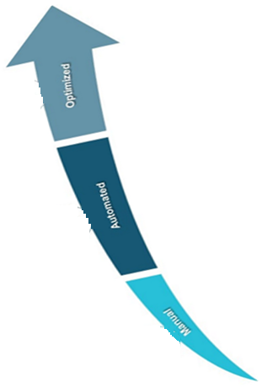
МОДЕЛЬ ИСПОЛНЕНИЯ БЮДЖЕТА, ПРИНЯТАЯ В КАЗНАЧЕЙСТВЕ АЛБАНИИ
Основные аргументы для Казначейства Албании в пользу централизации:
Оптимизировано
Автоматизировано
В ручном режиме
Итогом автоматизации стала децентрализация средств контроля на уровень MДВ. По завершении реформ традиционная роль ТОК («привратника») больше не потребуется. В результате они станут выполнять новую, более важную роль, занимаясь обучением и подготовкой, централизованным управлением ликвидностью и бухгалтерским учетом.
Технология
Законодательство
Осведомленность
Централизация процессов в рамках AGFIS обеспечивает лучший контроль, эффективность и консолидированную финансовую позицию
Законодательство (директивы по платежным услугам, многочисленные банковские счета и системы могут быть объединены)
Информирование Казначейства о рисках и способности управлять ликвидностью. Глобальный финансовый кризис подчеркнул важность более качественного управления ликвидностью/связанными с этим рисками (контрагента, валютный, процентной ставки)
10
Notes:
Automation has resulted in a decentralization of controls to MDAs. The traditional gatekeeper role of TDOs will be no longer required after implementation of the reforms. As a result they will be moving to a new value added role in training education, government cash manager and accountant.
AGFIS is not fully functional, but is used across most of the general government units, which additionally use local IT accounting systems
The movement toward treasury centralization has been in progress for many years and led by the need for greater:
Control and efficiency
1.1. Centralization of processes across the treasury system provides better control and efficiency
Visibility,
2.1. Provide treasury with a view of exposures and ability to manage liquidity
Cost reduction
3.1. Multiple bank accounts and systems can be consolidated
Ishte:The factors have allowed more Treasurers to continue toward centralization are:
Technology
Globalization of the markets [the global financial crisis emphasized the importance of managing liquidity and risks (counterparty, FX, interest rate)]
Legislation (single euro payment area, payment services directives)

Slide 11
Тратить эффективно. Расходовать ответственно.
СПАСИБО ЗА ВНИМАНИЕ!
Mimoza.Peco@financa.gov.al
Департамент казначейских операций
Notes:
In recent years, Albania has managed to face three consecutive crises, the 2019 earthquake, the Covid 19 pandemic and the current price crisis. Albania has been able to overcome the successive crises quite well, continuing with the continuous monitoring of the situation, the coordination of policies by the Albanian authorities, taking the necessary measures at the right time. The Albanian government has expressed its determination to continue the initiated reforms, fiscal consolidation and reduction of public debt. Fiscal consolidation is an important factor in the macroeconomic development of the country.

