Slide 1
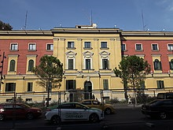




РЕСПУБЛИКА АЛБАНИЯ
MИНИСТЕРСТВО ФИНАНСОВ И ЭКОНОМИКИ
Банк Албании
Консолидация банковских счетов органов государственного управления на ЕКС в Центральном банке
Заседание тематической группы КС по управлению ликвидностью и прогнозированию ликвидности
27-29 ноября 2023 г.
Вена, Австрия
Notes:
Consolidation of cash under the Treasury System Account
Treasury development is an important component of public expenditure management.
Treasury system forms the backbone for recording and processing all financial transactions related to the budget for any level of government. An integrated treasury system offers several significant benefits in managing public monies more effectively, including, greater financial control, improved monitoring of the governments cash position, and better planning of future requirements, better fiscal reporting, and availability of better data for budget formulation. The establishment of an effective treasury system will also contribute directly to improving the transparency and accountability of government.
The main function of Treasury System is Cash management which as the combination of collection, distribution and investment of cash, requires projection of cash flows, a mechanism for payments and revenue collection, short-term instruments to finance the gap between cash flows, capacity to generate a return over cash balances and coordination across actors (institutions).
Full implementation of modern cash management is still a challenge

Slide 2





СОДЕРЖАНИЕ
Введение
Общая информация
Реформа
Охват
Notes:
REFORM
Treasury Single Account System (TSA) In order to minimize the cost of Government borrowings and to enhance the efficiency in fund flows to Autonomous Bodies (ABs) the Expenditure Management Commission (EMC), in its report (September 2015, Para 125) had recommended to gradually bring Autonomous Bodies under Treasury Single Account (TSA) coverage.

Slide 3
ВВЕДЕНИЕ
Законодательная база
Соглашения об уровне обслуживания
Определение​
Управление
- Закон «О Банке Албании»
- Закон «О государственных заимствованиях, долге и гарантиях государственного долга в Республике Албания»
- Закон «Об управлении бюджетной системой в Республике Албания»
ЕКС - это единая структура банковских счетов государства, важнейший инструмент консолидации и эффективного управления денежными средствам государства, позволяющий минимизировать затраты на привлечение заемных средств. В идеале включает остатки денежных средств всех государственных организаций, как бюджетных, так и внебюджетных.
Включают в себя рамочное соглашение (20.01.2015) и субдоговоры на оказание пяти конкретных услуг:
- об электронном взаимодействии между AGFIS и платежными системами БА: AIPS (RTGS) и AECH,
- об инструменте БА по управлению денежными средствами государства,
- о перечислении чистой прибыли БА на ЕКС и покрытии убытков БА,
- об управлении специальными банковскими счетами в БА по заказу Минфина,
- об организации аукционов по продаже государственных ценных бумаг, проведении расчетов по сделкам и ведении реестра государственных ценных бумаг.
- ЕКС курирует министр, отвечающий за финансы органов государственного управления.
- Введение ЕКС позволило снять с бухгалтерских подразделений обязанность управлять многочисленными банковскими счетами.
- Ответственность за управление оптимизированными банковскими счетами была передана Министерству финансов и экономики и осуществляется главным образом посредством системы AGFIS.
- Официальные комитеты и техническое рабочие группы.
- Протоколы по операциям
-
Notes:
Key factors to achieve government’s cash management objectives are well-defined institutional and legal framework.
Treasury established under a Presidential decree giving it the authority to monitor and control budget execution.
The arrangement are helpful when both parties respect the rules and timeliness of handling the relevant transactions (e.g. as fiscal or settlement agent)
SLAs are needed:
To avoid idle cash balance outside TSA
To avoid the volatility of the money market
To consider the management of operational risk
To standardize the accounting and business processing
To respect the timelines of the periodic reconciliation and financial reporting
To define the audit tracks of financial transactions
15 things to know about Treasury Single Account
1. TSA refers to Treasury Single Account, a public accounting system using a single account, or a set of linked accounts by government to ensure all revenue receipts and payments are done through a Consolidated Revenue Account (CRA) at the Central Bank of Nigeria (CBN).
2. The pilot TSA scheme commenced in 2012 using a unified structure of accounting for 217 government Ministries, Departments and Agencies, MDAs, for accountability and transparency in public fund management.
3. All government MDAs remit their revenue collections to the CRA through their individual commercial banks on a fee-for-service remuneration basis.
4. Although all monies earned by the federal government through value added tax (VAT), customs duties, immigration and other charges, are supposed to be paid into the CRA, a few exceptions border on accounts operated by joint venture partners with government, like oil mining leases (OMLs) in the oil and gas industry.
5. Deposit Money Banks (DMBs) are allowed to maintain revenue collection accounts for MDAs, but all collections must be remitted to the CRA at the end of every banking day; that is MDAs’ accounts with DMBs must be at zero balance at the end of every banking day.
6. TSA allows government banking to be unified, to enable the relevant stakeholders, such as the Ministry of Finance and Accountant General of the Federation to have full oversight of all cash flows across different bank accounts.
7. The different TSA account types include main account; subsidiary or sub-account; transaction account; zero balance account; imprest account; transit and correspondence accounts for different transaction purposes.
8. TSA helps check incidence of multiple accounts operated by government MDAs for collection and spending of government revenues.
9. TSA will ensure adequate monitoring of government revenue receipts and expenditures and block leakages, as no MDA is allowed to keep any operational bank account.
10. TSA will help check incidence of idle cash lying over extended periods in bank accounts held by spending MDAs, while government continues to borrow to execute its budgets.
11. Under TSA, DMBs using public sector funds deposited by MDAs to make free profits will not be possible.
12. To pay money under TSA, depositors make payment to a transit account in a commercial bank and the funds are automatically remitted to the CRA in the CBN at regular intervals, say at the end of the business day or at more frequent intervals
13. Payments through the TSA follow an electronic system, with direct payments or deposits to the bank account of the beneficiary MDA.
14. MDAs registered on the electronic payment platform, or CBN Payment Gateway, through the Settlement Centre, Funds Department, Office of the Accountant General of the Federation are granted access to funds collected on their behalf at the CBN.
15. The TSA scheme covers all MDAs as well as other institutions and parastatals that collect revenues and monies payable to FGN, including all forms of receipts, refunds, operating surpluses, transfers, donations, over-payment, taxes and customs duties, etc.
Legal basis
-Law no. 8269, dated on December 23, 1997, “On Bank of Albania” (revised)
-Law no. 9665, dated on December 18, 2006, “On state borrowing, debt and public debt’s guarantees in Republic of Albania” (revised)
-Law no.9936, dated on June 26, 2008, “On management of budget system in Republic of Albania” (revised)
Service level agreement (SLAs), which consists in the framework agreement (revised on January 20,2015) and five specific services sub-agreement as following:
On electronic communication between AGFIS and BoA’s payments systems: AIPS (RTGS) and AECH,
On BoA’s instrument for management of the government liquidity,
On the transfer of BoA’s net profit to MoF (TSA) and coverage of BoA’s losses,
On managment of the special bank accounts in BoA which are ordered by MoF,
On organization of government securities’ auctions, settlement of the transactions and keeping government securities register
on the relationship between the cash management function and the Central Bank.
2.
Covered by Legislation, Decrees, or Regulations
Formal committees and working groups
Memorandums of Understanding or Protocols on operations
Service level agreements (SLAs) for services
Informal arrangements
-----------------------------------
3.
The joint program for the development of the money market
Policies and operations for bill issuance and the respective roles of Central Bank Bills and Treasury bills
How the Central Bank reports its and the market’s views about the debt and cash management program and operations (this might be covered by one or other of the committees )
Choice of primary dealers or auction counterparties
The payment of interest on government balances at the central bank
Information exchanges – respective responsibilities, and issues covered (e.g. the prospective auction schedule, cash flow forecasts, banking information)
Where the treasury is able to borrow from the CB, understandings of the limits (sums, maturities, ability to roll over etc.) of borrowing
-----------------------------------
4.
The notice that both sides would give of any impending change in the auction pattern or timetable
The turnaround times by the central bank in handling any relevant transactions, e.g. as fiscal or settlement agent
Details of information flows in either direction, with intended timing, e.g. of cash flow forecasts or transactions across the TSA.
The basis of calculation of fees paid for the services (potentially covering compensation for any failure to meet the specified service)
The handling of any business continuity problem

Slide 4

ОБЩАЯ ИНФОРМАЦИЯ
1993
Сформирована структура Казначейства – центральный аппарат и 36 отделений
16 апреля
На постоянной основе
Казначейский контроль над финансовыми средствами государства
2010 Полное внедрение AGFIS
Все счета РБС под контролем Казначейства; выполняется консолидация банковских счетов; банковские счета консолидируются по принципу «один счет на провинцию/регион/область»
На постоянной основе
Банковские счета РБС постепенно переводятся под контроль Казначейства.
2006
Большинство счетов РБС под контролем Казначейства; при этом у РБС сохраняется по несколько счетов в разных банках.
2023
Все банковские счета РБС под контролем Казначейства. Консолидация банковских счетов: все счета консолидированы на ЕКС.
Notes:
Treasury Single Account System (TSA) - In order to minimize the cost of Government borrowings and to enhance the efficiency in fund flows
To enhance the efficiency of fund flows by using the 'just in time' principle for release of funds and thereby ensuring better Cash Management
II. To avoid parking of funds released in the commercial bank accounts.
III. Reducing Government borrowing through better cash management, resulting in lower interest burden
Advantages of Treasury Single Account.
The introduction of the TSA has borne numerous benefits for government and the economy as a whole
First of all, TSA allowed the government to discover and close accounts in commercial banks that had a 0% interest rate. Among those accounts, the Government also found and shut down quite a few fake accounts that were opened on behalf of the government. Those accounts were actually operated by private establishments, which did not benefit the government in the slightest.
The establishment of the TSA helped the Government get a stronger hold of its finances. With this new ability, it can have better plans for the good of citizens and have the funds for the implementation of said plans.
One of the biggest breakthroughs for the economy is that as there is a single account, any government structure can have access to it without paying outrageous fees to commercial banks.
The money that belongs to the Government is now under its full control and more secure than ever., it means that the government’s money is safe and accessible at any time.
With TSA there began an era of new payment opportunities. This means that can be used the online banking features
With all of the government money in one place, it is now possible to audit all government transactions. This means that all transactions are monitored, and all the information on them (like the date or purpose of payment) can be easily accessed. The audit of the TSA also allows to monitor the state of different agencies and to adjust the budgetary allocation accordingly.
Disadvantages of Treasury Single Account
As they say, nothing is perfect. Despite all of its advantages, TSA still has a few flaws. Here are a few of them:
Firstly, the introduction of a completely new system is always hard. It is hardest when it comes to the banking system, namely its performance and liquidity. The introduction of TSA might put unnecessary pressure on availability of credit and interest rates.
Secondly, the fact that the public corporations are also included in the TSA might distort the boundaries between the public and government sectors, and limit the operational independence of said corporations. They might lose their autonomy to introduce strategies that are commercially oriented. In fact, many universities can seriously suffer from the loss of autonomy.
Another challenge of the TSA is that not everyone actually understands what it is, how it works or why it is important. Many people are confused or ignorant on the topic of TSA; therefore, the support for it has been lackluster at times.
==========================
1993: The implementation of the TSA concept in the management of government cash resources significantly changed the current system of managing the budget related receipts and payments at accounting units and financial reporting at different levels of the government.
Describe the coordination arrangements in place between the Ministry of Finance / Treasury and Central Bank relating to policy and operations:
1.Regular meetings Minister/Governor to handle high level policy issues
2.Committee structures, e.g. Public Debt Committee (PDC) for high level policy coherence;
3.Cash Coordination Committee (CCC) for daily or weekly operations
4.Technical working groups or just day to day operational interaction
==================================
1.Meetings Minister/Governor to handle high level policy issues by cases
2.Public Finance Management Committee
3.Public Debt Strategy Committee (PDSC) for high level policy coherence;
4.Liquidity and Debt Management Committee (LDMC) for monthly trends of cash flows by scenarios;
I. Përgatitja e buxhetit
Grupi i menaxhimit te buxhetit
Grupi i menaxhimit të buxhetit vendor
II. Menaxhimi i investimeve publike
Grupi i menaxhimit te investimeve publike
III. Monitorimi i zbatimit të buxhetit
Grupi i monitorimit te buxhetit
Grupi i monitorimit te buxhetit vendor
IV. Realizimi i të ardhurave tatimore/doganore
Grupi i monitorimit të të ardhurave tatimore
Grupi i monitorimit të të ardhurave doganore
V. Menaxhimi i pagesave dhe i likuiditetit
Komiteti i menaxhimit të likuiditetit
Monitorimi i pagesave/arrears
VI. Menaxhimi i borxhit publik
Grupi i strategjisë të borxhit
Monitorimi i borxhit
Grupi i Eurobondit
Monitorimi i marrëveshjeve
VII. Analizat makroekonomike
Kuadri Makro (i rishikuar)
VIII. Auditi brendshëm,
Komiteti i Auditimit të Brendshëm
IX. Auditi i jashtëm
Raporti vjetor i KBFP
X. Kontrolli financiar dhe inspektimi
Mbledhje e Bordit të KBFP-Raporti vjetor i KBFP
XI. Komitete të tjera
Grupi i menaxhimit te riskut fiskal
Komiteti i PFM

Slide 5

ОХВАТ
Одной из задач является обеспечение всестороннего охвата ЕКС, т.е. в идеале он должен включать остатки денежных средств всех государственных организаций, как бюджетных, так и внебюджетных, для обеспечения полной консолидации денежных средств государства.
Классификация государственного сектора в Албании
Институциональные сектора / субсектора
Центральное правительство
ОМСУ
Специальные фонды
Социальное обеспечение Медицинское страхование Компенсация имущества бывшим владельцам
Публичные финансовые корпорации
Центральный банк
Публичные нефинансовые корпорации
Внебюджетные институциональные сектора / субсектора
Внебюджетные структуры центрального правительства
Внебюджетные структуры ОМСУ

Slide 6
ОХВАТ
Банковские счета в банковской системе, открытые от имени государства:
ЕКС
СПЕЦИАЛЬНЫЫЕ СЧЕТА
КОНКРЕТНЫЕ СЧЕТА
1
2
3
Фонды иностранного финансирования (займы/гранты)
Генеральная прокуратура
Национальное агентство природных ресурсов
Агентство по управлению арестованными/ конфискованными активами
Фонд экспроприаций
И т.д.
ЕКС - ALL
ЕКС - EUR
ЕКС – USD
ЕКС - SDR
Институт социального обеспечения
ФОМС
Агентство по управлению имуществом
Консолидация денежных средств
На ЕКС
За пределами ЕКС Консолидация посредством учета
За пределами ЕКС
Консолидация посредством учета
Notes:
One of the challenges is to ensure that the TSA has comprehensive coverage, i.e., it should ideally include cash balances of all government entities, both budgetary and extrabudgetary, to ensure full consolidation of government’s cash resources.
Continuous monitoring over the foreign financing accounts in banking system in collaboration with project implementation units. The loan agreements must be approved/ratification by law.
Also, the control of justified documentation to open the new bank account in Central Bank and then in commercial bank.
The other funds are approved by specific legislation.
It is reported every month on the data of transactions carry out through these accounts, inflow/outflows. So, they are consolidated by AGFIS in the fiscal indicators data every month.

Slide 7
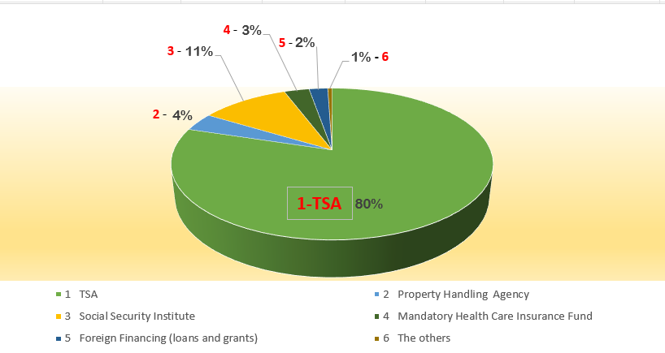
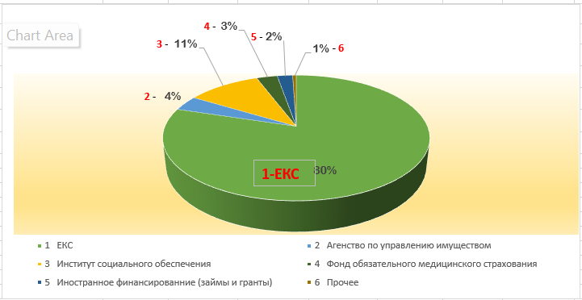
ОХВАТ
Банковские счета от имени органов государственного управления
Notes:
Total Out of TSA = 32,554,876,892 ALL
TOTAL = 161,025,260,797 ALL

Slide 8





АНАЛИЗ SWOT
Сильные стороны
Слабые стороны
Возможности
Угрозы
- Органический закон о бюджете утвердил ЕКС в качестве объединенного казначейского счета.
- Система AGFIS, которая стандартизирует бухгалтерский учет и обработку хозяйственных операций; определяет «аудиторский след» финансовых операций.
- Соглашение об уровне обслуживания помогает обеим сторонам соблюдать правила и сроки обработки соответствующих операций (в качестве фискального или расчетного агента).
- Операции по иностранному финансированию не стандартизированы для бухгалтерского и хозяйственного учета (ежемесячная отчетность), так как осуществляются через коммерческий банк, вне ЕКС;
- Ключевые аспекты функциональных возможностей не имеют того уровня конкретизации, который необходим для проведения надежного анализа.
- Неиспользованный в течение года бюджет/невыполненный кассовый план и его расходование в конце года.
- Расширение охвата AGFIS.
- Обучение в рамках иностранной технической помощи.
- Операционный риск
(не выдерживаются сроки периодической сверки и представления финансовой отчетности; человеческие ошибки, ошибочное указание банковского счета получателей)
- Не определены «следы» для электронного аудита финансовых операций, которые осуществляются вне ЕКС.
- Нет точной финансовой информации от коммерческих банков.
- Волатильность денежного рынка.
Notes:
To avoid idle cash balance outside TSA
To avoid the volatility of the money market
To consider the management of operational risk
To standardize the accounting and business processing
To respect the timelines of the periodic reconciliation and financial reporting
To define the audit tracks of financial transactions
The prescription on treasury functions, linked to a broader policy context in fiscal management objectives, and the design and investment planning for supporting information systems, which are indispensable for the operation of modern treasury and financial management systems

Slide 9


РЕФОРМА
Цель - превратить управление ликвидностью в процесс, результатом которого является обеспечение наличия необходимого объема средств в нужное время в нужном месте для исполнения государственных обязательств по платежам.
1
Предписание по увязке казначейских функций с более широким политическим контекстом целей бюджетного управления, разработке и планированию инвестиций в поддерживающие информационные системы, без которых невозможно функционирование современной системы казначейства и управления финансами.
2
3
Совершенствование ключевых аспектов в части функциональных возможностей, чтобы обеспечить соответствующий уровень детализации при выполнении надежного анализа. Создание структурированной системы сбора данных/информации.
4
Ежемесячная сверка данных об исполнении бюджета с данными банковской системы и закрытие неактивных банковских счетов за пределами ЕКС.
Совершенствование прогнозирования движения денежных средств на ЕКС для сохранения буфера ликвидности, снижения рисков и предотвращения отклонений в ходе исполнения. Эффективность зависит от надежного прогнозирования движения денежных средств.
Notes:
Setting up formal coordination mechanisms between cash management and budget, debt management and monetary policy implementation would be a good first step to better manage government’s liquidity and response to stress conditions.
Establishing a structured data/information collection framework,
Consolidation of cash flows through a centralized system of bank accounts
Well-defined institutional and legal framework are key factors to achieve government’s cash management objectives
Liquidity Buffers and Managing Excess Cash Balance
The trade-off between liquidity risk and cost of carry: how to define the liquidity buffer size? Cash flow deviation; large outflows; debt redemption; ability to stay out of the market in stress periods.
Needed infrastructure, instruments, credit risk assessment skills and strict coordination with the funding side.
Coordination and cash remuneration arrangements with the Central Bank (holistic view).

Slide 10







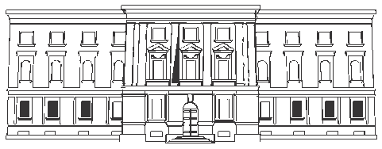
РЕСПУБЛИКА АЛБАНИЯ
Q & A
Спасибо за внимание!
Мимоза Пилкати (Мimoza Pilkati (Peço))
Директор
Департамент казначейских операций
Главное управление казначейства/Министерство финансов и экономики
Aдрес: Blv. Dëshmorët e Kombit, Nr. 3, Tiranë, Shqipëri
Moб. телефон: +355684047161
E-mail: mimoza.peco@financa.gov.al
Webpage: www.financa.gov.al

