Slide 1
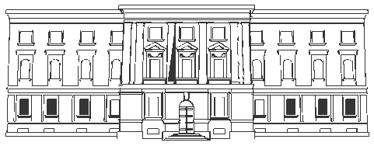
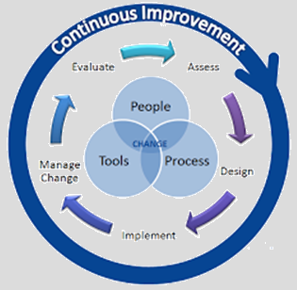
Albanian FMIS(AFMIS)
REPUBLIC OF ALBANIA
MINISTRY OF FINANCE AND ECONOMY
Integrated AGFIS with other systems
Notes:
We are in process of launching the Albanian Financial Management Information System (AFMIS) implementation, which will integrate AGFIS with other systems include in treasury operations such as: HRMIS, Public procurement and the Customs Systems. We are interested to exchange experience with other countries members of PEMPAL about the challenges in implementation such interfaces and to learnt how to overcome the difficulties we will face during “live” implementation of these component of the AFMIS project. Also we are interested to know the comprehensive functionalities of this platform implemented in other countries and their interoperabilities.

Slide 2
Current status
AGFIS online with 36 TDO’s and 15 BI’s
AGFIS integrated with Commercial Banks, Central Bank, Tax Information System
Manual monthly accounting balances information of Special Funds (HI, SI, expropriation funds), Custom Revenues, PIU for FFP.
Yearly information on assets, inventory, rights and liabilities accounting balances of general government units and financial information of extra budgetary units.
Sharing new developments on the IT ‘s using in Treasury operations
New functionalities
AGFIS integration with HRMIS for payroll of budgetary employees.
Implementation of output code for operational expenditures (not only for investments like it is now) for a better budget monitoring and planning process.
AGFIS integration with APP information system for real time check of available budgetary funds prior procurement process (strait forward to prevent arrears creation)
Web Portal & Electronic Archive implementation for justified documents on financial transaction executed through AGFIS (giving access into WP to more than 1300 BI’s)
AGFIS integration with Custom Information system.
AGFIS integration with MTBP, PIM, IPSIS, BPPM (DW).
36 Territorial Branches under CT
14 central government institutions
1 Municipal of Tirana

Slide 3
Topics for discussion on IT technical support
The challenges of implementing and maintaining AFMIS
The risks involved (technological risks, functionality risks) in FMIS
The approach that MOFE, TDOs, BIs employees (users) will have for using an entire new system
Security
The approach of users when DS is applied?
The new system’s implementation as:
Backup
Case of catastrophes
Creating an emergency plan document
Other security measures suggested for AFMIS
BCC
DRC
Etc.
Analyzing the use of digital signature (DS)

Slide 4
Topics for discussion on new functionalities-Future
Bank Accounts of Foreign financing
Carrying out transactions through Treasury Single Account (TSA)
Data Warehouse coverage
Daily information interfaced from related systems (Tax, Customs, AGFIS, EAMIS, PIM, Special Funds-SSI, HIS, Ex-owners compensation, HRMIS)
Data Warehouse functions
Generating complex and comprehensive reports to enhance the forecasting and cash management
Etc.
Closing partially accounts on commercial banks
The carrying out the foreign financing’s transactions through AFMIS gradually
The forecasting of cash flows in daily basis through Data Warehouse (DW) information
The extending of coverage of accounting data (extra budgetary units)
Notes:
MoFE-Ministry of Finance and Economy
TDOs-Treasury District Offices
BIs-Budget Institutions

Slide 5
Thank you for your attention!
REPUBLIC OF ALBANIA
MINISTRY OF FINANCE AND ECONOMY
Contacts:
Business Processing Department: aurela.velo@financa.gov.al
ICT Department: ervin.muca@akshi.gov.al
Treasury Operations Department: mimoza.peco@financa.gov.al

