Slide 1

PEMPAL Budget Community of Practice (BCoP)
Update on BCoP activities
Anna Belenchuk, BCoP Chair
Ministry of Finance, Russian Federation
March 18, 2019
2019 Annual BCoP Plenary Meeting, Tashkent

Slide 2
Presentation outline
1. Update on BCoP activities, including development of BCoP Action Plan for 2019-2020
2. Brief report on activities of the BCoP Budget Literacy and Transparency Working Group

Slide 3





















BCOP MEMBERSHIP
21 countries are BCOP members.
100 members from the Ministries of Finance from 20 different countries attended at least one BCOP event in the last year.
Two working groups:
Budget Literacy and Transparency Working Group (BLTWG) – 16 member countries
Program and Performance Budgeting Working Group (PPBWG) – 15 member countries

Slide 4
BCOP PRIORITIES
BCOP aims to strengthen budget methodology, planning, and transparency in PEMPAL member countries through:
1. Sharpening tools for effective fiscal management - a broad topic that includes topics of Program and Performance Budgeting Working Group (PPBWG) discussed continuously (including monitoring and evaluation tools), as well as other tools, discussed periodically (e.g. fiscal risks, intergovernmental fiscal relations, capital budgeting etc.).
2. Strengthening fiscal transparency and accountability with a focus on topics of Budget Literacy and Transparency Working Group (BLTWG), including budget literacy, citizens’ budgets, and public participation initiatives.
3. Expanding internationally available data on PEMPAL countries through benchmarking using pre-meeting thematic surveys and more formal surveys (e.g. PEMPAL surveys, International Budget Partnership, and OECD surveys).

Slide 5
BCOP ACTIVITIES IN FY2017 AND FY2018
Main features of BCOP’s work in FY2017 and FY2018:
More formalized collection of country priorities – now collected through pre-event online surveys before each annual plenary meeting.
Two working groups (BLTWG and PPBWG) drive most of the BCOP activities, as the most common budgeting reform priorities of BCOP countries continuously include the topics of these working groups.
Therefore, BCOP annual plenary meetings are formatted around the themes of two working groups, with each hosting one day of the event, while additional most common priorities are introduced in the first half-day of the meeting.
Increased focus on developing knowledge products, with four products already developed :
  Results of the 2016 OECD Performance Budgeting Survey: OECD and PEMPAL Countries
  Breaking Challenges in Constructing Citizens’ Budgets for PEMPAL Countries
  Performance Indicators in PEMPAL Countries: Trends and Challenges
  Background Paper on Public Participation in Fiscal Policy and Budget Process

Slide 6
BCOP ACTIVITIES IN FY2017 AND FY2018 (cont.)
Strengthening BCOP’s relationships with other development partners:
  Continuation and deepening of close cooperation with OECD through
    OECD’s substantive contribution to BCOP events on a regular basis;
    BCOP’s participation in and increasing meaningful contribution to annual OECD CESEE SBO network meetings;
    BCOP’s attendance at and contribution to annual meetings of the OECD Network on Performance and Results; and
    Facilitation of participation of PEMPAL countries in OECD surveys on budgeting processes and procedures and performance budgeting.
  Close collaboration with the International Budget Partnership (IBP) and Global Initiative for Fiscal Transparency (GIFT) through
    IBP and GIFT’s substantive contribution to BCOP events;
    IBP and GIFT’s substantive contribution to BCOP’s knowledge products;
    BCOP’s participation in and substantive contribution to the GIFT workshop in 2018; and
    Joint PEMPAL – GIFT learning visit in the Fall 2018.
Following the principles of prudent financial management while expanding BCOP activities by undertaking substantial work via VC workshops and virtual correspondence and interaction with other development partners:
  FY2018 was BCOP’s most active year with 13 events held and work done on multiple knowledge products.

Slide 7
BCOP FY2018 EVENTS
OECD Senior Budget Officials’ Network for Central, Eastern, and South-Eastern Europe (SBO CESEE) – Paris, July 2017
PPBWG workshop on performance indicators – VC, September 2017
BLTWG workshop on public participation– VC, October 2017
BCOP participation in the OECD Senior Budget Officials’ Performance and Results Network meeting - Paris, November 2017
PPBWG Workshop on performance budgeting in Austria – Vienna, March 2018
BCOP Annual Plenary Meeting on Improving Effectiveness and Accountability of Public Expenditures: Trends in Intergovernmental Fiscal Relations, Performance Budgeting, and Budget Participation – Vienna, March 2018
BCOP participation in the OECD SBO CESEE meeting – Zagreb, May 2018
BCOP participation in GIFT’s workshop on Digital Tools, IT, and Citizen Engagement - Zagreb, May 2018
Four meetings of the Executive Committee (July, 2017, December 2017, March 2018, and May 2018). Minutes available on the PEMPAL website.

Slide 8
THEMATIC FOCUS OF BCOP IN FY2019
Current priority topics for budgeting reforms in BCOP countries, as collected in March 2018 are:
1. Program and performance budgeting
i. programs,
ii. performance indicators, and
iii. monitoring and evaluation of expenditures, including spending reviews
2. Budget literacy and transparency
i. citizens’ budgets,
ii. budget literacy, and
iii. public participation
3. Integrating capital budgeting/public investment in budget planning (assessing its effectiveness, prioritizing)
Thus, the overwhelming majority of our countries’ priorities are related to topics of the two working groups of BCoP.
BCoP will consistently continue to deepen the scope of work of its working groups.
The format of the 2019 BCOP plenary meeting will remain the same as in 2017 and 2018, with capital budgeting selected as the additional topic.

Slide 9
BCOP’s WORK APPROACH IN FY2019
Two working groups continue to be driving force of BCOP’s work with continued focus on knowledge products and further collaboration with the OECD and GIFT.
Key focus of the Budget Literacy and Transparency WG (BLTWG) will be on:
  finalizing the knowledge product on public participation and
  further analysis of the results of the 2018 Open Budget Survey.
Key focus of the Program and Performance Budgeting WG (BLTWG) will be on:
  developing the knowledge product on spending reviews and
  participation in the 2018 OECD Performance Budgeting Survey and developing a knowledge product with analysis of the survey results.
Country priorities will continue to be collected in an online survey format and BCOP will also start collecting members’ suggestions on topis for cross-COP meetings and members’ feedback on usefulness of knowledge products.
BCOP will continue to update and improve the list of all BCOP knowledge resources with links, grouped by topics, and circulate it to all members during annual plenary meetings. This will also be useful for induction of new members.

Slide 10
BCoP Activities in FY2018-FY2019
Current fiscal year
1. | Cross-CoP Executive meeting | July 4-6, 2018 | Budapest, Hungary
2. | Participation of some BLTWG members in the International Conference Citizens’ Participation as a Development Resource: Russian and Global Experience in Participatory Budgeting, Day 2 of the Moscow Financial Forum | September 7, 2018 | Moscow, Russia
3. | Learning visit on public participation at the national and local level in Portugal for BLTWG, co-organized with GIFT + Executive Committee meeting | October 14-18, 2018 | Cascais/ Lisbon, Portugal
4. | Participation of a small delegation of PPBWG leaders in the OECD Performance and Results Network meeting | November 26-27, 2018 | Paris, France
5. | Plenary Meeting of all BCoP members + Executive Committee meeting | March 18-21, 2019 | Tashkent, Uzbekistan
6. | Videoconference meeting of PPBWG | May 2019
7. | Videoconference meeting of BCoP Executive Committee | May 2019
Next fiscal year
8. | Attendance of BCoP Executive Committee at the annual OECD CESEE Senior Budget Officials meeting + ExCom meeting held back to back | TBC, June/July 2019 | Minsk, Belarus
9. | Videoconference meeting of PPBWG | September 2019
10. | Participation in OECD Performance and Results Network meeting | TBC | Paris, France

Slide 11
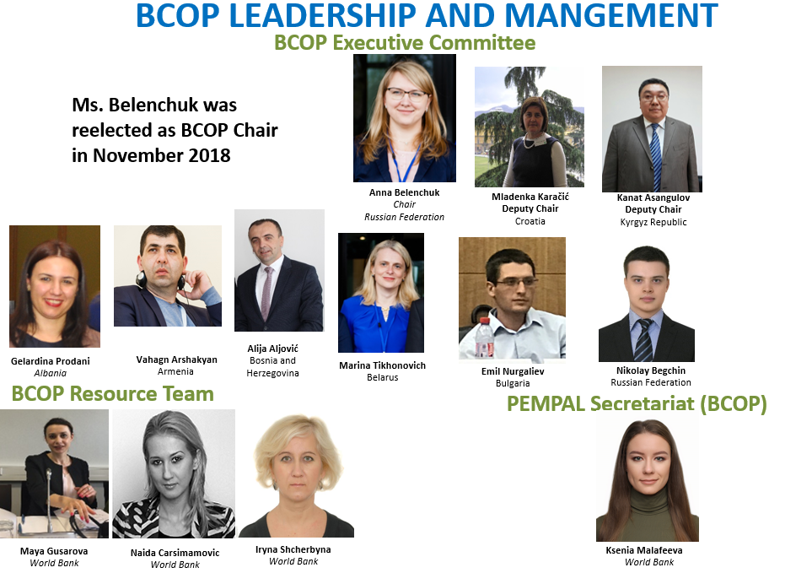

BCOP LEADERSHIP AND MANGEMENT
BCOP Executive Committee – representatives from 8 countries

Slide 13
Update on activities of the BCoP Budget Literacy and Transparency Working Group

Slide 14
Background information on BLTWG
The objective is to study international experience in improving budget literacy of the public, budget openness and accessibility, and citizen engagement.
Tasks:
Reviewing advanced international practices in budget literacy and transparency and public participation.
Experience sharing between budget experts from BLTWG member countries for the purpose of designing standard approaches to implementation of similar projects.
Creating new BCoP knowledge products on the basis of gained results, such as recommendations on carrying out similar projects in PEMPAL countries.
  Partnerships: World Bank: budget literacy; International Budget Partnership (IBP): success factors in the Open Budget Index; OECD/ Global Initiative for Fiscal Transparency (GIFT): inputs to the preliminary version of the Budget Transparency Toolkit; OECD SBO meetings: reports on BLTWG activities and on the knowledge product on constructing citizen budgets.
  BLTWG members (16 countries): Albania, Russia, Armenia, Kosovo, Kyrgyz Republic, Croatia, Turkey, Belarus, Bosnia and Herzegovina, Romania, Tajikistan, Ukraine, Uzbekistan, Kazakhstan, Moldova, Serbia.

Slide 15
Update on BLTWG activities in 2018
The focus of BLTWG activities gradually shifted from general issues of budget openness and its measurement in 2015-2016 to best practices in budget literacy in 2015–2017 and ultimately has been moved to public participation in the budget process.
Main activities of BLTWG in FY2018 included:
  i) Development of a concept for the knowledge product that would promote further reforms in public participation;
  ii) Review and discussion with the International Budget Partnership of findings on public participation in the IBP 2017 Open Budget Survey;
  iii) Review and discussion with GIFT of new best practices included in the GIFT Guide on Principles and Mechanisms of Public Participation in Fiscal Policy;
  iv) Review and discussion of citizen participation practices in PEMPAL countries (Georgia, Kyrgyz Republic, and Croatia);
  v) Review and discussion of digital tools, information technologies, and citizens’ engagement during the GIFT workshop (Zagreb, Croatia).
BLTWG held three key events in FY2018: it hosted one day of the agenda of the Annual Plenary Meeting in Vienna (Austria); a working videoconference was conducted to discuss the knowledge product; and some WG members took part in the above GIFT workshop.

Slide 16
BLTWG knowledge products for downloading
Title | Link
1. Public Participation in Fiscal Policy and Budget Process: How to Create and/or Strengthen the Mechanisms in PEMPAL Countries. Background paper | ENG: https://www.pempal.org/sites/pempal/files/filefield_paths/bcop_public_participation_backgroud_paper_august2017_eng.doc RUS: https://www.pempal.org/sites/pempal/files/filefield_paths/bcop_public_participation_backgroud_paper_august2017_rus_full.doc BCS: https://www.pempal.org/sites/pempal/files/filefield_paths/bcop_public_participation_backgroud_paper_august2017_bcs.docx
2. Breaking Challenges in Constructing Citizens’ Budgets for PEMPAL Countries | ENG: https://www.pempal.org/sites/pempal/files/event/2017/Budget%20COP%20Events/Jun22_Moscow%2C%20Russian%20Federation/files/bcop_citizens_budgets_june2017_eng.doc RUS: https://www.pempal.org/sites/pempal/files/event/2017/files/bcop_citizens_budgets_june2017_rus.doc BCS: https://www.pempal.org/sites/pempal/files/event/2017/Bud%C5%BEet%20Doga%C4%91aji/Jun22_Moskva%2C%20Rusija/files/bcop_citizens_budgets_june2017_bcs.docx

Slide 17
BLTWG Plenary Agenda
BLTWG agenda for today:
Murray Petrie from GIFT will present an overview of public engagement mechanisms existing at the national level.
Ministry of Finance of the Republic of Uzbekistan will present information on the progress in fiscal transparency and public participation reforms carried out over the last two years using lessons learnt by PEMPAL countries.
Two PEMPAL countries (Croatia and Russian Federation) will present their innovative practices that have been recently introduced.
On March 21, together with the World Bank team for the Local Initiatives Support Program, BLTWG will conduct a workshop on implementing participatory/initiative budgeting in countries with multi-level budget systems.

Slide 18
Thank you for your attention!

