Slide 1
PEMPAL/IACOP World Bank
March 29, 2017 Budapest, Hungary
The role of the senior management in establishing accountability in the centralized and decentralized administration: internal and external factors
Strategy of Internal Control in Brazil
Gustavo Ungaro
São Paulo State General Ombudsman Former President of CONACI - National Council of Internal Control in Brazil
conaci.org.br ouvidoriageral.sp.gov.br gustavoungaro@sp.gov.br

Slide 2
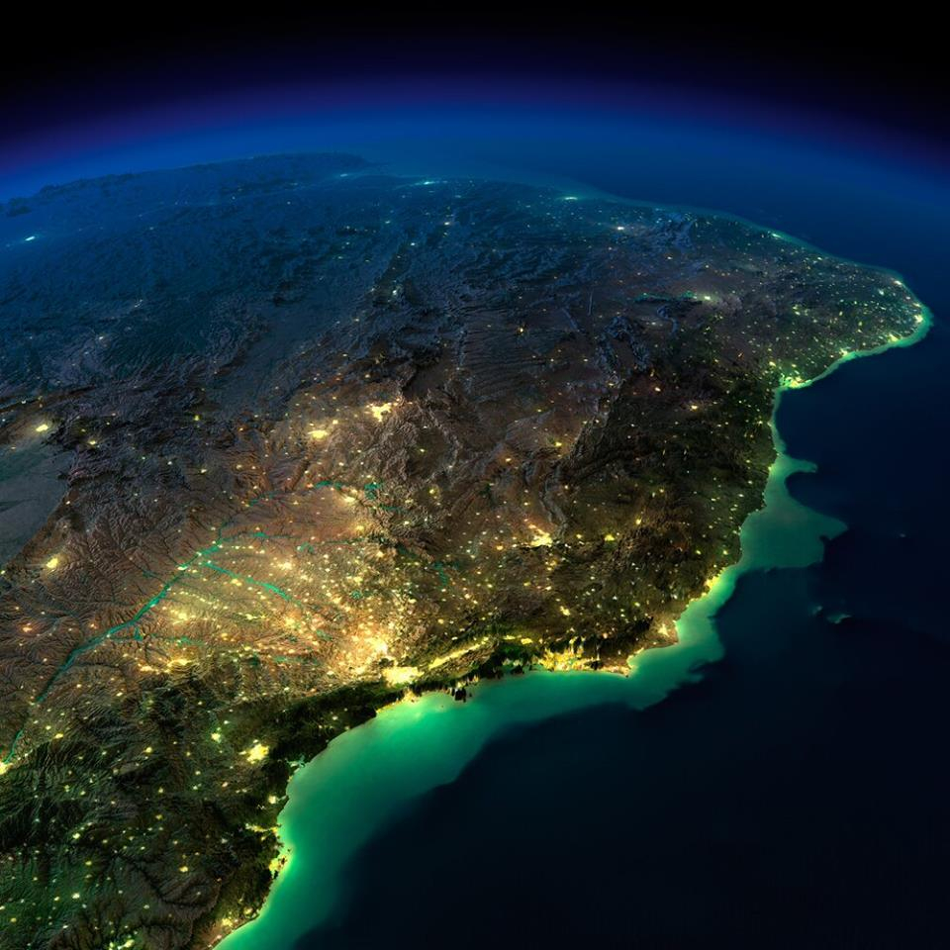
Brazil
206 millions habitants
Democratic Federative Republic
27 States
5570 Cities
conaci.org.br ouvidoriageral.sp.gov.br gustavoungaro@sp.gov.br

Slide 3
Federal Constitution - 1988
Article 70:
Control of accounting, finance, budget, operations and assets
Aspects related to the lawfulness, legitimacy, efficiency, subsidies and waiver of revenues
External Control to be conducted by National Congress. Internal Control to be executed by the Internal Control System of each Constitutional Power
Accountability
Article 74:
Purpose of the Internal Control System: establishment and evaluation of objectives
Financial and Economic evaluation with regards efficiency and effectiveness of the results
Control of the Credit transactions
Support to external control
conaci.org.br ouvidoriageral.sp.gov.br gustavoungaro@sp.gov.br

Slide 4
PUBLIC CONTROL
at federal level
EXTERNAL CONTROL
INTERNAL CONTROL
Public Prosecution - MP
General Controller of the Union - CGU
National Congress
Federal Audit Court - TCU
conaci.org.br ouvidoriageral.sp.gov.br gustavoungaro@sp.gov.br

Slide 5
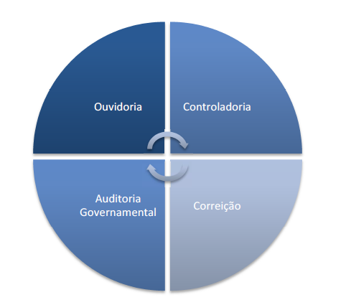
Macrofunctions of the Internal Control
PEC nº 45/2009 (Proposed Constitutional Amendment)
Inclusion of item XXIII to article 37 in the Constitution:
Activities of the internal control system (article 74) are essential to the public administration
Following macrofunctions are included in the internal control system:
Ombudsman
Controlling
Government Auditing
Correction
Functions to be performed by permanent state bodies, organized into specific careers
conaci.org.br ouvidoriageral.sp.gov.br gustavoungaro@sp.gov.br

Slide 6
CONACI
CONACI (National Council of Internal Control)
Civil Association
46 Members: public internal control agencies of the all 26 States, the Federal District, the Union and 18 State Capitals
Purpose:
Development of an effective performance in the control of public administration
Contributing to the prevention and combating corruption
Striving for greater integration between the Internal Control Agencies aiming: exchange of experiences, knowledge and tools
Effective means strengthening of its institutions and contributing to the full implementation of the democratic rule of law.
Recurring Meetings:
Four 2-days technical meetings per year
One 2-days annual seminar (800 participants).
conaci.org.br ouvidoriageral.sp.gov.br gustavoungaro@sp.gov.br

Slide 7
Macrofunctions of the Internal Control
PEC nº 45/2009 – CONACI members
Macrofunctions already organized in formal structures: 38% with the 4 macrofunctions
Most common macrofunctions: Internal Audit and Controlling
conaci.org.br ouvidoriageral.sp.gov.br gustavoungaro@sp.gov.br

Slide 8
AUDIT TYPES
DIRECT
INDIRECT
Centralized
Decentralized
Integrated
Shared
Outsourced
coordinated by the internal control system with the help of public and private institutions
performed by crowded servers in the central agency
performed exclusively by non-governmental organization
performed by the sectoral bodies servers
performed by the central and sectoral agency servers
conaci.org.br ouvidoriageral.sp.gov.br gustavoungaro@sp.gov.br

Slide 9
AUDIT TYPES – Brazil´s Diagnosis* (CONACI Members)
*Research conducted by CONACI amongst its members in 2016 (april to June). There were 44 members who responded to the research.
conaci.org.br ouvidoriageral.sp.gov.br gustavoungaro@sp.gov.br

Slide 10
Implementing the Recommendations after Audit
conaci.org.br ouvidoriageral.sp.gov.br gustavoungaro@sp.gov.br

Slide 11
International Standard Adopted
INTERNATIONAL STANDARD | QUANTITY | %
COSO | 8 | 18,18%
IA-CM | 3 | 6,82%
IA-CM (em implementação) | 3 | 6,82%
INTOSAI | 3 | 6,82%
Do not use international standards | 31 | 70,45%
conaci.org.br ouvidoriageral.sp.gov.br gustavoungaro@sp.gov.br

Slide 12
CONACI IA-CM
IA-CM evaluation occurred in 5 System Control Entities from different 5 States (2015): Minas Gerais, Maranhão, Piauí, Distrito Federal and Mato Grosso do Sul
Documents revision, ratification of self evaluations and report analysis in some cases to identify possibility for improvements
Evaluation Results: all the 5 entities need shall develop and implement essential processes and activities in order to achieve Level 2 (Infrastructure)
conaci.org.br ouvidoriageral.sp.gov.br gustavoungaro@sp.gov.br

Slide 13
CONACI Strategic Planning: 2016 - 2018
Actions to strenghten the macrofunctions of the Internal System Control
With regards Audit, main actions: ramp up the World Bank partnership, Improvement of the Governmental Internal Audit legislation and frameworks, Evaluate the Internal Control System bodies based on the IA-CM model, Development of training programme and certification for the Internal Auditor
conaci.org.br ouvidoriageral.sp.gov.br gustavoungaro@sp.gov.br

Slide 14
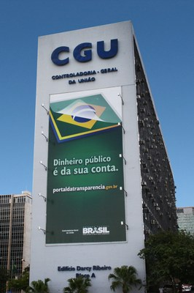
SFC – Secretaria Federal de Controle Interno
Activities related to the Internal Control System (Federal)
Evaluate government programs´ execution
Check legality
Evaluate results with regards efficiency and effectiveness
Support to the External Control
WWW.TRANSPARENCIA.GOV.BR

Slide 15
WWW.TRANSPARENCIA.SP.GOV.BR

Slide 16
Strategy of Internal Control in Brazil
The role of the senior management in establishing accountability in the centralized and decentralized administration: internal and external factors
internal
eyes and ears, meetings – must show the results
of an effective internal audit: reduce costs, collaborate to hit the targets, detects frauds, prevent corruption,
less risk to the chief of the government
external
stimulate the citizen participation and
the organizations of civil society
interact with the parliament and with the media
International exchanges
conaci.org.br ouvidoriageral.sp.gov.br gustavoungaro@sp.gov.br

