Slide 1
Use of Country Systems
in Europe and Central Asia
Use of Treasury System for implementation of Bank-financed projects

Slide 2
Why Use of Country Systems?
Successful development
    Partner governments’ capacity to implement policies and manage public resources through their own institutions and systems
Strengthen rather than bypass country systems
    Better national institutions are the more effective and long-term solution to governance and corruption challenges and to mitigating fiduciary risk
Institutional commitment
    Paris & Accra
    GAC

Slide 3
FM Sector Board Guidance
"Where feasible, FM staff ensures that the FM requirements for individual projects are adapted to the country’s circumstances, make use of the country’s normal systems where capacity permits...." Consequently the use of country systems (UCS) is the default position when FM arrangements are considered for projects

Slide 4
Coverage and Development in the Use of FM systems
Budgeting – Armenia, Georgia, Kyrgyz
Funds Flow (Designated Accounts)
  Complete use in Albania, Armenia, Georgia, Moldova, FYR of Macedonia
  Partial use in Kyrgyz Republic, Montenegro and Tajikistan
  Planned in Serbia
Accounting and reporting - limited (Kyrgyz Republic)
Internal control and internal audit - limited
External Audit - Turkey Treasury Controllers
Notes:
A rather specific system exists in Montenegro in this area and it was subject to an assessment by the Bank's team in this fiscal year. Although the projects' designated accounts are held in commercial banks, it could be concluded that to a large extent the country systems are used since all payments flow from the designated accounts through the Single Treasury Account on to respective payees. All payments are thus appropriately captured and recorded in the system which the Treasury uses for its operations.

Slide 5
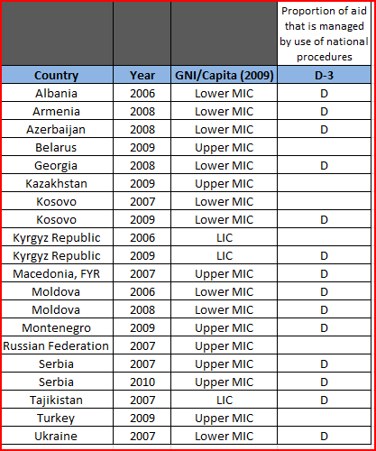
What indicators say?

Slide 6
Bank requirements on Accounting or Financial Reporting
International Public Sector Accounting Standards (cash basis or accrual) issued by IPSASB
International Financial Reporting Standards issues by IASB
National standards and Chart of Accounts if do not deviate substantially or provide sufficient information
Documented in Project Financial Management Manual

Slide 7
Bank requirements for Funds Flow
Financial Institution should be:
Financially sound
Authorized to maintain the designated account in the currency agreed on by the Bank and the borrower
Audited regularly and receive satisfactory audit reports
Able to execute a large number of transactions promptly
Able to perform a wide range of banking services
Able to provide a detailed statement of the DA
Part of a satisfactory correspondent banking network
Charge reasonable fees for its services

Slide 8
Major Risks of Funds Flow
(also escalated by the crisis)
Risk that inadequate funds will be made available for project implementation
Risk of unpredictable availability of funds or diversion of projects funds
Risk that the treasury is unable to make payments in foreign currency or to open a letter of credit
Risk of lapse of unutilized budget allocation for the project at year-end
Risk of mandatory country procurement procedures
Notes:
PEFA indicator PI 16, regarding the availability of funds for commitment of expenditures, is a useful indicator.
Dimension (ii) of PEFA indicator PI 16, regarding the reliability and horizon of periodic in-year information to ministries, departments, and agencies on ceilings for expenditure commitment, is a useful indicator. In addition, CPIA Question 13 Dimension (b) provides useful information on whether budgets are implemented as intended in a controlled and predictable way.
If the Bank’s Procurement Unit finds that the country procurement procedures are not acceptable to the Bank and requires the use of the Bank’s procurement procedures, the treasury may not be able to process payments on contracts. In such situations, the treasury may need to issue a separate communiqué or an order permitting an exception.

Slide 9
Practical considerations
Compulsory vendors database at the Treasury to which the payment orders need to refer
Requirements on payments forecast/cash projections
Payments to various consortium members under a contract
System of regular generation of the DA statements
Availability of electronic banking system
The mechanism for recovery of erroneous payments
Payments falling in different fiscal years (FY): budgeting vs execution
Payments to local as well as to foreign contractors
Notes:
(for instance, if 90/10 disbursement percentage was mistakenly set instead of 80/20, whether there is a
procedure to receive the required 10% GCF back).

Slide 10

Entering point
CFAA and PEFA to identify weaknesses
Consistent dialogue and assessment of on-going improvements in Treasury
Principal agreement to advance Treasury and transfer all DAs/SAs
Many years of sustained work by the Bank team and Government counterparts in building capacity in government systems

Slide 11

The transition process (1)
MOF confirms in writing that (i) all the Bank requirements are complied with, (ii) the changes in Treasury procedures and software had been completed, and (iii) the system is ready for piloting.
The Bank assessed those arrangements and provided recommendations addressed before piloting.
MOF drafts a Note describing the funds flow procedures (including payments processing, opening of Letter of Credits, currency conversion) which was agreed with the Bank.

Slide 12

The transition process (2)
4. Two pilot projects DAs were transferred to the Treasury based on the evidence of completion of the previous two steps.
Bank monitored the piloting and provided new recommendations to make the system ready for wider transfer.
A time bound transition plan was developed for transfer of all the DAs/SAs.

Slide 13

Key results (achieved in several countries)
On-line Treasury Client system is now used for all the Bank-financed projects (all payments processed within one day!)
Most importantly this system is now available for all other budget programs
Substantial saving on operating expenses under projects was achieved (bank fees/charges)
Improved cash management and financial savings to the Government
Enhanced government ownership

Slide 14
Thank you!
Questions?

