Slide 1
Coverage of funds included in the Treasury Single Account (TSA) Ministry of Finance Republic of Armenia 2023

Slide 2
Laws and regulations (defining rules for the Treasury Single Account (TSA) and regulation of Treasury subaccounts)
Republic of Armenia Law On the Treasury System
Republic of Armenia Law On the Budget System in the Republic of Armenia
Government of Armenia Decision N 706 dated June 15, 2018, On Approval of Budget Execution Processes in the Republic of Armenia (state and municipal budgets and budgets of governmental non-profit organizations and other legal entities serviced by the Treasury)
Republic of Armenia Law On the State Budget of the Republic of Armenia for 2023
Government of Armenia Decision N 2111 dated December 29, 2022 On Measures to Ensure Execution of the Republic of Armenia State Budget for 2023
Account Service Level Agreement between the Ministry of Finance of the Republic of Armenia and Central Bank of Armenia N 11/301261 dated January 5, 2007.

Slide 3
Treasury Single Account (TSA) and Treasury subaccounts
In 1996, a Treasury Single Account in Armenian drams was opened in the name of the Ministry of Finance and is maintained by the Central Bank of Armenia.
The Treasury Single Account includes the following subaccounts:
Subaccounts for funds of the Republic of Armenia state budget (1996);
Subaccounts for funds of local budgets of Republic of Armenia municipalities (2000);
Subaccounts for state and municipal extrabudgetary funds (2001);
Subaccounts of project implementation units for earmarked loans and grants (provided to Armenia by foreign states and international organizations), irrespective of their organizational and legal status (2010);
Subaccounts of governmental non-profit organizations (2018);
Subaccounts of funds established by the State and municipalities and also by legal entities established by these funds (2018, discretionary; currently not all of these funds moved their accounts to the Treasury from banks, however, a draft government decision is now discussed according to which having an account with the Treasury will become mandatory);
Subaccounts of municipal non-profit organizations (2018, discretionary; as of now not all of these entities have moved their accounts from the banks);
Subaccounts of companies in which the share owned by the State or a municipality exceeds 50 percent or in which the share (in total) of the State or municipality exceeds 50 percent and also of legal entities established by these companies (as of now not all of them have moved their accounts from the banks; however, a draft government decision is now discussed which is supposed to make having an account with the Treasury mandatory).

Slide 4
Number of Treasury clients
Government authorities – 101,
including regional government bodies (marzes) - 10;
Municipalities – 79, and settlements included in municipalities – 447,
A municipality consists of one settlement or several settlements combined by a common territory;
Project Implementation Units for earmarked loans and grants (provided to Armenia by foreign states and international organizations) - 45;
Governmental non-profit organizations - 2312;
Municipal non-profit organizations - 3;
Funds established by the State - 3.

Slide 5
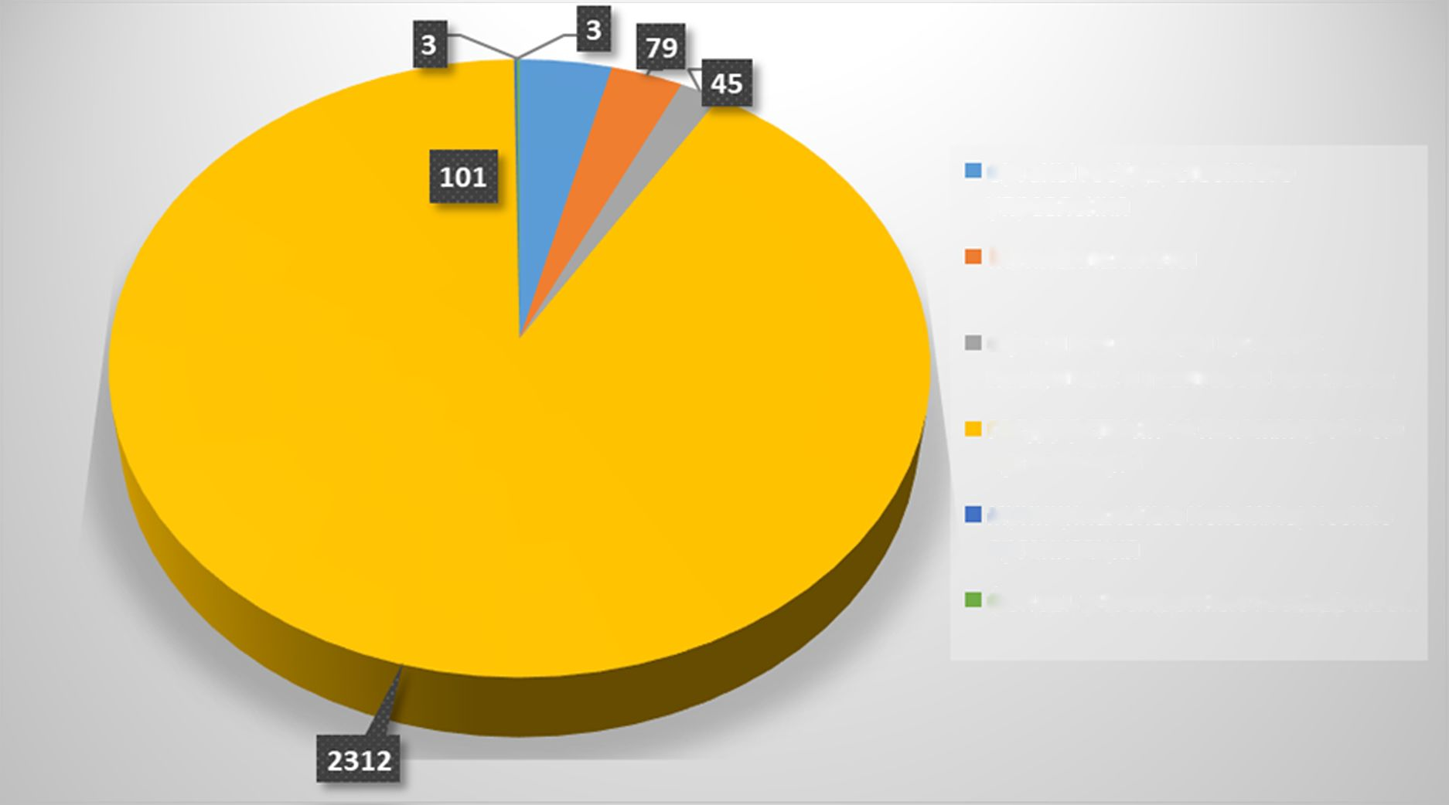
Treasury clients chart
Government authorities
Municipalities
Project Implementation Units for earmarked loans and grants
Governmental non-profit organizations
Municipal non-profit organizations
Funds established by the State

Slide 6
Treasury information systems
Treasury Operational Day – 1998
This Treasury information system is used for accounting of all funds, management of Treasury subaccounts and performance of treasury operations (integrated database from 2014).
Client – Treasury - 2010
A Treasury information system that enables treasury clients to manage their accounts. All documents are filed with the treasury only electronically.

Slide 7
Treasury’s authority to manage funds in the TSA
In case there are free balances on other subaccounts of the Treasury Single Account, the difference between inflows to the state budget of the Republic of Armenia and expenditures financed from the state budget at the end of any day may be negative provided that:
the balance in the state budget of the Republic of Armenia on the last day of the budget year (excluding loans or grants provided by international organizations and foreign states and extrabudgetary funds) is not negative;
processes of payments planned to be made from other subaccounts of the Treasury Single Account are not disrupted.
The Treasury may make deposits with the Central Bank for terms of from 15 days to 1 year.
The possibility of investing temporarily free funds in deposit accounts in commercial banks is now discussed.

Slide 8
Issues arising in connection with movement of foreign currency accounts from banks to the Treasury
As concerns keeping records of Treasury clients’ funds in foreign currencies, the following approaches are discussed:
Keep records only in Armenian drams.
Keep records also in foreign currencies, as is now performed for Project Implementation Units for earmarked loans and grants (2010) and governmental non-profit organizations (2018).
Explore the possibility and advisability of opening foreign currency TSAs with the Central Bank.

Slide 9
ՇՆՈՐՀԱԿԱԼՈՒԹՅՈՒՆ
THANK YOU

