Slide 1














GOVERNMENT
PAYMENTS
STATE TREASURY AGENCY AZERBAIJAN
Nazim Gasimzade
Director

Slide 2



Open Banking Roadmap Azerbaijan
2021/2022
2021/2025
Pillar 2
Pillar 1
Creating a legislative framework
Ensuring effective management
Responsible
AZ Central Bank - CB
AZ Bank Association - ABA
AZ FinTech Association - AzFina
2021/2023
Pillar 3
2022/2025
Creating an interoperable technological environment
Pillar 4
Accelerating the implementation process

Slide 3
Open Banking Roadmap
Actions & Responsibilities
CB
ABA
AzFina
Ensuring effective management with the involvement of ecosystem participants for the implementation of Open Banking
Establishment of a Working Group to effectively coordinate the implementation of Open Banking approach
Conducting regular meetings of the Working Group, formulating a regulatory framework and ensuring accountability
Enactment of the law on “Payment Services and Payment Systems”
Pillar 2
Formation of a regulatory framework for Regulatory Sandbox
Creating a legislative framework and recommendations to support Open Banking approach
Establishment of a regulatory framework for obtaining information on credit institutions and banking products through an Open API
Pillar 3
Formation of regulatory framework for Dispute Management System
Pillar 4
Formulation of security requirements during operations performed through an Open API
Formulation of API requirements for payment transactions
Formulation of API requirements for retrieving account information

Slide 4
Open Banking Roadmap
Actions & Responsibilities
CB
ABA
AzFina
Establishment of a centralized Open Banking Platform by the Central Bank
Adaptation of technical infrastructures of banks operating in the country (automated operating system, mobile and internet banking resources) to the requirements of regulatory documents for Open Banking
Creating an interoperable technological environment in accordance with the Open Banking approach
Adaptation of FinTechs’ technical infrastructure to the requirements of Open Banking regulation
Ensuring the integration of banks and FinTechs operating in the country into the Central Bank's Open Banking Platform
Identifying Open Banking-based business solutions and encouraging their implementation
Organization of trainings to increase the awareness of ecosystem participants about Open Banking
Accelerating the process of implementation of the Open Banking approach by ecosystem participants and providing monitoring function
Conducting incentive measures (hackathon, webinar, etc.) to speed up the process of development of Open Banking-based products and services
Continuous upgrading the regulatory framework for Open Banking in the light of international experience and organization of monitoring function in accordance with requirements

Slide 5
Treasury Information Management System
Treasury Information Management System(TIMS)
Information about interactive operation and balance via Swift
Payments via Swift
CB
Treasury Single Account
(TSA)
Payment /Salary
Income to TSA
Public Sector Entity
Salary
Commercial Banks
Taxpayers
Payments
Suppliers

Slide 6










Open banking APIs
Payment service providers
IPS PAY
Customer's Bank
Open APIs
Open APIs
Obtaining information about the customer's bank account
Querying the current account balance
Authorization to initiate payment
Status exchange between parties
Notes:
The Open Banking API Specifications define the methods and parameters that enable interactions between participants in the fintech ecosystem,

Slide 7
Instant Payment System (IPS)
01
Unlike traditional systems, funds are processed into customer accounts as soon as the payment transaction is completed
There is no liquidity risk
05
02
Funds are immediately available to the receiving party
Instead of hard-to-remember payment details, the customer needs to write the other party's mobile number and FIN number
06
03
The participants of the system are not limited to banks, but also create integration opportunities for non-banking organizations.
The use of banking services is expanding as 3rd party organizations have access to banking services
07
04
Opportunities for applying innovative solutions are increasing (QR code, identifiers, etc.)
Fairer competitive environment is created among market participants
08

Slide 8

Opportunities
Card infrastructure integration :
Instant transfers from account to account
Use of card accounts
More information can be transferred via ISO 20022 XML than ISO 8583
Lack of liquidity risk
Infrastructural facilities :
Direct integration with the internal information system of the Bank
Centralized database
Innovative solutions
Integration with non-bank organizations
Provision of digital services at a distance
Profitability:
Low tariff policy
Reducing cash transaction costs by stimulating cashless payments
Low transaction cost

Slide 9






Payment Types of IPS
Personal transfers and cashing
P2P
Points of sale
C2B
E-commerce
C2B
Utility and budget
C2B, C2G, B2B, B2G
Business transfers
B2B, B2G, B2P
Government payments
G2P, G2B

Slide 10

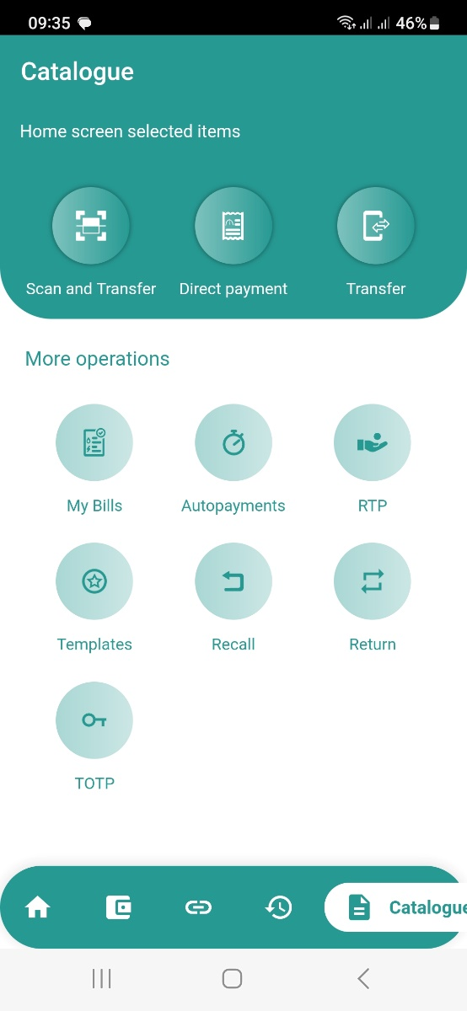
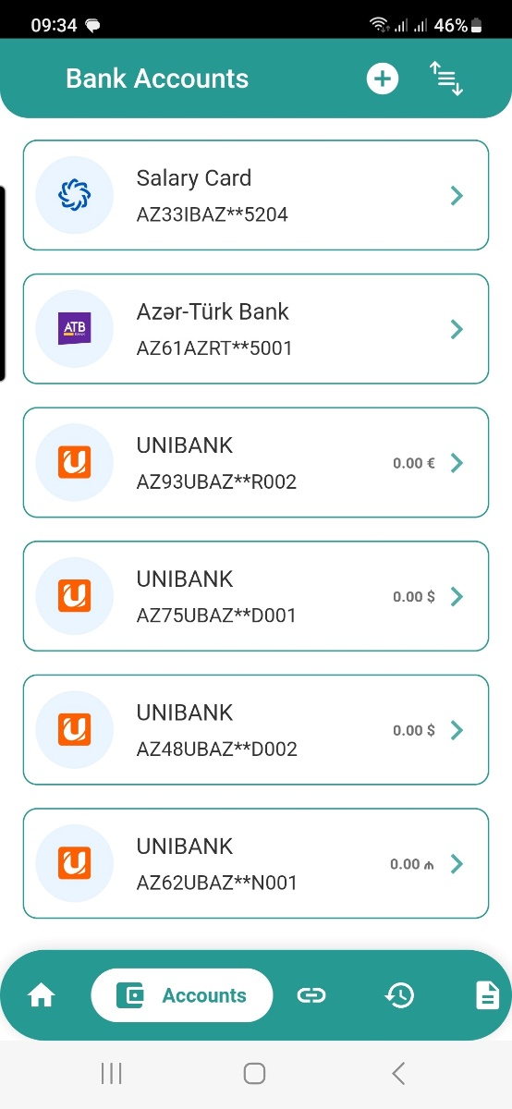
IPS application

Slide 11
209,3
128.9
82,7
3.8

Slide 12
T
A
K
Y
U
H
N
O

