Slide 1
TREASURY SINGLE ACCOUNT
STATE TREASURY AGENCY OF AZERBAIJAN
VIENNA
NOVEMBER 2023

Slide 2

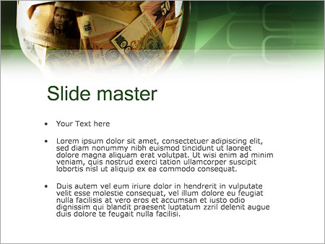
Legal and regulatory framework for the TSA:
Article 19 of RA Law On the Budget System
Cash execution of the state budget occurs through the State Treasury.
All receipts of and payments from the state budget, off-budget contributions and payments, operations of extrabudgetary funds (excluding revenues, operating expenses and investments of the State Oil Fund), operations related to borrowings under government guarantees to bridge the budget deficit, and other government financial operations – all are performed through the State Treasury.
The balance of funds in the TSA (free cash) can be managed or provided for management.
The exclusive right to manage the TSA and the right to debit its accounts belongs to the State Treasury. Any transfer or withdrawal of funds from the TSA without State Treasury’s authorization is prohibited.

Slide 3
Treasury services
BO accounts financed from the budget
STA
Deposit accounts and accounts for payment orders
BO accounts financed from extrabudgetary funds
State Oil Fund of the Republic of Azerbaijan (SOFAZ)
Deposit account for VAT
Government Social Protection Fund

Slide 4

TREASURY SINGLE ACCOUNT
Subaccounts of independent credit distributors
Social Protection Fund
Cash balances in TSA, including
Accounts for payment orders
Projects financed from the State Oil Fund
Off-budget accounts
VAT
… other accounts

Slide 5
Managing free balances of cash in TSA
SOFAZ
Foreign banks
TSA
(Cash balances)

Slide 6
State Oil Fund
Receipts
Cash management
SOFAZ
Transfer
Strategic projects
State budget
Economic development

Slide 7


