Slide 1
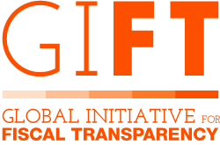
Sudjelovanje javnosti
i uporaba digitalnih alata
u proračunskom ciklusu
Sastanak Zajednice prakse za proračun (BCOP) PEMPAL-a
22. – 24. ožujka/marta 2023. | Ljubljana, Slovenija

Slide 2
Mreža GIFT
26 vlada
9 mreža međunarodnih organizacija
Brazil (Transparentnost –CGU), Filipini (Odjel za proračun i upravljanje), Meksiko (red za riznicu i javni dug) +23 vladinih agencija za proračun
Svjetska banka, MMF, OECD, IFAC, MITRE, OCP, CABRI, Global Integrity, PEFA
19 organizacija civilnog društva
Glavni upravitelji GIFT-a
4 financijera/zaklade
58 predvodnika
IBP, Fundar, ILDA, CBPP, Inesc, ICEFI, ACIJ, Fiscal Observatory, Seknas, IFP, Funde, PSAM, Emerging M, NHCDR, Social Watch, Solidaridad, Innovaap, CIEP, EF
Hewlett F., Luminate,
Ford F., DfID
Notes:
Established in 2011, GIFT is a global network that facilitates dialogue between governments, civil society organizations, international financial institutions and other stakeholders to find and share solutions to challenges in fiscal transparency and inclusive participation in fiscal policies.

Slide 3
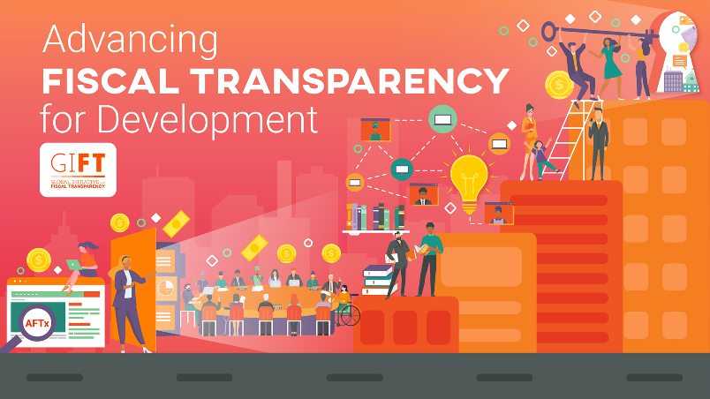
Online tečaj na temu unapređivanja fiskalne transparentnosti u svrhu razvoja
BESPLATAN
Dostupan na FRANCUSKOM I ENGLESKOM
Certifikat tečaja
5 modula s jednostavnim materijalima
Osnove fiskalne transparentnosti; Međunarodne norme i standardi; Uloge različitih aktera, uključujući MF-ove, VRI-jeve, parlamente i civilno društvo; Digitalni alati; Praktični pristupi; Primjeri diljem svijeta
http://aftx.learning.fiscaltransparency.net/

Slide 4
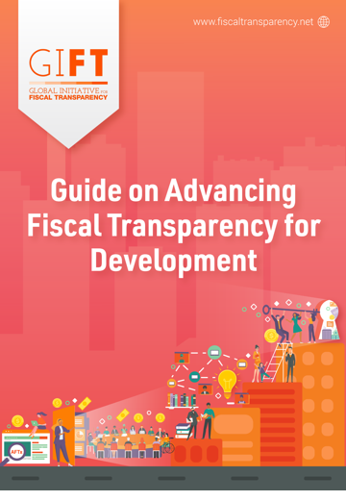
Vodič za unapređivanje fiskalne transparentnosti u svrhu razvoja
Jednostavan za uporabu
Temeljen za online tečaju
Svi ključni elementi fiskalne transparentnosti na jednome mjestu, uključujući komplementarnost između različitih međunarodnih normi i standarda
https://fiscaltransparency.net/fiscal-transparency-guide/

Slide 5
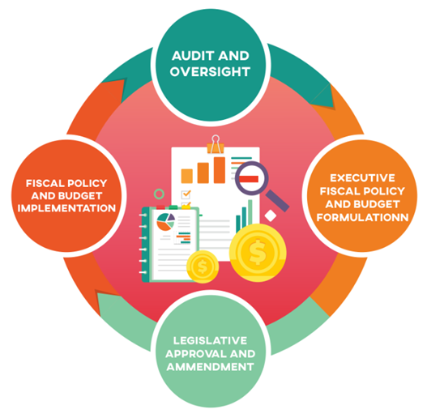
Definiranje sudjelovanja javnosti u fiskalnim politikama
U proračunskom se procesu sudjelovanje javnosti odnosi na niz različitih načina na koje su civilno društvo, tvrtke i drugi nevladini akteri u izravnoj i javnoj interakciji s vladom u pogledu fiskalnih problema uključujući oporezivanje vlade i naplatu prihoda, dodjelu sredstava, stvarnu potrošnju i učinak, reviziju i upravljanje javnom imovinom i obvezama.
Notes:
Public participation is a means to ensure that all those with a stake in, affected by, or intended to benefit from fiscal policies have a voice in decisions that affect their lives. At the heart of fiscal transparency and public financial management is the relationship between the public and the government.
The importance that state actors give to public participation reflects their acceptance and commitment to democratic life and the basic principle that non-state actors are key agents of good governance and sustainable development. Public participation by non-state actors is a critical democratic mechanism through which the government's decision-making process and public policies can be made more legitimate, efficient, equitable, accountable, and sustainable. It can strengthen policy choices, increase public support for budget decisions, and strengthen oversight, all of which can ultimately improve outcomes. When public participation is inclusive and effective, listening and engaging with the marginalized members of society, it especially benefits the poor and the most vulnerable, who are traditionally excluded. Members of the public can provide critical information on their needs and priorities and, through monitoring budget implementation, reduce mismanagement, thus further enhancing budget efficiency and effectiveness.

Slide 6
Naša teorija promjene:
Na čemu se temelji ideja sudjelovanja javnosti?

Slide 7
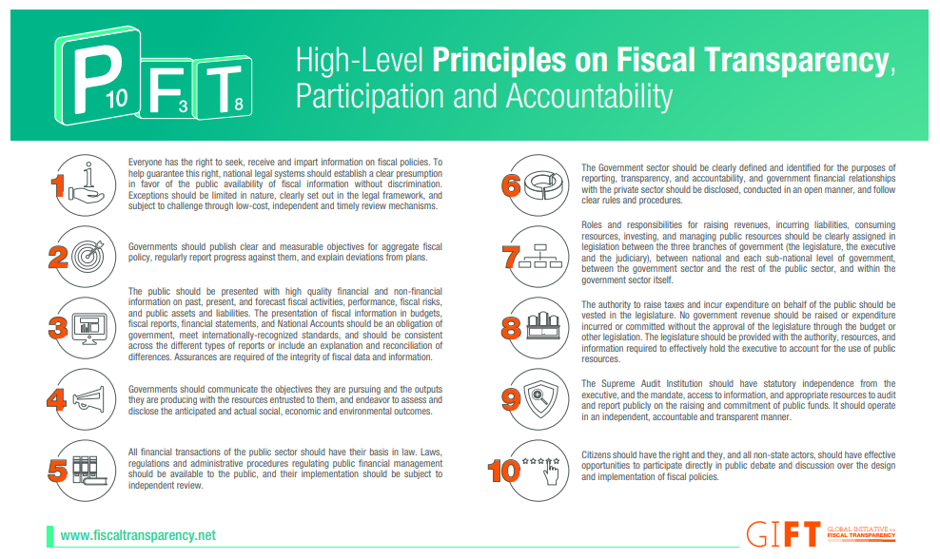
GIFT-ovo Načelo visoke razine br. 10
„Građani , kao i svi nevladini akteri, trebali bi imati pravo i učinkovite prilike da izravno sudjeluju u javnoj diskusiji i debati o izradi i provedbi fiskalnih politika.”
Notes:
One of the GIFT network’s first initiatives was to review the plethora of international standards and norms on fiscal transparency for comprehensiveness and consistency. This prompted the development in 2012 of the High-Level Principles on Fiscal Transparency, Participation and Accountability, 10 principles that were ‘…intended to guide policy makers and all other stakeholders in fiscal policy in their efforts to improve fiscal transparency, participation and accountability, and to help promote improvements in the coverage, consistency and coherence of the existing standards and norms for fiscal transparency.’ Principle 10 focuses on Public Participation.

Slide 8
Notes:
Given the limited historical guidance on how public entities should engage directly with the public in managing public resources, the GIFT network embarked on a substantial multi-year work program to generate greater knowledge about country practices and innovations in citizen engagement. In 2016, after an extensive public consultation process, GIFT launched 10 Principles of Public Participation in Fiscal Policies. This guidance states that public authorities should endeavor to ensure that citizens and other non-state actors have effective opportunities to participate directly in public debate and discussion with respect to the design, implementation and review of fiscal policies, while observing 10 interdependent principles.

Slide 9
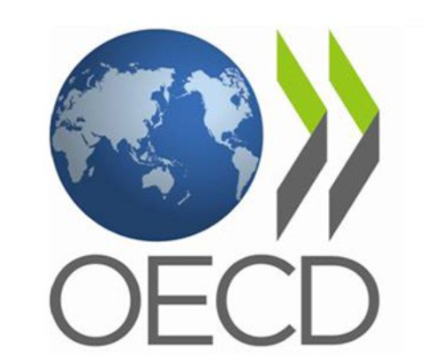
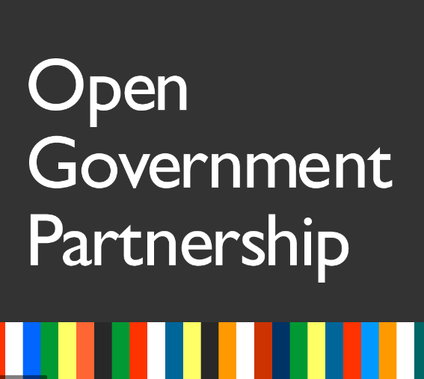
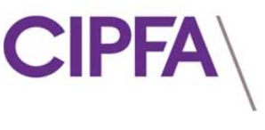
Notes:
The GIFT PP principles include select concepts that are also included in other norms and standards developed by international development institutions including the Organisation for Economic Co-operation and Development (OECD), the International Monetary Fund (IMF), International Federation of Accountants (IFAC), Chartered Institute of Public Finance and Accountancy (CIPFA) and the Public Expenditure and Financial Accountability (PEFA), among others.

Slide 10
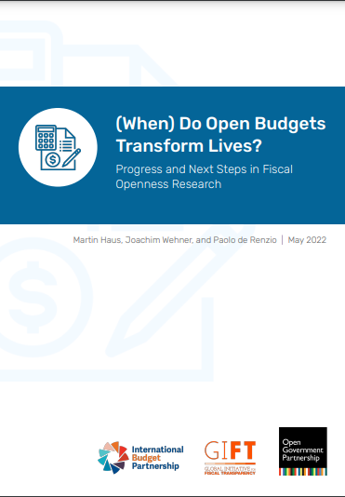
Sudjelovanje javnosti: Zbog čega?
Dokazi o prednostima fiskalne otvorenosti uključuju:
Veću naplata poreza
Povećanu potražnju za javnim dugom i niže troškove zaduživanja
Manje pogrešnih alokacija i prikupljanja => povećana odgovornost
Veća kontrola javnosti nad vladinim institucijama
Kredibilitet proračuna i poboljšani krajnji rezultati razvoja
Notes:
Over the years, numerous studies have demonstrated that budgetary openness can lead to several benefits:
- higher tax collections: When governments are more inclusive and transparent, citizens have greater trust in them, and are more willing to pay their taxes, which can reduce enforcement costs and increase collections;
- increased demand for sovereign debt and lower borrowing costs: The amount that lenders are willing to lend and to charge borrowers for doing so, largely depends on the risk associated with that lending. A lack of fiscal transparency creates uncertainty and increases risk perceptions. A lack of transparency also increases the cost of monitoring a country, and monitoring influences a country’s behaviour, which in turn affects its credit spreads;
- Budget information disclosure can reduce misallocations and promote accountability by helping oversight institutions to hold governments to account, as well as by incentivizing citizens to monitor governments, and public officials to refrain from corrupt behaviour. When information regarding the performance of public institutions is made publicly available, media, interest groups, and concerned communities are likely to use this information to exert pressure on public authorities to respond, explain, justify and eventually correct themselves.
- Improved budget credibility and development outcomes: Fiscal transparency reduces the government’s informational advantage making it more likely that it will implement and undertake its programs in line with its publicly released plans/projections as contained in its budgets, as it is aware that its progress is being monitored by the public. Fiscal transparency coupled with public participation can lead to improved development outcomes, as it empowers the public to not only understand the priorities that the government is pursuing but also to contribute to these choices, by providing the government with feedback. As such, government policies are more likely to be appropriately designed to meet the public’s needs and consequently to lead to enhanced developmental outcomes.

Slide 11
Uloga informacijskih sustava
i digitalnih alata u fiskalnim politikama
Tehnologija može pridonijeti učinkovitijim, transparentnijim, pravednijim i utjecajnijim fiskalnim politikama
Notes:
Advances in information and communications technologies have revolutionized the role played by information systems and digital tools in fiscal policies. If technology is used in a purposeful and results oriented manner, fiscal policy can be more efficient, transparent, equitable, and impactful; potentially improving lives the world over. Governments can get access to better data for evidence based policy making; and the public can potentially access the same information public officials have, directly from the source. This can form a virtuous cycle, as the benefits of fiscal transparency are seen, the pressures to improve the quality of information and as such the underlying systems increase. Digitalization allows for greater storage and tracking of information through electronic records, the linking of data registries between different parts of government, and enhanced capabilities to handle and analyze large data sets, in short periods of time. Many countries are already finding that with digitalization, it costs less to collect taxes, manage public finances, and deliver public services.
Governments can get access to better data for evidence based policy making; and the public can potentially access the same information public officials have, directly from the source. This can form a virtuous cycle, as the benefits of fiscal transparency are seen, the pressures to improve the quality of information and as such the underlying systems increase. Digitalization allows for greater storage and tracking of information through electronic records, the linking of data registries between different parts of government, and enhanced capabilities to handle and analyze large data sets, in short periods of time. Many countries are already finding that with digitalization, it costs less to collect taxes, manage public finances, and deliver public services.

Slide 12
Upotreba digitalnih alata
Objava i distribucija informacija i (otvorenih) podataka
Javno savjetovanje
Savjetovanje o zakonodavstvu
Participativno planiranje proračuna
Monitoring projekta
Pritužbe i odgovornost
Notes:
Governments can use digital tools to disseminate more information, internally and externally, in different formats via fiscal transparency portals and social media. More recently, national and local governments are starting to leverage on digital tools to proactively engage citizens in public decision-making: through digital citizen assemblies, public consultations, collaborative legislation, goals tracking, and participatory budgeting, social audits and accountability.

Slide 13
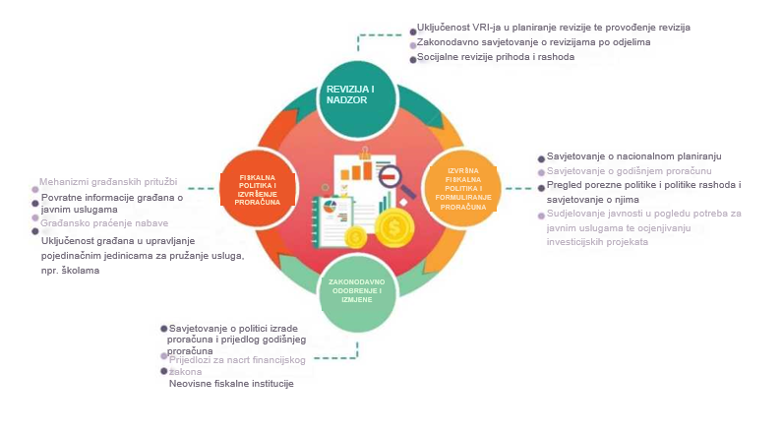
Primjeri sudjelovanja javnosti u proračunskom ciklusu
Notes:
There are different purposes for public participation across the 4 stages of the fiscal policy cycle, with distinct tools that can be used to design, plan, and implement appropriate participation mechanisms.

Slide 14
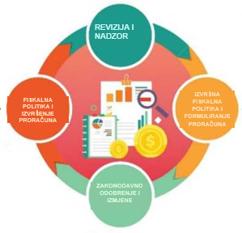
U PRAKSI: sudjelovanje javnosti i upotreba digitalnih alata u proračunskom ciklusu

Slide 15
Faza 1: Izrada proračuna
Pitanje za Ministarstvo financija (MF) je kako uključiti različite aktere kako bi se za nacrt proračuna uzeo u obzir širok raspon perspektiva
Notes:
In the budget formulation phase, engaging diverse actors enables the government to draw on the wide range of information and perspectives, such that civil society feedback can be integrated into the blueprint of financial management for a certain budget period.
This is impactful in terms of:
Getting a common understanding of issues;
Ensuring that budget policy priorities match the public interest;
Garnering support for their implementation; and
Building trust.
The executive, being the lead player during this phase, often invites non-state actors, including civil society and the private sector, to engage in various forums.

Slide 16
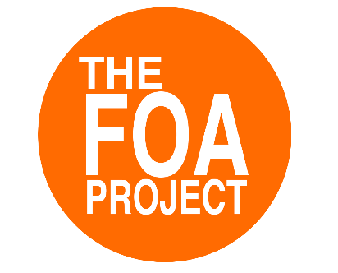
Primjeri po zemljama
Mobilna aplikacija Benina (Google Playstore)
Nacionalni savjetodavni forum Nigerije o nacrtu srednjoročnog fiskalnog okvira 2023. – 2025. (Društvene mreže i platforma za sastanke u virtualnom formatu)
Južnoafričko pretproračunsko savjetovanje o fiskalnoj politici (društvene mreže, e-pošta, platforma za sastanke u virtualnom formatu i Vulekamali)
Notes:
In the Fiscal Openness Accelerator Project of GIFT, Ministries of Finance in pilot countries have all initiated public participation mechanisms that either developed new digital tools or leveraged on existing platforms.

Slide 17
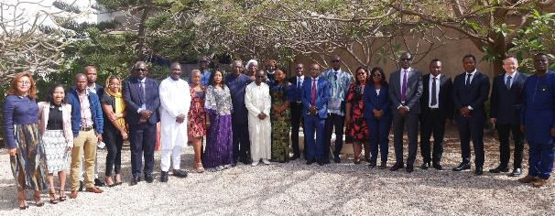
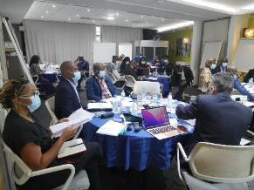
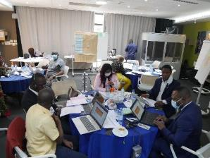
Ključni elementi modela Akceleratora fiskalne otvorenosti
Formalna obveza Ministarstva financija (MoF) – potpisan je Memorandum o razumijevanju
Ustanovljena je savjetodavna skupina vlade i civilnog društva s jasnim opisom posla
Izgradnja kapaciteta i učenje uz međusobnu podršku
Izrada i provedba akcijskog plana za pilot-projekt mehanizma sudjelovanja javnosti u proračunskom procesu na nacionalnoj razini

Slide 18
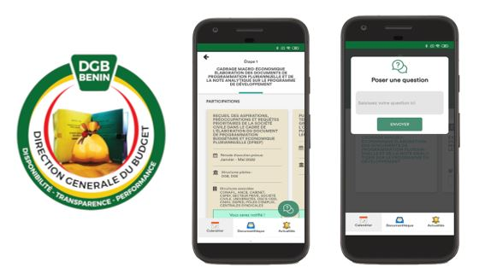
Mehanizmi sudjelovanja javnosti u projektu FOA: Benin
Benin je razvio mobilnu aplikaciju Bousprob , alat za upozorenje i monitoring koji je besplatno dostupan u servisu Google Playstore i sadrži biblioteku informacija o proračunu, informira korisnike o mogućnostima uključivanja u proračunski proces i pruža platformu za prikupljanje njihovih povratnih informacija
Notes:
Benin has developed Bousprob mobile application, an alert and monitoring tool available freely on the Google Playstore that features a library of budget information, informs citizens on opportunities to engage in the budget process and provides a platform to collect their feedback.

Slide 19
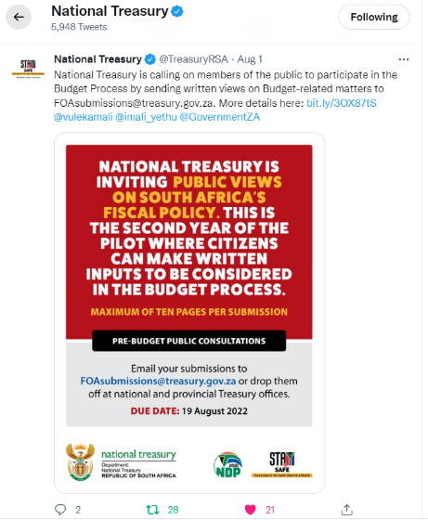
Mehanizmi sudjelovanja javnosti u projektu FOA: Južna Afrika
Pretproračunska savjetovanjaJužne Afrike:
1. godina: Javno savjetovanje koje je omogućilo prostor za prezentaciju i dijalog o preporukama organizacija civilnog društva o utvrđivanju prioriteta proračuna i o tome kako se nositi s izazovima dugoročne fiskalne održivosti
2. godina: javni poziv za dostavu pisanih podnesaka o širokom rasponu tema (npr. fiskalna politika, proračunske reforme, sektorska pitanja) koje će analizirati skupine za funkcioniranje Riznice i podijeliti s Odborom za srednjoročne rashode
Notes:
South Africa's pre-budget consultations:
Year 1: public consultation event that provided a venue for presentation and dialogue on CSO recommendations on budget prioritization and how to deal with challenges of long-term fiscal sustainability.
Year 2: public call for written submissions on a broad range of themes (e.g. fiscal policy, budget reforms, sectoral issues) which will be analyzed by Treasury functional groups and shared with Medium-Term Expenditure Committee (MTEC).
Combined with offline and traditional The South African National Treasury made use of social media platforms and online meeting platforms in the promotion and conduct of the pre-budget consultations. After the consultations, a copy of all submitted recommendations and updates were posted online via the Vulekamali portal, a government and civil society supported online platform.

Slide 20
Mehanizmi sudjelovanja javnosti u projektu FOA:
Nigerija
Nigerija je provela nacionalno savjetovanje u hibridnom obliku. Ministar financija, proračuna i nacionalnog planiranja predstavio je nacrt srednjoročnog fiskalnog okvira za razdoblje 2023. – 2025. namijenjen doprinosima građana.
Tijekom skupa, pripadnici javnosti također su mogli postavljati pitanja uživo i virtualno. Odgovore na doprinose građana dala je najviša razina vlasti Ministarstva financija (ministar, generalni direktor za proračun itd.)
Notes:
Nigeria implemented a national consultation event in hybrid format. The Minister of Finance, Budget and National Planning, presented the draft 2023-25 Medium Term Fiscal Framework for citizen inputs.
During the event, members of the public were also able to ask questions in-person and virtually. Responses to citizen inputs were provided by the Minister of Finance herself, the Minister of State, Budget and National Planning; and the Director General of the Budget Office.

Slide 21
Faza 2: Zakonodavno odobrenje
Sudjelovanje javnosti zakonodavcima može pružiti nestranačku analizu proračuna i stajališta korisnika.
Mogu se upotrebljavati diskusije Odbora za proračun i drugi mehanizmi.
Notes:
During the legislative approval phase, the main purposes for public participation are to provide legislators with non-partisan budget analysis and various viewpoints. This is achieved mainly through Finance and Public Account Committee hearings and other mechanisms available to gather public inputs.
Expert groups such as think tanks, civil society organizations that specialize in the budget, and academia may provide valuable analyses. The legislature can, for instance, use this analyses to alter budget priorities, shift allocations, or increase executive accountability.

Slide 22
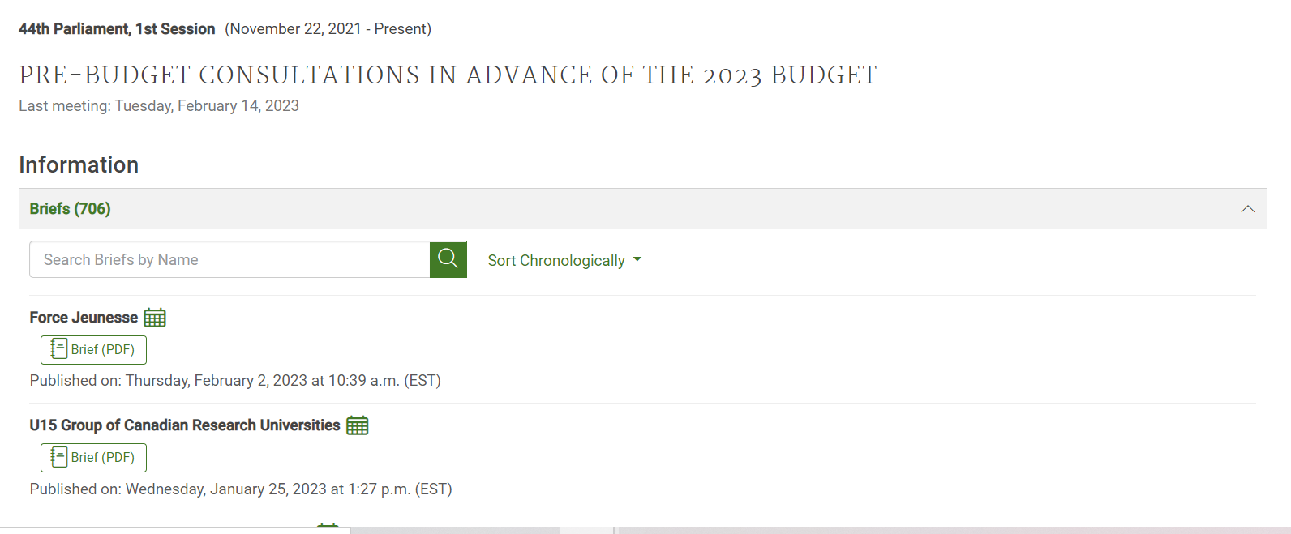
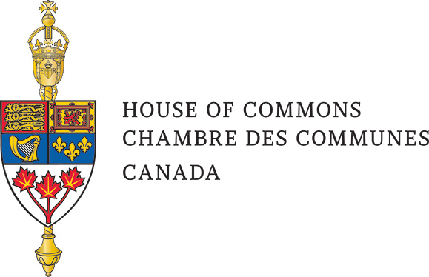
Pretproračunska savjetovanja Kanade od strane financijskog odbora
Notes:
In Canada, legislative committee meetings on the proposed budget are open for anyone to attend and also allows members of the public to testify. Witnesses can testify in person or online during the public hearings of the Committee, held in multiple cities on occasion, or can submit briefs online. Witness testimony is recorded and is published on the website of the Committee. The summary of written submissions is also published. The consultation process is open for a reasonably long period of time (the online process is open for 60 days, while in-person consultations for a two-week or longer period, though in 2016 the consultations took place in a reduced four-day timeframe). Based on the pre-budget consultations, the Committee forms its recommendations, which are publicly available on the website of the Committee so the public can check how the Committee has considered public feedback.

Slide 23
Faza 3: Provedba proračuna
Može se upotrijebiti niz mehanizama:
Mehanizmi savjetovanja, suradnje i povratnih informacija kako bi se osiguralo učinkovito i efikasno pružanje javnih usluga
Mehanizmi za rješavanje pritužbi
Praćenje inicijativa u pogledi vrijednosti novca od strane nevladinih aktera
Notes:
A variety of mechanisms can be used to oversee government’s implementation of fiscal policy. Key players include government at different levels, legislature, CSOs, the media, community groups, the private sector, academia, and the general public. Governments can consult and collaborate with these actors to ensure that the budget is executed as intended for public service delivery. Civil society actors can also take proactive initiatives to hold government or elected officials accountable by following budget and expenditure data, that is, by following the money.

Slide 24
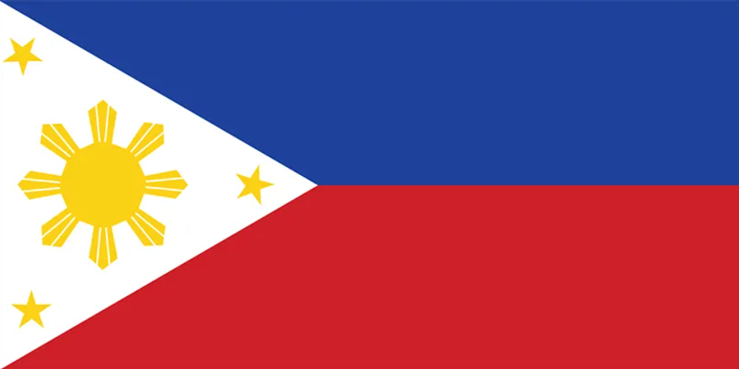
Mobilna aplikacija PH Devlive
Vlada Filipina uključuje javnost u monitoring izvršenja proračuna o provedbi projekata javne infrastrukture i to s pomoću s mobilne aplikacije pod nazivom Development Live (DevLIVE)
Notes:
In the Philippines there is a mobile android application called DevLIVE that was designed to gather citizens’ satisfaction feedback on the quality and implementation progress of government’s local infrastructure projects. Administered by the Department of the Interior and Local Government, it currently hosts budget execution and project implementation data of PHP 31.1 billion (USD 565 million) worth of locally implemented projects. It specifically collects user feedback on the following performance indicators: visibility, functionality, quality, accessibility, timeliness, relevance, and operations. From its pilot rollout in 2019, the government received 4,868 different feedback covering 1,029 projects in 264 pilot local government units, with a satisfaction rate of 95% on the progress of projects monitored.

Slide 25
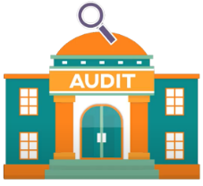
Faza 4: Revizija i nadzor
Vrhovna revizijska institucija treba obavještavati javnost o rezultatima revizije i preporukama te stvoriti prostore u kojima javnost može pomoći s monitoringom i revizijom javne potrošnje, ishoda i rezultata.
Notes:
In the final audit and oversight phase, public participation opportunities should be created by oversight institutions. The supreme audit institution should inform the public about its audit findings and recommendations as well as create spaces for the public to assist it in the monitoring and audit of public spending, outputs, and outcomes. For instance, it should hold consultations to receive proposals on entities and programs to be audited, and to garner focused contributions on particular areas, such as civil society collaborations on social audits.

Slide 26
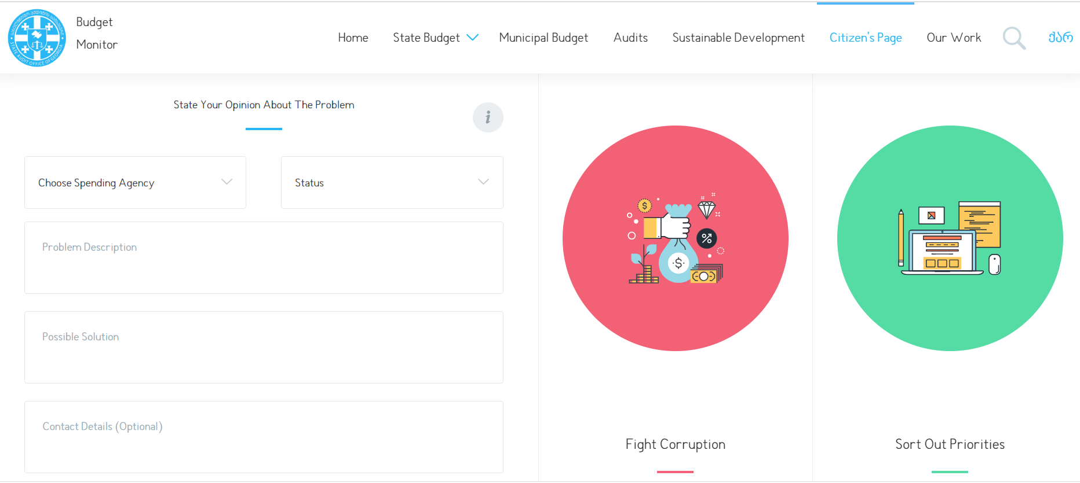
Monitoring proračuna u Gruziji
Notes:
The Budget Monitor of the State Audit Office of Georgia is one of the three recipients of the 2017 GIFT Public Participation in Fiscal Policy and Budget Making Award.
The web-platform enables citizens to filter, choose, compare, sort and export consolidated information about the state and municipal budgets (administrative costs, public debt, state purchases, budget deficit, capital projects, reserve funds, etc.), audit findings and corresponding recommendations in easy-to-interpret way.
It also enables citizens to engage constructively throughout the audit cycle. Through the Budget Monitor platform, citizens can send audit requests, suggestions, proposals, and inform SAOG about the deficiencies in the PFM system, contribute to the reduction of corruption risks and suggest the priority spheres for future audit(s). The possibility of two-way communication provided by this platform encourages citizens to participate in the monitoring process of public administration that should ultimately contribute to the improvement of good governance.

Slide 27
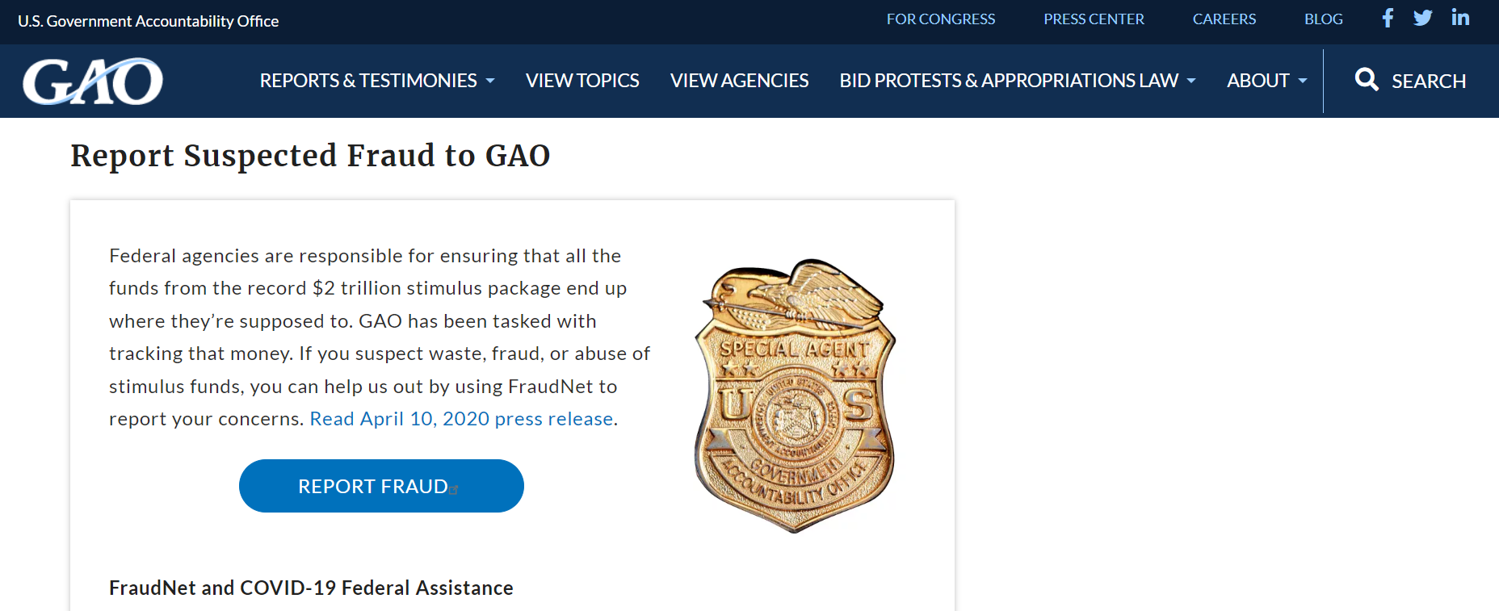
FraudNet SAD-ovog GAO-a
Notes:
FraudNET is GAO's hotline for the public to anonymously report government fraud, waste, abuse, or mismanagement of federal funds through offline and online means. In fiscal year 2022, GAO received 607 complaints on Fraudnet specifically on COVID-19 emergency funding. Related to this, the GAO also publish all non-classified reports, as well as the database of open recommendations on their public website.
Sources:
https://intosaijournal.org/engaging-with-civil-society-enables-high-quality-audits-in-critical-times-perspectives-from-the-u-s-gao/
https://www.gao.gov/coronavirus

Slide 28
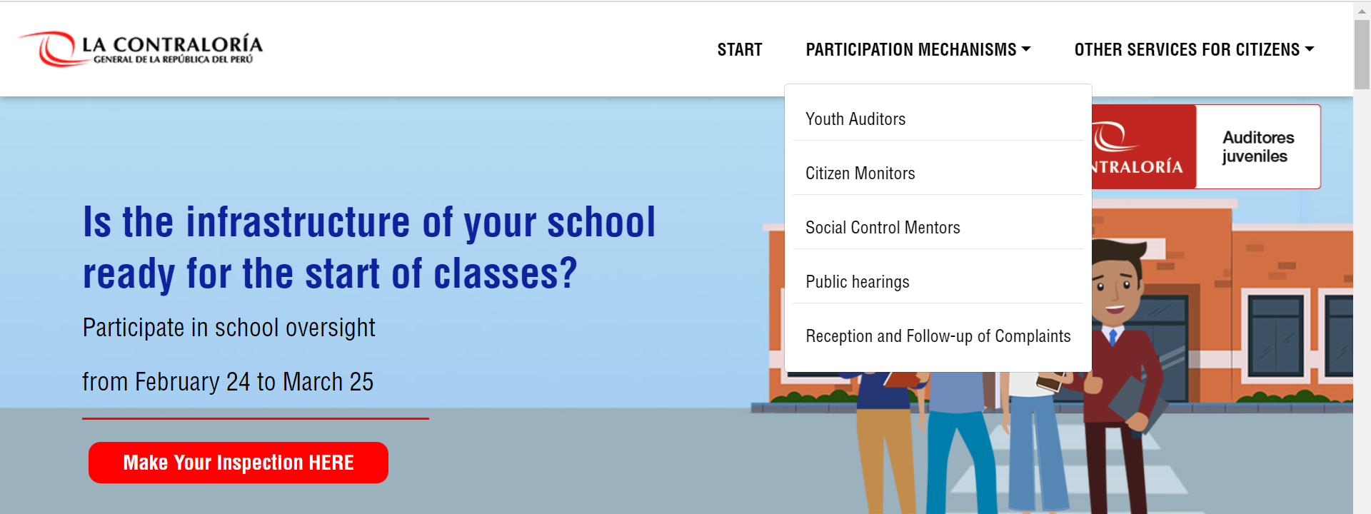
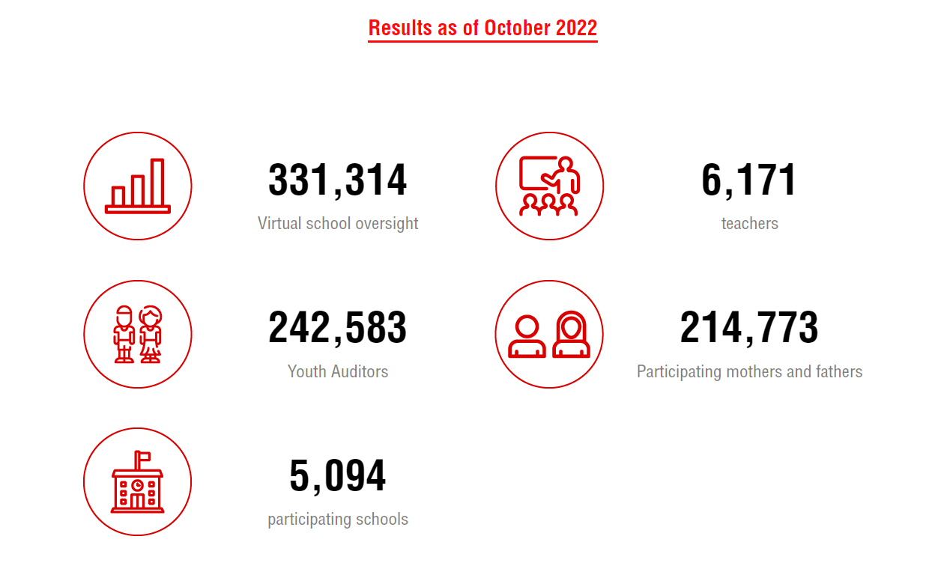
Portal za virtualni nadzor nad školama u Peruu
Notes:
In Peru, the SAI set up Virtual School Oversight (Veeduría Escolar Virtual) mechanisms to monitor the implementation of specific COVID response policies in the education sector, such as delivery of school materials and distance education equipment.
As of October 2022, Peru’s Office of the Comptroller General reports that over 330,000 oversight activities were, with the involvement of over 5000 schools, 6100 teachers, 242,000 youth auditors, and 214 thousand participating parents.
Aside from the Virtual School Oversight initiative, Peru's SAI places emphasis on citizen participation as a strategy to strengthen accountability and transparency in all stages of the government’s control cycle. Their Citizen Monitors program are aimed at Peruvian citizens, over 18 years of age, who wish to participate in citizen oversight in person and/or online. The public are informed about audits that have been conducted and invited to provide feedback about alleged illegal irregularities in a Public Hearings Program. In addition, a Youth Auditors Program, seeks to contribute to the consolidation of a culture of integrity in the citizenry, encouraging high school students to learn to exercise social control in order to ensure the proper functioning of public services.
Source:
https://controlsocial.contraloria.gob.pe/auditoresjuveniles/#formulariove
https://fiscaltransparency.net/wp-content/uploads/2023/02/Guide-on-Advancing-Fiscal-Transparency-for-Development.pdf

Slide 29
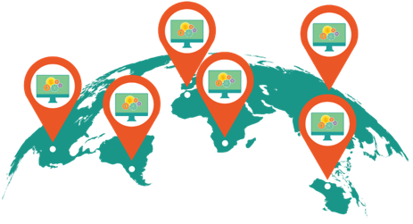
Dostupni digitalni alati
za usvajanje/prilagođavanje

Slide 30
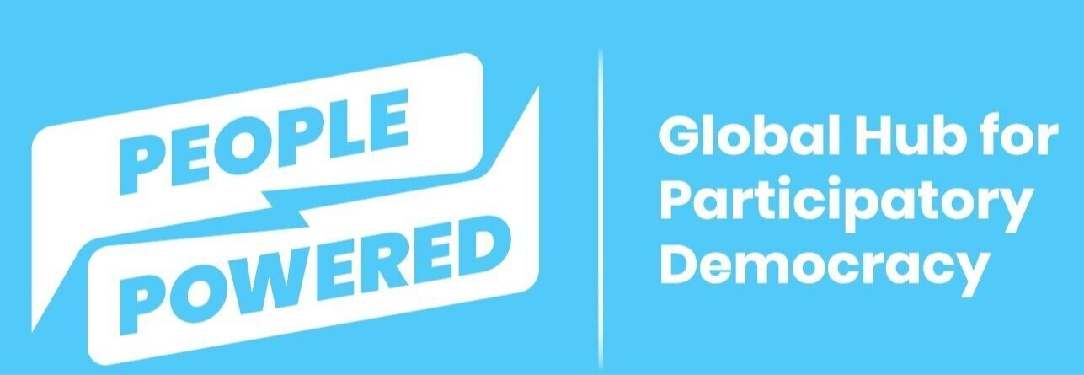
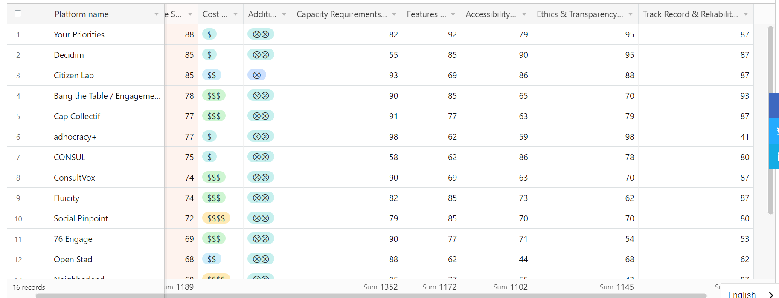
Ocjene platforma za digitalno sudjelovanje
Notes:
This February 2023, People Powered published its 2022 Digital Participation Platforms (DDP) Ratings, a report that evaluated 32 existing digital participation platforms, based on a review by a committee of civic tech experts and includes platform user input from over 400 users. The ratings are based on six criteria: cost, capacity requirements, features, accessibility, ethics/transparency, and track record/reliability. The ratings can be useful in selecting existing platforms that can be considered for adoption or customization by different government or non-government stakeholders that plans to implement digital budget participation initiatives. From these tools, we feature three digital toolboxes with modules that can be used to promote public participation across the budget cycle.

Slide 31
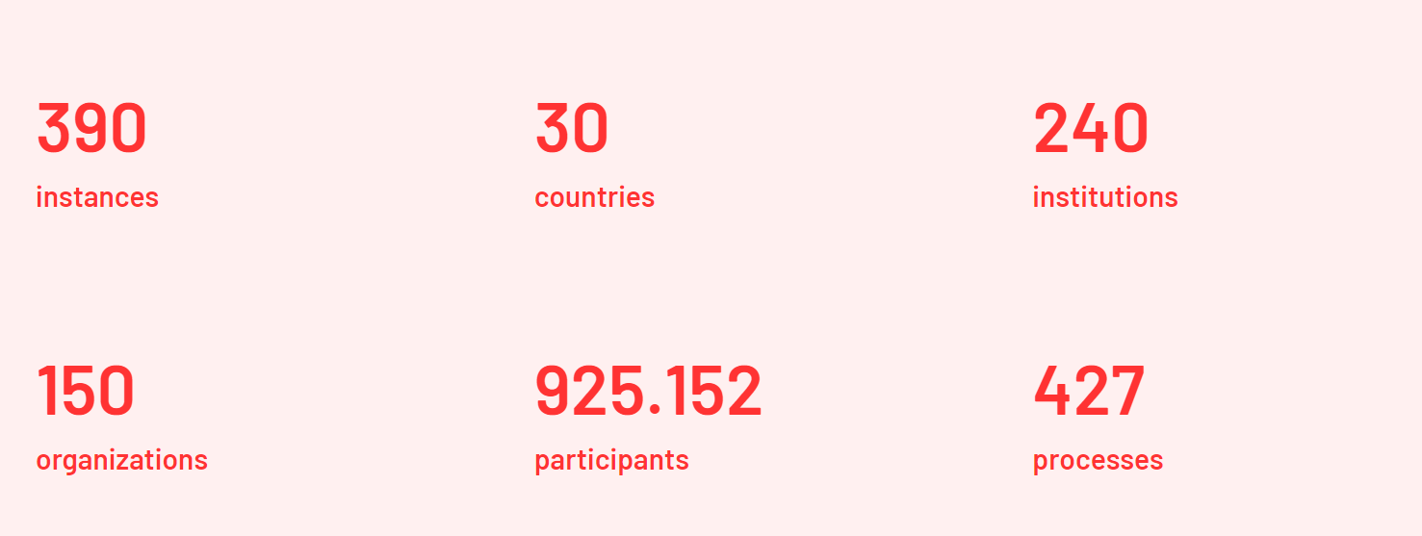
Decidim: stvaranje, aktivacija/deaktivacija i upravljanje različitim procesima sudjelovanja (npr. izborni proces, participativna izrada proračuna, proces strateškog planiranja, zajedničko pisanje propisa ili normi, dizajn projekta ili izrada plana javne politike).
Notes:
Decidim allows the creation, activation/deactivation, and management of various participatory processes. These are distinguished from other spaces by being structured in different phases within which all of the components can be incorporated. Examples of participatory processes it supports are: an election process, participatory budgeting, a strategic planning process, the collaborative writing of a regulation or norm, the project design or the production of a public policy plan.
Source: https://decidim.org/features/

Slide 32
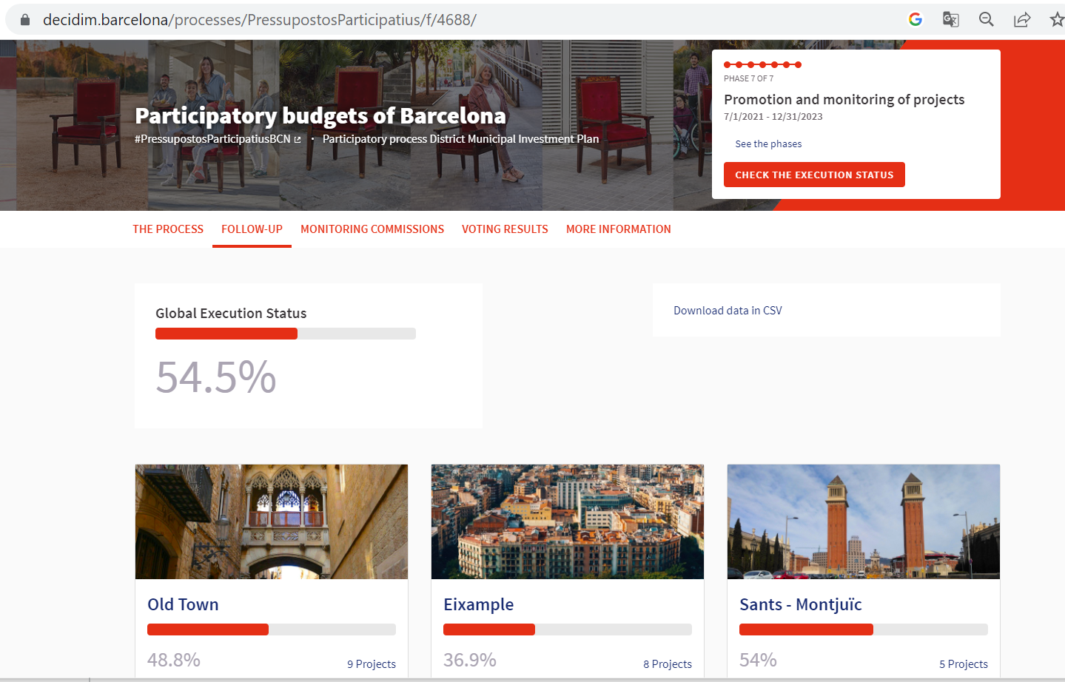
Decidim.Barcelona
Notes:
In Barcelona, they proactively use Decidim as their online platform to facilitate their participatory budget initiative for FY 2022, which began on February 3, 2020 and with public voting that ended on June 2021. The project dedicated 30 million euros from the municipal budget for 76 projects which got the most votes from residents of Barcelona.
The Decidim Barcelona website features the process, scope, constraints, timelines of their participatory budgeting initiative, including: an overview of participatory budgeting, FAQs page, copy of the policy approved by the City Council that institutionalized the initiative, and how 30 million euro budget was also divided for each district. In terms of closing the feedback loop and publishing results, the portal facilitated online voting and exchanges on proposed initiatives. Then, the voting results are also published, even for those projects that did not make the cut. The website also features functionalities for anyone to access information and participate in the monitoring of the selected projects together with designated district monitoring commissions composed of govt and representatives from the chosen projects.

Slide 33
Your Priorities: platforma za stvaranje ideja, otvoreno promišljanje i društveno umrežavanje koja postoji od 2008. i uključuje tisuće projekata
Notes:
Your Priorities is an open source online idea generation, deliberation & decision-making social networking platform connecting governments and citizens since 2008 in thousands of projects
Source: https://citizens.is/your-priorities-features-overview/

Slide 34
Notes:
Your Priorities was used by the City of Reykjavik in Iceland as its main consultation platform to solicit feedback from its residents on projects and initiatives that they wish to be prioritized by the local government.
Source: https://betrireykjavik.is/domain/1

Slide 35
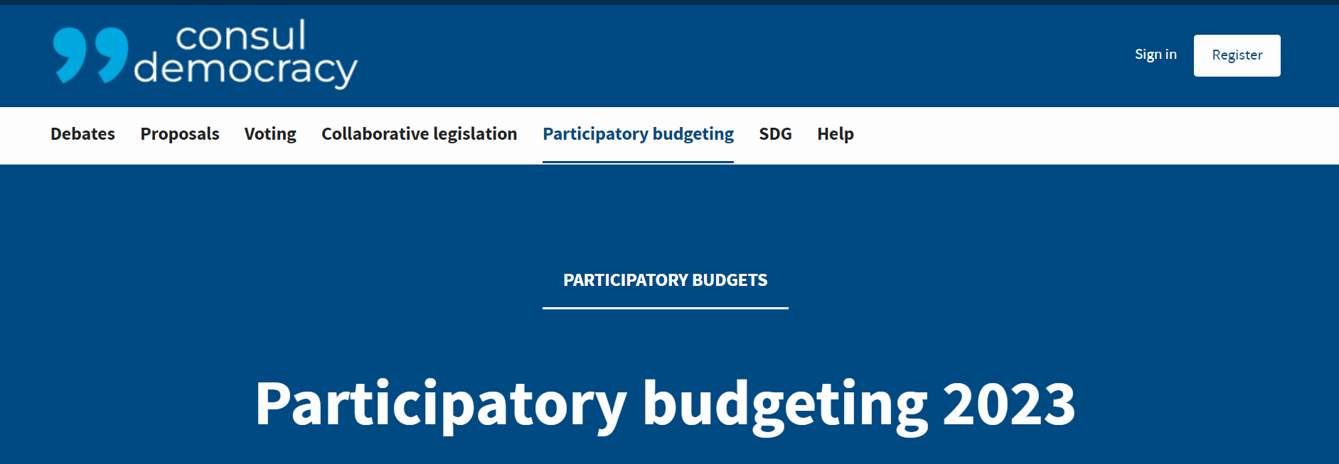
Notes:
Consul is another free software for citizen participation. Processes that can be facilitated through this platform include the following:
Debates-Anyone can open threads on any subject, creating separate spaces where people can discuss the proposed topic. Debates are valued by everybody, to highlight the most important issues.
Proposals -A space for everyone to create a citizens' proposal and seek supports. Proposals which reach to enough supports will be voted and so, together we can decide the issues that matter to us.
Participatory budgeting-Participatory budgets allow citizens to propose and decide directly how to spend part of the budget, with monitoring and rigorous evaluation of proposals by the institution. Maximum effectiveness and control with satisfaction for everyone.
Voting-Secure voting system for citizen proposals and enquiries from the institution. Everyone can decide easily on the most important issues from their phones.
Consultation on Legislation-Any legislative text can be shared with the public to receive comments on any particular part of it. The comments are associated with the discussed parts using a color code, which allows an easy visualization of improvable parts. It also enables the creation of related debates previous to the text drafting, for better subsequent development.
A key feature of Consul is also an SDG module that links SDG indicators to data collected and uploaded.
According to their website, Consul has been used by 35 Countries 135 Institutions 90 Millions of citizens worldwide. A concrete example is Decide Madrid, where members of the public can make proposals, vote in citizen consultations, propose, support or vote for projects with participatory budgets, decide on municipal regulations and open debates to exchange opinions with other people.
Source:
https://consulproject.org/en/#contact
https://decide.madrid.es/budgets

Slide 36
Zaključci
Anketa o otvorenom proračunu: potreba za više otvorenih prostora za dijalog i sudjelovanje u procesu izrade proračuna
Sudjelovanje javnosti ima značajne prednosti
Iskustvo GIFT-a ukazuje na to da sljedeći čimbenici pomažu:
Vodstvo Ministarstva financija i institucionalna podrška
Jasnoća pravila sudjelovanja
Gradnja okruženja povjerenja i suradnje
Ulaganje sredstava/podrška
Kolaborativno učenje i učenje od kolega / okruženje u kojem se stvara pritisak
Notes:
With a global average score for participation of just 14 out of 100, the Open Budget Survey 2021 shows that public budgets remain primarily an elite conversation with very few spaces for ordinary people to engage and have a say. Governments need to exert more effort in terms of opening spaces for meaningful dialogue with community members on ways towards better targeting and implementation of programs, protection of spending allocations for critical and vulnerable sectors.
A successful PP mechanism needs: MoF leadership and bureaucratic buy-in; international, collaborative and peer-to-peer learning environment & peer pressure; resource investment/support; clarity of rules of engagement; culture of trust and collaboration; leveraging on international indices.
In terms of enabling factors, we have observed that high-level political will and bureaucratic buy-in from senior and technical level or career officials from the MoF play a crucial role in driving progress and overcoming challenges, also most especially when countries dedicated a team of competent staff on the initiative. There is also great value found in convening stakeholders in an international setting and promoting a collaborative and peer-to-peer learning environment. In the FOA project our regular country assemblies encouraged peer exchange and peer pressure to meet our objectives.
Good participation requires resources. To have more meaningful outputs and outcomes from the process , peer-learning and capacity-building activities on budget literacy and public participation, and action planning is important. Such activities require significant amount of time and financial investment.
The Advisory groups, with the presence of both government and civil society, are also a key strength of the project. The culture of trust within and among the members of the Advisory Group, established under an international collaborative setting that we have in the FOA project, allowed for a constructive and conducive environment that facilitated the free sharing of ideas and provided a structure and formality to the collaboration between government and CSOs.
Having clarity on the engagement framework is very important and was critical to ensure that the project moved forward in each country, particularly given the disruption of COVID-19.
Lastly, international indices also serve as useful measures and incentive for countries to make progress and sustain PP activities. International comparative measures such as the OBS, for example, fuel a race-to-the-top culture and government's desire to sustain and further deepen public participation efforts.

Slide 37
Zaključci
Digitalizacija može dodatno olakšati sudjelovanje javnosti
Postoje besplatna rješenja otvorenog koda koja se mogu prilagoditi
Digitalni alati mogu uključiti, ali i isključiti pripadnike javnosti: Inicijative sudjelovanja javnosti trebaju se služiti mješavinom strategija putem interneta i izvan njega kako bi se osiguralo da se više stavova uzme u obzir
Održivost, uključivost i institucionalizacija ključni su izazovi
Notes:
Technology is a powerful tool and can be maximized to facilitate public participation. There are a variety of ways on how digital tools can be leveraged on. There are also existing solutions that are free, open source, and customizable.
Digital tools can reach more stakeholders in countries with good ICT infrastructure, but can limit participation in countries that lack or have weak ICT infrastructure. In FOA countries, lack of effective ICT infrastructure and weak connectivity posed real challenges in implementing fully virtual meetings and later on hybrid sessions, especially during the height of the pandemic. PP initiatives should employ a mix of online and offline strategies to ensure enough voices, especially those from vulnerable sectors, are heard and taken into account.
Sustainability, inclusion, and institutionalization are key challenges that need to be addressed when establishing PP mechanisms

Slide 38
HVALA!
Povežite se s nama!
@fiscaltrans
@fiscaltransparency
@fiscaltransparency
www.fiscaltransparency.net

