Slide 1
ELECTRONIC DOCUMENT management as part of the PUBLIC FINANCE MANAGEMENT PROCESSES
www.ivcmf.by

Slide 2
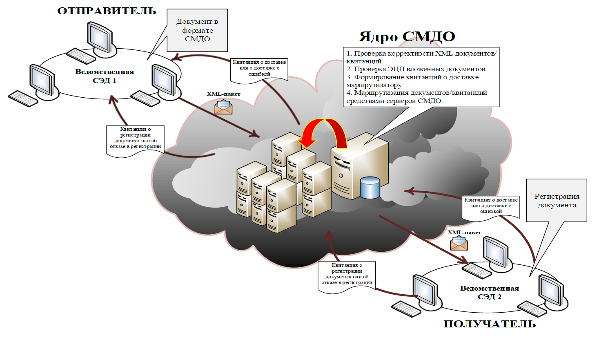
Electronic Document Management in the Republic of Belarus
SENDER
Document in SMDO format
SMDO Nucleus
1. Verification of XML-documents/acknowledgements.
2. EDS verification in attached documents.
3. Generating delivery acknowledgements for the router.
4. Routing documents/acknowledgements by means of SMDO servers.
Agency
EDWS 1
Acknowledgement of delivery or erroneous delivery
XMLpackage
Acknowledgment of registration or rejection
Document registration
Acknowledgement of delivery or erroneous delivery
XMLpackage
More than 15,000 SMDO (inter-agency document management system) subscribers in Belarus
More than 6,500 DoXlogic-Fly users
Acknowledgment of registration or rejection
Agency
EDWS 2
RECEIVER

Slide 3
DoXlogic-Fly Document Management System
DoXLogic-Fly today is not only a system that manages the electronic document flow at an enterprise, but also the most powerful multi-user tool for managing a whole suite of business processes, including :
Office workflow management
Requests from citizens and organizations
Administrative procedures, laws and regulations
Agency archive
Conference management, conference room management
Mobile Manager’s Office
Unique contour solution
Interaction with other information systems
Notes:
В рамках создания электронного правительства в Республике Беларусь ключевым принципом является применение обмена электронными документами, как при работе с юридическими лицами, так и при работе с гражданами.
Электронный документооборот во всем мире развивается ускоренными темпами, и сегодня можно с уверенностью сказать, что в скором времени переход всех предприятий Республики Беларусь на электронный документооборот неизбежен
Внедрение технологий электронного документооборота во многом обосновано:
Повышением эффективности работы;
Экономией ресурсов компаний (что позволит направлять их в более продуктивное русло);
Таким образом, переход от передачи документов обычным способом к электронному документообороту — процесс нужный, важный и необратимый

Slide 4
DoXlogic-Fly Document Management System
Web-interface
E-signature at all stages of document processing
Scale-up capacity: thousands of users may operate within the single system
Access to business functions
Role-based access
Access to sites
Employee replacement mechanism
Secured work
with documents
and assignments.
Increasing number
of users
Access Control
Contour Solution
Logging/
audit
Automating cross-cutting processes for several legal entities. Delineation of the workspace. Document exchange both through SMDO and within the contour
Data entering and updating
Execution of business operations
Report generation
Notes:
Тоже быстро

Slide 5
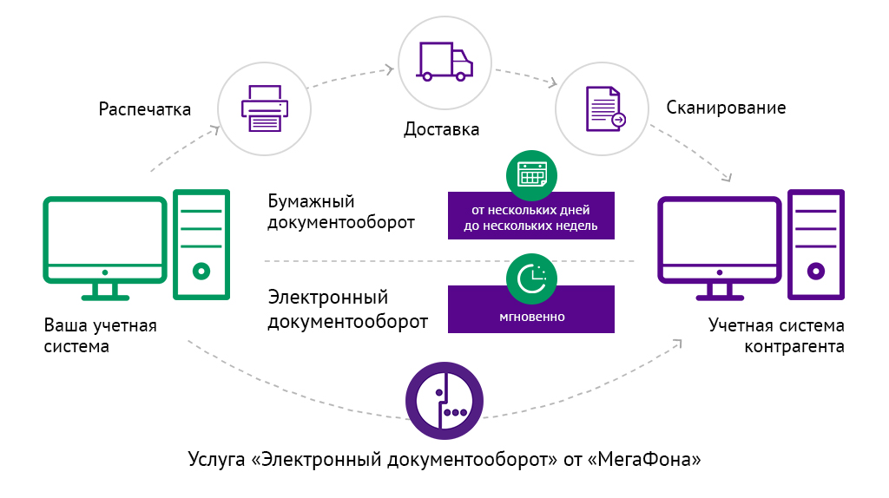
Workflow Document Exchange Platform
Print out
Scanning
Delivery
Sending legally binding e-document in hard copy
Sending legally binding e-document electronically
Counterparty 1
Counterparty 2
workflow
Workflow Document Exchange Platform
with EDS
Notes:
Сказать для чего она, ее назначение

Slide 6
Е-Storage
PREREQUISITES for the CREATION of E-Storage
01
02
03
04
Ensuring single entry of data into the IS
Need to use one file and document version for IS
Growing number of ISs using same files and documents
Need to reduce total number of files stored within IS
Notes:
Сказать для чего она, ее назначение

Slide 7
Data Storage and Analysis System. Е-Storage
“As Is”
“To Be”
Govt Procurement IS
Budget execution
Budget planning
Govt Procurement IS
Budget execution
Budget planning
BYN
BYN
BYN
BYN
Documents, justifications
Workflow Cloud Service
Accounting systems
EDWS
E-Storage
(exchanged files and documents)
BYN
Workflow Cloud Service
EDWS
BYN
Accounting systems
Notes:
Сказать для чего она, ее назначение

Slide 8
IS – E-Storage Interaction Principles
IS interacting with E-Storage
Exchanged Information
E-Storage
Storing document files with reference to document RCC
Storing ED with reference to RCC
Storing RCC/document file metadata
Provision of a unique ID for RCC, file or ED
Storing document RCC change records
API for obtaining document RCC, ED, files, ED, files , EDS, metadata, and control total
Info on ED + files and EDS
ED, signed data, EDS
Transfer of document info, files and related EDS
Transfer of ED, signed data file and EDS
Receipt of files, ED using ID
ID cards or links to documents or files (ID)
Notes:
Сказать для чего она, ее назначение

Slide 9
Advantages of E-Storage
Dedicated solution for information systems to store files and documents and ensure prompt access.
Ensuring legal relevance for long-term storage
01
04
01
04
Possibility to search files and documents stored by different information systems
02
Heavy-duty, scalable solution
05
02
05
Providing an open API to connect information systems
Using object storage for reliable file storage and storage system scaling
06
03
03
06
Notes:
Сказать для чего она, ее назначение

Slide 10
Thank you for your attention!
RUP IVC Minfin
https://ivcmf.by
sed@ivcmf.by
Notes:
Очень быстро

