Slide 1

Update on Progress
PEMPAL Budget Community of Practice (BCOP)
Budget Literacy and Transparency Working Group
Anna Belenchuk, MoF Russian Federation
Chair of BCOP and Leader of Working Group
June 23 2017

Slide 3
Conclusions from Preliminary 2017 Results
All countries perform well in making the ‘Executive Budget Proposal’ and the ‘Enacted Budget’ publically available (18 countries)
Most countries (17 countries) make publically available their ’In-Year Report’, ‘Year-end Report’, and ‘Audit Report’. Several countries produce the document but either do not make it available to the public, or publish it late (BiH In-Year Reports; Serbia Year-end Reports; and Tajikistan Audit Reports).
‘Pre-budget Statement’ - several countries are not producing them, or publishing late, or not making them available to the public (in 2015 and 2017)
Worst category is Mid-Year Report with only 6 countries producing them and making the available to the public. Several countries produce them but do not publish them – this could be an easy reform – by putting these documents in a timely way on the MoF website (Moldova, Hungary (IACOP) and Czech Republic (IACOP).

Slide 4
Conclusions from Preliminary 2017 Results
Bulgaria and Georgia are our two countries that made all budget documents available to the public.
Russia, Romania and Turkey also not far behind with all the documents but the Pre-budget statement made available and Moldova similarly except for the Mid-Year Report. This one missing document for each of these countries was in fact produced – but either published late, or not published online, as assessed by IBP.
Citizens Budgets have improved significantly since 2015. Congratulations to Albania, Kazakhstan, Moldova, Romania, Turkey, and Ukraine!
Lets see how the results have changed from 2015 to 2017…..

Slide 5
Notes:
The worst category of accessibly budget documents still remains citizens budget in the region, which only 8 countries were reported to have in 2015. We hope that our work on Citizens Budgets will improve this result in the next survey and preliminary 2017 results indicate that it has.

Slide 6
Knowledge Product on Citizens Budgets – Final Draft Completed with international advice
Written comments were provided by several international organizations: OECD, International Budget Partnership, Global Initiative for Fiscal Transparency (GIFT) and the Institute of Public Finance (Croatia). Please see your background materials for the latest copy of the document, with their comments incorporated.
On April 18, I also presented our findings on an online CEF webinar.
Our work has been well received. International organizations have commended our efforts and some of their feedback has been included in a Foreword at the start of the Knowledge Product document.
Additional country cases will also be added to the attachment.
If you have any final comments on this revised document, please provide them by the end of June, as we will finalize and publish the document on the PEMPAL website in July.
The challenge for us now is to build on this work, and use the Citizens Budget as a tool to facilitate increased public participation in the budget process.

Slide 7

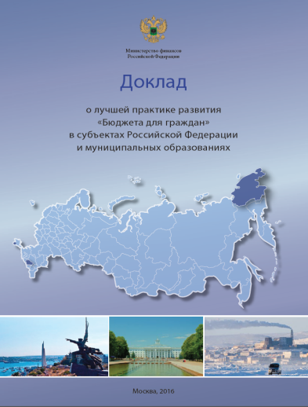
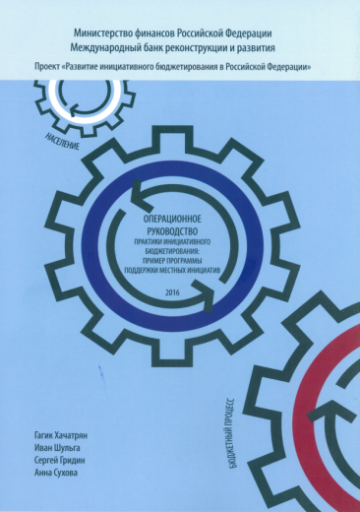
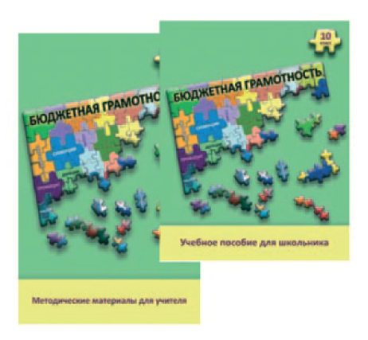
“Citizens Budget” in Russia is a joint project of the
Open government and the Ministry of Finance of Russia
Annual publication of the brochure "Budget for Citizens" to the draft and the law on the federal budget (http://minfin.ru/common/upload/library/2016/12/main/1288_BDG_2017.pdf)
Methodical support of “Citizens Budgets" at the regional and municipal level (https://www.pempal.org/events/plenary-meeting-budget-community-and-meeting-budget-literacy-and-transparency-working-group)
Annual preparation and publication of the Report on best practices of regional and municipal Citizen Budgets (http://minfin.ru/common/upload/library/2016/10/main/DBDG16_11-09-2016_with_cover_omsk.pdf)
Development of participatory budgeting practices for municipal and regional budgets (http://budget4me.ru/)
Competition of ideas among the population on the presentation of budget data in an understandable form (http://www.fa.ru/faculty/finec/news/Pages/2017-03-14-konkurs-proektov-po-predstavleniyu-byudzheta-dlya-grazhdan-2017-goda.aspx)
Implementation of measures to increase the budget literacy of population (http://mamso.ru/bgs/)

Slide 8
Future Activities of the Working Group
 | Action Plan 2017-18 | Timeframe
Current FY
1. | Budget Literacy Conference + Back-to-Back Meeting of Working Group | June, Moscow
Next FY
1. | VC learning event to progress new knowledge product on public participation in the budget process and examination of 2018 Open Budget Survey results (if available) | September/October 2017
2. | Visit to a country to examine good practices in public participation approaches. | April 2018
3. | Possible joint projects with IBP and GIFT currently under discussion. | To Be Discussed
Focus of the Working Group has been on budget literacy and citizens budgets. Today we want to get your expectations on a new Knowledge Product on public participation in the budget process (i.e. participatory budget practices). We will meet again in September/October to discuss available research in these reforms which will be collated for us by Deanna. GIFT and IBP have also agreed to provide input and hopefully OECD will too (-:

Slide 9
Next Steps in Reforms
  Warning from GIFT and IBP: public participation needs longer to be built and to become sustainable (compared with the publication of budget documents).
  Requires working on two levels: Government; and with civil society/public i.e. Introduce mechanisms for the public to participate, but also initiatives to increase their demand for budget information (especially in countries where civil society is not vibrant or active).
  As a start, citizens can be consulted on what they would like to see in the Citizens Budget, and more generally how they would like to engage in the budget process.
    To assist us, IBP will identify country case studies (from OBS 2015 and 2017) where countries have just recently moved from producing Citizens Budgets to using these as a tool for increased participation, including those who do not have a strong civil society sector (given some of our countries are in this position).
    A clear description of what its Open Budget Survey (OBS) is measuring on public participation to identify what is good practice will also be provided.

Slide 10
Next Steps in Reforms
  GIFT will identify available research on the benefits of public participation, so this can form part of our knowledge product.
  A first draft will be prepared by Deanna for the September/October videoconference meeting (VC) which will include available research, country case studies, and OBS requirements. Anything else? (Tell us in the roundtable later this morning)
  Once this first draft of the document is completed, we then need to discuss what is feasible in our countries and how we can input to the document, to make it meaningful and useful to progress our reforms. That will be our task to share our ideas at our September/October VC, when we next meet.
  The draft document will be circulated to you, a few weeks before the VC to give you time to prepare your input.
  In this VC, we also need to start planning for a study visit in April 2018 (i.e choose options from the country cases included in the document, that have good practices in public participation, that you would like to examine in more depth). Thank you for your attention!

