Slide 1


2019 Annual Plenary Meeting of the PEMPAL Budget Community of Practice
Republic of Croatia, Ministry of Finance
Uzbekistan, Tashkent, 18 – 21 March 2019

Slide 2


Evaluating and Prioritizing Capital Expenditures
Republic of Croatia, Ministry of Finance
Uzbekistan, Tashkent, 18 – 21 March 2019

Slide 3
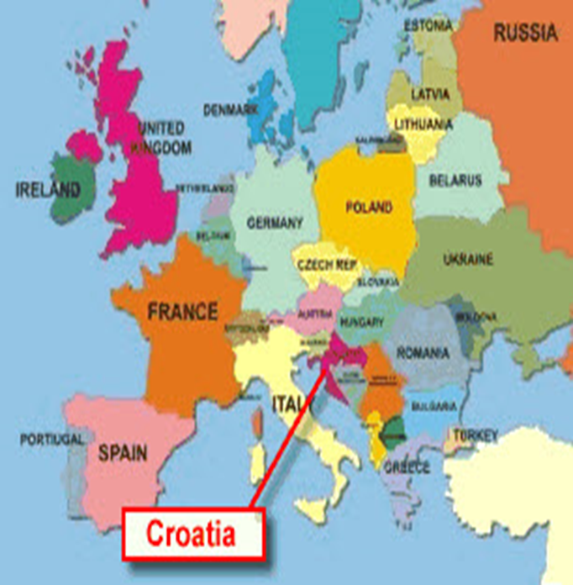
Basic information on the Republic of Croatia
Population: around 4.3 million (2011)
Capital, population: Zagreb; 790,017
Area: 56,542 km²
Language: Croatian
Average life expectancy: around 77.9
GDP per capita: current USD 13,384 (2017)
Literacy: 99%
EU Member State: as of 1 July 2013

Slide 4
The Structure of Public Administration in Croatia
The Republic of Croatia is a unitary state with two types of lower (local) government levels:
  local and regional self-government units:
    regional self-government units (20 counties)
      The City of Zagreb (special status - county status and city status)
    local self-government units (127 towns and 428 municipalities)

Slide 5
Investments or capital expenditures
The Budget Act (Official Gazette, 87/2008, 136/2012 and 15/2015) stipulates the following:
“Investments or capital expenditure are investments made to increase and preserve asset value, investments in land, buildings, equipment and other long-term tangible and non-tangible assets, including investments in education and training, new technology development, improvements to quality of life and other investments generating benefits.” (Article 3, item 15)
“Funds from the sale and exchange of non-financial assets of the State or local and regional governments and from insurance-based compensation shall be used for the capital expenditure of the State or local and regional governments, for investment in shares and capital interests, and for repaying the principal on long-term borrowing.” (Article 70, paragraph 1)

Slide 6
Investments or capital expenditures
“The capital expenditure referred to in paragraph 1 of this Article shall be expenditure for the procurement of non-financial assets, expenditure for the maintenance of non-financial assets, and capital grants granted to companies in which the State or local and regional governments have a decisive influence on management for the procurement of non-financial assets and additional investment in non-financial assets.” (Article 70, paragraph 2)
“The capital revenues referred to in paragraph 1 of this Article shall be revenues from the sale of non-financial assets, receipts from the sales of securities and receipts from the sale of shares and capital interests.” (Article 89, paragraph 3)

Slide 7
The types, contents and usage of budget classification
...have been stipulated by the Ordinance on Budget Classification (OG 26/2010 and 120/2013)
Budget classification types are the following: organizational, program, functional, economic, and location, as well as source of funds.
For example:
  Organizational classification contains linked and inter-aligned budget and budget user sections. It is established by defining the organizational levels, sub-levels and budget users.
  Program classification is done by defining programs, activities and projects, and by defining main programs within the government budget.
  The main program is composed of programs designed to achieve the goals of the Government Program Strategy for a three-year period.

Slide 8
The types, contents and implementation of budget classification
  The program is a set of independent, closely connected activities and projects that share common goals.
  A program consists of one or more activities and/or projects, and an activity or project can belong to only one program.
  An activity is a part of a program which has no set time frame and its planned expenditure and expenses for goal achievement have been determined by the program.
  A project is a part of a program with a set time frame, where expenses and expenditure for goal achievement have been determined by the program.
  Projects are planned as one-off and can be current or capital.
  Current project implementation does not increase assets, while capital projects entail investments in assets.

Slide 9
Economic classification of capital expenditures...
... has been stipulated by the Ordinance on Budget Accounting and Chart of Accounts (OG, no. 124/2014, 115/2015, 87/2016 and 3/2018)
  421 Construction facilities (which includes roads, railways, other traffic facilities, gas pipelines, the water supply system, etc.),
  451 Additional investments in construction facilities,
  382 Capital donations,
  386 Capital assistance/grants (for credit and other financial institutions, companies, cooperatives, farmers and trades)

Slide 10
2020 Regional Development Strategy for the Republic of Croatia
Based on the Regional Development Act (OG no. 147/2014, 123/2017 and 118/2018), the Croatian Parliament has adopted the 2020 Regional Development Strategy for the Republic of Croatia. (OG no. 75/2017).
The Strategy includes a developed Action Plan together with specific activities, programs and projects, a financial plan and defined indicators of results.
The Action Plan is a Strategy implementation document that encompasses a further elaboration of the defined Strategy measures for specific activities, programs and projects, which will be implemented during a specific three-year period, in accordance with the budget.
The Action Plan links the Strategy with all expected implementation financing sources.
  The table Source of Funds is annexed to the Action Plan
  (https://razvoj.gov.hr/o-ministarstvu/djelokrug-1939/regionalni-razvoj/razvojne-strategije/strategija-regionalnoga-razvoja-republike-hrvatske-za-razdoblje-do-kraja-2020-godine/3244).

Slide 11
2020 Regional Development Strategy for the Republic of Croatia
The 2020 Regional Development Strategy for the Republic of Croatia includes:
  three strategic goals
    each goal has three priorities,
      priorities are achieved by implementing several measures (the number of measures varies from two to five measures per priority).
  The three strategic goals are:
  1. Increasing the quality of life by encouraging sustainable territorialdevelopment,
  2. Increasing the competitiveness of regional economy and employment
  3. Systematic management of regional development.

Slide 12
Strategic goal 1 Increasing the quality of life by encouraging sustainable territorial development,
STRATEGIC GOAL 1 | INCREASING THE QUALITY OF LIFE BY ENCOURAGING SUSTAINABLE TERRITORIAL DEVELOPMENT
Horizontal questions | Demographic impact (explanation in the RDS with references to various measures which have a demographic impact for all four strategic goals)
PRIORITY 1.1: | Increasing knowledge and capabilities for a better quality of life
Measure 1.1.1. | Improving regional and local development capacities in education, upbringing and sports
Measure 1.1.2. | Improving health care and social welfare at regional and local levels
Measure 1.1.3. | Supporting cultural identity affirmation and civil society development
PRIORITY 1.2: | Ensuring and improving basic local and regional infrastructure
Measure 1.2.1. | Developing locally significant public infrastructure
Measure 1.2.2. | Developing regionally significant public infrastructure
Measure 1.2.3. | Sustainable use and valuation of cultural and natural heritage
Measure 1.2.4. | Supporting environmental protection and energy efficiency at local and regional levels
PRIORITY 1.3: | Supporting aided areas and areas with special developmental features
Measure 1.3.1. | Supporting aided areas
Measure 1.3.2. | Supporting sustainable island development
Measure 1.3.3. | Supporting the development of mountainous areas
Measure 1.3.4. | Supporting the quality of life and urban development
Measure 1.3.5. | Creating favourable living conditions in border areas
An improved Development Index is a functional tool for implementing activities, programs and projects and for their monitoring within the context of goal achievement for the RDS of Croatia; especially for monitoring the strategic goal “Increasing the quality of life by encouraging sustainable territorial development”

Slide 13
Strategic goal 2 Increasing the competitiveness of regional economy and employment
STRATEGIC GOAL 2 | INCREASING THE COMPETITIVENESS OF REGIONAL ECONOMY AND EMPLOYMENT
Horizontal questions | Demographic impact (explanation in the RDS with references to various measures which have a demographic impact for all four strategic goals)
PRIORITY 2.1: | Improving economic infrastructure at regional and local levels
Measure 2.1.1. | Defining and applying clear criteria for establishing and financing entrepreneurial zones
Measure 2.1.2. | Activating state assets at local and regional levels (link 1.2.1., 3.1.4.)
Measure 2.1.3. | Developing local capacities for programs of historic city centre maintenance and objects of cultural heritage (link 1.2.1., 1.2.3., 3.3.1.)
PRIORITY 2.2: | Creating a supportive business environment at regional and local levels
Measure 2.2.1. | Strengthening local and regional supporting institutions for entrepreneurs
Measure 2.2.2. | Activating local development by supporting new economic entities and innovative economic concepts
Measure 2.2.3. | Developing a collaborative economy by supporting associations of economic entities at regional and local levels
Measure 2.2.4. | Better use of development potentials of protected natural areas, focusing on national parks and nature parks (link 1.2.3.)
Measure 2.2.5. | Increasing regional attraction with territorial branding
PRIORITY 2.3: | Strengthening human resources and education aligned with economic needs at regional and local levels
Measure 2.3.1. | Increasing workforce skills through training at regional and local levels
Measure 2.3.2. | Encouraging migrations to areas that lack a workforce
An improved Regional Development Index is a functional tool for implementing activities, programs and projects and for their monitoring within the context of goal achievement for the RDS of Croatia; especially the strategic goal “Increasing the competitiveness of regional economy and employment”

Slide 14
Strategic goal 3 Systematic management of regional development.
STRATEGIC GOAL 3 | SYSTEMATIC MANAGEMENT OF REGIONAL DEVELOPMENT
Horizontal questions | Demographic impact (explanation in the RDS with references to various measures which have a demographic impact for all four strategic goals)
PRIORITY 3.1: | Effective management (in accordance with the principle of subsidiarity)
Measure 3.1.1. | Improving the cycle of public policy management at all management levels
Measure 3.1.2. | Improving regional development project management
Measure 3.1.3. | Improving the quality of public services through cooperation in functional and fiscal decentralization processes
Measure 3.1.4. | Increasing the effectiveness of asset management at all levels of public governance
PRIORITY 3.2: | Efficient inter-sectoral cooperation (in accordance with the participation principle)
Measure 3.2.1. | Aligning the implementation of public policies between line ministries at national and regional levels
Measure 3.2.2. | Improving the vertical and horizontal coordination of stakeholders in regional development management
PRIORITY 3.3: | Strengthening financial and administrative capabilities for local and regional development
Measure 3.3.1. | Strengthening the stakeholder position in regional development management and development project implementation
Measure 3.3.2. | System improvement and increasing the effectiveness of state aid on all levels of governance
Developing the index for measuring quality of regional and local development management, the European Commission’s Quality of Government Index (QoG), Charron et al., 2012 “Regional Governance Matters: A Study on Regional Variation in Quality of Government within the EU“. This index can be used to measure progress in achieving strategic goals.

Slide 15
Measure 1.3.4. Supporting the quality of life and urban development
STRATEGIC GOAL 1 | INCREASING THE QUALITY OF LIFE BY ENCOURAGING SUSTAINABLE TERRITORIAL DEVELOPMENT
PRIORITY 1.3: | SUPPORTING AIDED AREAS AND AREAS WITH SPECIAL DEVELOPMENTAL FEATURES
Measure title 1.3.4. | Supporting the quality of life and urban development
Measure description | Implementing activities aimed at resolving issues of unemployment, social exclusion, poverty, large consumption of energy, pollution, traffic congestion, poor connections with the surrounding areas etc. in urban areas Supporting activities which react to demographic changes in cities Supporting integral revitalisation of historic city centres Supporting the development of green urban infrastructure Supporting solutions used to establish sustainable urban mobility systems …
Spatial scope | Cities, local self-government units (LSU included in urban areas and agglomerations) (if necessary, list the names of areas/groups of LRSGU/statistical or functional regions)
Authority level and title of the measure (co)holder | National: Ministry of Regional Development and EU Funds (MRDEF) Regional/county: __________________________________________ Local: Cities, local self-government units (included in urban areas and agglomerations)
Financial framework (total) | HRK (Croatian kuna) ________________
Output indicator | Number of implemented development projects in urban areas (name of indicators for monitoring measure achievements, baselines and target values)
Potential environmental impact | X Positive __ Neutral __Negative Recommendation:

Slide 16
Spending units required to implement strategic goals, priorities and measures
Regional development policy is based on partnership and cooperation between the public, private and civil sectors.
The implementation of strategic goals, priorities and measures depends on the cooperation between:
  state administration bodies,
  local and regional self-government units,
  economic entities,
  the scientific community,
  social partners, and
  civil society organisations,
    all for the purpose of meeting the needs of citizens in their area.

Slide 17
Other acts and subordinate legislation related to investments and capital expenditures
Act on the Strategic Planning and Development Management System in the Republic of Croatia (OG, no. 123/2017).
Act on the Strategic Investment Projects of the Republic of Croatia (OG, no. 29/2018 and 114/2018).
  The Government of the Republic of Croatia has, at the proposal of the Commission for Evaluating and Determining Strategic Project Proposals, adopted the Decision on naming the “Dubrovnik Water-Utility Infrastructure Development” project a strategic investment project of the Republic of Croatia (OG no. 13/2019).
    The project can be funded through EU funds and programs.
  Participants in the project realization:
    Ministry of environmental protection and energy,
    Ministry of construction and spatial planning,
    the Public Administration Office of the Dubrovnik-Neretva Country and
    administration offices in the City of Dubrovnik.

Slide 18
The “Development of the Dubrovnik Water-Utility Infrastructure” project
34 ENVIRONMENTAL PROTECTION AND MAINTENANCE (Main program)
3408 DEVELOPMENT OF THE WATER SUPPLY AND DRAINAGE SYSTEM (Program)
Code | Title | Execution 2017 | Plan 2018 | Budget for 2019 | Budget forecasts for 2020 | Budget forecasts for 2021
077 | MINISTRY OF ENVIRONMENTAL PROTECTION AND ENERGY | 2,110,554,200 | 3,302,133,639 | 3,666,064,318 | 4,140,673,443 | 4,082,391,564
07705 | Ministry of environmental protection and energy | 1,084,178,158 | 1,642,147,461 | 1,925,809,077 | 2,486,459,301 | 2,525,123,659
K784038 | OP COMPETITION AND COHERENCE 2014 – 2020 PRIORITIES 5 AND 6 | 415,914,106 | 953,400,088 | 985,723,687 | 1,585,795,967 | 1,756,937,850
11 | General revenue and receipts |  | 2,000,000
36 | International and general budget aid |  | 2,000,000
363 | General budget aid |  | 2,000,000
12 | Aid funds | 40,085,460 | 75,902,852 | 115,058,308 | 185,962,967 | 214,348,217
31 | Personnel expenditure | 607,886 | 646,500 | 772,350 | 787,500 | 803,050
311 | Wages (gross) | 509,235 | 538,500 | 648,100
312 | Other personnel expenditures | 11,063 | 12,750 | 12,750
313 | Wage contributions | 87,588 | 95,250 | 111,500
32 | Material expenditures | 114,747 | 319,500 | 296,250 | 275,250 | 216,750
… | …

Slide 19
2030 National Development Strategy for the Republic of Croatia
During the implementation of the 2030 National Development Strategy for the Republic of Croatia it is important to reach a consensus of all political parties and citizens in the country.
Citizens have so far responded to and sent over 1500 questionnaires and submitted over 150 ideas for the vision of Croatia 2030 online at the website of the Ministry of Regional Development and EU funds (https://razvoj.gov.hr/nacionalna-razvojna-strategija-republike-hrvatske-do-2030-godine/3832).
The 2030 National Development Strategy for the Republic of Croatia defines the development direction and strategic goals, which are elaborated in short-term and mid-term national plans and local and regional self-government development plans.

Slide 20

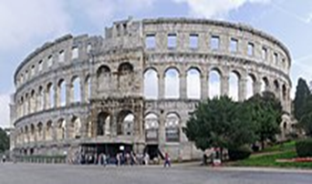
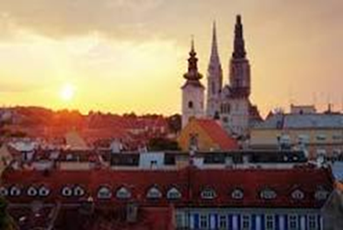
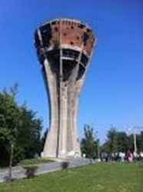
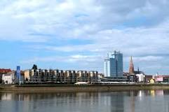

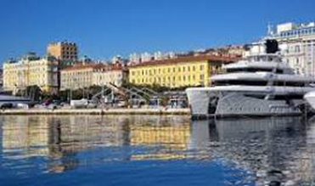
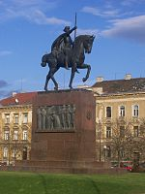
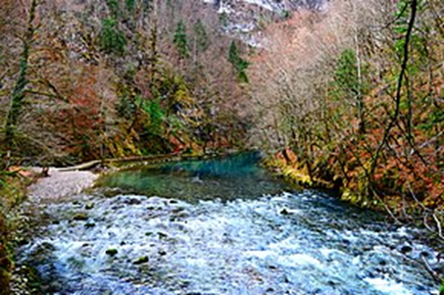
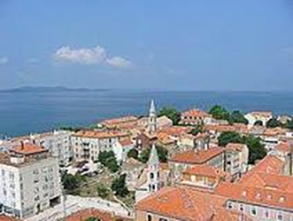
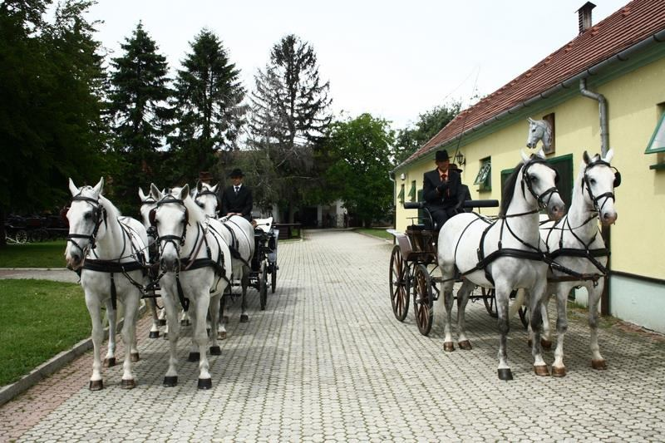
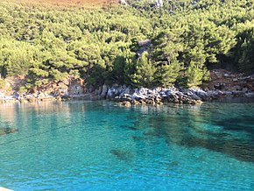
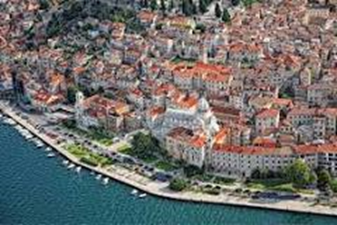
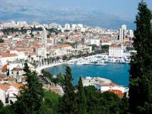
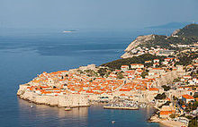

Thank you!
Any questions?

