Slide 1
«LAW No 5018 and BUDGET »
Ministry of Finance
General Directorate of Budget and Fiscal Control
Turgay ÇETİN
Financial Specialist
March, 2016

Slide 2
PRESENTATION PLAN
Law No 5018 and Budgeting Approach
Basic Cycle of Public Financial Management
Classification of Public Financial Management Sector
Detailed Expenditure/Financing Program

Slide 3
5018 and Budgeting Approach

Slide 4

LEGAL INFRASTRUCTURE OF THE BUDGET
Constitution of 1982
Law No 5018
Central Government Budget Law
Other Laws
Secondary Legislation

Slide 5
LEGAL INFRASTRUCTURE OF THE BUDGET
Constitution Art. 161;
The beginning of the fiscal year and preparation, implementation and control of the central government budget are regulated by Law.
Law No 5018
Scope
Preparation Principles
Legal Principles
Fiscal Year

Slide 6

BASIC CYCLE OF PUBLIC FINANCIAL MANAGEMENT PROCESS
DEVELOPMENT PLAN
MEDIUM TERM PROGRAM
MEDIUM TERM FISCAL PLAN
(2014-2018)
5-YEAR POLICY AND PRIORITIES
(2016-2018)
MACRO POLICIES
BASIC ECONOMIC FIGURES
(2016-2018)
THREE-YEAR TOTAL INCOME AND EXPENDITURE ESTIMATES
TARGETED DEFICIT AND BORROWING SITUATION
APPROPRIATION CEILING
THREE-YEAR BUDGET

Slide 7
CENTRAL FISCAL ACTORS
MINISTRY OF FINANCE
MINISTRY OF DEVELOPMENT
UNDERSECRETARIAT OF TREASURY
MTFP
PREPARATION AND IMPLEMENTATION OF THE BUDGET
PERFORMANCE BUDGETING
DP-MTP
INVESTMENT PROGRAM
STRATEGIC PLANNING
CASH MANAGEMENT
BORROWING

Slide 8
Classification of Public Financial Management Sector

Slide 9




BUDGET TYPES
NATIONAL ECONOMY
GENERAL GOVERNMENT?

Slide 10
BUDGET TYPES
NATIONAL ECONOMY
BUSINESS WORLD
PUBLIC
HOUSEHOLD
GENERAL GOVERNMENT
OTHER
CENTRAL GOVERNMENT
SOCIAL SECURITY INSTITUTIONS
LOCAL ADMINISTRATIONS

Slide 11
BUDGET TYPES
GENERAL GOVERNMENT
CENTRAL GOVERNMENT
(Tables No I,II,III)
SOCIAL SECURITY INSTITUTIONS
(Table No IV)
LOCAL ADMINISTRATIONS
(Municipalities , Provincial Private Administrations…)
General Budget
(Table No I)
Special Budget
(Table No II)
Regulatory and Supervisory Agencies
(Table No III)

Slide 12
Budget Preparation Process

Slide 13
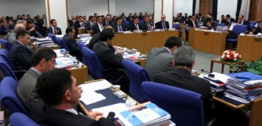


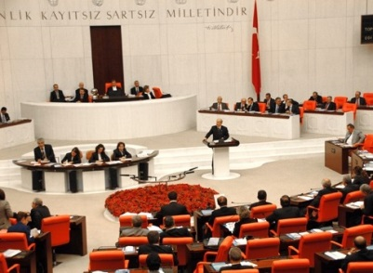





PBC
MTP
17 October
September
First Week
17 October – 12 December
CGB Proposal and Performance Programs
MTFP
September 15
GA
October
First Two Weeks
End of September
October
First Week
Negotiations
Budget Call Guide
Proposal
Investment Notice
Guide
HPC

Slide 14
Detailed Expenditure/Financing Programs

Slide 15
DETAILED EXPENDITURE/FİNANCING
PROGRAM
Expenditure
Income
Financing
General, Special and Regulatory and Supervisory Agency
Budgets
GENEL, ÖZEL BÜTÇELİ İDARELER VE DDK’LAR
E-Bütçe

Slide 16
DFP/DEP CONSTITUTION PRINCIPLES
ECONOMIC PROGRAM
INCOME AND EXPENSE OUTTURN
DFP-DEP- PERCENTAGE
TRANSFERABLE CASH POSSIBILITIES
SEASONAL CHARACTERISTICS
CHARACTERISTICS OF THE EXPENDITURES ETC.

Slide 17
thank you for your attention…

Slide 18
ABBREVIATIONS
Law No 5018 : Public Financial Management and Control Law
MTP : Medium Term Program
MTFP : Medium Term Financial Plan
DP : Development Plan
HPC : High Planning Council
GA : General Assembly
PBC : Planning and Budget Commission
CGB : Central Government Budget
DFP : Detailed Financing Program
DEP : Detailed Expenditure Program

