Slide 1
Budget Transparency A New, Global Toolkit
Ronnie Downes
Deputy Head – Budgeting and Public Expenditures, OECD
Moscow, June 2017

Slide 2
Overview
Budget Transparency – The OECD’s approach
Why a toolkit?
The content and the structure of the toolkit
Next steps for Budget Transparency

Slide 3
Transparency – a simple concept…

Slide 4
Transparency – a complex concept
Of what?
Revenues
Expenditures
Processes
Plans
Performance
Risks
To whom?
Citizens
Peers
Int’l bodies
Markets
For what?
Participation
Trust
Confidence
Better decisions
Impacts
Notes:
[translation notes: “of what” means “what are we being transaprenct about? What is the subject matter”
“to whom” i.e. to whom are we being transparent”
“for what” i.e. “for what purpose, why?”
“int’l bodies” means international bodies]

Slide 5
OECD’s starting point
“Openness about policy intentions, formulation and implementation”
Budget reports (7 in total)
Specific disclosures
Non-financial assets
Contingent liabilities
Integrity & accountability
Audit
Parliamentary scrutiny
Public availability on internet
Promote public understanding

Slide 6
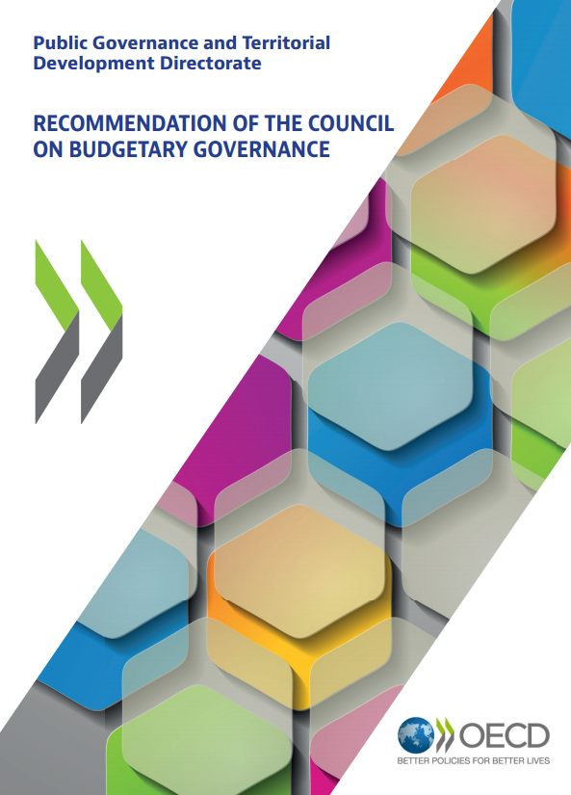
OECD’s Budgetary Governance Recommendation
10 budget principles
Transparency and accessibility
Inclusive, participative and realistic debate
Link to Open Data
Link to Fiscal risk
Link to Audit and Control

Slide 7
The G20 Context
Background of G20 Anti-corruption Working Group (ACWG): Implementation Plan 2015-16
“Promoting greater budget transparency and fiscal openness plays an important role in anti-corruption efforts, including by deterring illicit diversions of public money by corrupt officials and promoting good governance”
“Promoting greater budget transparency and fiscal openness has important links to the G20 resilience agenda, including by fostering greater public confidence in the stability and soundness of public finances.”
“develop a G20 practical toolkit on budget transparency”

Slide 8
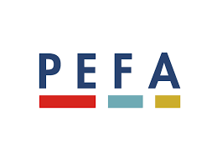
Do we need more rules for budget transparency?
Notes:
[no need for translation except for Slide Title]

Slide 9
3 useful roles for a “toolkit”
Help to self-assess level of budget transparency, and to plan and implement transparency-focused reforms
Reinforce key messages by bringing together the insights of the international community of budget transparency
Provide a gateway to resources that are already available across the international community

Slide 10
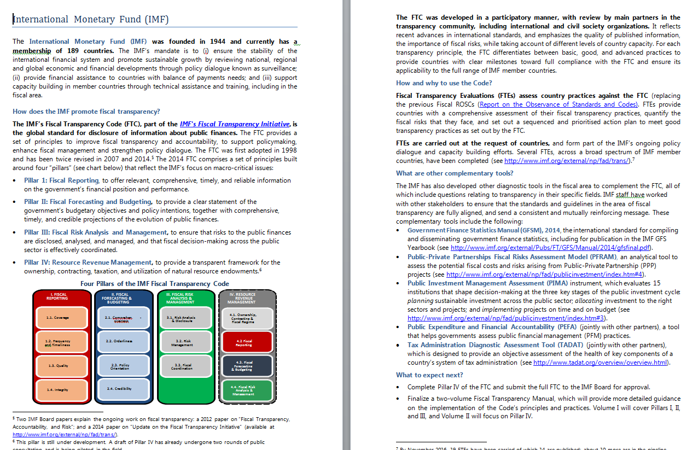
Notes:
[no need for translation – this slide is for “illustrative” purposes, it is not intended to be read]

Slide 11
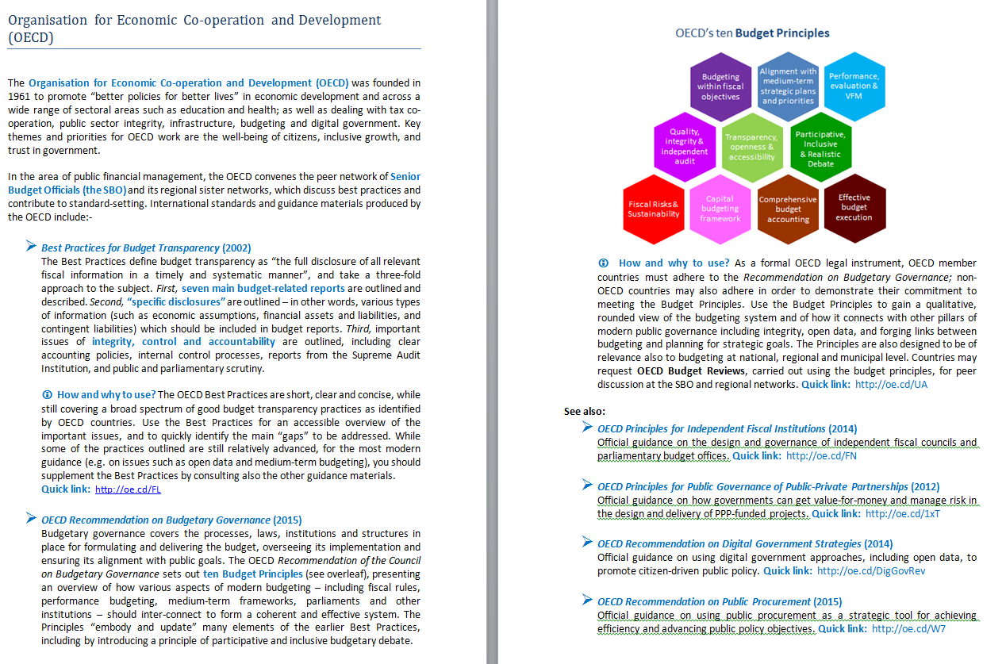
Notes:
[no need for translation – this slide is for “illustrative” purposes, it is not intended to be read]

Slide 12
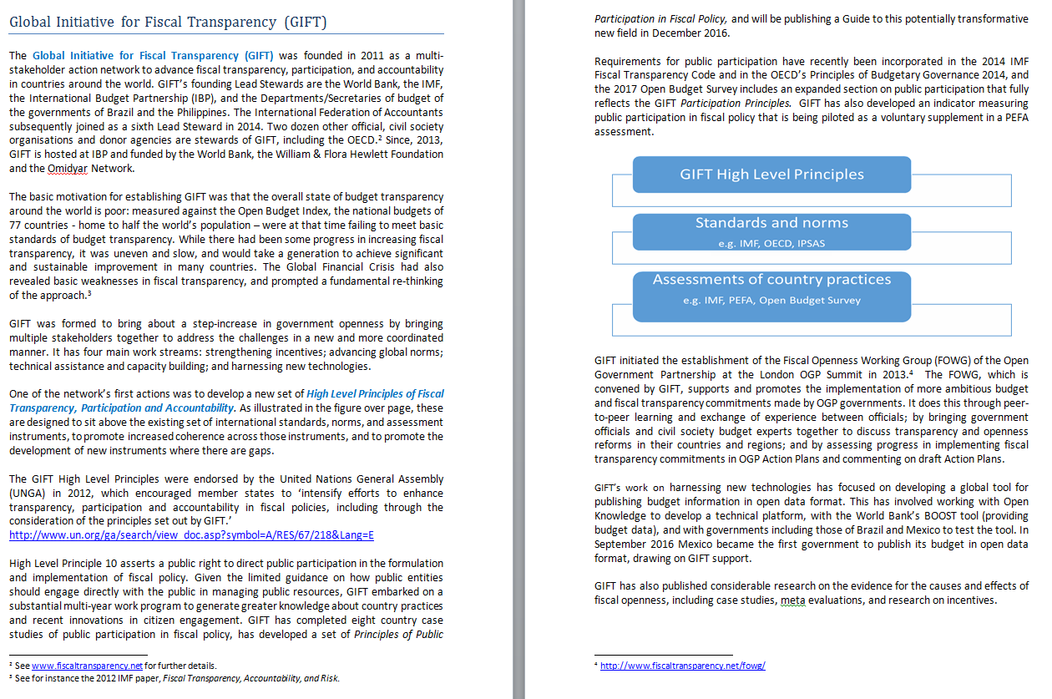
Notes:
[no need for translation – this slide is for “illustrative” purposes, it is not intended to be read]

Slide 13
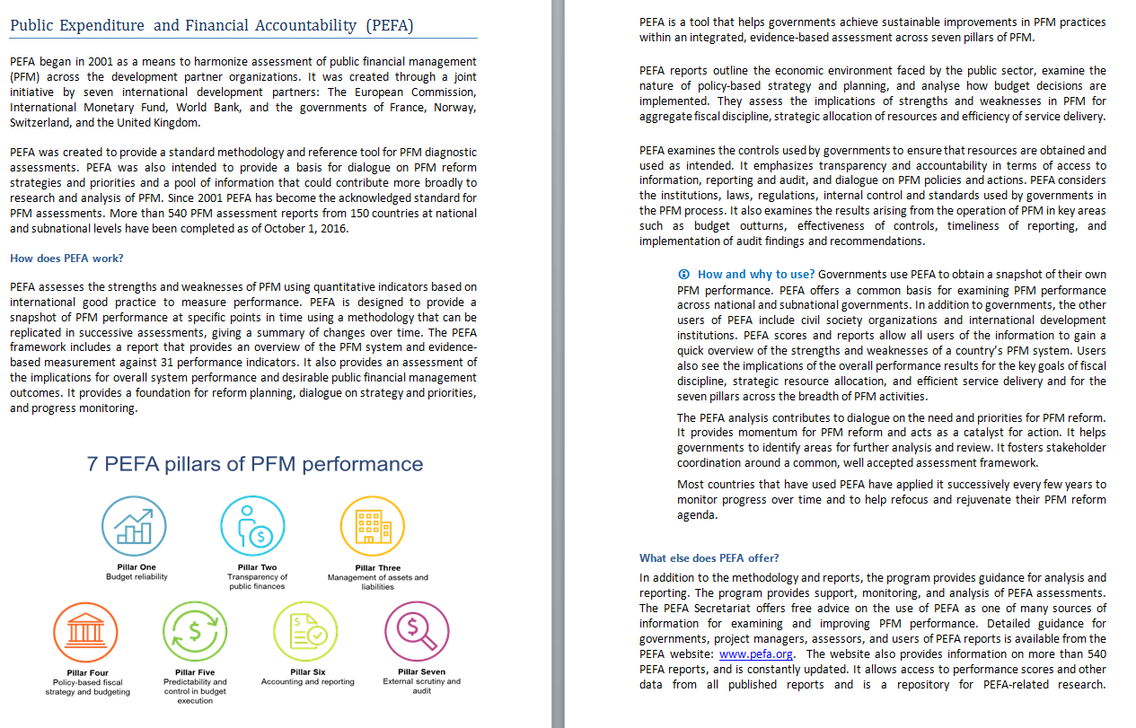
Notes:
[no need for translation – this slide is for “illustrative” purposes, it is not intended to be read]

Slide 14
Structured in five institutional spheres
C
Benefiting from parliamentary engagement and scrutiny
D
Supporting parliamentary capacity
Parliamentary
Involvement
E
Management and internal control of public money
A
Providing useful budget reports
during the annual cycle
F
Supporting the role of the Supreme Audit Institution
B
Including the right financial information in budget reports
Government
Reporting
Independent
Oversight
G
Designing effective Independent Fiscal Institutions
Budget Transparency
Toolkit
H
Making the budget accessible to the public
K
Opening up public contracting and procurement
I
Using open data to support budget transparency
L
Revenues and expenditures in resource endowments
Openness and
Civic Engagement
Interaction with the
Private Sector
M
Infrastructure governance for integrity, VFM and transparency
J
Making the budget more inclusive and participative

Slide 15
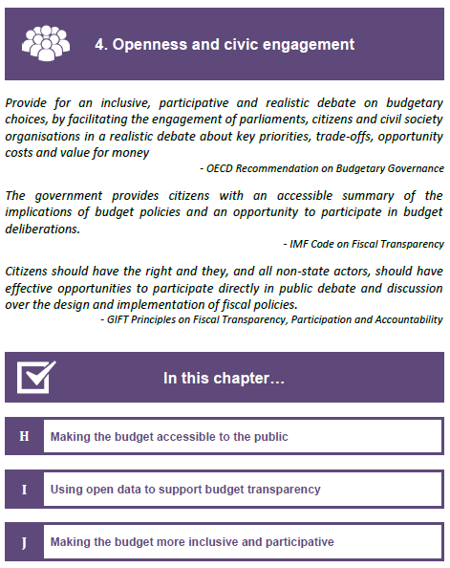
Structure of the Chapters
Colours and icons for easy navigation within the document.
Quotes from publications of leading institutions in the area to highlight the relevance of the topic
Overview of the chapters content
Notes:
[only the green text needs to be translated]

Slide 16
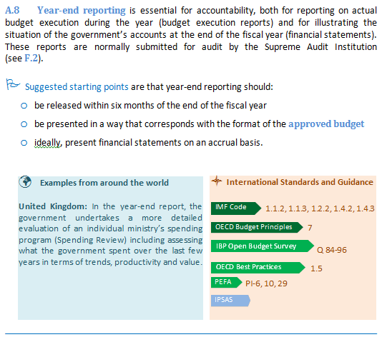
Structure of the Chapters
Topic summary
Suggested Starting Points
Country examples
and
“Signposts” to international standards
Notes:
[only the green text needs to be translated]

Slide 17
Some benefits of this approach?
Over-riding principle: simple and user-friendly
While remaining faithful to underlying standards
Comprehensive coverage of budget transparency
First time all of these diverse aspects have been “signposted”
Toolkit: Roles of diverse institutions, sectors
Purposes: transparency, accountability, anti-corruption
Practical guidance to put transparency into practice
Country examples – links to Code, Principles, PEFA etc

Slide 18
What’s next?
How Project has benefited from much feedback
International organisations
SBO networks
Final document now ready to be published
Will be maintained / updated on collaborative principles
How to use?
Self assessment by countries, institutions
Education, capacity development of practitioners
OECD Open Government tools

Slide 19
Transparency → Accessibility → Participation?
Are budgets yet fully transparent?
Fiscal risks -- State corporations -- Long-term “holes”
Are budgets yet fully accessible?
Bureaucratic -- technical -- open data -- lag times
What are the different models and limits of “participation?”
“THIS IS PARLIAMENT’S ROLE” – so get them more involved
“LISTEN & RESPOND DIRECTLY TO CITIZENS” – Swiss model
“CSOs CAN MEDIATE CITIZENS’ CONCERNS” – Social partnership
“OPEN GOVERNMENT MEANS OPEN DATA” – let citizens and CSOs find their own way – make their own paths
Country-specific solutions versus international norms
Notes:
[translation notes: “mediate” here means “channel, convey, represent” citizens views
CSOs – civil society organisations]

Slide 20
Thank you for your attention!
Contact: ronnie.downes@oecd.org

