Slide 1


GovTech Maturity Index
Trends in Digital Governance
Cem Dener, Lead Governance Specialist & Global Lead for GovTech May 2023

Slide 2

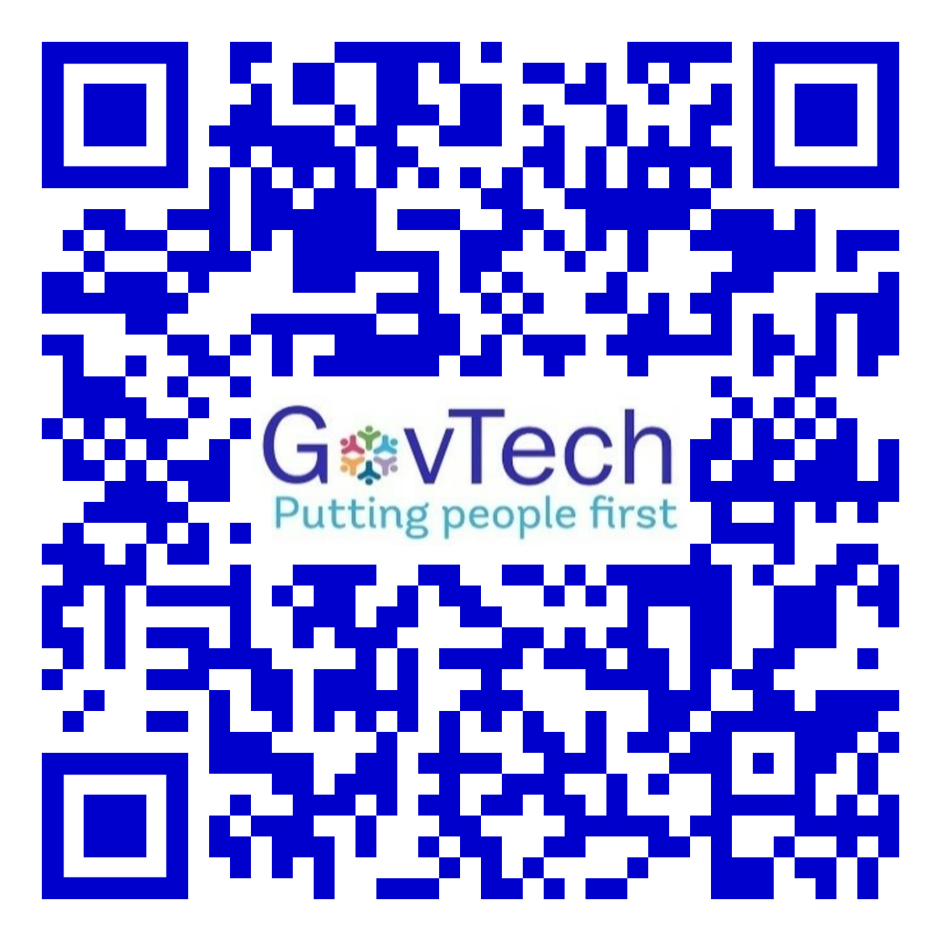
Contents
What is GTMI?
The GTMI Team
How is the 2022 GTMI update different?
International Outlook
Presenting Regional / Country Overviews
GTMI Main Findings & Recommendations
GTMI Data Dashboard & Regional Briefs
GovTech > GTMI web page & 2021 GTMI Report
OLC > GovTech Academy e-Learning Courses
GTMI Data > 2022 GovTech Dataset
Project Data > 2022 DG/GovTech Projects Database

Slide 3

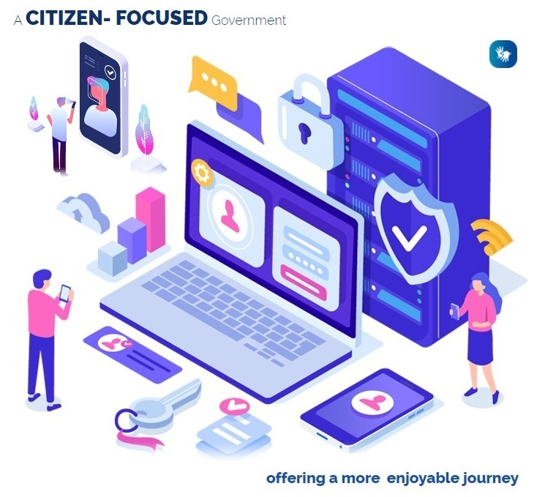




What is GTMI?
GovTech Maturity Index (GTMI)
measures the state of four GovTech focus areas
in 198 economies
using 48 key indicators
to inform operations, research & analytics
Core Government Systems Index (CGSI)
17 indicators
Public Service Delivery Index (PSDI)
9 indicators
Digital Citizen Engagement Index (DCEI)
6 indicators
GovTech Enablers Index (GTEI)
16 indicators
Target users: Government officials, World Bank teams, and practitioners involved in digital transformation

Slide 4











The GTMI Team
Cem Dener
Lead Governance Specialist & TTL
Hubert Nii-Aponsah
Consultant
Youngseok Kim
Sr. Governance Specialist
Kimberly D. Johns
Sr. Public Sector Specialist
& Co-TTL
Asami Okahashi
Governance Specialist
Gustavo A. Zanabria
Consultant
Freida Siregar
E.T. Consultant
Till Hartmann
Junior Professional Officer
Susie Youngyun Lee
Junior Professional Officer
Çağla Giray
Consultant
Charles V. Blanco
Sr. Public Sector Specialist
João Vasconcelos
Sr. Governance Specialist
Hunt La Cascia
Sr. Procurement Specialist

Slide 5









The ITSDA Team
The ITSES Team
GTMI Online Surveys
GTMI Data Dashboard
Anna Maria Kojzar
Senior IT Officer
Parisa Nazarijam
Consultant
Manar Eliriqsousi
Senior IT Officer
Misun Cho Kim
IT Officer
Hristo A. Nikodimov
IT Officer
Varun V. Doiphode
IT Officer
Shrikant Bhaskar Shinde
Consultant
Violeta S. Yovcheva
IT Officer
Kaloyan Velichkov
Consultant
Abdullah Bin Qamar
Consultant

Slide 6
How the 2022 GTMI update is different
Consultations
Consultations with 9 relevant int’l organizations and 10 WBG groups involved in DG/GovTech
New Indicators
New > 5 out of 40 key indicators + 2 out of 8 external indicators measuring less-known areas
Online Surveys
Central Gov (CG) GTMI Online Survey & Subnational Gov (SNG) GTMI Survey [ Pilot ]
Inclusion
CG GTMI > 850+ officials from 164 economies + SNG GTMI > 350+ officials from 20 countries
Privacy
WBG DPO accreditation to maintain the GTMI contact list. Protection of personal data.
Participation
CG GTMI > 135 economies submitted directly + Remote data collection for remaining 63
SNG GTMI > 122 SNG entities (states, municipalities) from 17 countries submitted directly
Validation
Sufficient time for data collection (Mar-Jun) and validation (Jul-Aug)
Transparency
Regular updates + All participants informed about 2022 GTMI groups before public release
Data Dashboard
Maps and graphs to digest and explore GTMI findings and GovTech projects database
Open Data
Both 2020 and 2022 editions of the GovTech Dataset are available at WBG Data Catalog

Slide 7
2022 GTMI Update: Timeline
Launch 2022 GTMI update
Consultations with 9 external + 10 internal groups
Complete the revision of GTMI indicators
Launch GTMI online survey
Develop CG and SNG GTMI online surveys
Direct participation of 135 economies + 63 remote data collection
Data validation for 198 economies
Calculate 2022 GTMI groups
2022 GTMI groups & GovTech global dataset updated
Publish 2022 DG / GovTech projects database (1480 WB prj in 147 countries)
Launch GTMI Data Visualization Portal
Nov 2022
Nov 2021
Mar 2022
Sep 2022
Oct 2022
Dissemination

Slide 8
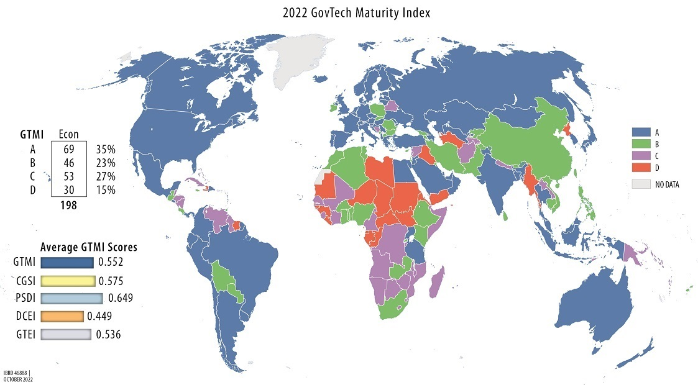
2022 GTMI: International Outlook
There are 154 established Digital Government/GovTech entities around the world,
and good practices are highly visible in 69 economies out of 198.
2020 GTMI is based on remotely collected data
2022 version is mainly based on online survey data provided by government officials
Based on the GTMI component scores, each economy is grouped into one of four categories (A to D)
Group | Score | GTMI
A | 0.75-1.00 | Very High > GT Leaders
B | 0.50-0.74 | High > Significant Focus
C | 0.25-0.49 | Medium > Some Focus
D | 0.00-0.24 | Low > Minimal Focus
GTMI showcases a country’s overall advancement in digital transformation.
GTMI is not intended to create a ranking or assess a country’s readiness for or performance of GovTech.

Slide 9
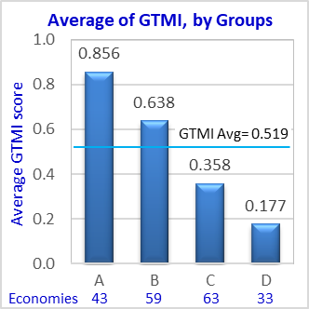
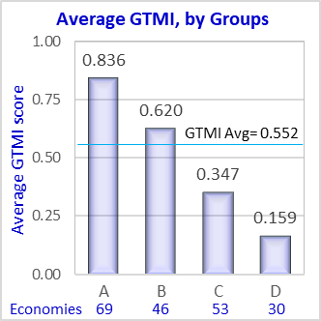
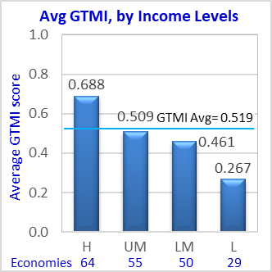
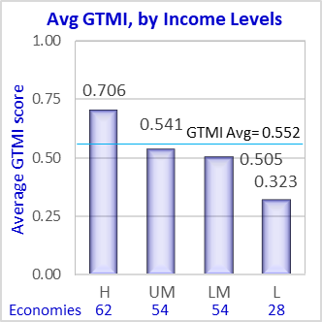
2022 GTMI: International Outlook
Despite progress in online service delivery
and underlying shared platforms,
the digital divide widens.
2020
2022
The GTMI global average value has risen from 0.519 in 2020 to 0.552 in 2022.
There is an overall improvement in GovTech maturity levels across economies
136 economies (69 %) remained in their GTMI group compared to the 2020 data.
52 economies (26 %) moved up one level
(B to A = 29, C to B = 16, D to C = 7)
10 economies (5 %) moved down one level
(A to B = 3, B to C = 3, C to D = 4).
2020
2022
Also, according to ID4D 2021 Dataset, there are
850+ million people without an ID.

Slide 10
GTMI Key Indicators
Ind | GTMI Key indicators | Points | Weight
 | Core Government Systems Index (CGSI)
I-1 | Is there a cloud platform available for all government entities? | 0 - 2 | W1
I-2 | Is there a government enterprise architecture framework? | 0 - 2 | W1
I-3 | Is there a government interoperability framework? | 0 - 2 | W1
I-4 | Is there a government service bus platform? | 0 - 2 | W1
I-5 | Is there an operational FMIS in place to support core PFM functions? | 0 - 2 | W3
I-6 | Is there a TSA supported by FMIS to automate payments and bank reconciliations? | 0 - 2 | W3
I-7 | Is there a Tax Management Information System in place? | 0 - 2 | W3
I-8 | Is there a Customs Management Information System in place? | 0 - 2 | W3
I-9 | Is there a Human Resources Mgmt Information System with self-service portal? | 0 - 2 | W3
I-10 | Is there a Payroll System (MIS) linked with HRMIS? | 0 - 2 | W3
I-11 | Is there a Social Insurance system providing pensions and other SI programs? | 0 - 2 | W1
I-12 | Is there an e-Procurement portal? | 0 - 2 | W2
I-13 | Is there a Debt Management System in place? (Foreign and Domestic debt)? | 0 - 2 | W3
I-14 | Is there a Public Investment Management System (PIMS) in place? | 0 - 2 | W2
I-15 | Is there a gov Open-Source Software (OSS) policy/action plan for public sector? | 0 - 2 | W2
I-16 | UN Telecommunication Infrastructure Index (TII) | 0 - 1 | E1
I-17 | Does gov have a national strategy on disruptive / innovative technologies? | 0 - 2 | W2
 | Public Service Delivery Index (PSDI)
I-18 | UN Online Service Index (OSI) | 0 - 1 | E1
I-19 | Is there an online public service portal? (Also called "One-Stop Shop" or similar) | 0 - 2 | W2
I-20 | Is there a Tax online service portal? | 0 - 2 | W2
I-21 | Is e-Filing available for tax and/or customs declarations? | 0 - 2 | W2
I-22 | Are e-Payment services available? | 0 - 2 | W2
I-23 | Is there a Customs online service portal (Single Window)? | 0 - 2 | W2
I-24 | Is there a Social Insurance/Pension online service portal? | 0 - 2 | W2
Ind | GTMI Key indicators | Points | Weight
I-25 | Is there a Job portal? | 0 - 2 | W2
I-26 | Is there a digital ID that enables remote authentication for (online service access | 0 / 1 | E2
 | Digital Citizen Engagement Index (DCEI)
I-27 | UN E-Participation Index (EPI) | 0 - 1 | E1
I-28 | Is there an Open Government web site / portal? | 0 / 1 | W2
I-29 | Is there an Open Data portal? | 0 / 1 | W2
I-30 | Are there nat’l platforms for citizens to participate in policy decision-making? | 0 / 1 | W1
I-31 | Are there gov platforms for citizens to provide feedback on service delivery? | 0 / 1 | W1
I-32 | Does the gov publish its citizen engagement statistics and performance regularly? | 0 / 1 | W2
 | GovTech Enablers Index (GTEI)
I-33 | Is there a gov entity focused on GovTech (digital transform, whole-of-gov? | 0 - 2 | W1
I-34 | Is there a dedicated gov entity in charge of data governance or data mgmt? | 0 - 2 | W1
I-35 | Is there a GovTech / digital transformation strategy? | 0 - 3 | W3
I-36 | Is there a whole-of-government approach to public sector digital transformation? | 0 - 2 | W1
I-37 | Are there RTI laws to make data/info available to the public online or digitally? | 0 - 2 | W3
I-38 | Is there a data protection / privacy law? | 0 - 2 | W3
I-39 | Is there a data protection authority? | 0 - 2 | W3
I-40 | Is there a national ID (or similar foundational ID) system? | 0 / 1 | E2
I-41 | Are records in the national ID system stored in a digitized (electronic) format? | 0 / 1 | E2
I-42 | Is there a digital signature regulation and PKI to support service delivery? | 0 - 3 | W3
I-43 | ITU Global Cybersecurity Index (GCI) | 0 - 1 | E1
I-44 | UN Human Capital Index (HCI) | 0 - 1 | E1
I-45 | Is there a gov strategy / program to improve digital skills in the public sector? | 0 - 2 | W1
I-46 | Is there a strategy and/or program to improve public sector innovation? | 0 - 2 | W1
I-47 | Is there a government entity focused on public sector innovation? | 0 - 2 | W1
I-48 | Is there a gov policy to support GovTech startups and private sector investments? | 0 / 1 | W2

Slide 11
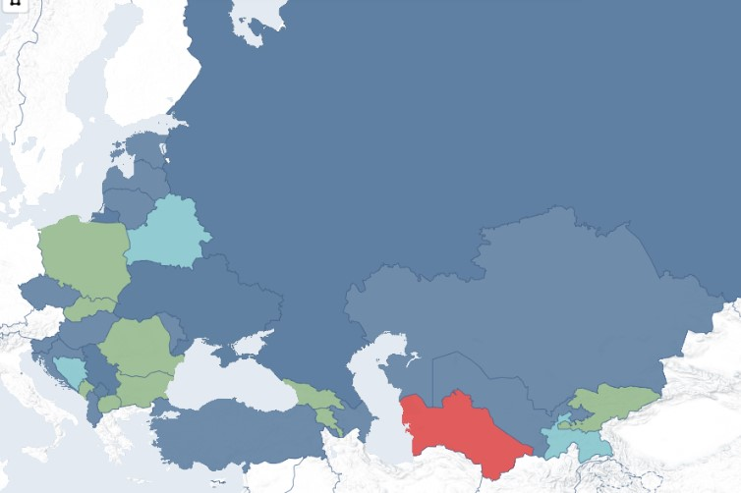
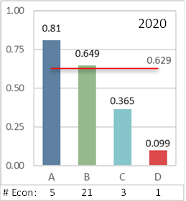
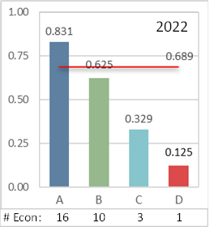
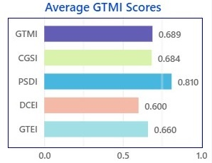
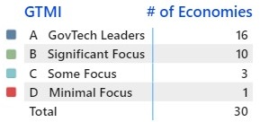
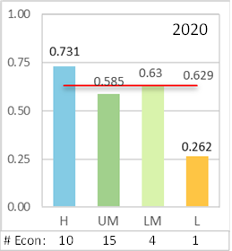
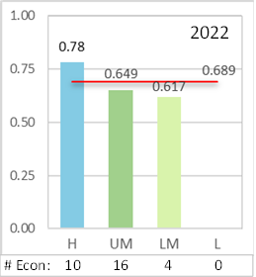
Zoom In: Europe & Central Asia
GTMI
2022 Update
2022 GTMI Regional Outlook, Europe & Central Asia
Average GTMI Scores, by GTMI Group, ECA
ECA is the most mature region in GovTech domain.
Gaps in DCE
Group A (16)
ALB, AZE, HRV, CZE, EST, HUN, KAZ, LVA, LTU, MDA, RUS, SRB, SVR, TUR, UKR, UZB
Group B (10)
ARM, BGR, GEO, KSV, KGZ, MNE, MKD, POL, ROU, SVK
Group C (3)
BLR, BIH, TJK
Group D (1)
TKM
Estonia
Latvia
Russian Federation
Lithuania
Belarus
Poland
Average GTMI Scores, by Income Level, ECA
Czech Republic
Ukraine
Slovak Republic
Kazakhstan
Slovenia
Hungary
Moldova
Croatia
Romania
Bosnia
& Herzegovina
Serbia
Montenegro
Kosovo
Bulgaria
Georgia
Uzbekistan
Kyrgyz Republic
Albania
North Macedonia
Armenia
Türkiye
Azerbaijan
Turkmenistan
Tajikistan

Slide 12
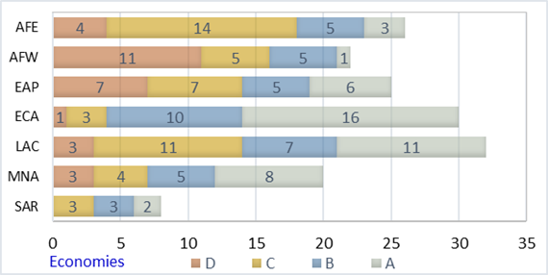
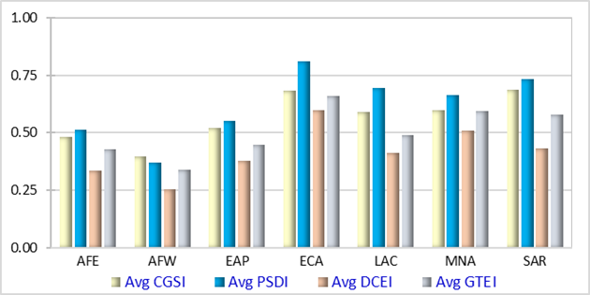
Zoom In: Europe & Central Asia
GovTech Maturity in the World Bank Regions, by GTMI Group, 2022
Average GTMI Scores, by Region, 2022
ECA maturity levels are higher than all other regions, demonstrating a substantial focus on especially in public service delivery core government systems.
Opportunities for further improvements exist in all countries regarding digital citizen engagement, use of open-source software, digital skills, and innovation strategies and programs.
ECA region made relatively stronger progress in GovTech initiatives, especially on online services and the modernization and interoperability of core government systems, as well as the broader GovTech enabling environment.
Like other regions, there was slower progress in improving citizen engagement.

Slide 13
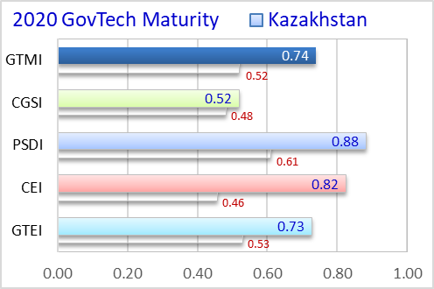
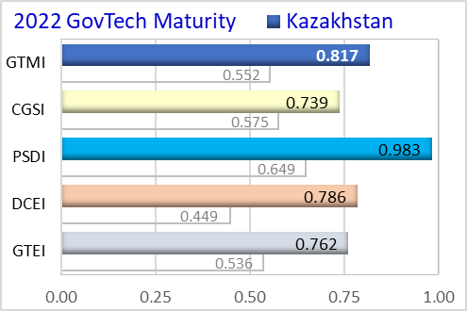
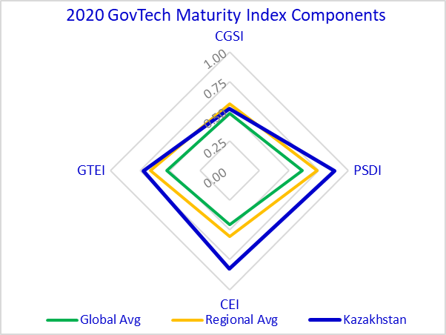
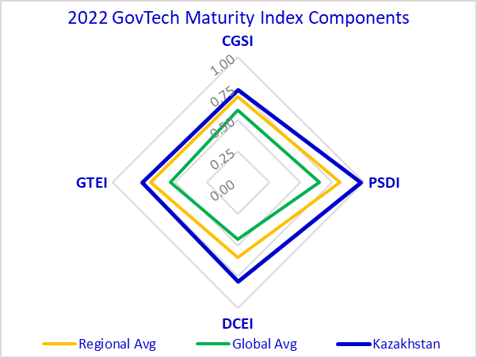
Zoom in: Kazakhstan
2020 GovTech Maturity
2022 GTMI update
Progress >
Improvements in all four GovTech focus areas. GTMI Group = A (moved up)
Core government systems and shared digital infrastructure in place
Substantial focus on public service delivery channels and enabling environment
Policy and programs to support digital skill development and innovation
Possible improvements >
Transition to government cloud and interoperability framework in progress
Monitoring the performance/use of existing systems and services
Coordination of transition to whole-of-government approach
Incentives for GovTech startups

Slide 14


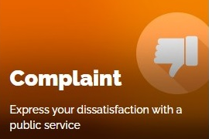


2022 GTMI: Main Findings
What do you want?
Progress amidst a widening digital divide
26% of 198 economies improved their GovTech maturity levels
Dedicated GovTech entities are visible in 154 economies (78 %)
Adoption of WoG is in progress in 140 economies (70 %)
85 economies (43 %) institutionalized the WoG approach
Public Service Delivery Index (PSDI) > highest avg score (0.649)
Citizen Engagement Index (DCEI) > lowest avg score (0.449)
ECA, MNA, LCR, SAR regions > higher GTMI component scores
AFR and EAP > recorded the lowest scores
HIC (58 %) and UMIC (26 %) dominate Group A
Only 16 % of both LMIC and LIC are in Group A
Urgent needs in 45 (of 59) IDA and 8 (of 15) Blend countries
GovTech foundations are weak in 86 % of FCV economies

Slide 15

Recommendations
Digital divide > Sustain high-level commitment and allocate adequate resources
CGSI > Improve interoperability and expand shared digital platforms (WoG approach)
PSDI > Extend human-centric transactional and connected services (life events)
DCEI > Develop multifunctional citizen engagement platforms to improve public trust
Access & Use > Monitor and report the use and quality of online public services
GTEI > Invest on digital skills and innovation and promote data-driven culture
Public data platforms > Promote the use of public data to create added economic value
Private sector > Provide more incentives to GovTech startups/ SMEs
Innovative tech > Explore possible use of DT to improve operations and online services

Slide 16
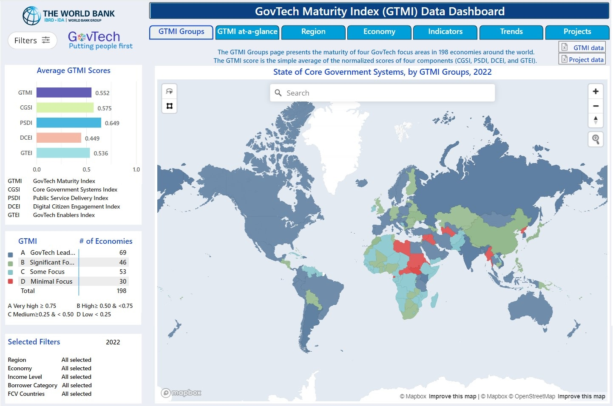
GTMI Data Dashboard

Slide 17
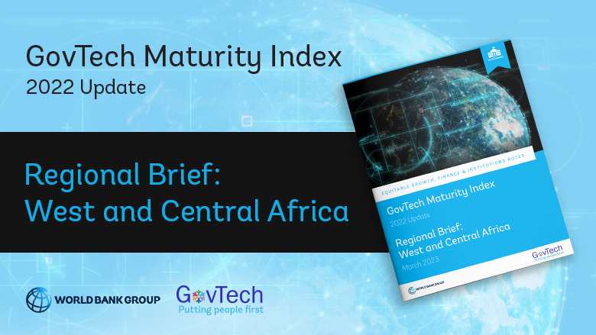
GTMI Regional Briefs
A series of 2022 GTMI Regional Briefs were prepared to present an overview of the progress in GovTech maturity within the last two years, along with the good practices, gaps, and opportunities for accelerating public sector digital transformation.
AFE East and Southern Africa
AFW West and Central Africa
EAP East Asia and Pacific
ECA Europe and Central Asia
LAC Latin America and the Caribbean
MNA Middle East and North Africa
SAR South Asia

Slide 18
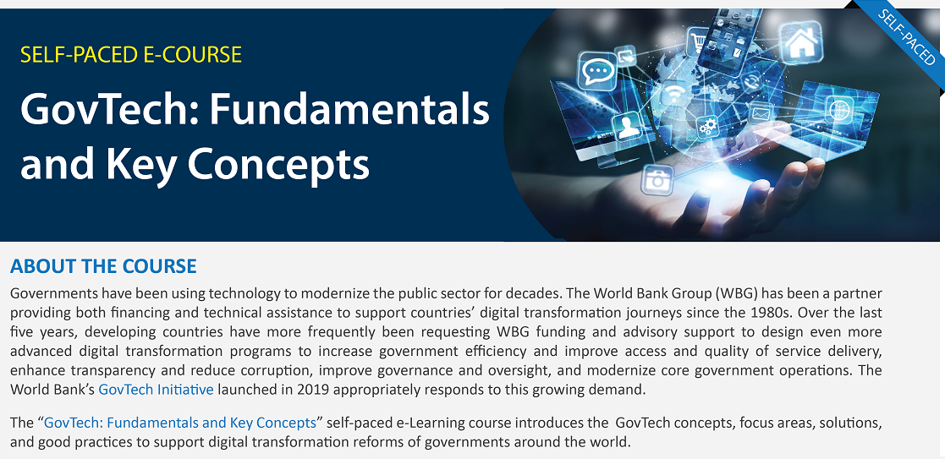
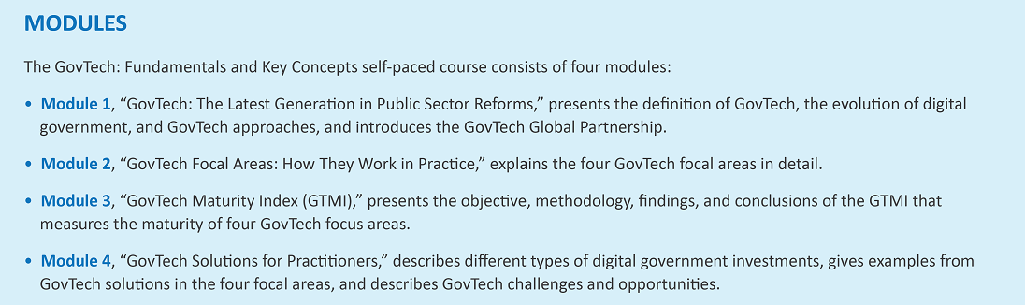
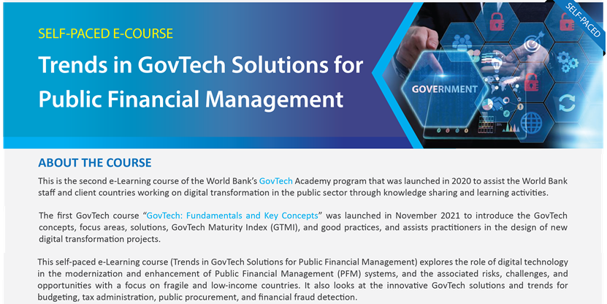
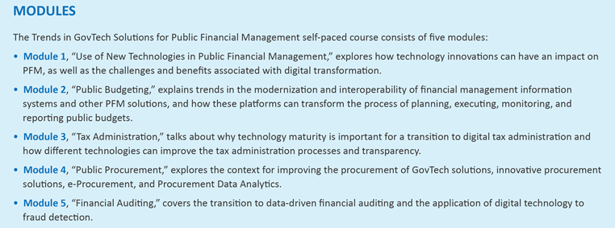
GovTech Academy
GovTech Academy e-Learning courses
launched through Open Learning Campus (OLC)
GovTech OLC e-Learning course #1:
GovTech: Fundamentals and Key Concepts
GovTech OLC e-Learning course #2:
Trends in GovTech Solutions for PFM

Slide 19

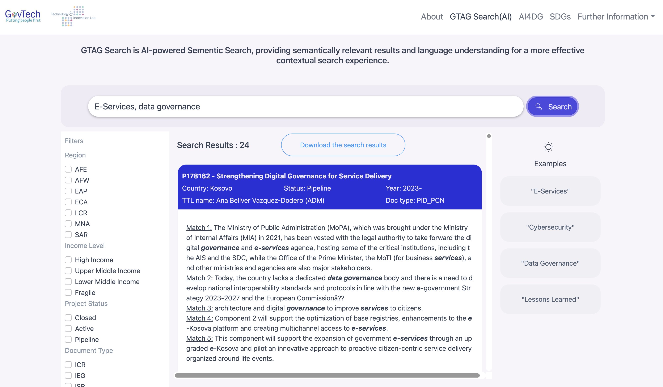
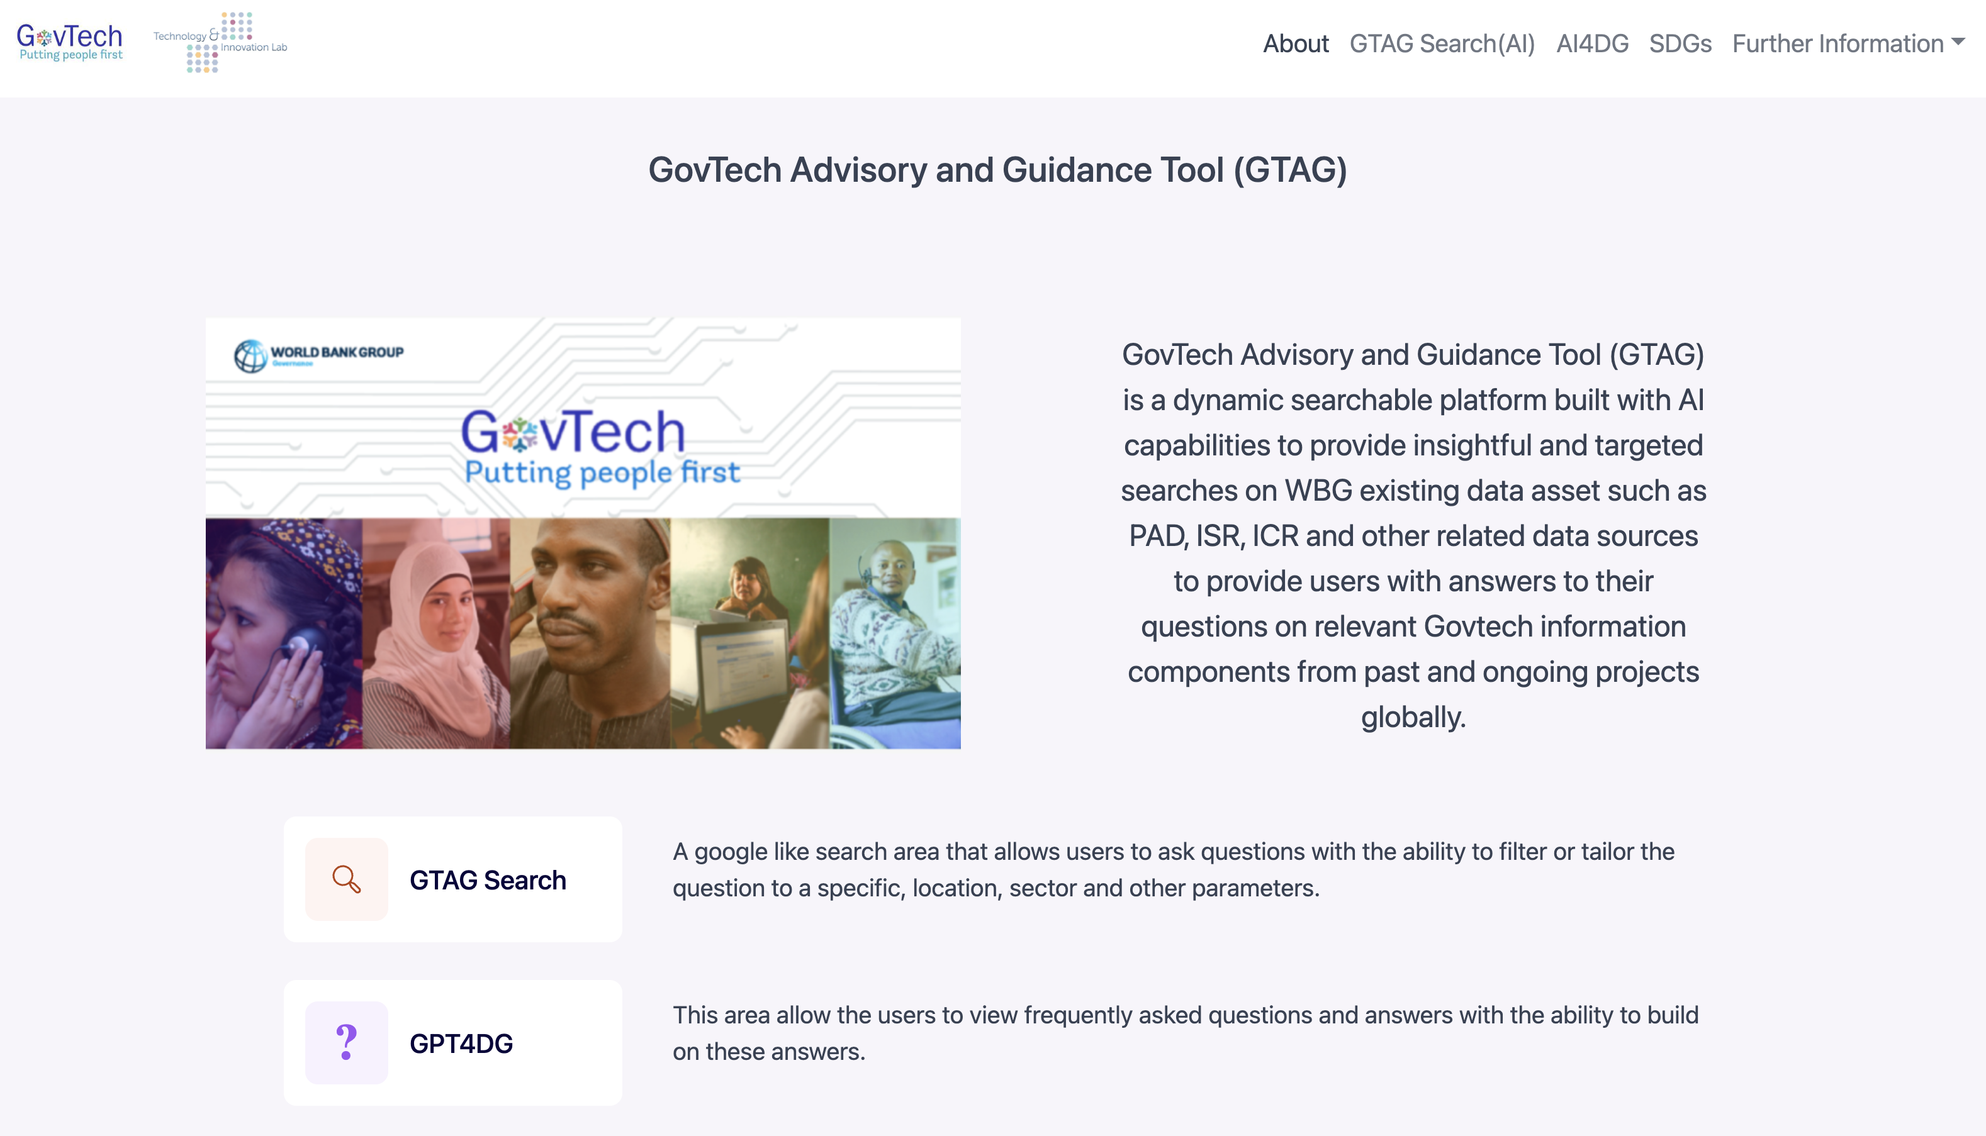
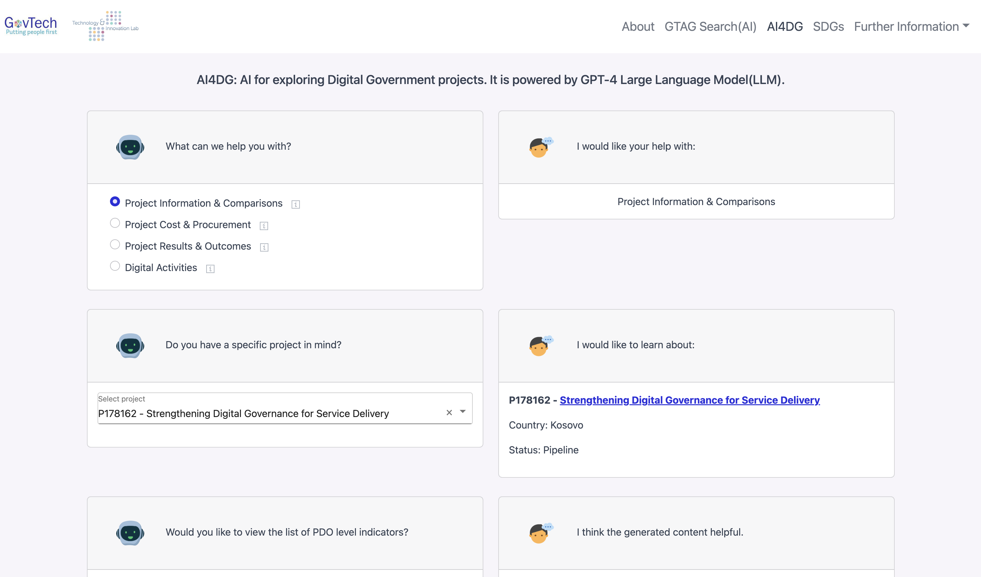
GovTech Advisory and Guidance Tool (GTAG)
GTAG Search (AI)
Surfacing Hidden Data (Pilot Implementation)
AI4DG
Increased knowledge and capacity for Digital Government/GovTech problem identification and project design across the World Bank and beyond, by providing good practice examples of GovTech related components, objectives, activities and performance indicators, budgets, drawing on existing GovTech projects and projects with GovTech focused components.
Task teams will be able to search relevant project documents that fit client needs and development objectives in a more efficient manner.

Slide 20
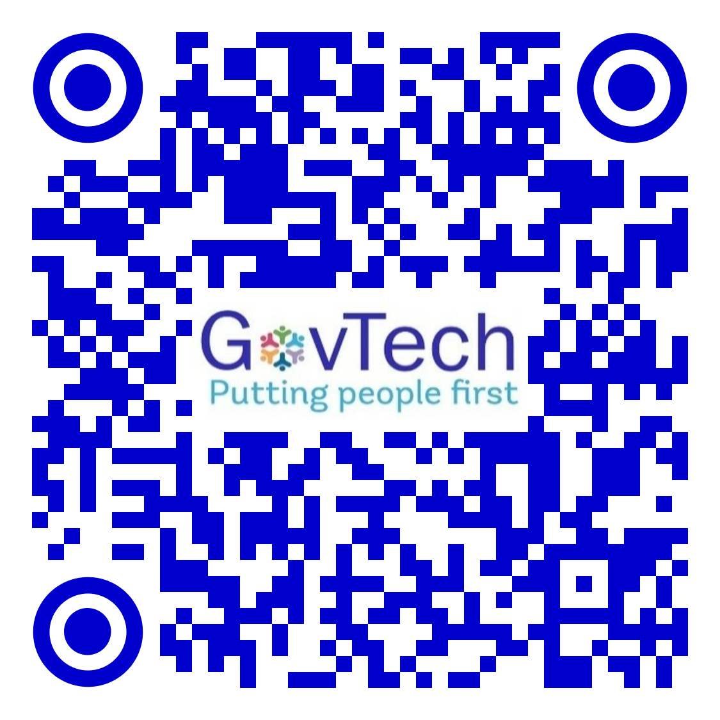
2022 GTMI Update
Q&A
GovTech/GTMI web page: https://www.worldbank.org/en/programs/govtech/gtmi
GTMI Dashboard: https://www.worldbank.org/en/data/interactive/2022/10/21/govtech-maturity-index-gtmi-data-dashboard
GTMI Report (OKR): https://openknowledge.worldbank.org/handle/10986/36233
2022 GTMI Update (OKR): https://openknowledge.worldbank.org/handle/10986/38499
GovTech Dataset: https://datacatalog.worldbank.org/search/dataset/0037889/GovTech-Dataset
GovTech Projects Database: https://datacatalog.worldbank.org/search/dataset/0038056/digital-governance-projects-database
GovTech OLC e-Learning course #1: https://olc.worldbank.org/content/govtech-fundamentals-and-key-concepts
GovTech OLC e-Learning course #2: https://olc.worldbank.org/content/trends-govtech-solutions-public-financial-management

