Slide 1
BORROWING AND CASH&DEBT MANAGEMENT COORDINATION UNDER PANDEMIC
«Turkey’s Case»
TCOP Virtual Annual Plenary Meeting
3/6/2021

Slide 2


Contents
Current Institutional Set-Up & Governance for Cash & Debt Management
1
2
Measures Taken to Limit the Impact of the Pandemic
3
Cash & Debt Management Coordination under Pandemic
4
Adjustments in Borrowing Policy
5
Management of Operational Risks under Pandemic

Slide 3
Current Cash & Debt Management Set-Up & Governance-I
Minister of T & F
Deputy Minister
Deputy Minister
DG of Debt Office
DG of Public Finance
DG of PFM & Transformation
Borrowing programs and strategies
Issuance of domestic and external debt
SUKUK operations
Investor relations
Cash management
Risk management
Receivables management
Treasury accounting
Coordination with the Strategy and Budget Organization for mid –term programming, budget preparation and execution processes
Day-to-day cash & debt mng. coordination
Info sharing on up-to-date budget outlook & risks

Slide 4
Current Cash & Debt Management Set-Up & Governance-II
Debt and Risk Management Committee
Composition
Minister (Chair for critical meetings)
Deputy Minister (Chair for ordinary meetings)
DG of Debt Office
DG of Public Finance
DG of Foreign Economic Relations
DG of Programs & Economic Research
Duties and Responsibilities
Determining borrowing&cash management strategies and risk limits f annually for a 3-year period
Monitoring these strategies and limits
Determining policies for Treasury guarantees and on-lending and receivables
Coordination and Technical Work
Performed by Middle Office
Technical work and analysis for borrowing cost and risks
Presenting analysis, reports and proposals to the Committee
Annual Meetings
Monthly meetings
Evaluation of Macroeconomic Outlook
Core annual strategies and limits
Global economic conditions
Macroeconomic indicators
Financial sector overview
Annual borrowing program
Debt and Risk Issues
Mandate for Cash & Debt Mng.
Budgetary realizations and projections
Cash realizations and projections
Foreign and domestic borrowing markets
Overview of risks
Guarantee and on-lending limits

Slide 5
Measures Taken to Limit the Impact of the Pandemic
a) Financial Measures
1
2
3
Budgetary Measures
UIF Employment
Measures
Credit Measures
Deferral of tax and social security payments for selected industries and small businesses
Reduction in VAT in certain sectors
Cash aid to 5,5 million low income families
Increase in lowest monthly pension allowance for retirees
Bonus payments to public healthcare employees
Support package to SMEs
Other
Deferral of loan payments at state-owned banks
State guaranteed low interest working capital loans to support companies
Increase in the limits of Credit Guarantee Fund
Other
Short-term employment allowance
Cash-based wage support
Unemployment payments
Extended minimum wage support
Other
Effect on the demand for government bonds from Unemployment Insurance Fund (UIF)
No immediate direct effect on government cash & debt management
Empowered capital structures of public banks through special category on-lent bonds
Directly affecting central government budget & cash balance
b) Regulatory Measures
1
2
Central Bank Measures
Banking Supervisory A. Measures
Increase in outright purchase limits
Special liquidity facility to purchase Treasury securities held by the UIF
Introduction of 1 3 and 6 month FX swap auctions
Liquidity support to exporters
Other
New “asset ratio” to accelerate the injection of financing sources into the real sector
Temporary exemption of banks from liquidity coverage ratio requirements
Capital adequacy calculation measures
Other

Slide 6

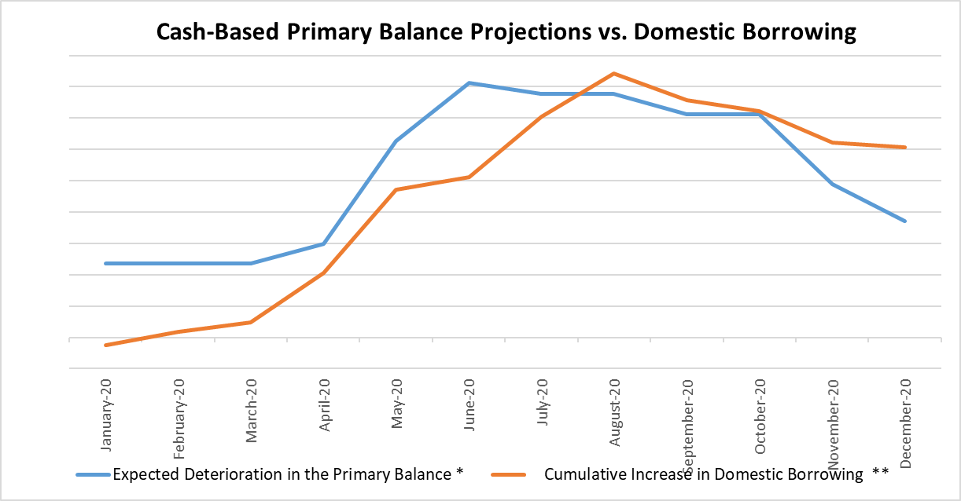
Cash & Debt Management Coordination under Pandemic
Existing strategic benchmark for pursuing a strong liquidity buffer policy and a borrowing strategy aligned with that policy helped to enter the pandemic stage with a comperatively well-built financial position and limited the level of potential PFM vulnerabilities due to Covid-19 pandemic
A prudent cash management approach has been taken during the pandemic by incorporating all the major potential risks in the cash forecasts and dynamically revising them based on the realizations
A well-established day to-day cash & debt management coordination mechanism with its ad-hoc components in addition to the formal ones was the key to give proactive debt-management responses based on dynamic government cash profile
Considerably higher liquidity buffer has been targeted compared to pre-covid area which guided the debt management policy in addition to the additional explicit financing needs.
* Deterioration in the up-to-date cash-based primary balance projections with respect to the original annual financing program
** Increase in the cumulative domestic borrowing with respect to the original annual financing program

Slide 7
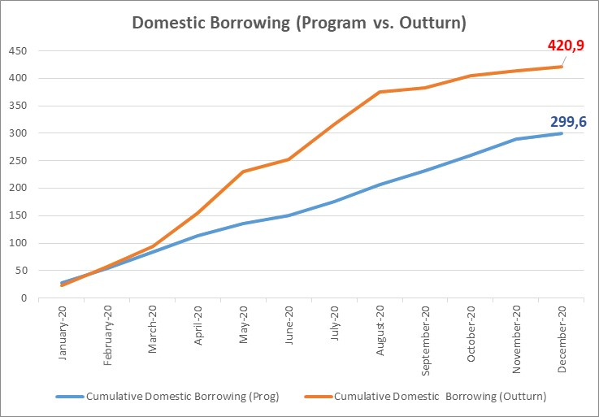
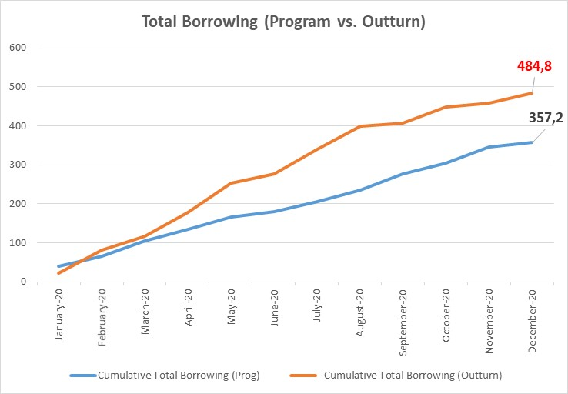
Adjustments in Borrowing Policy
In addition to the deterioration in the budget prospects and the additional financing need for a higher liquidity buffer, the challenges in front of tapping the Eurobond market for a certain period of time put the majority of the burden on the domestic borrowing side
Due to market conditions during most acute days of the pandemic, the demand towards short –term and floating-rate securities led to temporary modifications in the domestic borrowing policy
A wide set of borrowing instruments enabled an effective management of the borrowing needs. (e.g. TLREF-linked floating rate bonds (the first secured overnight financing rate-indexed sovereign bond example (to the best of our knowledge), gold-bonds and SUKUKs
The share of the FX and gold bonds and SUKUKs in the overall borrowing composition increased in line with the demand for these securities mostly due to the dollarization in the economy

Slide 8
Management of Operational Risks under Pandemic-I
An operational risk framework has been on-hand for many years with a risk database dynamically updated based on new risk events
A critical component of the operational risk framework has been the «Public Finance Emergency and Business Continuity Plan»
Content of the Plan
Critical Processes
Scenarios
Business Continuity (BC) Policy and BC Committee
Business Impact Analysis and Critical Processes
Critical and Alternate Personnel
BC Scenarios
Other Relevant Documents
7 identified process e.g.
Execution of the borrowing auctions
Preparation of the daily cash program and conveying it to the CBRT
Execution of the budgetary payments
Execution of the external and domestic debt repayments
Other
6 different scenarios e.g.
Unavailability to use the internal offices
Unavialability to use the IT Center
Decrease in the number of critical personnel due to contingencies
City-wide/country-wide natural disaster
Other

Slide 9
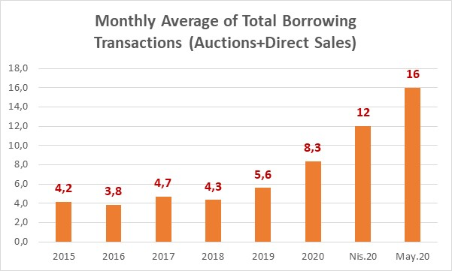
Management of Operational Risks under Pandemic-II
Relying on the business continuity plan a specific action plan has been developed based on 3 different specific pandemic- related scenarios. (Nearly-normal course of business, rotation-based working model, total quarantine)
Critical processes has been reconsidered and critical personnel has been determined for each scenarios (Inventory of recurrent and project-based tasks, check-list for business continuity measures and updated communication details of personnel)
Remote-working drills for borrowing auctions have been conducted several times and different types of auctions have been simulated which helped to execute the historically high number of auctions smoothly
*Excluding buy-back and switch operations
A comprehensive inventory of communication details of major stakeholders has been developed (e.g primary dealers/market makers)
The procedures for the participation to the autions and direct sales have been revisited and necessary regulatory top-management approvals have been secured to relax the requirements on the market participants (e.g. Relaxation in the signatory procedures for direct sales, flexibility in case of technical contingencies)

Slide 10
Thank You!

