Slide 1
CASH BUFFER PRACTICES
«Turkey’s Case»
Videoconference
PEMPAL Treasury Community of Practice Cash Management and Forecasting Thematic Group
December 3, 2019
İlyas TUFAN

Slide 2


Contents
Cash Buffer Concept
1
2
Determining the Buffer Components
3
Setting and Managing the Buffer & the Target Band
4
Cash Buffer Policy & Practice in Turkey
5
Other Country Examples

Slide 3
Cash BUFFER CONCEPT
1

Slide 4
Cash Buffer Policy
Liquidity Buffer
- Highly liquid assets kept for the stress periods as a precautionary measure and to ensure that sufficient funds are always available to meet any net daily central government cash shortfall (cash, credit lines, repos, allocations from International Financial Institutions etc.)*
Cash Buffer
- The minimum level of cash balances to be sure of meeting day to day cash requirements, at all times, under all circumstances, taking into account the availability of other liquid resources**
Liquidity/Cash Buffer Policy
- A set of coherent rules, procedures and methodologies for identifying, setting, targeting, monitoring, reporting and investing the liquidity/cash buffer.
Sources : *Policy Note on the Results of the OECD Liquidity Buffer Questionnaire, Turkish Treasury, 2011
**Williams, M. «Targeting the Cash Balance: the Cash Buffer”, PEMPAL TCOP Meeting, Ankara, 2016

Slide 5
Objectives of a Cash Buffer Policy
Cash Management Purposes
Debt Management Purposes
Controlling,
Refinancing Risk
    time differences between cash
    inflows and outflows
    revenue-based deviations
Short-term bond auction volatilities
    expenditure-based deviations
Notes:
Content Layouts

Slide 6





Components of a CB
Macro
economic
Risks
PFM Risks
Broad Risk Universe
PoliticalRisks
1
Financial
System
Risks
Other
Risks
Market Risks
Credit Risks
Operational Risks
Budgetary Risks
Treasury Risks
2
Macroeconomic outlook
Interest rates
Exchange rates etc.
Guarantees
On-lending
Debt assumption
(PPP Projects)
HR risks
IT Risks
Stakeholder Risks
Deterioration in the revenue outlook
Tax cuts and reliefs
Additional exp.
Cash & Debt M. Risks
Liquidity Risk
Refinancing Risk
3
Effect on Cash Flows
Effect on Operating Flows
Effect on Financial Flows
4
Buffer for
Operating Flows
Buffer for
Financial Flows
«Transactions buffer»
Cash Buffer
«Safety buffer»

Slide 7
DETERMINING the buffer components
2

Slide 8
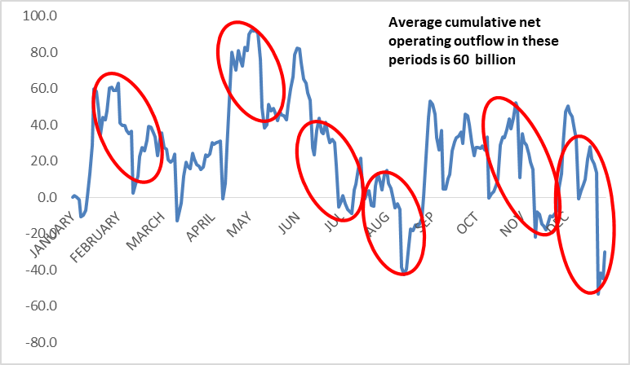
Identifying Transactions Buffer- Cumulative Net Operating Outflows
The profile of the net flows could act as an input for determining the required cushion.
The time frame and ability to react to adverse conditions affecting the flows, e.g
via short-term borrowing, determines the duration of the net outflows to take into consideration.

Slide 9
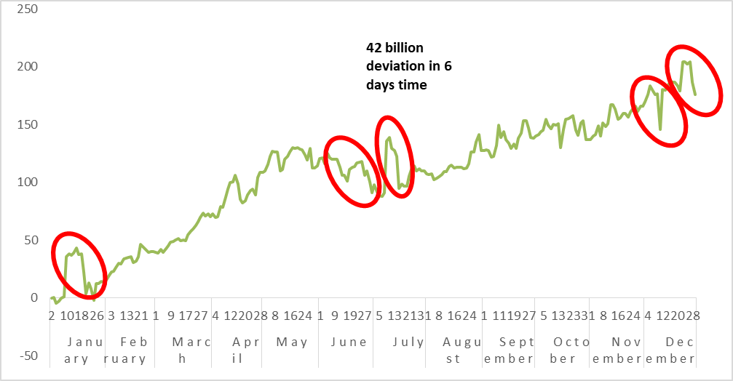
Identifying Transactions Buffer- Cumulative Forecasting Errors
The level of the net outflows may not be much of a concern as long as they are
forecasted sufficiently in advance and and it is possible to react to the expected outflows e.g. by adjusting Tbill issuance.
Then, the level of the cumulative forecasting error in a period becomes essential for
the identification of the buffer.
It is likely to indicate a lower buffer level compared to the one calculated based on the
net outflows since the volatility of the errors is expected to be lower than the volatility of the flows themselves.

Slide 10
Identifying Transactions Buffer- Scenario Analysis-I
Building alternative scenarios reflecting simulations of adverse circumstances could prove useful while identifying the buffer level.
It may enable to develop specific assumptions for the period subject to forecasting and provide clear projections for the liquidity risks to be encountered.
Could be especially handy when a significant change in the cash flow pattern is envisaged or there are many one-off components in the projected flows.
Example: Assumptions of the scenario

Slide 11
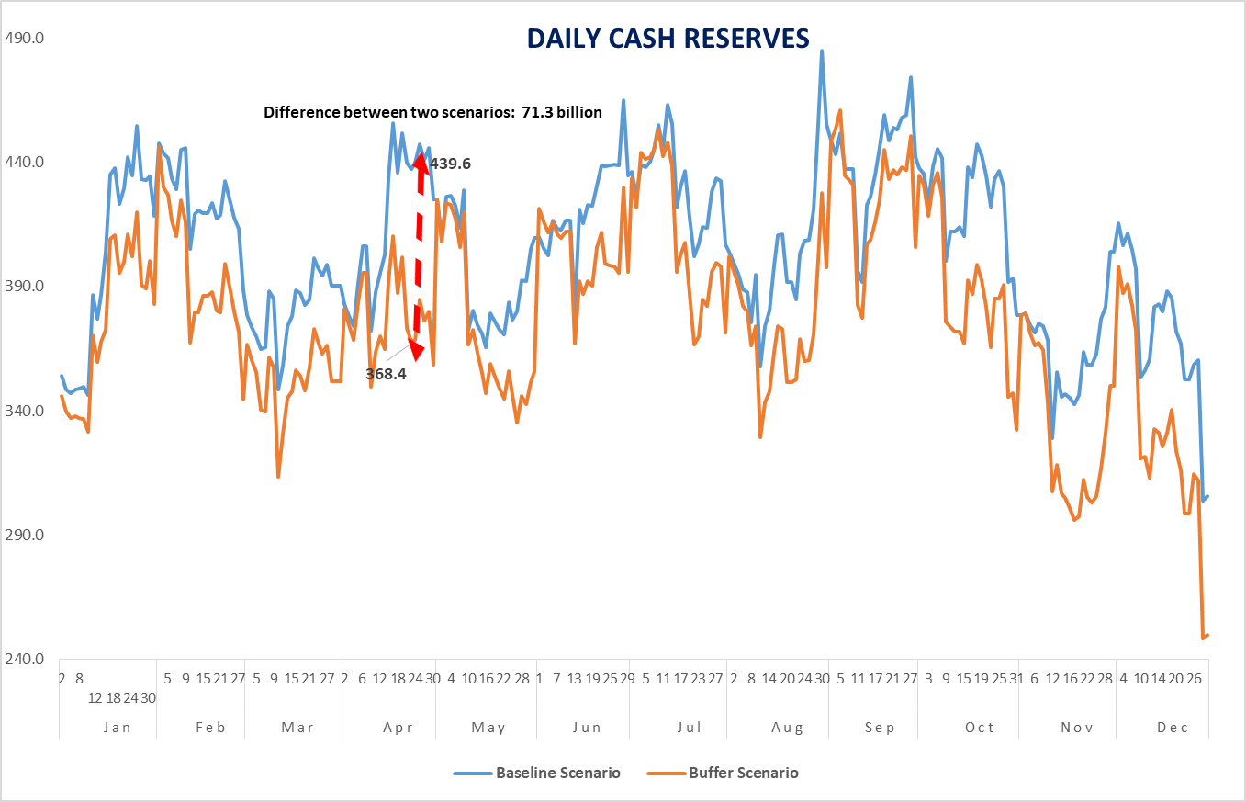
Identifying Transactions Buffer- Scenario Analysis-II

Slide 12
Identifying Transactions Buffer- Comparison of Methodologies
 | Cumulative net operating outflows | Cumulative forecast errors | Scenario analysis
Advantages | -Could be handy when lacking the forecast error information | -Takes into account forecastable net outflows | -Forward looking -Adjustable according to different scenario assumptions
Disadvantages | -Could be over-cautious -Does not take into account forecastable net outflows -Backward looking | -Backward looking | -Highly dependent on the reliability of the scenario assumptions

Slide 13

Identifying Safety Buffer- Parameters
(An Alternative)
Identification of Risky Periods
Duration of Risky Periods
Examine monthly «Bids/Total Redemptions» ratio for the recent 15-20 years
Calculate the main statistics (mean, SD) of that ratio
Determine a threshold for the identification of risky periods (e.g 1 standard deviation below the mean)
Identify the duration of the periods when «Bids/Redemptions» ratio remained below the threshold level.
Get the average or maximum of these periods as a benchmark for the duration depending on the level of prudence and pattern of the periods
1
2
Ability to Borrow During Risky Periods
Other Financing Sources&Possibilities
Check the total financing needs during these periods.
Examine how much of the financing need was to be covered by borrowing.
Take into account other financing sources apart from borrowing (e.g. primary surplus, privatization receipts etc.-)
Other financing possibilities - safety nets (borrowing from central bank, credit lines with commercial banks, overdraft option etc.) may enable to keep a lower buffer level
3
4

Slide 14
Identifying Safety Buffer- Risky Periods

Slide 15

Identifying Safety Buffer- Example
A smooth redemption profile is assumed to prevail.
It is assumed that the foreign market will dry up during risky periods.

Slide 16
Identifying Safety Buffer- Static vs. Dynamic Buffer
A static safety buffer may not be able to capture the effects of the peaks and troughs in the redemption profile.
A dynamic buffer methodology could be an alternative when the volatility of the profile is high.

Slide 17
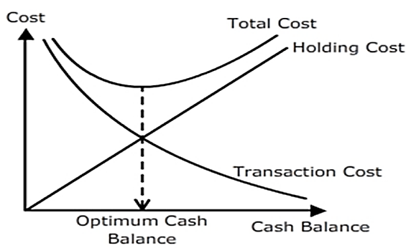
Other Aproaches for Determining CB
Simple Aproaches
  x % of total annual/monthly revenue, expenditures.
  x day/month equivalent of total revenue, expenditures or debt service.
  Contain implicit assumptions (like revenue and expenditures can go down and up by x% from the baseline projections or debt service could not be covered by new borrowing for x months etc. in an adverse situation.)
  Likely to lead to keeping excess resources or being short of treating the liquidity risks adequately as long as
  the rule of thumb assumptions do not rely on solid previous data and experience.
    Mathematical Models
  Models for determining optimum cash balance for a firm could be could be adapted to government cash management practices.
  E.g . «Baumoll» model, «Miller-Orr» model or «Stone» model.
  Aim to determine optimum cash level by considering opportunity cost of carrying reserves and the transaction cost for short-term provisions.
  Not easy to determine the parameters of the models and hard to be interpreted by the high-level policy makers.

Slide 18
Setting AND MANAGING the Buffer & the Target Band
3

Slide 19
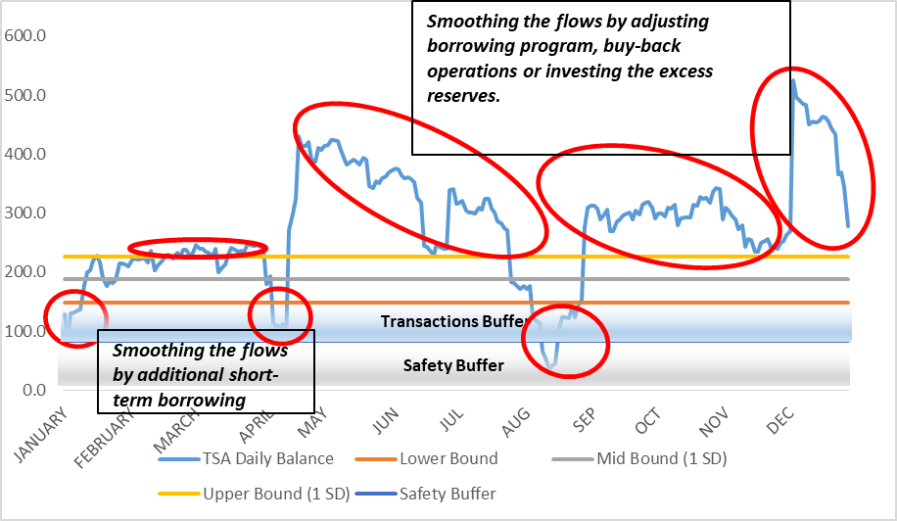
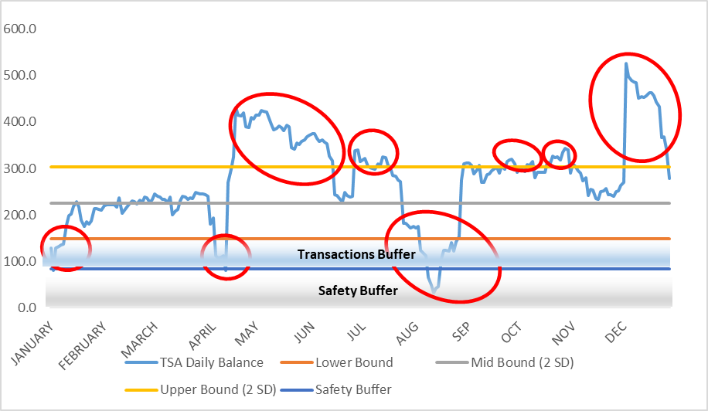
Identifying the Target Band
After setting the cash buffer as the sum of transactions and safety buffers, a band could be identified for targeting the daily reserves
The band width could be determined by assesing the opportunity cost of carrying excess reserves and the capacity and availability of the cash & debt managers to conduct short-term active cash management operations.
A narrower band will limit the cost of keeping excess cash but will likely require more frequent active cash management operations.
A wider band would capture more of the volatility of the daily cash reserves. (Assuming the cash flows are distributed normally and the mid-band is equal to the average daily reserve level, a band width equal to ‘1 SD’ and ‘2SD’ of the distribution would capture 38% and 67 % of the total volatility, respectively.)

Slide 20
Setting and Managing the Buffer Policy
Setting and managing the buffer policy requires several key high-level policy decisions.
Key Determinants
Level of risk aversion
Ability to react to adverse conditions
Availability of other financing alternatives
Rigidity of the expenditure profile
Setting the target band width
Cost of keeping excess reserves vs. operational manageability for the cash&debt management
Key Determinants
Variability of the active cash management instruments
Capacity to perform active cash management operations
Determining the buffer level
«Cost» of carry vs. «risk» of lacking required funds
PD1
PD2
Key Determinants
Credit risk
Loss of interest income when a contingency emerges
Investing the buffer
Central bank vs. commercial banks
- Demand deposits vs. term deposits
PD4
PD3
Disclosing the buffer
Transparency and guidance to the market vs. concern for showing Treasury’s hand at the auctions

Slide 21
Revising the Cash Buffer Policy
Input Parameter
Revision in the CB Policy
    1) Level of forecasting errors
    1) Level of transactions buffer
    2) frequency of the use of short-term financing instruments
    2) Level of transactions buffer
    3) variability of alternative financing
    sources/facilities
    3) Level of safety buffer
    4) level of debt service
    4) Level of safety buffer
    5) level of financial market
    development
    5) Level of cash buffer and width
    of the target band
    6) use of active cash management strategies and instruments
    6) Level of cash buffer and width
    of the target band
Notes:
Content Layouts

Slide 22
Cash Buffer Policy & Practice in Turkey
4

Slide 23
Major Parameters of the CB
Debt Redemption Profile
Demand for Auctions
Non-financing Sources
Historical analysis of demand/repayments ratio
Historical analysis of demand during risky periods
Primary balance
Privatization revenues

Slide 24
Determining CB
Historical Analysis
Defining Risky Periods
Analyzing Demand During Risky Periods
Adding Non-financing sources
Conditions and Duration of Risky Periods
Financing availability during risky periods
Forecast PB and privatization revenues
Bid/Repayments Ratio
Periods when the bid/redemption ratio is below a threshold are defined as risky periods
The duration of risky periods are determined
The ratio of PB and privatization over redemptions are calculated
CB is determined after considering all these components as a percentage of monthly repayments
Bid/Repayments ratio profile for recent 15 years is analyzed
Statistical indicators (mean,STDEV) are calculated
% of the total financing need that is provided by borrowing during risky periods is determined
A component for obligatory payments has been added
  The daily average of envisaged obligatory payments has been added for each month.
A dynamic buffer methodology is set
The level of buffer varies from month to month depending on the redemption profile of the upcoming period. (Changed from a static buffer structure in 2017)

Slide 25
Other Indicators
Target cash balance
  The component for the obligatory payments is more prudent
  The net cumulative outflow (revenue – obligatory payments) is considered.
  Obligatory payments are defined as personnel emoluments + payments of local accounting units + transfers to SSI + transfers to local government
    Maximum level for FX reserves
  Redemption profile for FX type payments
  Upper Limit = Average amount of redemptions in FX for 3 months
  If the amount exceeds upper limit+allowance => Convert the excess amount of FX (including the allowance) to local currency

Slide 26
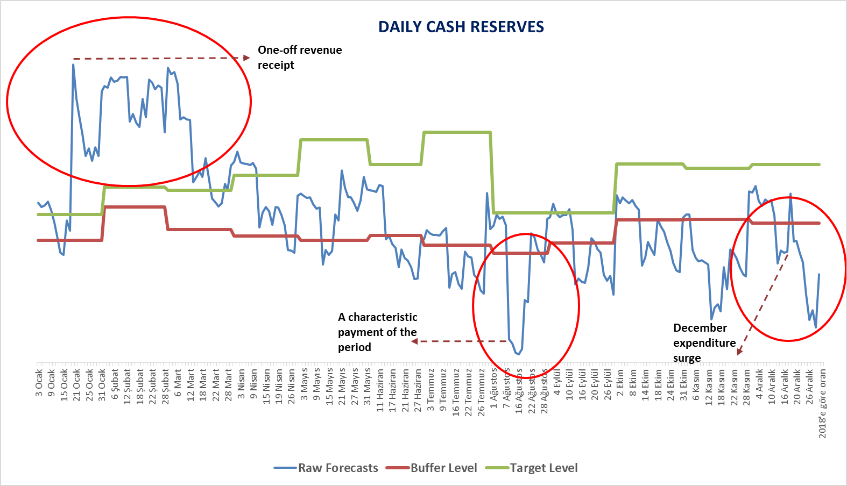
Structure of the Buffer & Target (Example)
Indicates the timing and maturity of the additional borrowing and surpluses to be invested via alternative channels.
Also, provides an idea for the expenditure planning.

Slide 27
Setting and Managing the Buffer Policy-I
The buffer is determined by the Debt and Risk Management Commitee annually. (End-October of the previous year)
It is part of the set of strategic benchmarks alongside the other debt mangement benchmarks.
The cash reserve outturn is submitted on a daily basis by the Cash Management Department to the Middle Office who is responsible from monitoring the strategic benchmarks.
The performance outcome for each strategic benchmark including the liquidity buffer is presented to the Committee by the Middle Office.

Slide 28
Setting and Managing the Buffer Policy-II
Weekly buy-back operations are conducted actively both for cash & debt management purposes.
3 types of instruments to balance timing differences of cash inflows and cash outflows within a month were introduced in 2008 with «Regulation on Financing Through Money Market Cash Operations»
  Cash Transaction Note (CTN)
  Reopen with the Commitment or Repurchase (RCR)
  Deposit Auction
Instruments have at most 30 days of maturity.

Slide 29
Investing the Buffer
The buffer is kept at the Central Bank according to the Remuneration Protocol between Treasury and the Bank.
The TL balances are remunerated automatically on a daily basis with the policy rate. (1 week repo rate) and the interest is accrued on the each following morning.
The FX balances are also remunerated on a daily basis with the market rates (BIS rate for USD, EUR and GBP- Tokyo Repo Rate for JPY) and the interest is accrued at the beginning of the following month.

Slide 30
OTHER COUNTRY EXAMPLES
5

Slide 31
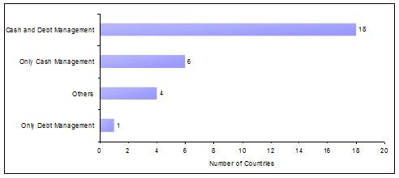
Motivation and Purposes of Keeping Liquidity Buffer
Motivations
Purposes
Source :Policy Note on the Results of the OECD Liquidity Buffer Questionnaire, Turkish Treasury, 2011

Slide 32
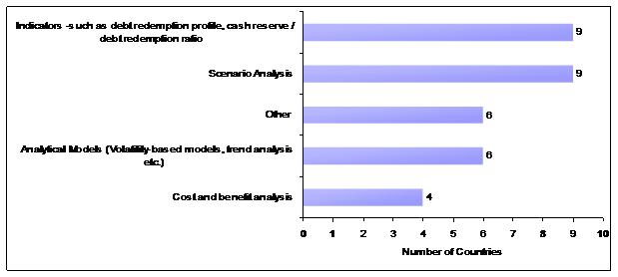
Models and Methods Used in Determining Liquidity Buffer
Methods in Determining Currency Composition of the Liquidity Buffer
Models Used in Determining Liquidity Buffer
Source :Policy Note on the Results of the OECD Liquidity Buffer Questionnaire, Turkish Treasury,2011

Slide 33





Cash Buffer-Country Examples-I
Brazil: A prudential liquidity cushion of at least 3 month of debt servicing (principal plus interest). Another cushion in foreign convertible currency maintained exclusively to pay the federal government external debt equivalent to the amount required to pay at least 12 months of external debt
Italy: A legal requirement for Treasury balances at the central bank to exceed a minimum level of €10 billion until end 2011 which has been replaced with an objective to invest in the banking sector any surplus above €1 billion.
Uruguay: A target equivalent to 12 month of debt servicing
Morocco: A nominal target equivalent to %1 of total revenues
Hungary: A safety reserve is calculated by considering adverse market conditions and assumed time it would take for the markets to return to normal
Sources: (1) The Philippines, Strengthening Cash Management”, IMF TA Mission Report, 2014
(2) The Target Cash Buffer, Government Bond Market Peer Group Survey Analysis, 2014

Slide 34
Cash Buffer-Country Examples-II
Note: data as of 2016
Source: PEMPAL Website (https://www.pempal.org/events/pempal-tcop-thematic-group-meeting-cash-management)

Slide 35
References
«Policy Note on the Results of the OECD Liquidity Buffer Questionnaire», Turkish Treasury, 2011.
Williams, M. «Targeting the Cash Balance: the Cash Buffer”, PEMPAL TCOP Meeting, Ankara, 2016. (see Day 2 materials)
«The Target Cash Buffer, Government Bond Market Peer Group Survey Analysis», (http://pubdocs.worldbank.org/en/361801442253296095/FS-Gemloc-PGD-May-6-2014-Survey-Analysis.pdf), 2014.
TCOP Thematic Survey on Treasury Single Account Practices in PEMPAL countries, PEMPAL Website, (https://www.pempal.org/events/pempal-tcop-thematic-group-meeting-cash-management), 2016.
Can, B. «The Impact of Expansion of TSA System on PFM in Turkey», Ankara, 2018.

