Slide 1

PEMPAL-Treasury COP
The Target Cash Buffer:
its Importance, Calculation and Implementation
Remote Workshop, February 2024
Mike Williams
mike.williams@mj-w.net

Slide 2
Outline
The Cash Buffer: what it is, why we need it
Determining the Buffer
and its Components
International examples
Some Issues Arising

Slide 3
Why do we need a Cash Buffer?
What is the Cash Buffer?
“The minimum level of cash balances to be sure of meeting day to day cash requirements, at all times, under all circumstances, taking into account the availability of other liquid resources”
Why do we need it?
To meet day to day volatility
To cope with forecasting errors
To tide over times of financial stress or crisis

Slide 4
New Risks
Need for cash buffers long understood; but the Global Financial Crisis (& Covid) drew attention to
Risk that domestic markets (not only FX markets) can dry up
Liquidity risk; activity in the interbank (especially) and repo markets fell
Several countries increased their cash buffer post-GFC (especially in Europe)
Recognised importance of a “financing continuity plan”
Cash buffers are part but only part of this
Note: cash buffer is separate from structural surpluses
Cash managers control cash or investments needed in the short-term [<3 months?]
May still be cost-effective to borrow to manage cash volatility (and wider benefits to money market)
Sums above the cash buffers, not part of management of daily fluctuation, should be managed separately (or used to repay debt)
Subject to different criteria, with different managers & different governance framework

Slide 5
Outline
The Cash Buffer: what it is, why we need it
Determining the Buffer
and its Components
International examples
Some Issues Arising

Slide 6
Two Types of Cash Buffers
Usually both a transaction buffer and a safety [or precautionary or market] buffer are necessary
Transaction buffer must be sufficient to meet daily treasury payments and transfers under most circumstances
But otherwise as low as possible to save costs
Emergency credit lines and borrowing can supplement transaction buffer
Maintaining a “safety” buffer on top of the “transaction” buffer is important for prudential reasons
Provide a safety reserve in the event of auction failure or other adverse market conditions that affect financing
Size depends on nature of risks and expected time to return to normality

Slide 7
Alternative Approach*
Buffer for Cash Management
Volatility of cash flows
Risk of extended period of outflows
Forecast errors
Mitigants include access to central bank, credit lines
Buffer for Debt Management
Focus on debt service for period ahead
Risk of market disruption to meet issuance targets
Mitigants include primary dealer underwriting
Essentially the same split as transactions/safety
    The analytical building blocks are the same; and safety nets apply to both
    Debt/cash split may be more intuitive if debt and cash management are institutionally separate – but decision making (at least) should be integrated
* see IMF How-to-note

Slide 8
Identifying the Transactions Buffer
Cumulative cash flows

Slide 9
Transactions Buffer: the Relevant Variables
1. The volatility of daily cash flows
2. The ability to forecast those cash flows
3. Ability to respond to the forecasts
4. The scope (& timescale) for managing unanticipated fluctuations
5. Safety nets
6. Cost of Carry

Slide 10
The Usefulness of Historical Volatility
If historical daily volatility is known, able to calculate relationship between size of buffer and chance that cash will always be enough
Example: buffer to give e.g. 99% confidence level that balance will not fall below zero over a month.* But:
Underlying distributions of flows may not be normal (should test)
Expect negative serial correlation (errors offset within the month: e.g. tax receipts may be delayed by just a day,
Is there a way of dealing with the residual 1%? Do we worry about black swans? Should we aim off for fat tails?
Possible to develop probabilistic models relating the optimal cash balance to the interest rate differentials (on overdraft or funding rate compared to the rate on cash balances). Measures cost of caution. But again assumes:
Normally distributed errors
Overdraft borrowing is available and acceptable
* Multiply daily standard deviation (StDev) by [square root of number of days in month]*[value of normal distribution at a 2% confidence level (1% for each tail)] = StDev*(22^0.5)*2.33 = StDev*11

Slide 11
The Value of Forecasting
With a good forecast possible to plan a smoothing strategy
    Borrowing (Tbills) and investment
If forecasts are “perfect” and Tbill market sufficiently liquid, theoretically no need for any cash buffer
The better the forecasts, the less the buffer

Slide 12
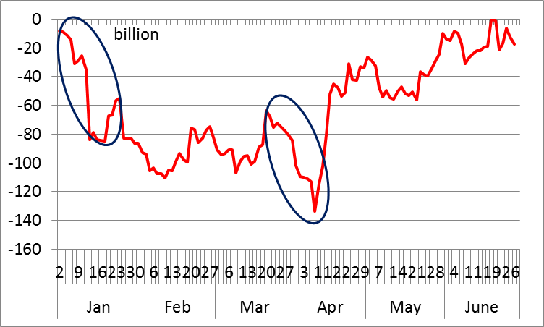
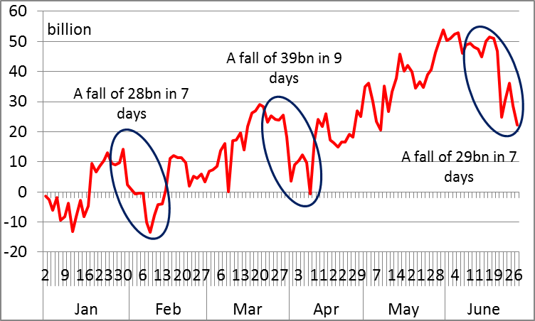
Example: Importance of Forecasts
Actual cumulative cash flow: fall of 80 billion in a short period
Cash flow forecasts: accumulated error in a short period suggests that 30 billion would be sufficient
Note: if it is not possible to respond to forecasts, then underlying volatility remains relevant – if Tbills issued weekly, likely still to be volatility within the week (unless repo is available)

Slide 13
Impact of Forecast Errors
Standard deviation of the errors in the forecast << standard deviation of the outturn
    but they will not be zero
    It is the cumulative error that is important
Identify: the maximum unanticipated fall in the cash balance over any period where intervention is no longer practical
    In this context, the timescale over which unanticipated fluctuations can be managed is important.
    In countries that issue Tbills regularly that is probably between 1-2 weeks
Transactions buffer = Maximum cumulative forecast error over reaction period

Slide 14
Transaction Buffer: Illustration
Deterioration 5.8 bn over 6 days
Deterioration 4.9 bn over 4 days

Slide 15
Other Example...

Slide 16
Focus on Cumulative Errors
October: cumulative negative error at start of month – 29,000 over 7 days.
June: at end of month, cumulative error 37,000 over 5 days. But linked with rescheduled bond sale. To the extent that decision was made earlier, no problem.
September v. volatile. Positive error mid-month, linked with bond auctions and a tax receipt, reversed itself, then deterioration 30,000 at end month
Suggests minimum balance c.30-40,000 [plus safety reserve] – needs more analysis

Slide 17
A Case for Scenario Analysis?
Forecast errors are backward looking – may want to cross-check with scenarios of adverse circumstances
Can link forecasts to specific assumptions; as necessary the buffer can be “released” when concerns are past
Potentially useful when a significant change in cash flow pattern is expected or there are many one-off components in forecasts
Examples: allow for:
Increased revenue or expenditure forecasts errors, compared with historical experience
One-off expenditure or revenue shock
Possibility of 2-tier buffer; some part held as near-cash reserve at higher rate? [eg Canada’s callable deposits]
Denial of market access

Slide 18
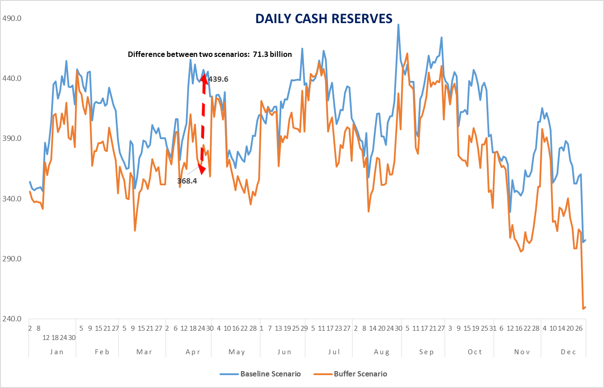
Scenario Analysis: an Example*
* Based on workshop ppt of Ilyas Tufan, 2022

Slide 19
Safety Buffer
Options
    Maximum amount of financing needed if the capital market was disrupted for [2-3] months and no or limited bond issuance could take place in that period
    Protecting auction program improves credibility of government
    Some countries allow explicitly for a failed government securities auction
Mitigants
    Underwriting obligations on Primary dealers
      Risk that will not in practice work at time of stress
      Slovak Republic : primary dealers obliged to set up a money market credit line to the government for trades on money markets worth at least €100 million, with a minimum tenor of 14 days

Slide 20
The Safety Buffer – other Considerations
Identification of risky periods (e.g. past poor auction performance – mean & standard deviation)
Duration of risky periods – identify average or maximum
Ability to borrow during risky period - taking account of other financing sources
Might imply need a dynamic buffer – that changes over time depending on perceived risk
(Türkiye example – see later)
Also plan for redemptions [strictly not part of buffer since they are known –definitional question]

Slide 21
Safety Nets?
Borrowing from the Central Bank
Breaking deposits
Not an option in many countries – quantum and tenor should be constrained
Credit lines with commercial banks
A useful option although it usually carries a cost
Often possible (not for repo) – with a penalty
Access to FX
Same day value?
Other cash sources?
Sovereign wealth funds – should be arm’s length

Slide 22
Outline
The Cash Buffer: what it is, why we need it
Determining the Buffer
and its Components
International examples
Some Issues Arising

Slide 23
Cash Buffers in Practice - 1
Cruz and Koç Survey of OECD Countries 2016
29/35 countries agreed that buffers are important and effective tool to mitigate refinancing and liquidity risk
Cash is the main asset, mostly in central bank, mostly domestic currency
Main purposes: to manage time differences; to reduce refinancing risk and to withstand severe liquidity strains, enhancing market confidence
Most common practice: a buffer sufficient to meet one month of expenditures – but great variation (following debt crisis Greece set cash reserves to cover debt service the next 4 years, exc Tbills)
Estimated by a range of liquidity indicators and scenario analysis
> half respondents disclose their cash balance regularly as a part of transparency of public finances
DMOs primarily coordinate governance of the buffer with the MoF & central bank
Several N.Europe countries operate with cash balances << 0.1% annual central government expenditure
But they have liquid money markets, sophisticated active cash management
Some plan to be long of cash and on-lend only when position is secure
Drying up of liquidity in financial crisis led some to be more cautious

Slide 24
Cash Buffers in Practice - 2
Some other approaches – the importance of signalling prudence
Buffer calculated as safety reserve in event of adverse market conditions – market closure or higher costs
Maintaining balances >= debt redemptions due in next month, implicitly allows for failed auction
To guarantee budget execution or debt service for [X] months
In Italy used to be (until 2011) a legal requirement for balances to exceed €10 billion – the peak of cumulative net outflows reached in any period
See also results of World Bank 2014 survey at annex
Uruguay focuses on risk of excessive cost of borrowing rather than access to borrowing – implies a large buffer
Comment
Simple approaches [x days of flows] risk excess reserves, which carry a cost
Buffer must have some analytical underpinning – from data and experience
Some cash rich countries do not have a buffer – but structurally surplus cash can still be put to good use => may be cost effective to borrow with Tbills to smooth cash flows even if there is surplus cash

Slide 25
PEMPAL Countries: 2021 TSA Survey
Only three countries reported a formal target for cash buffer
Albania: the buffer, minimum and maximum levels, is defined largely in relation to expenditure flows across a month. It can be varied as required.
Hungary: the buffer was first set in 2003. minimum balance set at 4-6 weeks of gross financing needs Increased following financial crisis to boost investor conference. In 2013 change in outlook implied target modified to 50% of bond and loan redemption in the first quarter. In 2017 switched to percentile of daily cash flows for minimum limit with optimal balance based on 6 weeks of financing plan
Türkiye: the buffer, also first set in 2003, is defined in relation to cash flows; it may also vary across the year
It may be that most countries operate a buffer in practice even if it is not formally defined
Most countries pointed to the volatility of revenues and expenditures; and the errors in forecasting them. Other factors included: the risk of auction failure; or of wider financial market disruption; or of contingent liabilities crystallizing
Safety nets: several mentioned ability to break deposits, and access to FX balances
8 of the 12 countries reported a buffer in the 2016 survey

Slide 26
Cash Balances: Some Country Examples
Central government cash balances at the central bank / GDP, 2018 data- Source: IMF Monetary and Financial Statistics

Slide 27
Outline
The Cash Buffer: what it is, why we need it
Determining the Buffer
and its Components
International examples
Some Issues Arising

Slide 28
Hypothecating the Buffer?
Should there be sub-categories within the buffer (“sub-buffers”) linked to specific expenditures or risks? For example:
A debt service sub-buffer linked to exchange rate or interest rate fluctuations
A contingencies buffer for non-budgeted expenditures
Ideally not:
Sub-buffers risk an unnecessarily high total buffer, with costs arising
The underlying calculation of both transactions and safety elements should take account of all risks
Possible exceptions
If cash is not fungible (there are protected or hypothecated balances in the TSA) that may need to be reflected in sub-buffers
Access to FX may need to be protected if there is a risk that the central bank is unwilling to supply on demand, or it is not available on the local market

Slide 29
Investing the Buffer
Normal presumption is that the buffer is held in the Central Bank
There are other options, at least for some part of the buffer
Part of the balance in the TSA – as seems to be the case from the survey
Avoids any credit or liquidity risk
If cash managed actively to keep TSA close to the buffer, no adverse implications for monetary policy
Should be remunerated at risk-free market rate (close to the policy rate) – reflects opportunity cost and to give the right incentives
Deposits with commercial banks; but beware of
Credit risk unless collateralized (or as reverse repo)
Liquidity risk unless very short term or callable (breaking term deposits incurs a penalty)
Money market funds – but claimed liquidity may be a chimera
Such options may be more relevant for a cash reserve fund above buffer (next slide)

Slide 30
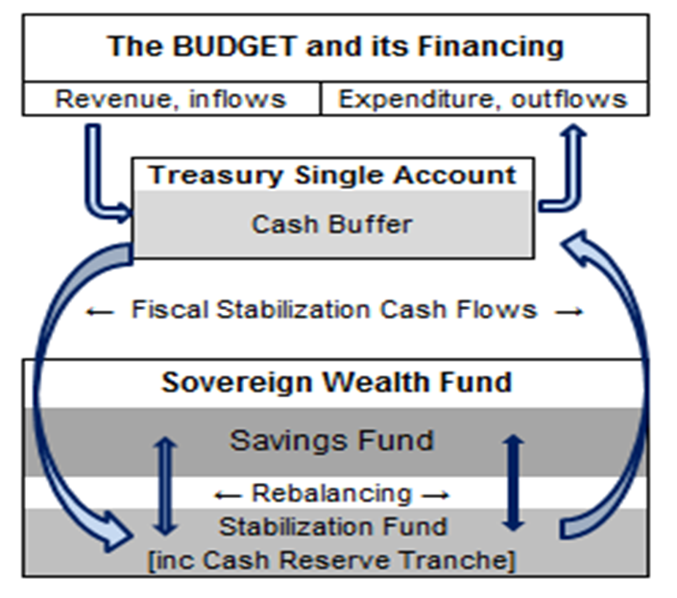
Cash Reserve Funds
Intermediate option between the buffer and longer-term funds.
    Especially if money market is thin or volatile
    Comprises a reserve source of liquidity if cash management problems; or a cushion against a concerning future scenario (e.g. banking collapse, impact of a pandemic)
    Examples: UK 3G 3-month cash fund; Peru’s market liquidity fund; Canada’s callable deposits with central bank
May be separate from stabilisation or wealth fund; or in a single vehicle – integrates seamlessly with cash management
    Excess cash flows into fund
    Stabilisation buffer in the fund defines scope for a long-term savings objective – periodic rebalancing
    “Cascading framework”

Slide 31
Changing the Buffer over Time
• Several countries have modified buffer – taking account of market conditions (change in interest rates as well as stressed markets), ability to manage cash balances more actively, and expected fiscal pressures/borrowing requirements
• Many countries increased during covid even if fallen back since
From year to year
Portugal: initially (2013) 100% of gross borrowing needs (exc Tbills), reduced to 50% in 2015, then 40% in 2017. Buffer was part of policy to improve market confidence – linked with transparent communications strategy
Poland: stronger fiscal position allowed reduction from PLN 85 bn to PLN 26 bn in Dec 17
Hungary: buffer increased following 2008-09 crisis; since fallen back
Within the year
Türkiye: minimum limit reviewed monthly – takes account of volatile redemption profile
UK: informs central bank each week of its target average balance for the week ahead

Slide 32
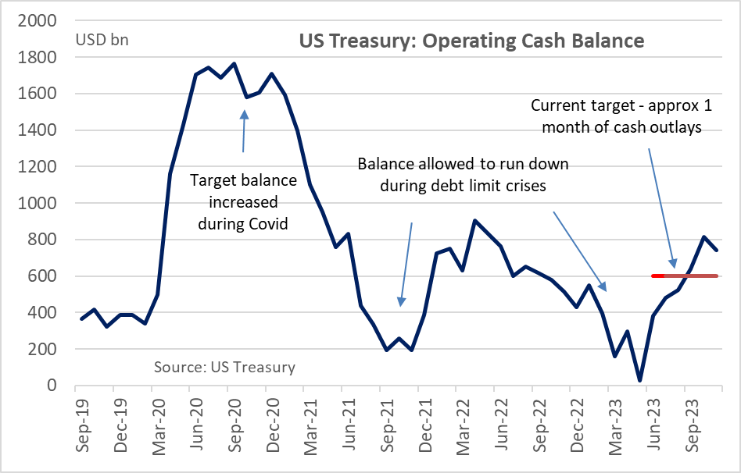
Variation over time: the US Example
Buffer requirements first identified in June 2015
    Emphasised role of avoiding potential disruption to financing programmes (e.g. auction calendars), in turn supporting predictability in public debt management.
    Based on assessment of emerging threats, including temporary loss of market access following a cyber-attack, storm or terror attack
    Original target: cash sufficient to cover one week of outflows in the Treasury General Account
    Since modified – see chart

Slide 33
Structure of the Buffer
Minimum floor is most common
Zone around a preferred balance – Australia
In Eurozone, ECB does not renumerate above a target level – to encourage countries to manage to the previously agreed level
Two tiers
Some countries distinguish between cash buffer and liquidity buffer
Hungary example
Minimum TSA balance is calculated using the extreme daily Treasury expenditures
Optimal TSA balance (to be targeted by the financing plan), based on the forecast error and financing risk in the annual financing plan (e.g. risk of higher deficit, risk of unsuccessful auctions, cash outflow in the retail debt program). Take account also of risk of market stress
Miller-Ord model can help to guide preferred band width – see annex

Slide 34
Governance
Who decides [or leads in recommending to decision makers]
Integrated DMO – issue does not arise
Example Hungary: ÁKK proposes the level of the minimum liquidity buffer; approved each year by Minister of Finance
In separate debt/cash functions:
Cash managers better placed to do the transactions analysis
But debt managers need to consider debt management/safety buffer
Implies a need to liaise – to ensure an integrated approach, and shared understanding of safety nets available
Essential to inform central bank
It must know what is being targeted as an input into its liquidity forecast required for open market operations
Advantages to informing the public
Public disclosure has a positive signalling effect on market participants, enhancing credibility of government.
Disclosing actual level of the cash buffer further increases the fiscal transparency and market confidence. Examples: Canada, Denmark, Italy and the US.
In more uncertain environment, some disclose the information about the policy (rationale and determinants) without providing information on the actual and target level of the buffer in order to avoid potential misperceptions
Review legislative requirements
Some countries currently would not allow over borrowing to build buffer

Slide 35
Some (General) Conclusions
Cash buffers just one part of the “financing continuity plan”
Need to consider:
Underlying volatility
Ability to forecast and take advantage of the forecast
Ability to react
Safety nets
Distinguish between a transactions buffer; and a safety or precautionary buffer
Avoid formulaic approaches: identify the drivers and consider the opportunity cost
Are there signalling advantages from telling the market?
Cost of carry

Slide 36
References
Yasemin Hürcan, Fatoş Koç, and Emre Balıbek “How to Set Up a Cash Buffer: a Practical Guide to Developing and Implementing a Cash Buffer Policy” (IMF How to Note 2020) https://www.imf.org/en/Publications/Fiscal-Affairs-Department-How-To-Notes/Issues/2020/12/21/How-to-Set-Up-A-Cash-Buffer-A-Practical-Guide-to-Developing-and-Implementing-a-Cash-Buffer-49955
Pedro Cruz and Fatoş Koç “The liquidity buffer practices of public debt managers in OECD countries”(OECD, 2018) https://www.oecd-ilibrary.org/finance-and-investment/the-liquidity-buffer-practices-of-public-debt-managers-in-oecd-countries_3b468966-en
World Bank “The Target Cash Buffer, Government Bond Market Peer Group Survey Analysis”(2014) (http://pubdocs.worldbank.org/en/361801442253296095/FS-Gemloc-PGD-May-6-2014-Survey-Analysis.pdf), 2014.
PEMPAL TCOP “Government Treasury Single Account and Cash Management in PEMPAL Countries” (2021 Survey Report) (https://www.pempal.org/knowledge-product/government-treasury-single-account-and-cash-management-pempal-countries).
Mike Williams “Targeting the Cash Balance” (Presentation at PEMPAL TCOP 2016), https://www.pempal.org/sites/pempal/files/event/attachments/pempal-mike_williams_targeting_the_cash_balance_mar16.pptx.

Slide 37
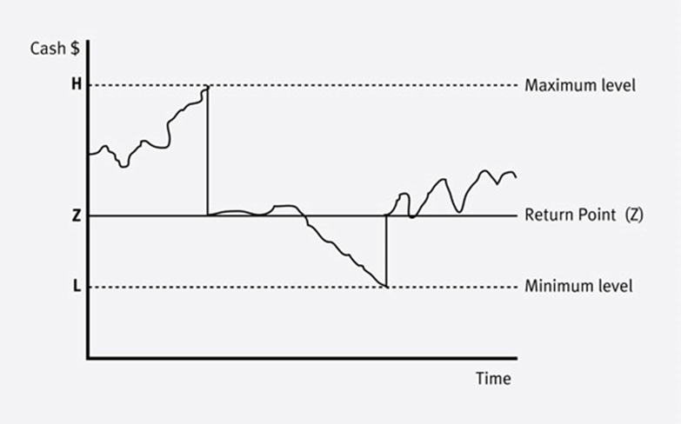
Annex: Some Other Techniques
Miller-Ord Model
Controls irregular movements of cash by the setting of upper and lower control limits on cash balance
    Difference between them depends on cash flow variance, interest rate and transactions costs
    At upper limit, buy securities; at lower limit sell securities – aim for a target between upper and lower limit.
    But it does not specify how to determine lower limit (“set by management”)
    Not used in practice by governments
Liquidity Cover Ratio (LCR)
Arises from from Basel process
Considers the high-quality liquid assets available to cover net outflows over a specified period
But
    Although potentially a useful indicator for management, it hides complexity and may be difficult to interpret
    It is a passive concept – in practice governments have options to respond to outflows
    Decision-makers need more information about the risks and sensitivities, and the cash flow impact of different shocks to which the government may be exposed, so that they can judge the action to be taken
    Little used in practice (although Colombia has explored it)

Slide 38
Annex: World Bank Survey*
Benefits of a buffer generally recognised (11 responses)
But motives vary
Different emphasis as between transactions/volatility and financial stress
Some countries (Hungary, Uruguay) quoted need to support debt management operations – e.g. buy-backs – or to reduce refinancing risk
Different views about telling the market
The target
Often expressed as months of financing – regular flows or specific lumpy flows (redemptions, auctions)
Some countries have no formal buffer
May be because too much/easy access to cash (Chile, Colombia) or not enough cash (Kenya, Nigeria)
All countries have some safety nets (borrowing from central bank and/or overnight from commercial banks)
Uruguay – a different approach
Deficit + amortization for 12 months (=4% of GDP)
Based on probability that market is “closed”
“closed” = EMBI+ 20%>trend; or Uruguay paying 200bps>EMBI+
Focus on external borrowing only – not clear why
* WB Capital Markets Group: Peer Group Dialogue – May 2014

