Slide 1
CASH MANAGEMENT
IN TURKEY
TURKISH TREASURY
Cash Management Department

Slide 2


Contents
1
Cash Management in General
2
Cash Planning Processes
3
Treasury Single Account and Monitoring
4
Managing Cash Reserves
5
Relationship with Debt and Risk Management
6
Public Treasurership System

Slide 3
Cash Management IN general
1

Slide 4



Public Financial Management Cycle
MTP/MTFP
Policy Making
and Revision
Budget
Exp/Revenue
Management
Audit and
Evaluation
Final
Account and
Reporting
Cash and Debt
Management
Treasury

Slide 5

Treasury Cash Flows
Special Budget
Regulatory
Bodies
General Budget
Special Budget
Revenue Admin.
Expenditures
Tax Revenues
Deficits
Surpluses
Social Security
Ins.
TREASURY
CMD
Deficits
PrivatizationRevenues
Privatization Admin.
Transfers from CG Budget
Local Government
New Borrowing
Capital Injection/Duty Loss Transfers
Dividends
Treasury
DMD
Debt Pincipal and Interest Payments
Public Banks/ Entp.
Extrabudgetary Funds

Slide 6
Financing General Budget
Budget
Cash Based Primary Balance
Cash Based PB
MoF
UT-CMD
Other Cash Flows
Privatization, Land Sales, Receipts from On-lendings and SDIF
Change in Bank Accounts
Strategic Benchmark
Debt Service
Principal+Interest Payments
Borrowing requirement ≤ Borrowing limit
Borrowing

Slide 7
CASH PLANNING PROCESSES
2

Slide 8
Annual Cash Planning
Annual cash program is prepared by the end of October based on budget projections
Cash Based Revenues and Expenditures
Cash Program on a Daily Basis
Annual Financing Program
Budget
Mid -September
Sep-Oct.
Sep-Oct.
End of October
Accrual Based Revenues and Expenditures in MTP and MTFP
Revenue side: subtracting one-time cash inflows and collections that do not create cash inflows
Expenditure side: subtracting payments do not create cash outflows and adding payments related to previous years’ budgets
Daily distribution of cash flows considering:
Tax calendar
Dividend payment schedules
Previous years’ realizations
Determining:
Borrowing schedule
Borrowing types

Slide 9
Monthly Cash Planning-I
  Forecasting tax and non-tax revenues via time series analysis and reflecting changes in regulations, recent economic developments
  Regular coordination with related institutions (Public Shareholder Executive, CBRT, Privatization Administration, Deposit Insurance Fund, Treasury Offices etc.)
Cash Inflows
Tax and non tax revenues, one-off items e.g. privatization
Forecasting non-interest expenditures by collecting the current cash needs of the public institutions via internet portal (CRS) both on a monthly and weekly basis
Regular monthly meetings with the major line agencies and MoF (budget appropriation information)
Previous spending performance is the major determinant for the allocations
Debt service projections are provided by Treasury’s back office.
Cash Outflows
Payments to ministries, universities, special budget adm., social security inst. etc.; debt service
Borrowing Requirement
Providing the expected non-borrowing financing amount and cash deficit information to the front office.
Determining the draft monthly cash program according to the borrowing projections of the front office
Coordination with debt office
Finalization
Finalizing the draft monthly cash program via meeting with the DG
Finalizing the monthly cash program via meeting with the Undersecretary
Approval of the program by the top management

Slide 10
Cash Request System-I
Since 2011
an internet portal for collecting cash requests, online and real time
CRS
eliminates paper based documentation
the data of cash requests are saved to Treasury database
different reports can be produced upon needs

Slide 11
Cash Request System-II
cash request information of 200 public institutions
regional accounting units, central accounting offices and special budget accounting offices.
CRS
feedback for the next month’s cash transfers
weekly revision during the month
classification based on main expenditure items

Slide 12
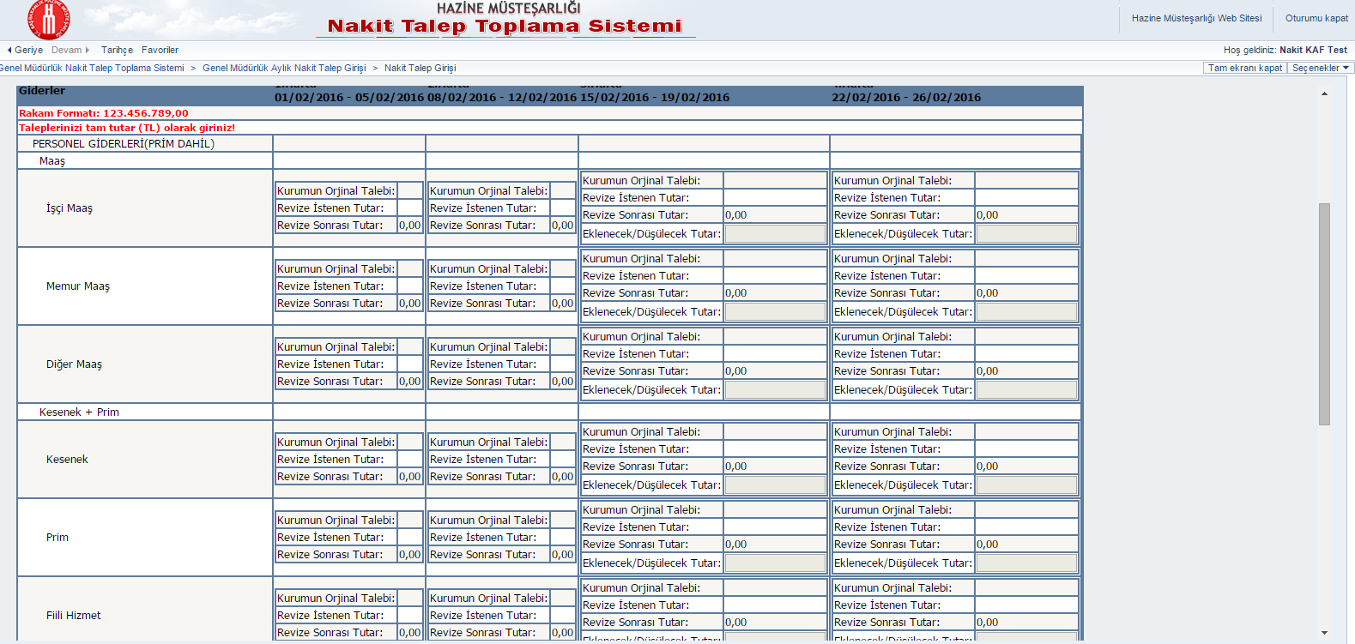
Cash Request System-III

Slide 13

Daily Cash Planning
Monthly program figures are translated into daily program figures
  Specific day of the week is determined for payments depending on the type of the administration, e.g. tuesdays for universities, wednesdays for line ministries.
Daily cash requests are collected via Public Electronic Payment System (PEPS)
  Each day institutions submit their cash requests categorized as personnel payments, other obligatory payments (e.g legal payments) and other payments.
Budget appropriation figures are gathered from PEPS
  In order to be able to make a payment all the budgetary processses should be completed.
  Determines the ceiling for the payments.
Cash reserves of the institutions are gathered from the Public Treasurship Information System
  Helps to determine whether the institution is really in need of the cash or not.
All the information is examined simulteanously and the next day’s cash allocation figures are determined

Slide 14
TREASURY SINGLE ACCOUNT AND MONITORING
3

Slide 15
Evolution of Treasury Single Account
Payments are made according to daily cash program.
Getting much more accurate data regarding to cash flows.
Forecasting cash flows are easier than before.
Seperation of collection and payment accounts.
All accounts are held in TCZB
The sweeping mechanism
Accounting units accounts and main account held in TCZB
The accounting units’ accounts are for both collections and payments
Weekly reconciliation
3rd Stage
2nd Stage
1st Stage
1972
2007
2011
1st Reform
2nd Reform
Due to the;
Latency of realization data regarding to both collections and payments,
Lack of controls regarding to payments of accounting units,
TSA has been reformed in 2007.
All payment accounts held in Ziraat Bank closed and the payment accounts for all accounting units opened in CBRT.
All collections are gathered in TSA and all payments are made from TSA held in CBRT.

Slide 16
Treasury Single Account-I
comprises general budget institutions
held at the Central Bank of Turkey
TSA
all the revenues are pooled and all the payments are made via TSA
other bank accounts are used for debt payments and receipts before pooled at the TSA
CBRT can use ZiraatBank as its correspondent

Slide 17

Treasury Single Account-II
CBRT Account No 416
External Debt Payments (for FX other than USD, Euro, JPY, GBP)
External Debt Payments
Changes in Exchange Rate
Tax and Non-Tax Income
Collections From Customs
Dividends
Treasury Levy etc.
TRZB Collection Account No 1000
CBRT Foreign Currency Account
External Borrowing
Domestic Borrowing in FX
Privatization Income
Receipts from SDIF
Changes in Exchange Rate
CBRT Account No 410 - TSA
Payments to:
Central Accounting Units
Universities
Public Enterprises
Local Governments
Extrabudgetary Funds
Social Security Institution etc.
Tax and Non-Tax Income
collected by regional units
Domestic Debt Payments
CBRT Account No 411
Receipts from Government Debt Securities Auctions

Slide 18
Monitoring
Deviations from daily cash program are reported daily to the top management
Deviations from monthly program are examined at the meeting with DG and Undersecretary
Monthly cash realizations are shared with public through Treasury’s website on a monthly basis
CMD’s KPIs are defined as the average monthly deviation in the total revenues and expenditures and CMD is subject to Turkish Court of Acccounts’s audits and accountable for these KPIs
Spending units are evaluated and ranked according to their spending performance on a monthly basis and they are regularly informed about their performance

Slide 19
ManagIng CASH RESERVES
4

Slide 20
Remuneration of Treasury Cash Reserves
The objective is to reduce the idle or low-yielding cash amount held at the central bank.
TL accounts are remunerated weekly and FX accounts are remunerated monthly with market rates.
Also, remaining TL and FX accounts are remunerated daily under market rates.
Treasury pays transaction fee to CBRT and ZiraatBank for banking operations.

Slide 21
Short-Term Money Market Operations
Regulation on Financing Through Money Market Cash Operations; November 8th 2008.
The objective is to minimize government borrowing costs by using short term cash instruments for managing cash flows.
3 types of instruments to balance timing differences of cash inflows and cash outflows within a month.
  Cash Transaction Note (CTN)
  Reopen with the Commitment or Repurchase (RCR)
  Deposit Auction
Instruments have at most 30 days of maturity
Not utilized so far due to strategic benchmark on holding strong cash reserves

Slide 22
RELATIONSHIP with DEBT AND RISK MANAGEMENT
5

Slide 23
Relationship with Risk Management-I
Strategic Benchmarks
Criteria for Cash Reserves
Daily Available Cash Reserves
Minimum Level
Liquidity Buffer
Maximum Level
FX Reserves
Money Market Operations

Slide 24
Relationship with Risk Management-II
Treasury keeps LB to conrol;
time differences between cash inflows and outflows
revenue-based deviations
expenditure-based deviations
Maximum level of FX reserves determined. If level of FX reserves exceed maximum level, the excess amount is converted to TL.
Minimum daily cash balance is determined to reduce the risks stemming from daily transactions.
Short Term Money Market Instruments used when daily available cash reserves falls below the determined lower limit for a temporary period.

Slide 25
Relationship with Risk Management-III
The Advantages of LB:
Enhances market confidence
Gives positive signals to the investors
Prevents liquidity squeeze in the market
Helps coping with the debt distress periods

Slide 26
Relationship with Debt Management-I
Sharing realistic cash flow forecasts regarding the timing and magnitude of public revenues and expenditures made by cash management units guides debt managers, provides flexibility, facilitates to be prepared against possible risks and increases efficiency in debt management by allowing determination of appropriate tools, timing and amount of borrowing more accurately (Williams, 2010)
Borrowing program is formed based on the revenue, expenditure and cash deficit forecasts of government cash management units.
Preparing and implementing borrowing strategies and financing programs properly requires the integration or at least close cooperation of debt management units with cash management.

Slide 27
Relationship with Debt Management-II
Short term money market operations are not considered as part of the borrowing program. For effectiveness and tranperancy, coordination with debt management is essential during short term money market operations.
There are several reasons for buy-back operations with regards to both cash and debt management. So buy-back operations requires close coordination between these two units.
Cash management unit should work in coordination with debt management in order to eleminate liquidity risks in case contingencies take place regarding cash flows .

Slide 28
Public treasurership system (PTS)
6

Slide 29
Public Treasurership System
Since 1996
formulates general principles for the utilization of public financial resources
PTS
banks send information regarding public financial resources
based on tax identification number
reports produced on a daily basis
data receive from PTS used in cash management operations

Slide 30
Scope of PTS
General budget institutions «DD; CBRT; ZB»
Special budget institutions «TD; DD; B; R; CBRT; TRZB; OPB»
Revolving funds and other funds «TD; DD; B; R; CBRT; TRZB; OPB»
Municipalities and special provincial administrations «TD; DD; B; R; CBRT; TRZB; OPB»
Social security institutions «TD; DD; B; R; CBRT; TRZB; OPB»
State-owned enterprises «TD; DD; B; R; CBRT; TRZB; OPB»
Other «TD; DD; B; R; CBRT; TRZB; OPB»
TD: Time Deposit, DD: Demand Deposit, B: Bonds, R: Repo/Reverse Repo
CBRT: Central Bank, TRZB: Ziraat Bank, OPB: Other Public Banks

Slide 31
Public Financial Resources from PTS
As of 31/12/2015

Slide 32
Distribution of Public Financial Resources on the Basis Institutions
As of 31/12/2015

Slide 33
Thank You!
TURKISH TREASURY
Cash Management Department

Slide 34
ANNEX-Abbreviations
MTP: Medium Term Program
MTFP: Medium Term Financial Plan
CMD: Cash Management Department
DMD: Debt Management Department
CG: Central Government
MoF: Ministry of Finance
UT: Undersecretariat of Treasury
PB: Primary Balance
SDIF: Savings Deposit Insurance Fund
TSA: Treasury Single Account
CBRT: Central Bank of Republic of Turkey
TRZB: Turkish Republic Ziraat Bank
CRS: Cash Request System
KPI: Key Performance Indicator
PTS: Public Treasurership System
TD: Time Deposit
DD: Demand Deposit
B: Bonds
R: Repo/Reverse Repo
OPB: Other Public Banks

