Slide 1

Public Electronic Payment System
Payment Systems Department
Ankara - March, 2016

Slide 2
Presentation Plan
    Introduction
    Workflow
    Results and Conclusion

Slide 3
Definition
    Transfer of public payments electronically
    Fully automated process, including bookkeeping and production and transfer of the EFT messages
    Real-time inquiry of payment status, bank statements and receipts electronically
Notes:
The public electronic payment system is developed to transfer public payments electronically. The process is fully automated, including the production of bookkeeping records, creation and sending of EFT messages. It also provides user with the real-time inquiry of payment status, bank statements and receipts electronically.

Slide 4


Public Electronic Payment System (PEPS)
Public Payments
Salaries
Service payments
…
Treatment payments
Accounting Office
Central Bank Of Turkey
Ministry of Finance
Treasury
Accounting Office
Accounting Office
EFT
Notes:
Salaries, treatment and medicine payments and service payments are examples of public payments. Accounting offices which make public payments are all using the KBS software system provided by the Ministry of Finance. They create payment orders by KBS. The system uses PEPS web services at the background to transfer and track the status of the payment orders. All of the accounting offices has accounts at our Ankara Branch from which the payments are made. At each day, before 9 a.m., Treasury sends its payment orders to Central Bank which distributes necessary amount of money for accounting offices to make their daily payments. After the Treasury payments are completed, the accounting offices has the money and their payments are sent electronically all around Turkey by EFT system

Slide 5
Presentation Plan
    Introduction
    Workflow
    Results and Conclusion

Slide 6
Public Electronic Payment System (PEPS)
Cash demand approval results
Cash demand approval results
Ministry of Finance
Treasury
Tax Office
Accounting Office
Rejection
&
return payments
Cash demands
Cash demands
CASH DEMAND
Payment Orders
Social Security Payments
Salary Payments
Rejection and Return of taxes
Medication & Treatment Fees
Service Payments
TIBS
Reconciliation reports,
Status report,
Account statements,
Bank receipts
Payment Orders
PEPS
Reconciliation reports, status reports
Receiver
(person, company or organization)
Receiving Participant (Bank)
Re-transfer of end-of-the day balances to the Treasury
M03
Accounting Office’s account
EFT
M09 (for returns)
Treasury’s Account
M03
M09 (for returns)
Receiver
(person, company or organization)
Accounting Office’s account
Receiving Participant (Bank)
...
M03
Accounting Office’s account
Transfers within CBRT
Re-transfer of end-of-the day balances to the Treasury
PAYMENT AND RECONCILIATION
Notes:
In the beginning of the workflow, accounting offices sends the cash demands to the treasury through Ministry of Finance systems. Tax offices are also connected to the system through the accounting offices for their rejection and return payments . Treasury evaluates the demands as a whole wrt. its budget plans and sends the approval results to the accounting offices through the system. After approvals, Accounting Offices creates payment orders for the payments whose cash demand is approved and sends to the Central Bank through PEPS. Treasury sends the required balances which have the same amount as the total approved cash demands as payment orders to the Central Bank through the TIBS, which is a secure e-signature based web services based system.
Each accounting unit has a payment account in the system. In the value date, first, Accounting Units’ payment accounts are credited from the Treasury’s account wrt the TIBS payment orders. After that, PEPS payment orders are processed by FIFO principle. In both systems, payment orders are performed only when there is enough balance in the account.
At the end of the value date, all unused balances remaining in the accounting offices’ accounts are returned back to the treasury’s account automatically. Similarly, all waiting payment orders are returned back (as an example waiting since the balance is insufficient) to the accounting offices by changing their status as ‘cancelled in the end of the day’.
Each step of the workflow can be monitored by treasury and accounting offices through TIBS and PEPS systems in the form of reconciliation reports, account statements, bank receipts and status reports which are provided electronically by digital signatures through PEPS web services.

Slide 7


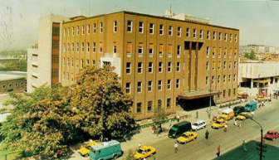

Phase-1 Workflow
Payment orders
waiting
for approval
Ministry of Finance
Treasury
Payment orders
approved by the
accounting offices
Branch
Approval
Approval
Display
CBRT Ankara Branch
EFT
Approved payment
orders
Accounting Office
Display
Bookkeeping records
and
EFT Messages
Notes:
The transition to PEPS is performed in two main phases. First, as a pilot project, payments were sent both electronically and in written. The workflow of Phase1 can be seen from the slide. First, treasury distributed money to accounting offices. The accounting offices transferred their payment orders to Central Bank. Then, they checked and approved the orders. After the approval, they generated a paper-based payment order, signed it and sent it to Central Bank Ankara Branch. The paper-based and electronic payment orders were compared at our Ankara Branch and if they matched, payment order was approved by the branch. After the approval, payments were sent to EFT system automatically. At each step, accounting offices could inquire accounting records, EFT messages and the status of their payments.

Slide 8
Phase-2 Workflow
Payment orders
waiting
for approval
Ministry of Finance
Treasury
Approval
Approved
Payment
Orders
CBRT Ankara Branch
Inquire
Accounting Offices
EFT
Inquire
Bookkeeping
records
and
EFT Messages
Notes:
When the pilot application is found successful, we proceed to phase-2, in which there are no paper-based or signed payment orders, so our Ankara Branch does not control or approve the payment orders. Payments are automatically sent to EFT after the approval of the accounting office. Again, accounting offices can inquire the status of their payments orders, accounting records and EFT messages real-time. This is the final phase of the system that is in use today.

Slide 9

User Management
Administrators
Provincial Treasurer
Provincial Treasurer
Provincial Treasurer
Head of Acc. Off.
Head of Acc. Off.
Head of Acc. Off.
Head of Acc. Off.
Head of Acc. Off.
Head of Acc. Off.
Head of Acc. Off.
Head of Acc. Off.
Head of Acc. Off.
End-users
End-users
End-users
Notes:
There are nearly 3000 active users in the system. All of their security tokens and certificates need to be managed. For the management of users, we designed a layered architecture. At the top of the architecture, there are administrator users. They are not allowed to make any payments, their only role is to manage user credentials and certificates. As central bank, we generate certificates to the administrators, which are less than five people. The system provides secured web services for user and certificate management electronically. Administrators use these web services to add/update/delete provincial treasurers, whose role includes supervision and management of the province’s accounting offices. Provincial treasurers manage the accounting officer’s heads’ credentials and certificates. Then, accounting officers defines and authorizes the end users responsible for performing the sending and tracking the payment orders.

Slide 10
Subsystems
    Secure web services that serve to accounting offices
    Web projects for
      Ankara Branch of CBRT,
      PEPS call center,
      Administration
Notes:
The main subsystem of KEÖS is the secure web services that serve to accounting offices to perform their operations. The system also has web based payments for our Ankara branch, call center and system administrators.

Slide 11
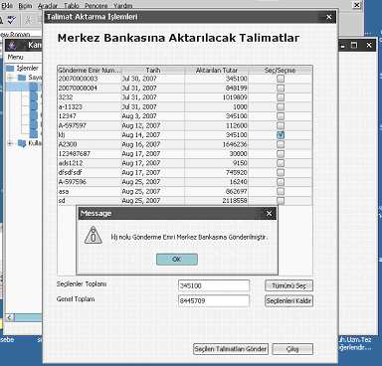
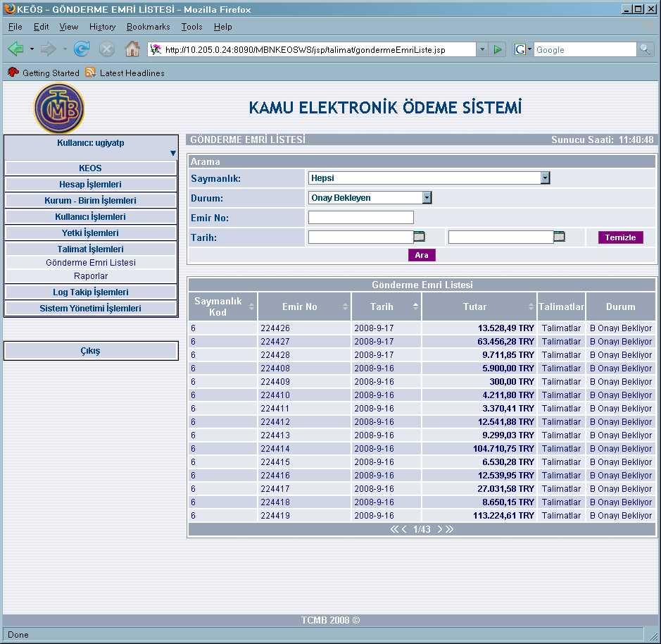
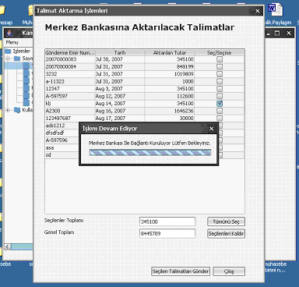
PEPS Web Services
MINISTRY OF FINANCE
Accounting Offices
CBRT
Ankara Branch
CBRT
PEPS
Web
Services
Notes:
In the left side of this slide, you can see the software that the accounting offices use, and in the right side, the software that our Ankara branch uses. The systems communicate by each other by the means off web services at the background. The users at accounting offices and our Ankara branch does need to logout their applications and login to other organizations software. The Ministry of Finance has been showed you a demo at the morning session. An the operations that you see has been performed real-time at our systems at the background by the web services.

Slide 12
Presentation Plan
    Introduction
    Workflow
    Results and Conclusion

Slide 13
Results and Conclusion
Before PEPS
Same account is used for payments and collections
When accounting office has balance from collections, it is used for payments of this office without Treasury’s control
Accounting office continue sending payments even if it does not have a balance in the account
Treasury cannot predict collection’s amount and timing
Spending over the Treasury’s plans
Treasury has minimum control over the system

Slide 14
Results and Conclusion
After PEPS
Every accounting office has:
    Domestic payments account
Central accounting offices also have
  Collections account
  Foreign payments account
Payments are made only when
  Treasury approves and sends money for the payment
  A payment order is sent by the accounting office through PEPS
Money in collections account is transferred automatically to Treasury, accounting office cannot use its balance
Balance left at the end-of the day in domestic payments account is transferred back to Treasury
All operations are performed electronically and can be controlled by each party instantaneously.

