Slide 1
PEMPAL TCOP Cash Management Thematic Group Meeting
REPUBLIC OF CROATIA
Ministry of Finance
- State budget cash flow forecasts -
Vienna, Austria
November 2023

Slide 2
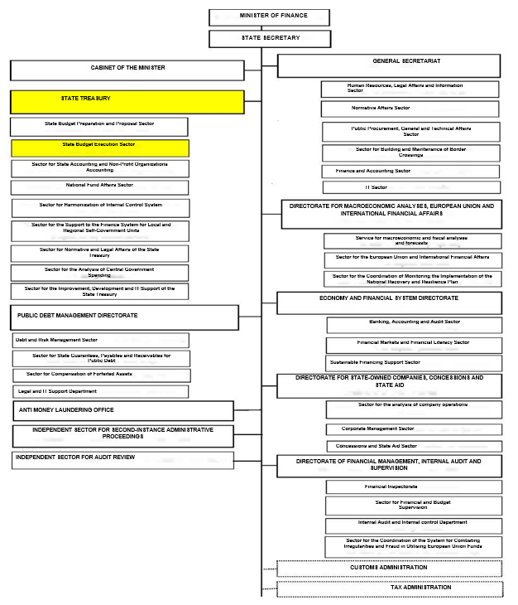
Organisation
State Budget Financial Flow
Planning Service
analysing budget categories for the purpose of state budget cash flow forecasting
state budget cash flow forecasting
monitoring and keeping records as regards the execution of the monthly, weekly and daily liquidity plan
monitoring the balance of funds held in the state budget accounts and spending unit accounts
preparing simulations of monthly financial flow movements every day on the basis of execution of expenditure and outlays as well as on the basis of generated revenue and state budget receipts

Slide 3
Data sources and frequency of forecasts
Prepared on ANNUAL, QUARTERLY, MONTHLY, WEEKLY AND DAILY LEVEL on the basis of
FORECASTS OF REVENUE, RECEIPTS AND OTHER INFLOWS
1) REVENUE FORECASTS
(Bureau for Macroeconomic and Fiscal Analysis and Forecasts)
2) RECEIPT FORECASTS
(Public Debt Management Directorate, EU and International Financial Relations Sector)
3) FORECASTS OF EU FUNDS INFLOWS
(National Fund Affairs Sector)
FORECASTS OF EXPENDITURE, OUTLAYS AND OTHER OUTFLOWS
1) EXPENDITURE FORECASTS
(State Budget Financial Flow Planning Service)
Forecasts and execution in the previous period
Financial plans of spending units
Commitments (notification of commitment, contract, purchase order)
Invoices, payment requests
2) OUTLAY FORECASTS
(Public Debt Management Directorate)
DAILY UPDATES
DAILY UPDATES
DAILY UPDATES
DAILY UPDATES
DAILY UPDATES
BALANCE OF FUNDS ON THE SINGLE ACCOUNT AND OTHER ACCOUNTS
Notes:
Na jedinstvenom računu državnog proračuna ostvaruju se svi priljevi (prihodi, primici i ostale uplate) i izvršavaju svi odljevi (plaćeni rashodi i izdaci i ostala plaćanja) proračuna i proračunskih korisnika državnog proračuna

Slide 4
Outflow categories
Inflow categories
Balance on the budget account held at the Croatian National Bank
EU inflows
Date
Liabilities, public debt
short-term loans,
balance of funds in other currencies and on state budget accounts held at credit institutions,
treasury bills principal balance

Slide 5
Using forecasts for decision making
State budget cash flow forecasts are used when making decisions related to the schedule of payments within a month, e.g. for the purpose of determining priority payments, determining the schedule of payment of larger amounts of expenditure per day of the month, and the like
Key decisions (whether on the method of financing a budget deficit or the placement of surplus funds) are made at the meetings of the Liquidity Commission which operates within the Public Debt Management Directorate
A potential surplus of available funds can be deposited with the Croatian National Bank and credit institutions (commercial banks), respecting the principles of safety, liquidity and profitability of investments
Interest is calculated on the state budget funds held at the Croatian National Bank (TSA) according to the Decision on the Interest Rates on the funds of public sector entities at the Croatian National Bank (which is in line with the with the decisions of the European Central Bank).

Slide 6
Challenges in cash flow forecasting
CALLS ON THE ISSUED STATE GUARANTEES, COURT DECISIONS
CHANGES IN THE MATURITY OF LIABILITIES
“URGENT” PAYMENTS
SPENDING UNITS NOT COMPLYING WITH THEIR OBLIGATIONS UNDER FUNDS PLANNING (certain expenditures are executed at the end of the year or remain unexecuted)
CASH FLOW FORECASTS DEPEND ON THE INPUT OF SPENDING UNITS (who do not consider a wider perspective of the state budget liquidity and whose possible poor planning and execution can lead to the adoption of inadequate decisions)
UNPLANNED/UNREALISTICALLY PLANNED PROJECTS/ACTIVITIES FINANCED FROM FLEXIBLE FUNDING SOURCES (EU FUNDS)
DIFFICULTIES IN PLANNING THE INFLOW OF EU FUNDS IN MORE DETAIL

Slide 7
Thank you for your attention!

