Slide 1
Civil Service Reform in Georgia
Maia dvalishvili

Slide 2
CIVIL SERVICE BUREAU
Independent Legal Entity of Public Law
Leading Agency Coordinating and implementing the Civil Service Reform
Supporting implementation of the anti-corruption policy through ensuring publicity of assets declaration, monitoring and providing guidance on ethics

Slide 3
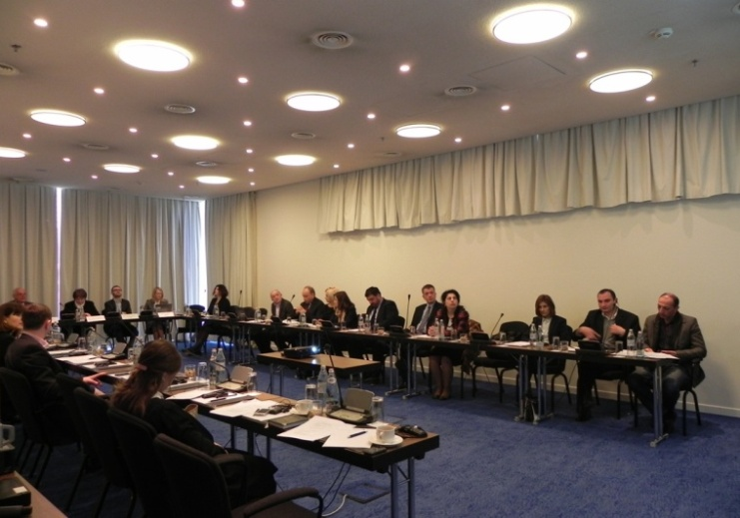
Civil Service Reform Concept
Creation of the Governmental working group
Regular meetings
Analyzes of the existed situation
Reflection of the recommendations to the draft

Slide 4
Adoption of the Concept
Governmental decree N627, 19th of November, 2014
Strategic document indicating concrete steps for reforming the Georgian Civil Service based on the EU categorization, which was used in other countries of transition

Slide 5
Categories of the Concept
List:
Definition and the scope of the CS
Centralized system for the management, coordination and oversight over the CS
The classification system
The remuneration system
Recruitment in civil service
Managing civil servants
Rights and duties of civil servants
Training and professional development
Equal opportunities for men and women

Slide 6
Civil service legislation
Civil Service Bureau started implementation of the concept by drafting the New Law on Civil Service
Same approach of drafting, meaning:
Creation of working group
Internal discussion
SIGMA involvement
Updating draft according the recommendations
Public discussions
Submission of the draft to the Government of Georgia

Slide 7
Enactment of the new Civil service Law
New Civil Service Law came into force from July 1, 2017
Clear definition of Functions of Civil servants, labor and administrative contract employees
Unified classification system
New regulations for admission to civil service
Carrier management system
Unified remuneration system
Performance appraisal and professional development

Slide 8
Functional analysis
To prepare the public institutions for the changes envisaged by the new Law on Civil Service it was essential to carry out the process of functional analysis which included:
Detailed analysis of line ministry portfolios; in-depth examination of structures (vertical analysis)
Develop general principals on organizational arrangements

Slide 9
Law on Salaries
Elaboration and adoption of the new Law on Remuneration in public institutions in 2017
The Law regulates not only the issues of salaries of professional civil servants, but also applies broadly to the "public service employees" regardless their legal status. It aims to establish a fair, transparent, and foreseeable system of remuneration of persons employed in the public sector.

Slide 10
Online Asset Declaration System in Georgia
Asset Declaration System is operational since 1998
However, it was only in February 2010 when the entire system became online-driven
All senior Georgian officials submit their asset declarations annually at www.declaration.gov.ge
Submitted declarations are published instantly on the website
More than 5600 public officials are obliged to fill out asset declarations

Slide 11
Development of Declarations Monitoring System
The amendments to the Law on Conflict of Interests and Corruption in Civil Service (CoI) have been adopted on October 27, 2015 and entered into force on January 1, 2017. The new amendments established a monitoring system for asset declarations of public officials.

Slide 12
Monitoring Procedure
The monitoring process is completed upon crosschecking of the information in different electronic databases in accordance with the principles of confidentiality.
comparing asset declaration information with:
Electronic databases administered by public institutions;
Information requested and provided by official;
No excess to private databases such as banks and other private financial organizations.

Slide 13
Ethics in Civil Service
Code of Ethics was adopted in 2017
dbb Academy experts trained seven Georgian trainers and developed a detailed civil servants training agenda within the Training of Trainers;
Systematic Trainings of Civil Servants on Ethics

Slide 14
Thank you!

