Slide 1
Are Public Financial Management Reforms Yielding Results in the Region?
Duncan Last
Regional PFM Advisor for South East Europe
Fiscal Affairs Department, IMF
OECD CESEE Senior Budget Officials Meeting
Ljubljana, 28-29 June 2016

Slide 2
Significant reforms implemented since 2000
Most CESEE countries enhanced their budgetary and accounting systems since 2000, both through peer group pressure and by significantly leveraging available technical assistance and capacity building. Among the notable improvements of the last decade:
Implementation of medium-term budget frameworks
Adoption of fiscal rules and fiscal responsibility frameworks
Unification of recurrent and investment budgets, broadening of institutional coverage, and reduction of extra-budgetary spending
Introduction of program budgeting
Regular in-year and end-year fiscal reporting, often in line with international standards (GFS, ESA)
Moving towards accrual accounting and IPSAS standards

Slide 3
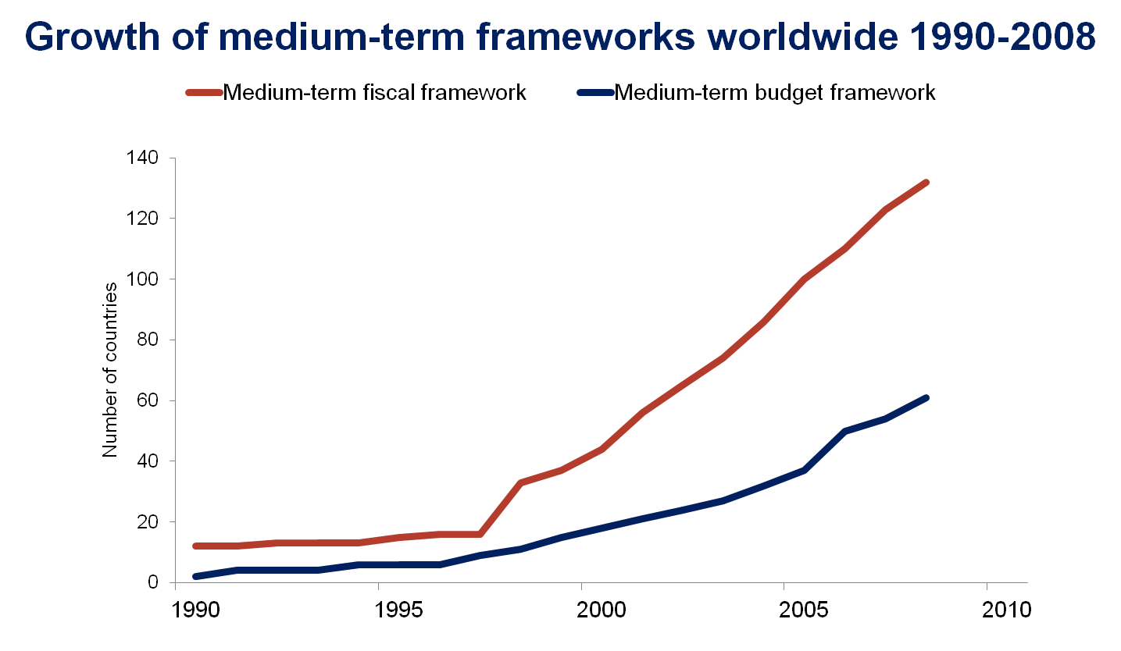
Selected reform results of the last decade Medium term frameworks

Slide 4
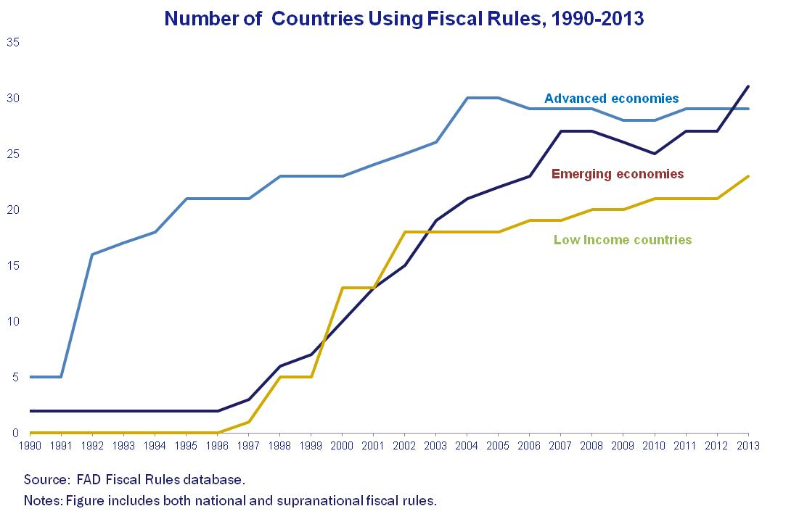
Selected reform results of the last decade Fiscal rules

Slide 5
Selected reform results of the last decade Progress in adopting fiscal reporting standards
Institutional coverage has expanded…
…and the shift from cash to accrual is underway…
…but few countries prepare full balance sheets …
…and frequency of reporting is still a problem.

Slide 6
However, the crisis stalled the progress and exposed weaknesses in PFM systems
Some earlier achievements were undermined…
fiscal rules broken, often soon after adoption
budget credibility undermined by significant revenue volatility and unanticipated spending pressures
…exposing weaknesses in PFM systems…
inadequate financial controls and uncontrolled arrears
untimely and questionable quality of general government/public sector data
ineffective monitoring and analysis of fiscal risks in the banking sector and in public enterprises
inefficient public investment spending
…and putting some advanced reforms on hold
notably performance budgeting and accrual accounting…

Slide 7
PFM reforms are now beginning to target some of the perceived weaknesses
Tightened expenditure controls and coverage…
improved commitment controls, including multi-year contracts
strengthened and expanded IT systems
greater focus on responsibility and accountability at budget manager level – internal financial control, fiscal responsibility statements
…improved forecasting and risk management…
focus on forward estimates, budget margins, contingency planning, and better reconciliation between forecast vintages
emphasis on analysis of new policies and fiscal space
establishment of fiscal risk units, particularly for SOE risks
renewed attention to central role in project appraisal and selection
…and greater transparency
more timely general government fiscal reporting
more readily accessible budget and accounting documentation
Notes:
Mention some of the new PFM tools
IMF has introduced new tools:
upgraded Fiscal Transparency Code and evaluation process (FTE)
tax administration diagnostic assessment tool (TADAT)
public investment management assessment tool (PIMA)
PPP fiscal risk assessment model (P-FRAM)
PEFA has just been upgraded:
four new indicators, expansion and refinement of existing indicators, and recalibration of baseline standards
Other institutions have also strengthened their diagnostic tools:
WB – public investment, public procurement
OECD, EC…

Slide 8
Fixing some of the problems is proving more difficult
How to reduce debt once the fiscal rule is broken…
debt reduction efforts imply cutting spending elsewhere…
…but how much to cut, and when, and how to get political support…
… and to deal with on-going external shocks & volatility…
secondary effects of the crisis in EU countries or Russia…
…make accurate or palatable forecasts difficult
So countries are starting to look at rational ways to find savings and control spending:
significant interest in spending reviews
working with line ministries to establish and enforce binding ceilings
more cost effective delivery of public services – value for money
greater reliance on public-private partnerships
But many are considering or already have IMF programs with expenditure rationalization and downsizing agendas.

Slide 9
References and reading list
Budina and others, Fiscal Rules at a Glance: Country Details from a New Dataset, IMF Working Paper 12/273.
Schaechter and others, Fiscal Rules in Response to the Crisis. Toward the “Next Generation” Rules, IMF Working Paper 12/187.
Cangiano, Marco, Teresa Curristine, and Michel Lazare (Eds.), 2013, “Public Financial Management and Its Emerging Architecture,” IMF book, http://www.imfbookstore.org/ProdDetails.asp?ID=PFMEEA
http://www.imf.org/external/datamapper/FiscalRules/map/map.htm
IMF, “New Fiscal Transparency Code”, 2014, http://blog-pfm.imf.org/files/ft-code.pdf
IMF staff report, “Making public investment more efficient”, 2015, http://www.imf.org/external/np/pp/eng/2015/061115.pdf
IMF, “PPP fiscal risk assessment tool (PFRAM)”, 2016, https://www.imf.org/external/np/fad/publicinvestment/pdf/PFRAM.pdf
PEFA Secretariat, “Framework for assessing public financial management”, 2016 https://www.pefa.org/sites/pefa.org/files/attachments/PEFA%20Framework_English.pdf

