Slide 1

Budgeting in Croatia

Slide 2
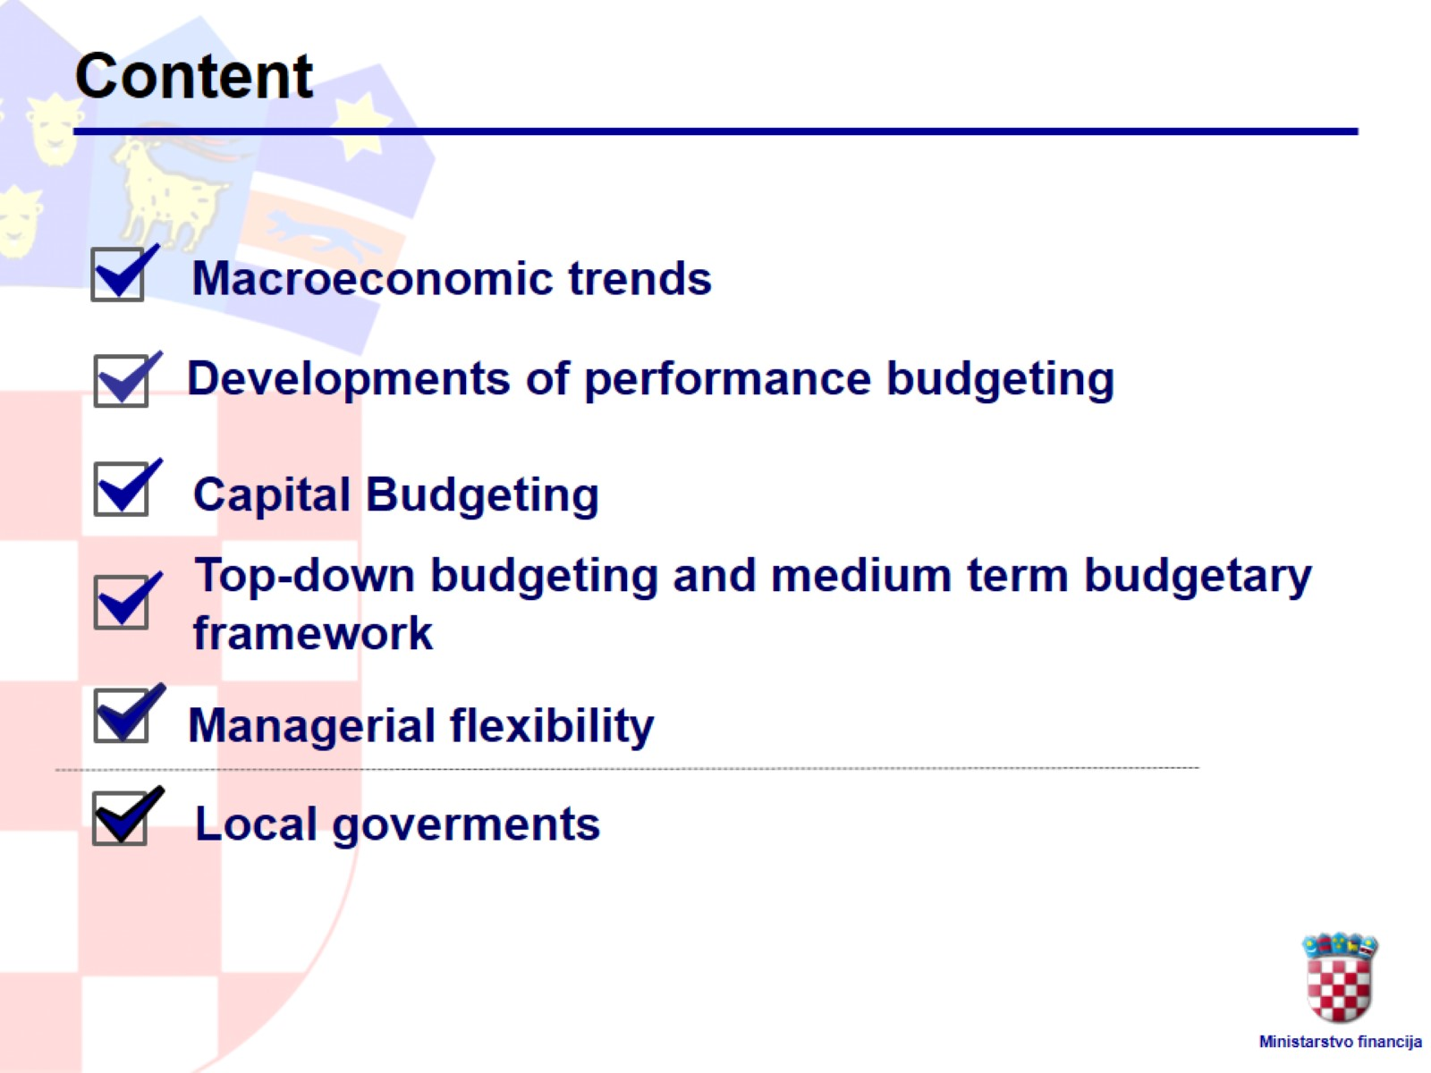
Content

Slide 3
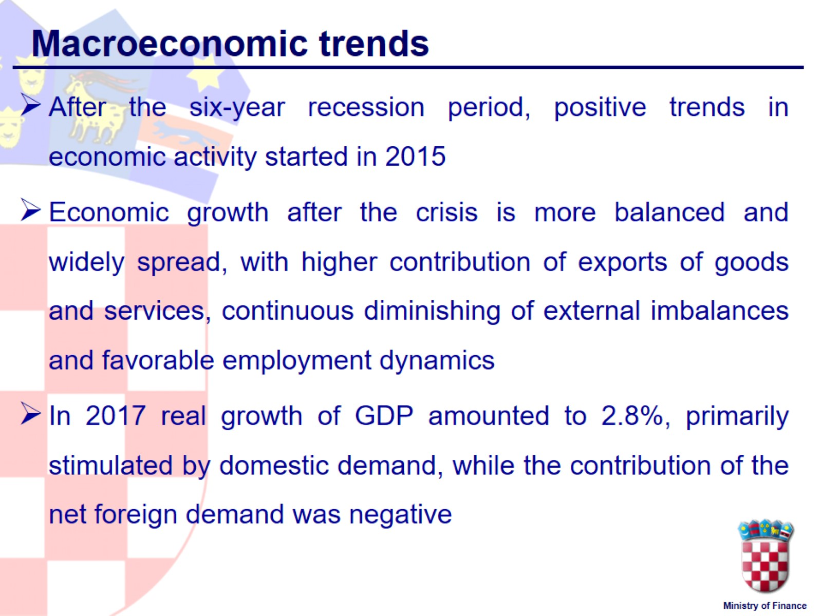
Macroeconomic trends

Slide 4
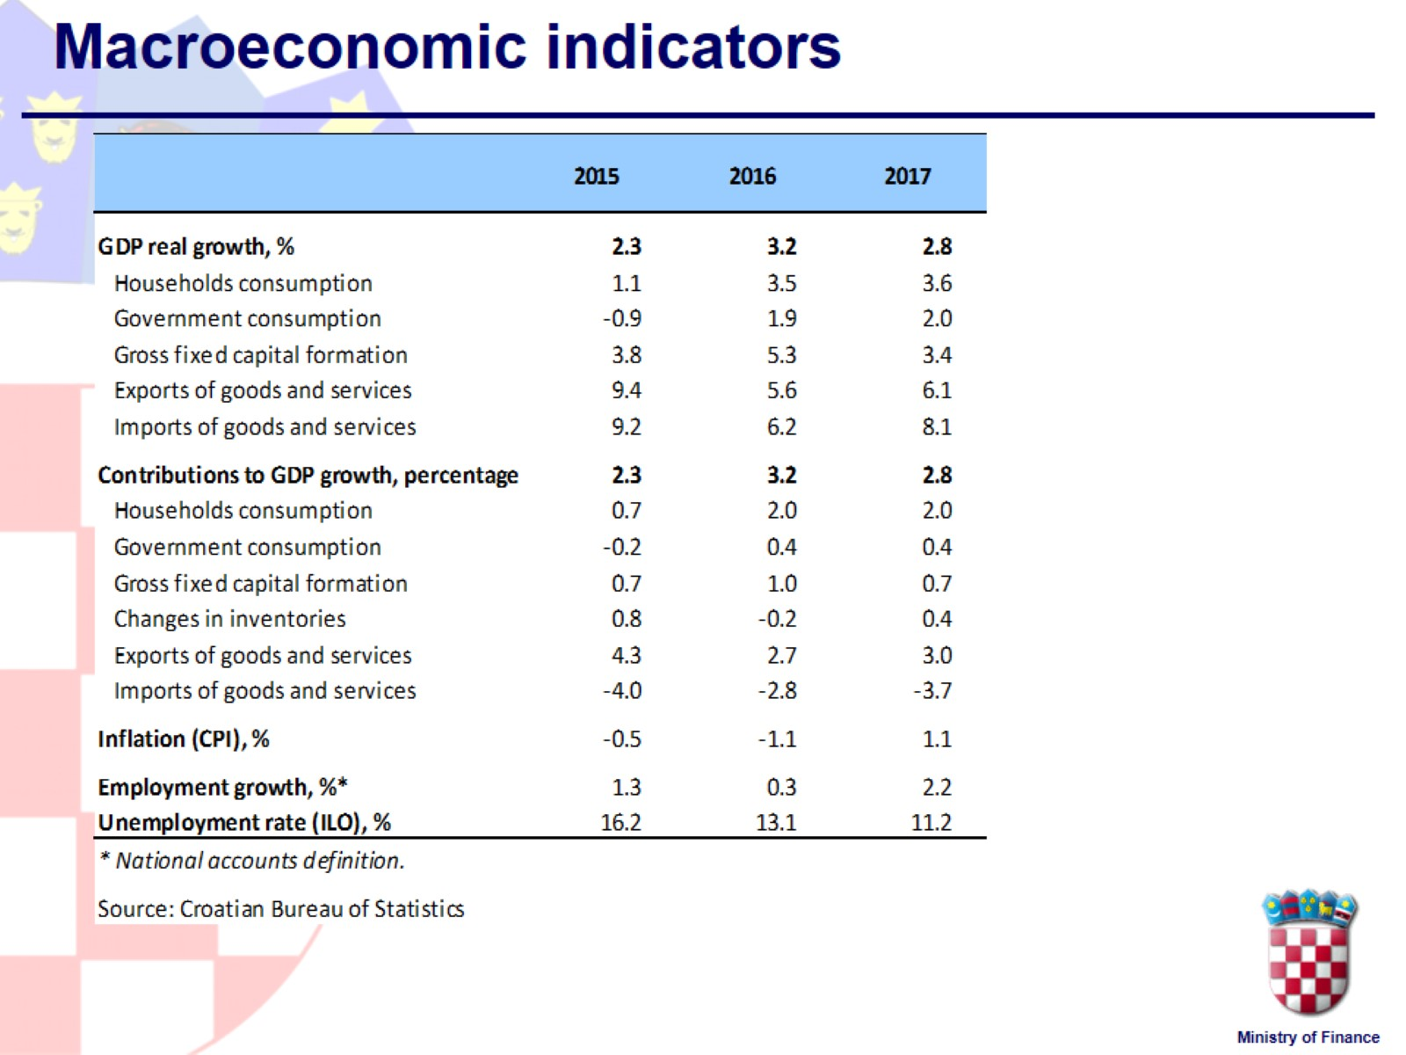
Macroeconomic indicators

Slide 5
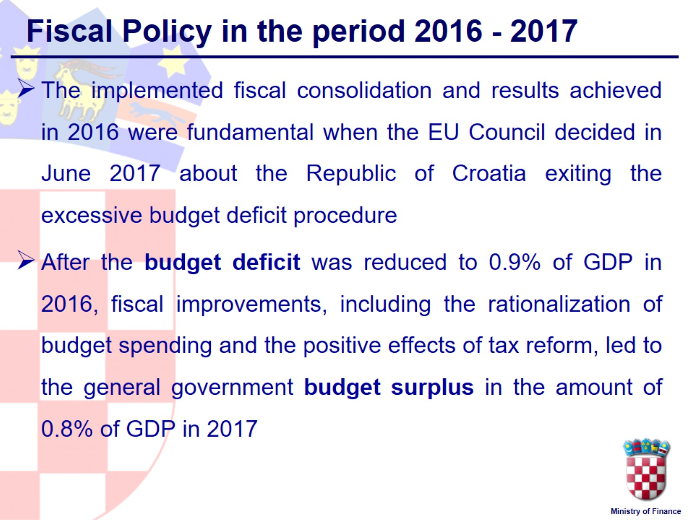
Fiscal Policy in the period 2016 - 2017

Slide 6
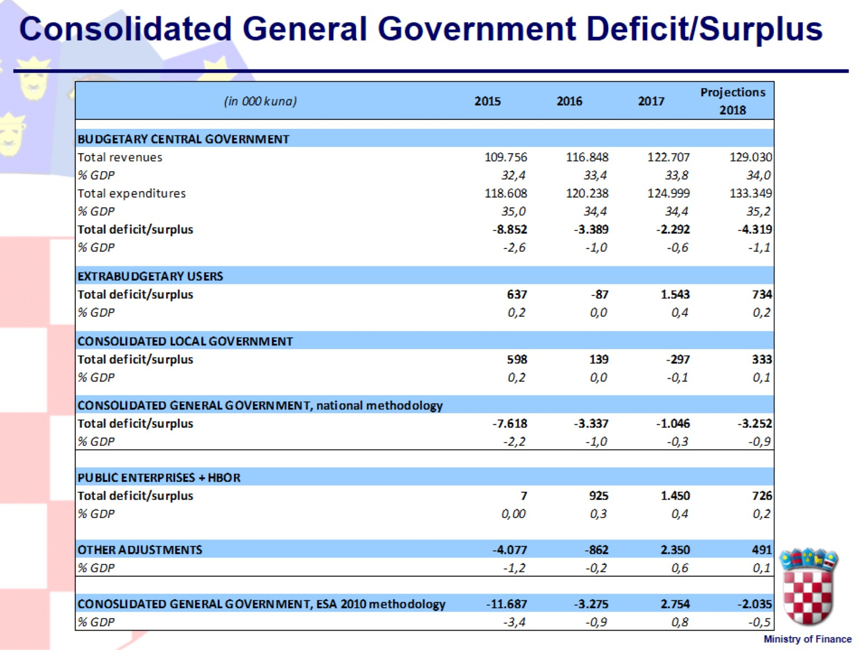
Consolidated General Government Deficit/Surplus

Slide 7
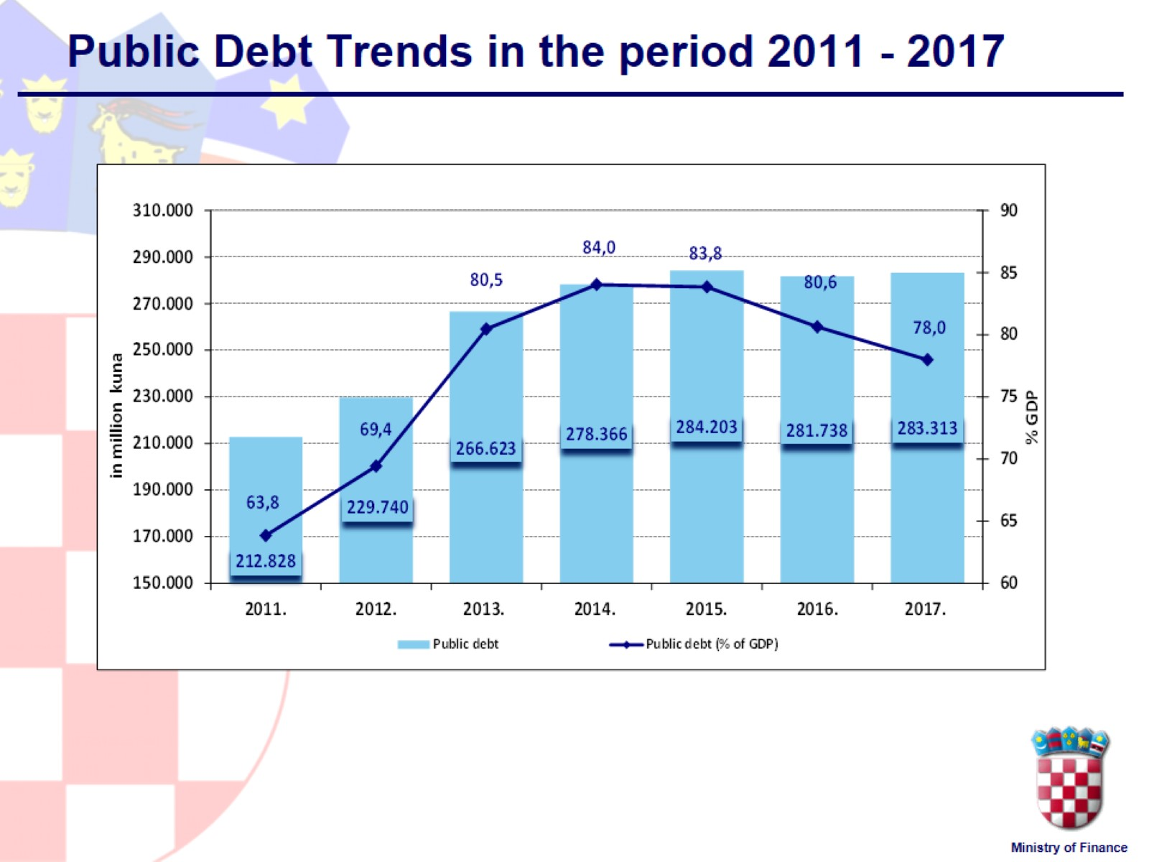
Public Debt Trends in the period 2011 - 2017

Slide 8
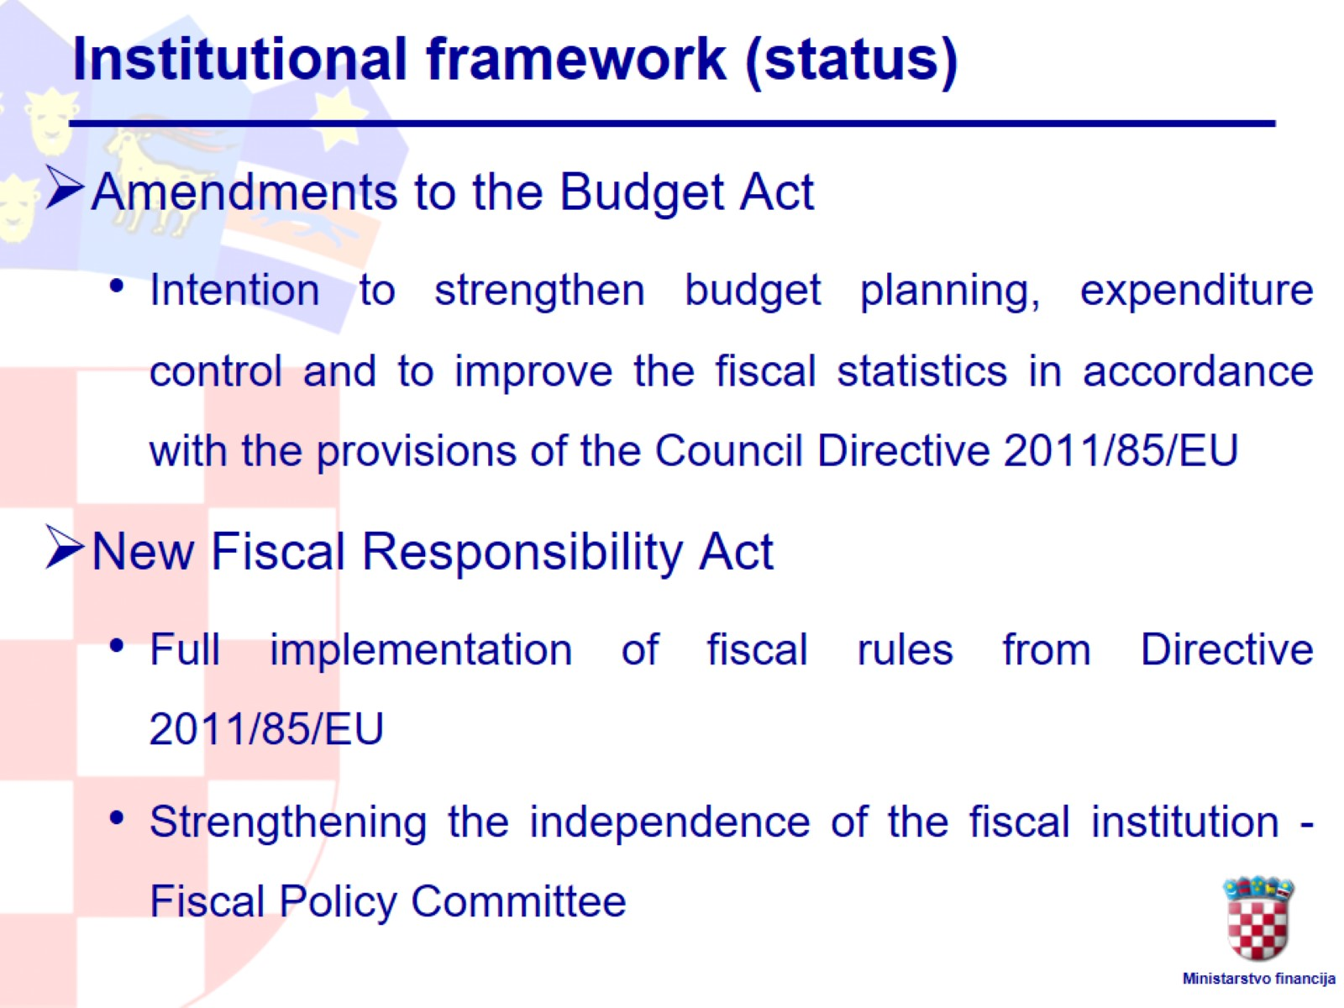
Institutional framework (status)

Slide 9
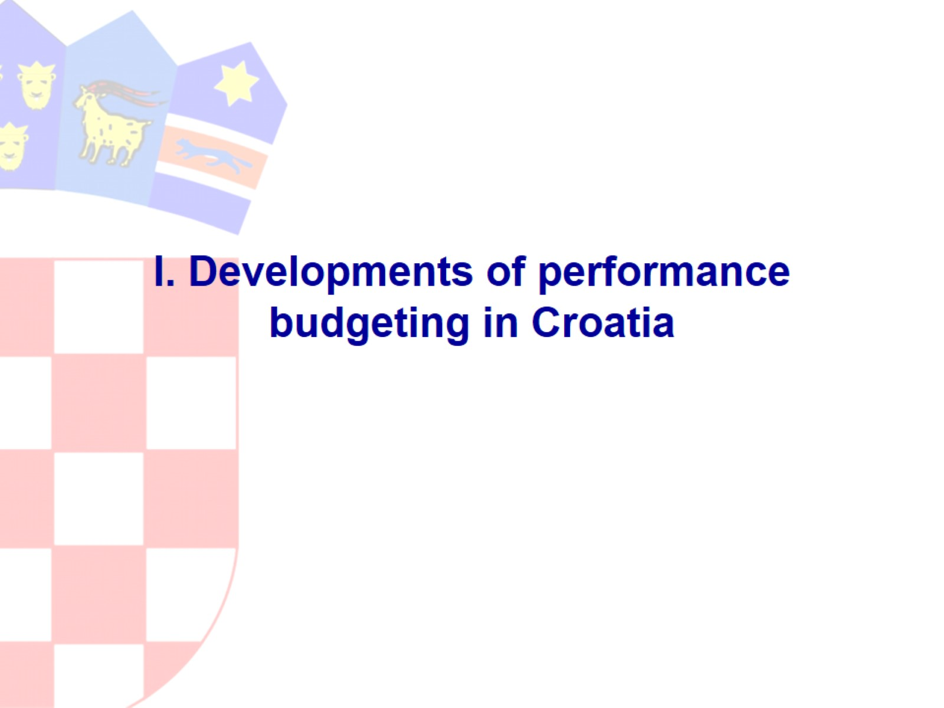
I. Developments of performance budgeting in Croatia

Slide 10
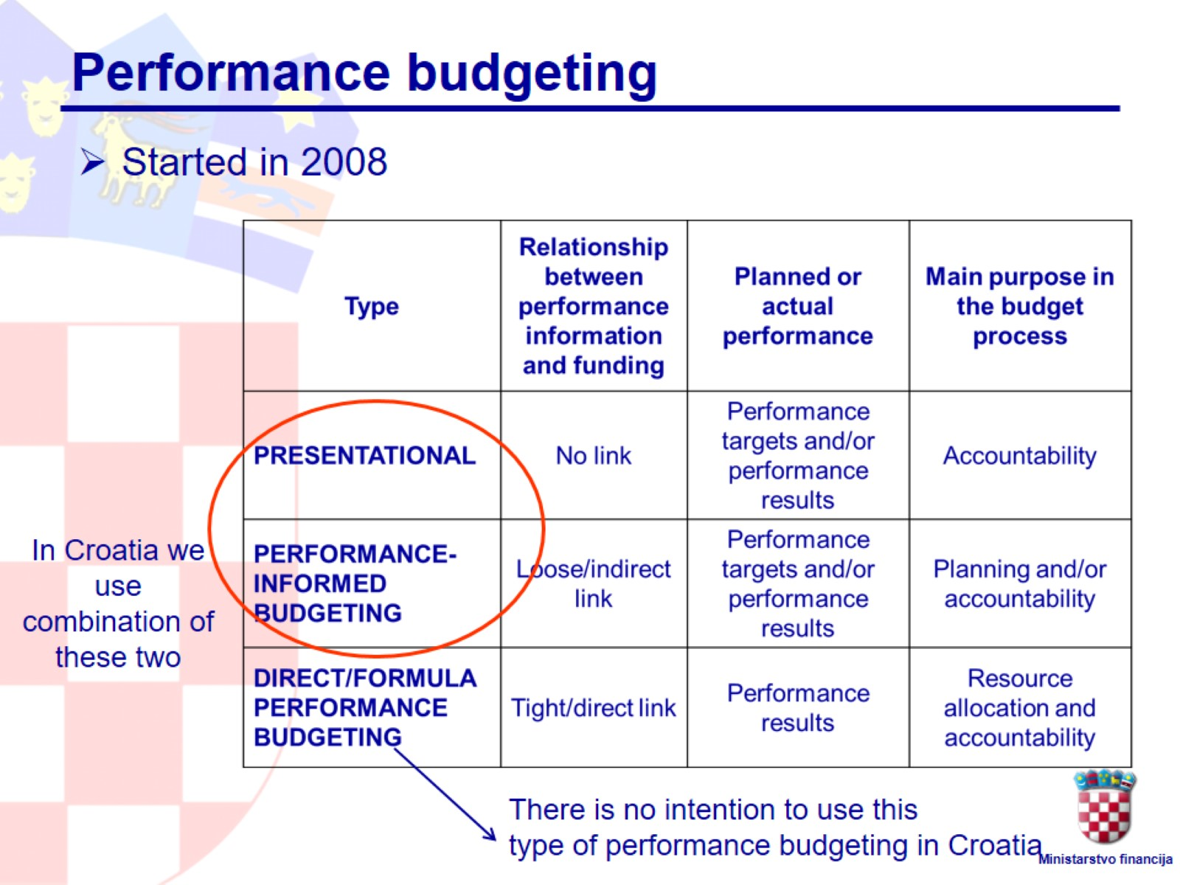
Performance budgeting

Slide 11
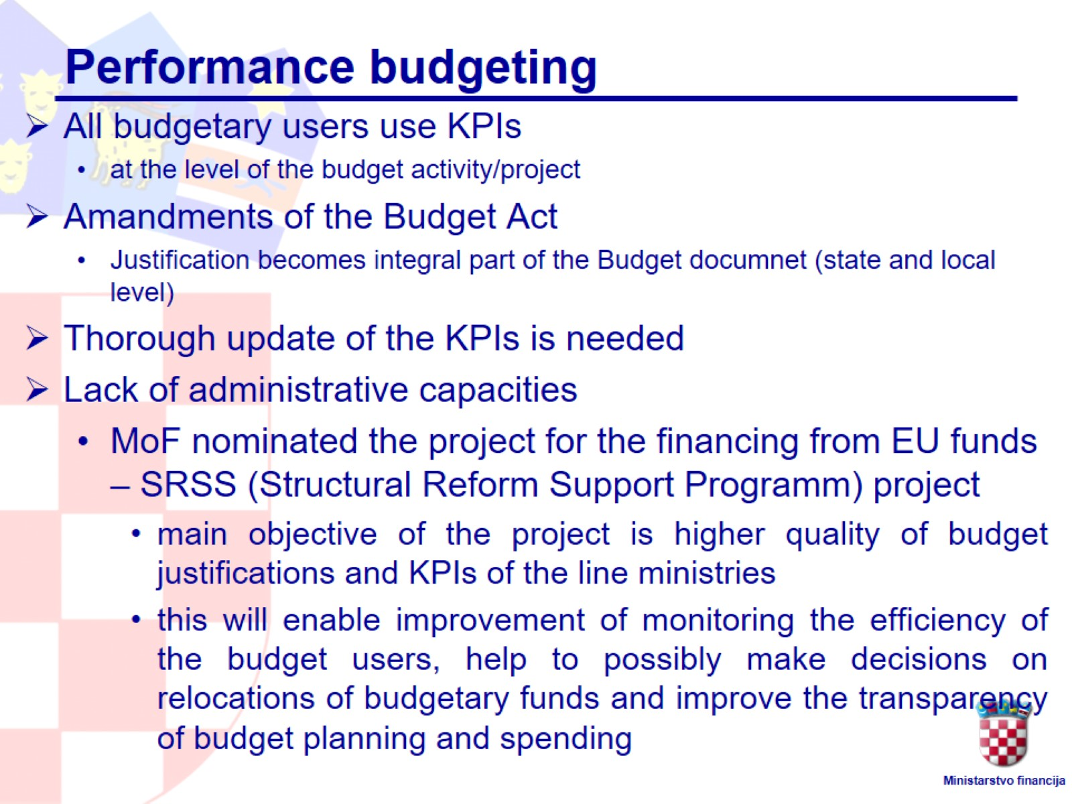

Slide 12
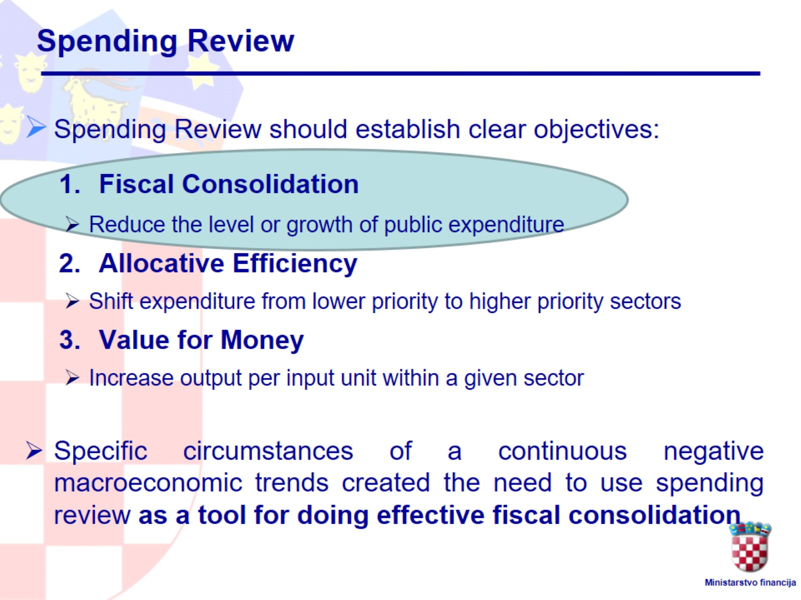
Spending Review

Slide 13
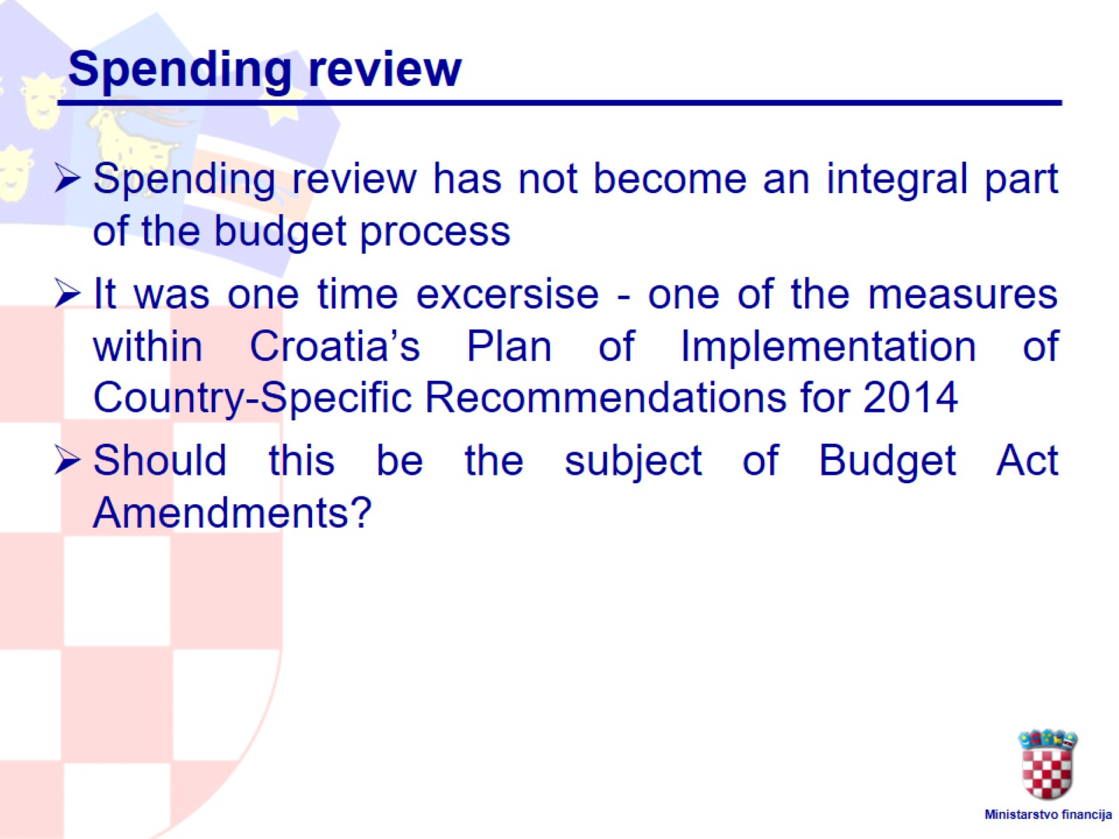
Spending review

Slide 14
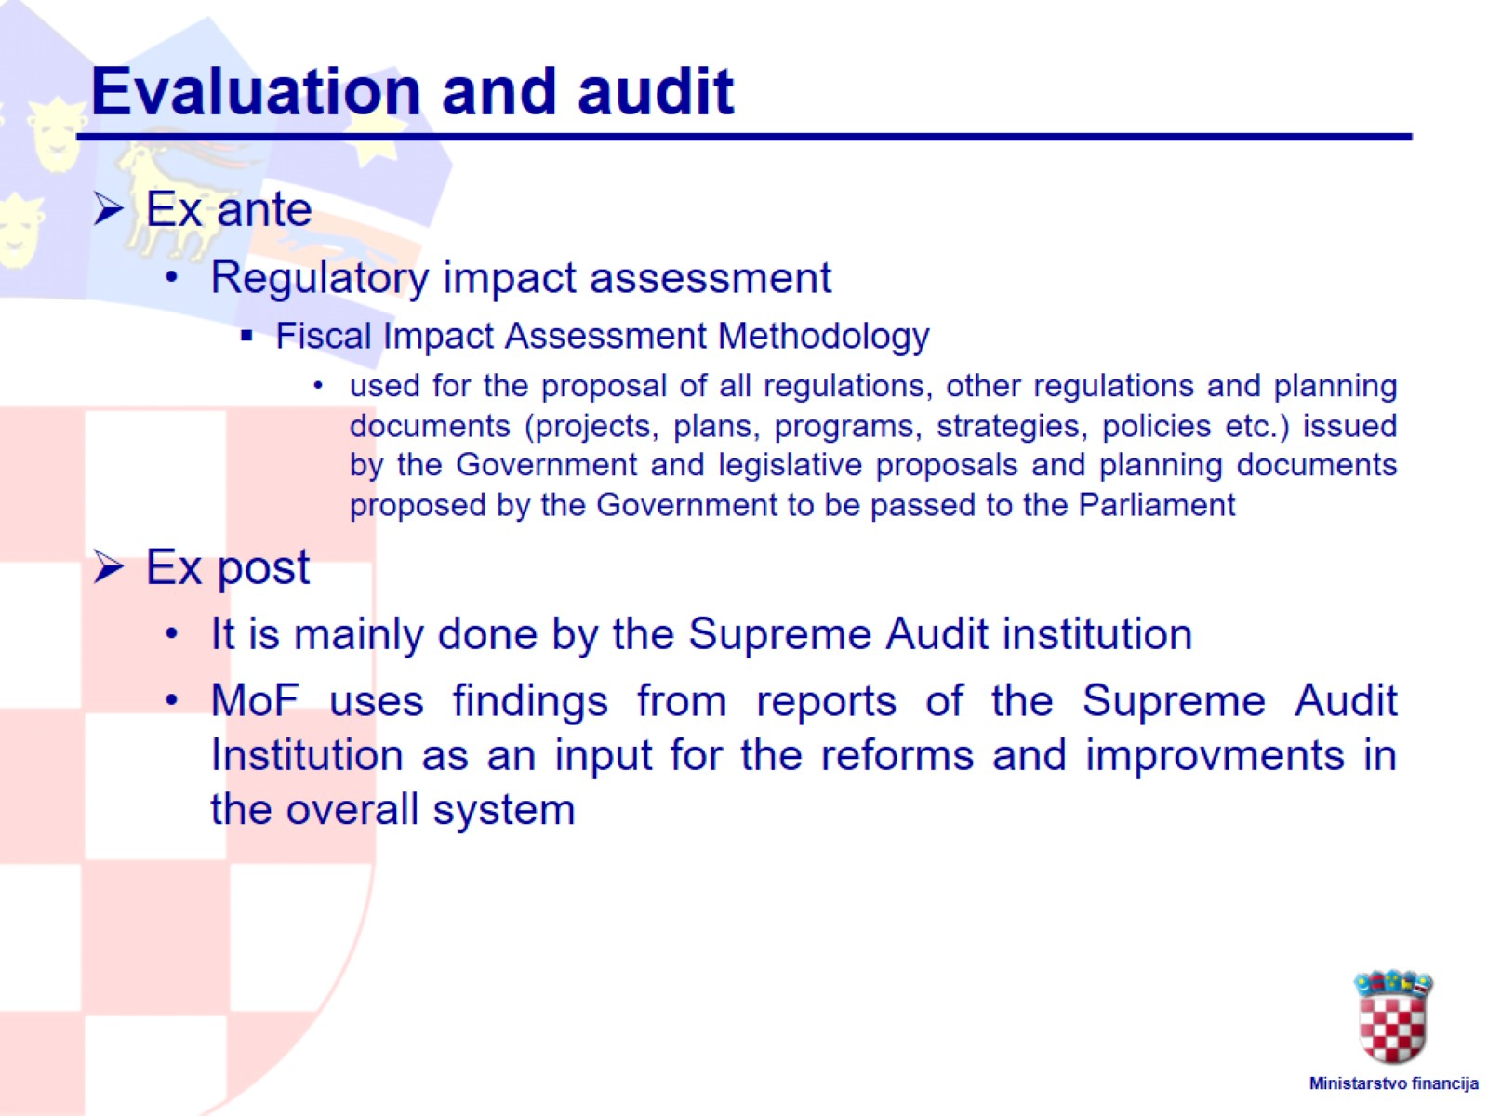
Evaluation and audit

Slide 15
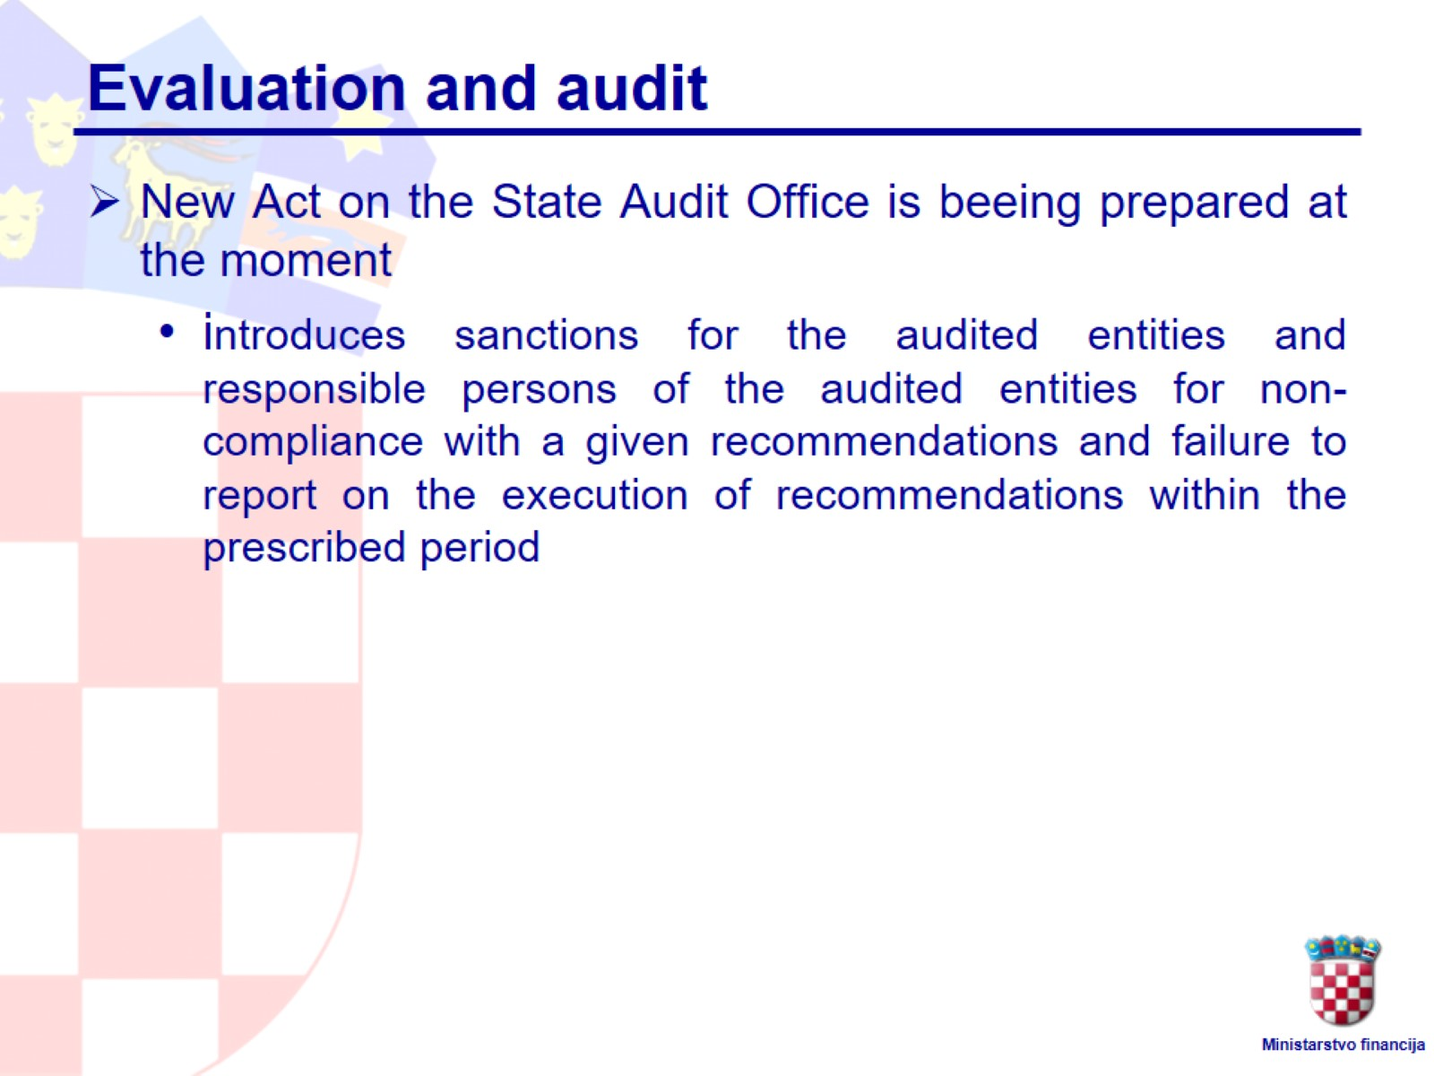
Evaluation and audit

Slide 16

II. Capital Budgeting

Slide 17
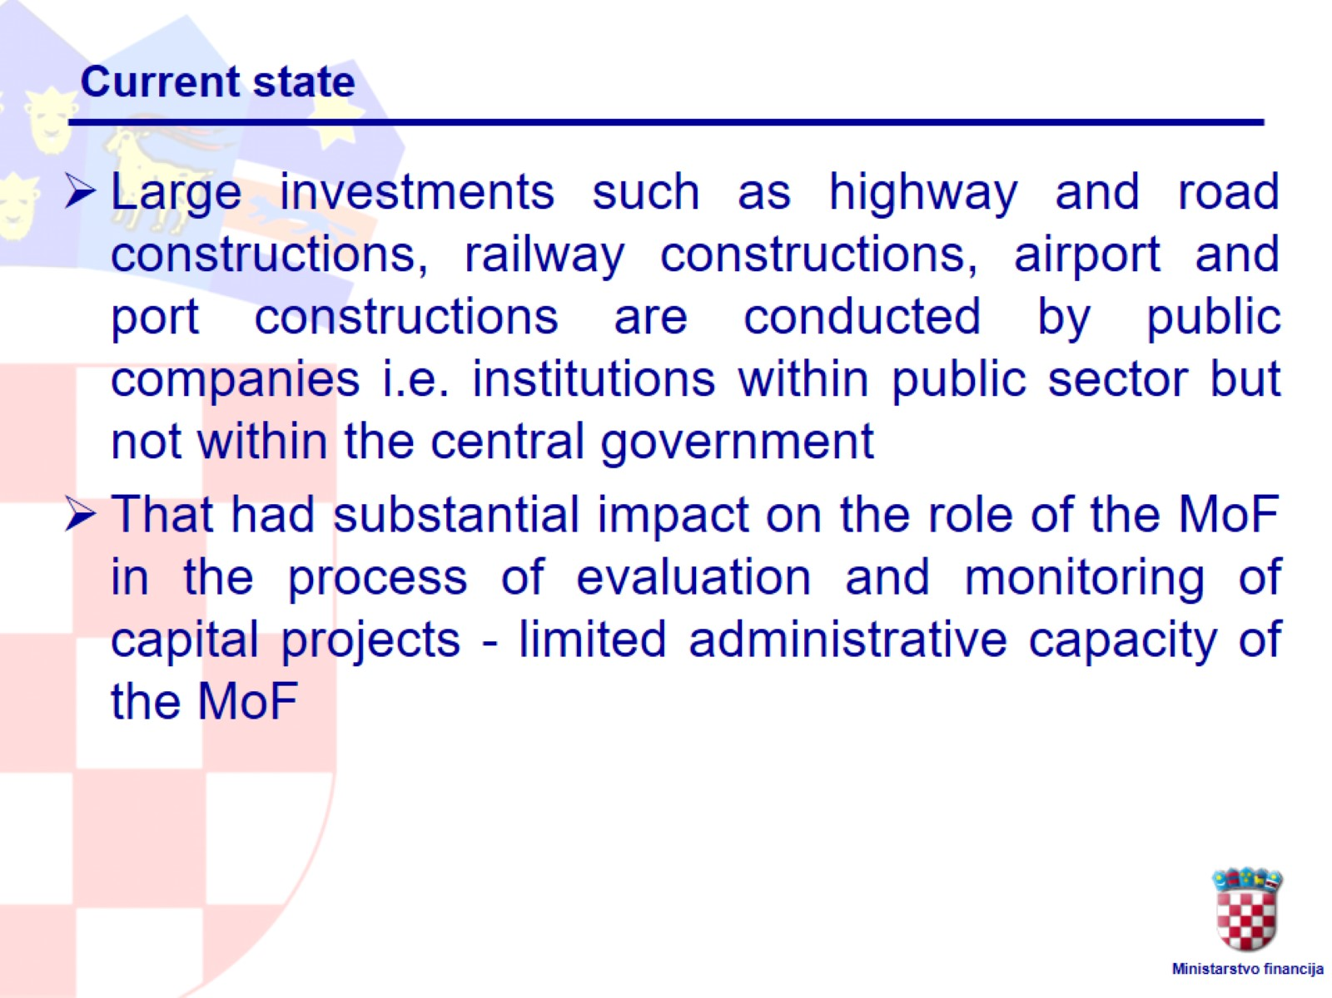
Current state

Slide 18
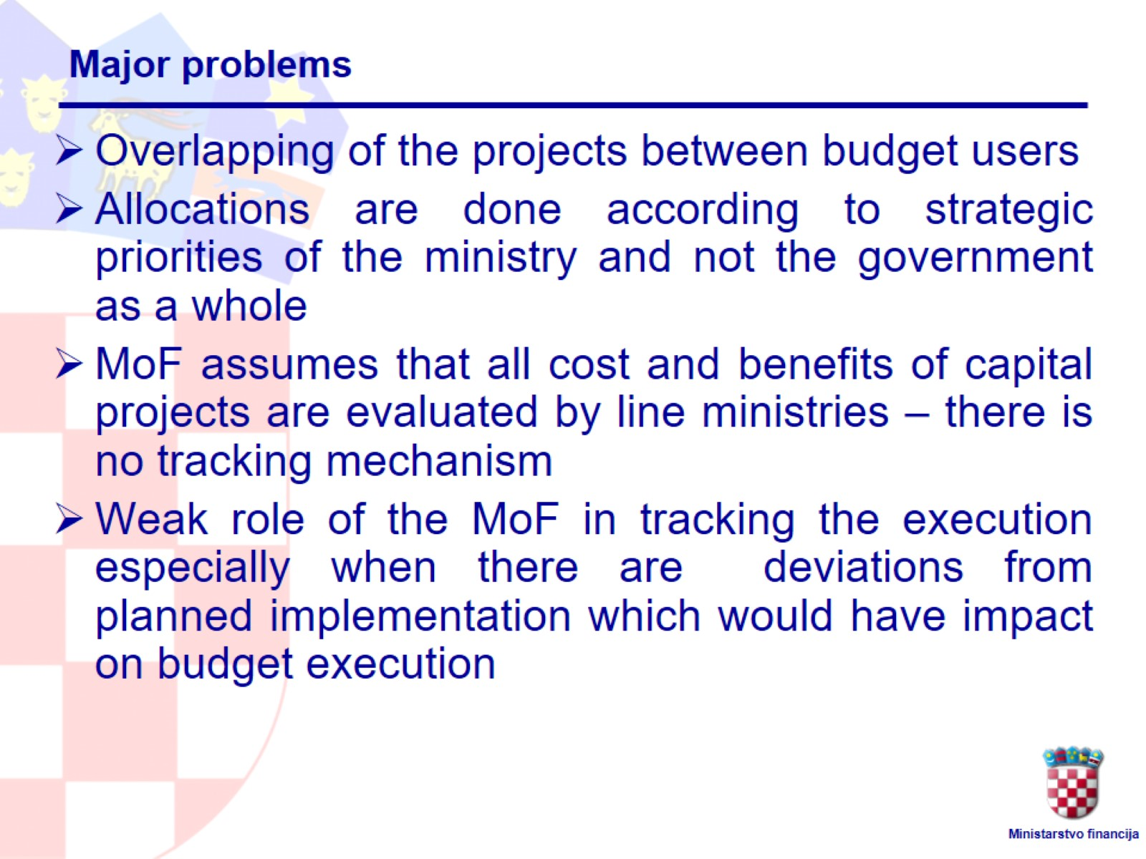
Major problems

Slide 19
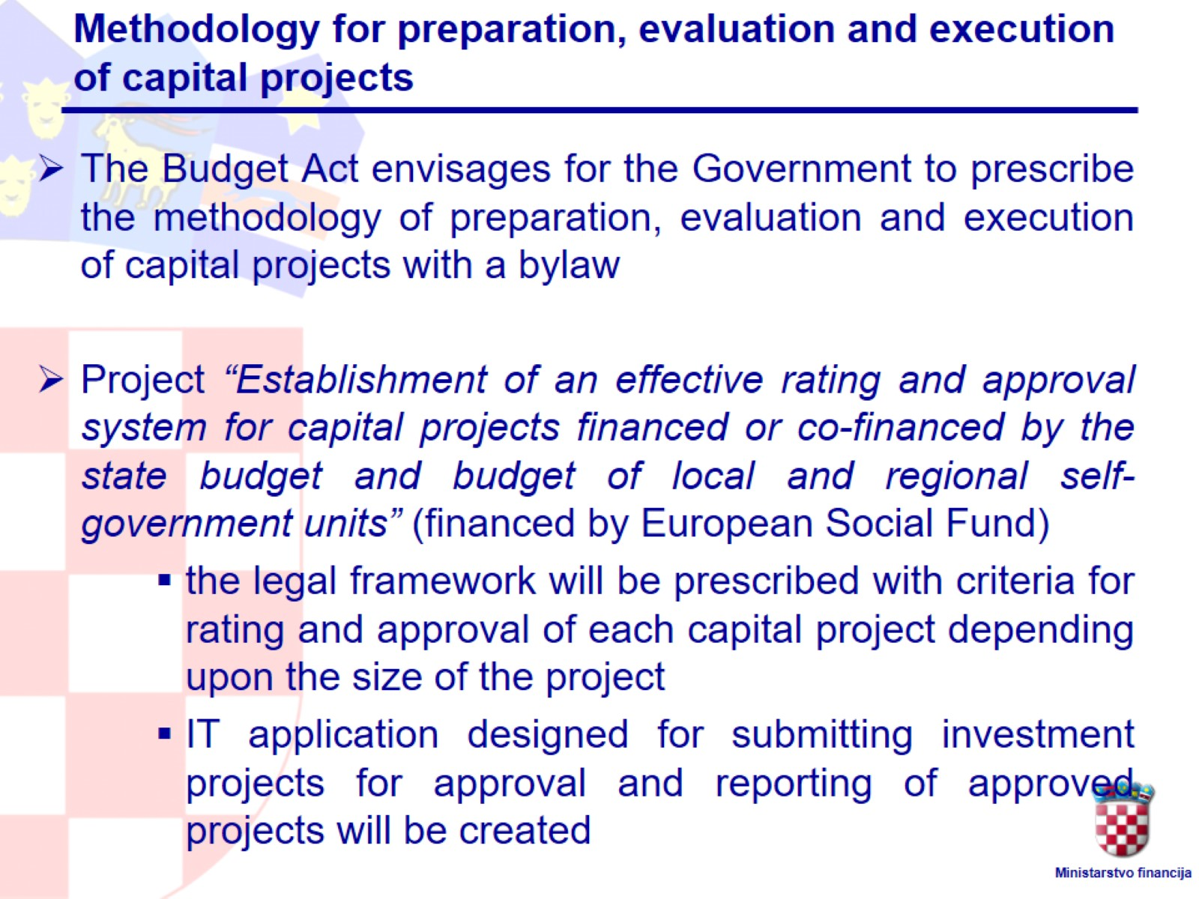
Methodology for preparation, evaluation and execution of capital projects

Slide 20
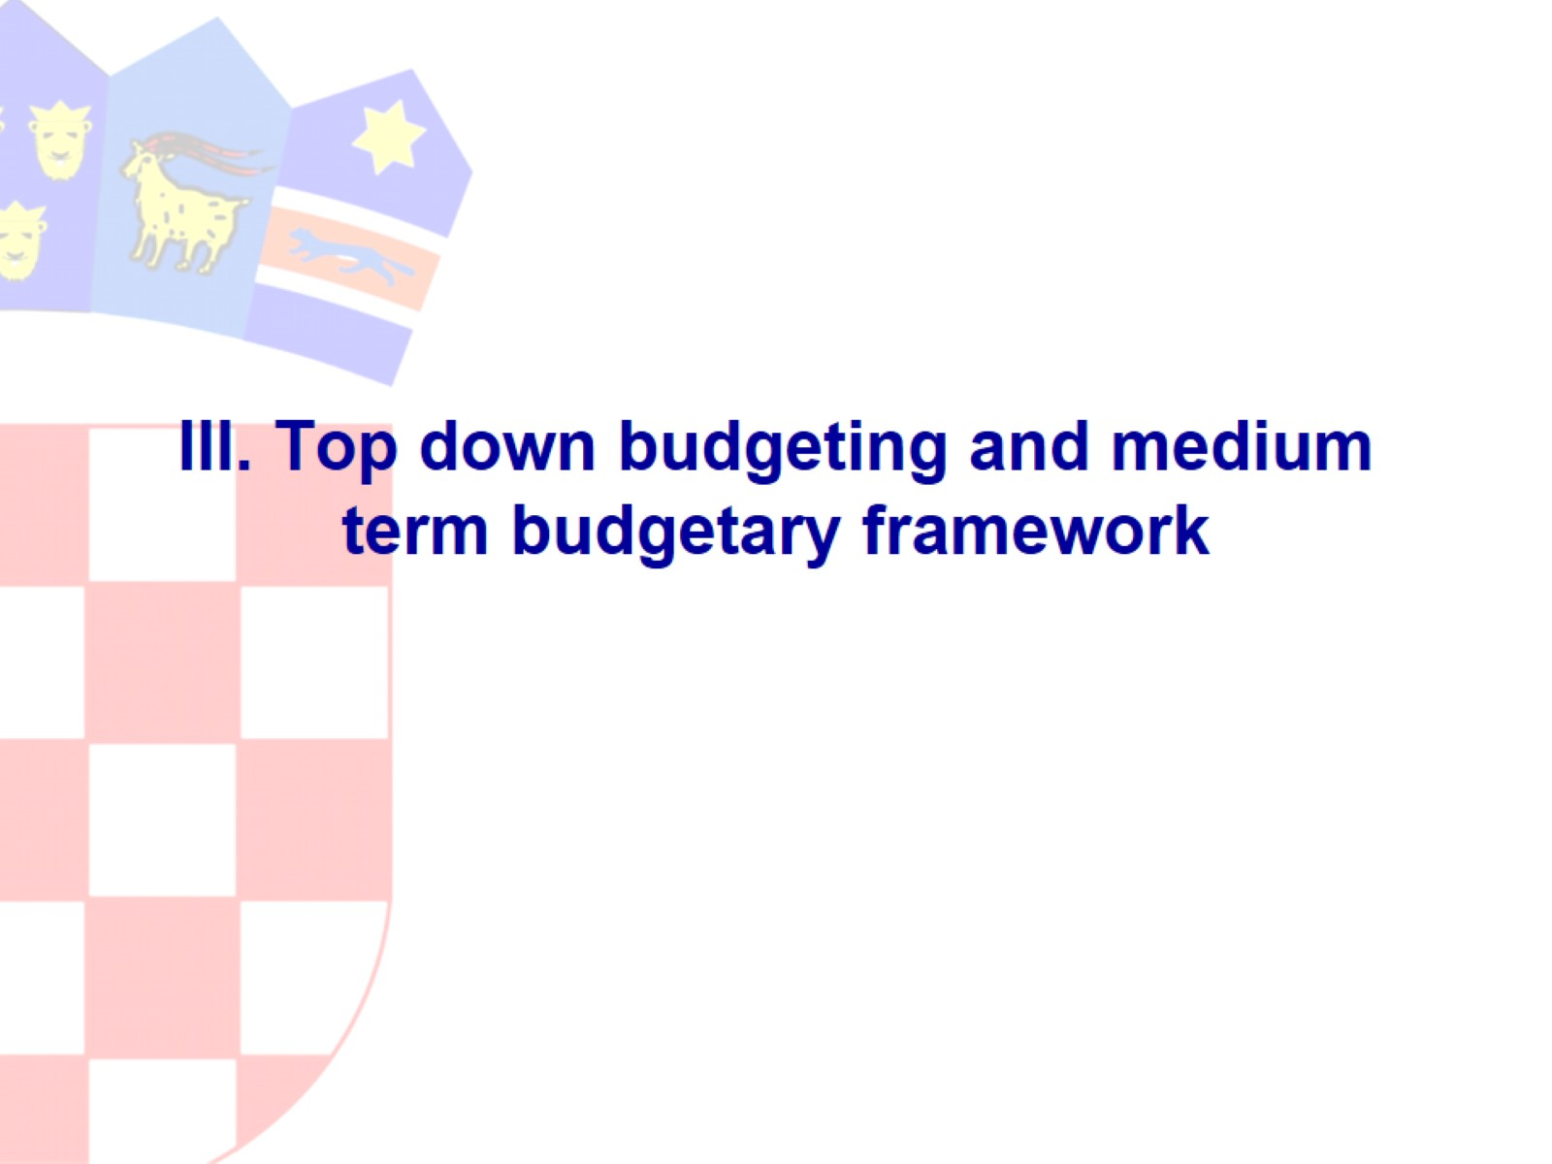
III. Top down budgeting and medium term budgetary framework

Slide 21
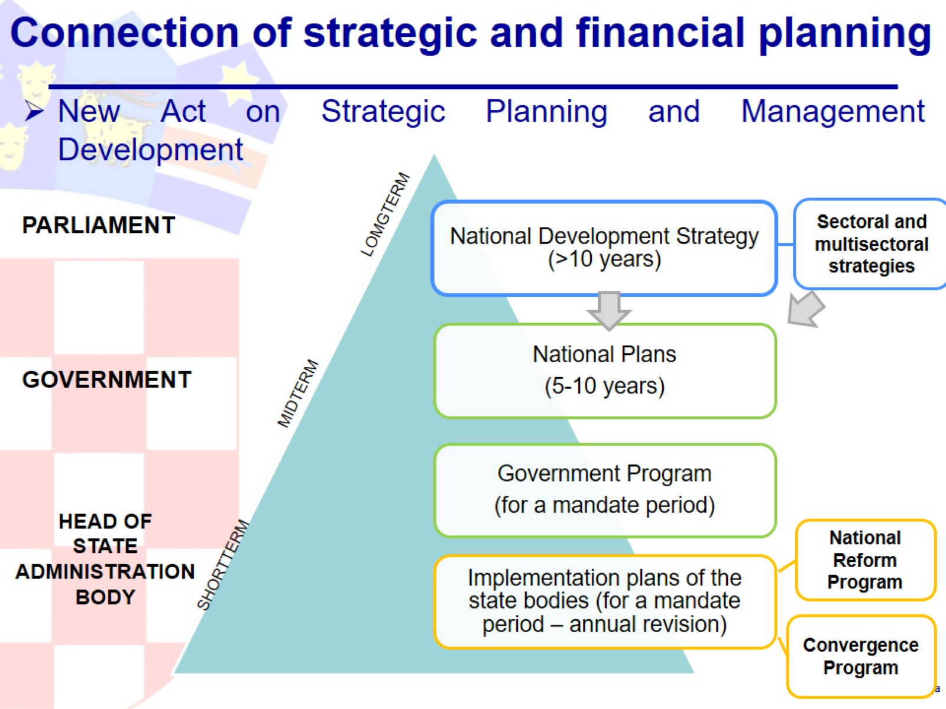
Connection of strategic and financial planning

Slide 22
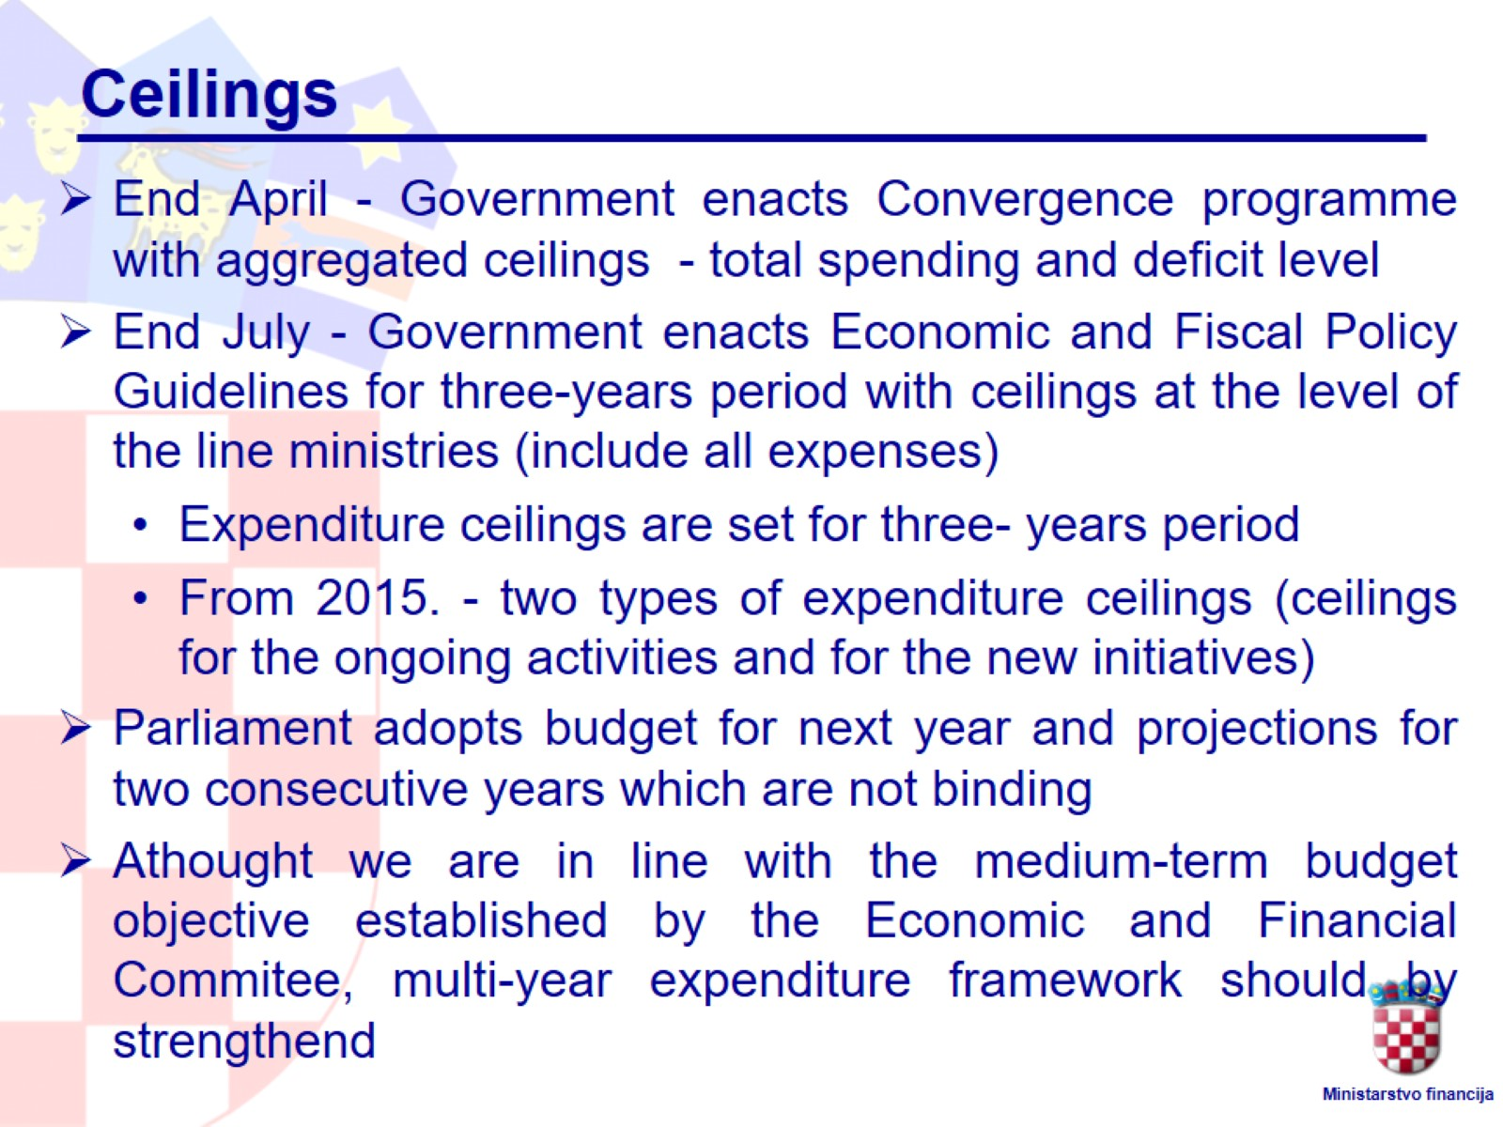
Ceilings

Slide 23

III. Managerial flexibility

Slide 24
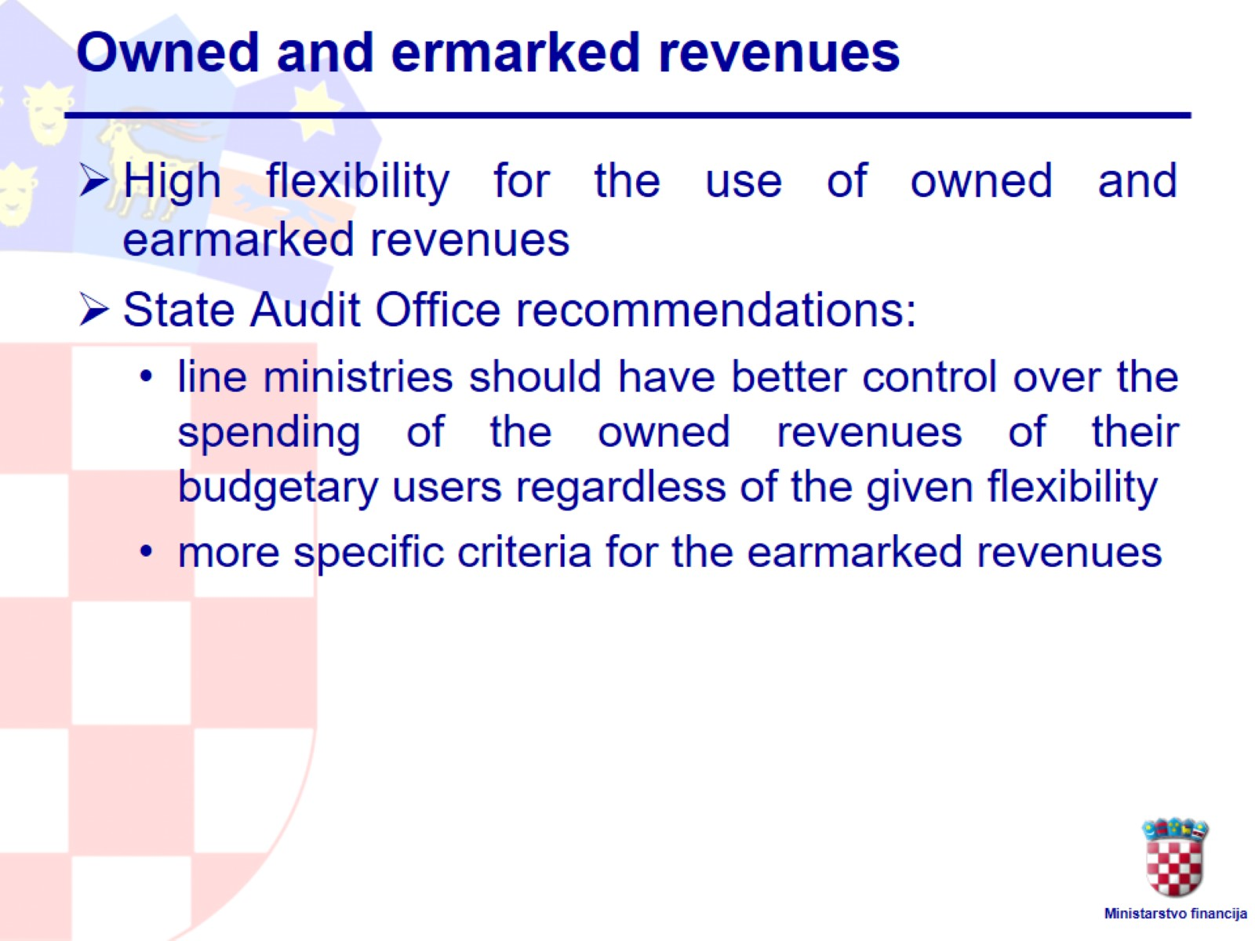
Owned and ermarked revenues

Slide 25

IV. Local goverments

Slide 26
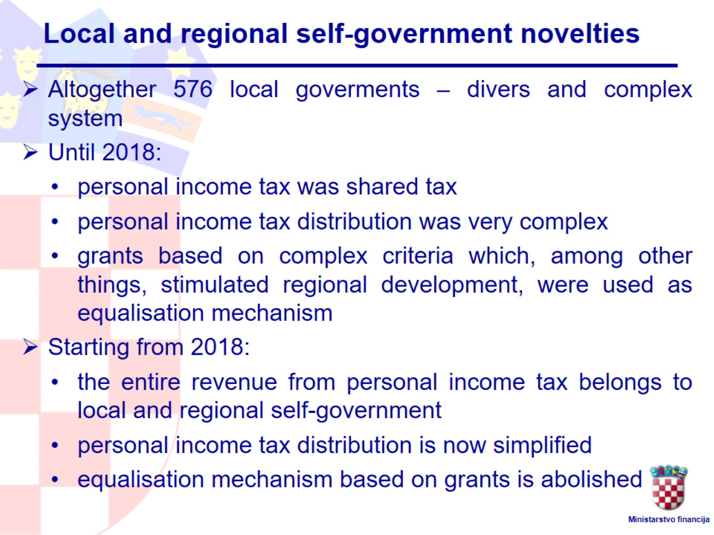
Local and regional self-government novelties

Slide 27
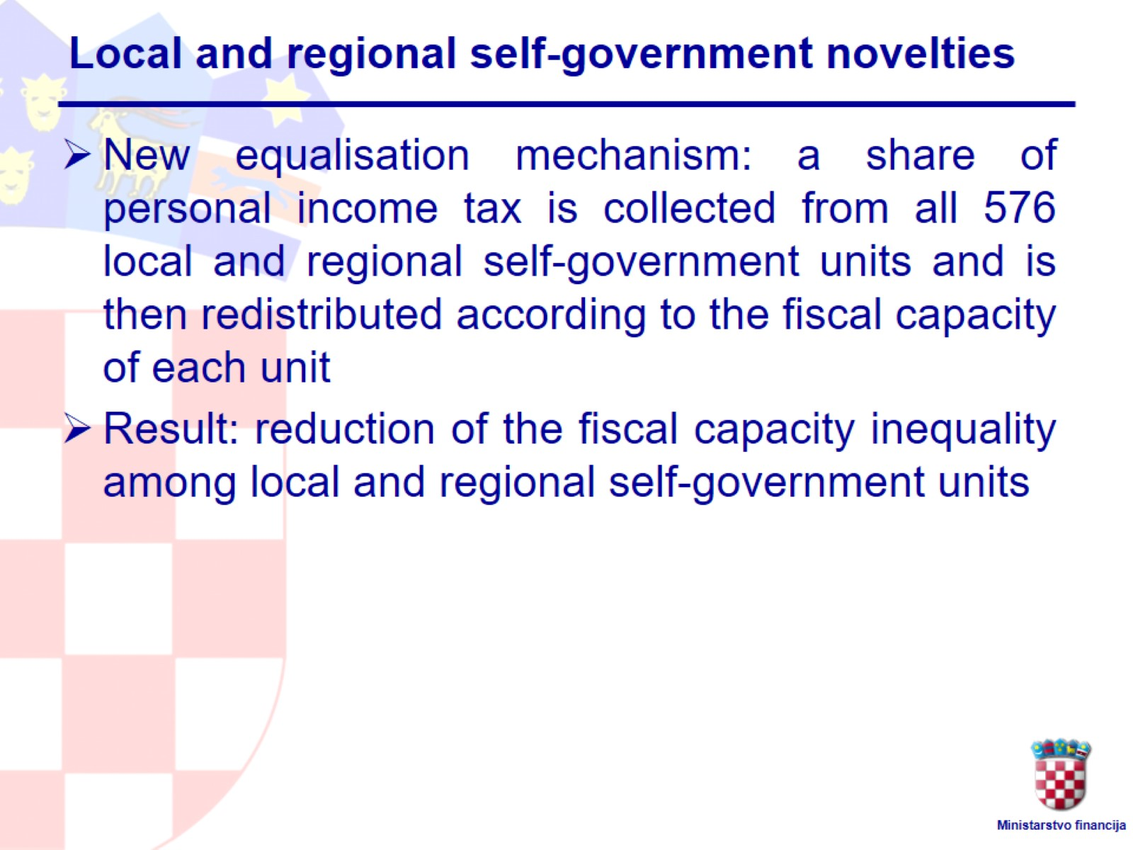
Local and regional self-government novelties

Slide 28
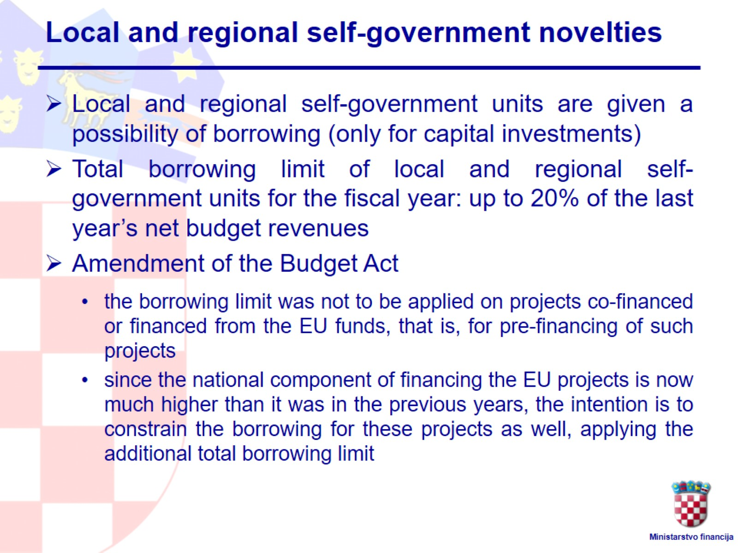
Local and regional self-government novelties

Slide 29
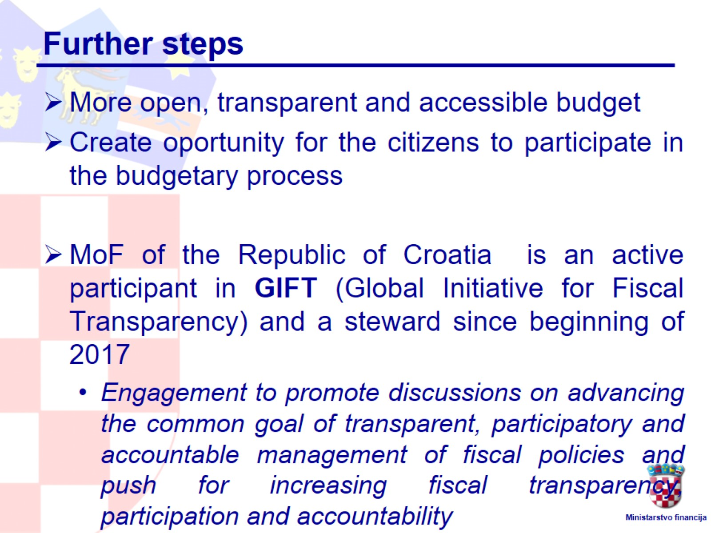
Further steps

