Slide 1
Analyzing and Managing Fiscal Risks:
Best Practices
Johann Seiwald
Fiscal Affairs Department
International Monetary Fund
June 28, 2016

Slide 2
Motivation for the Paper
Advanced Economies: Public Debt
(2007-2016, Percent of GDP)
Spring 2016
37% of GDP
Spring 2007
Source: Fiscal Monitor Database and staff estimates.
2

Slide 3
Motivation for the Paper
Emerging Economies, Excluding China: Public Debt
(2007-2016, Percent of GDP)
Spring 2016
9% of GDP
Spring 2007
Source: Fiscal Monitor Database and staff estimates.
3

Slide 4
Sources of Fiscal Risk
Fiscal risks large, under-estimated, non-linear and...
Size and likelihood of fiscal shocks by type
Source: Bova et al. (2016)
4

Slide 5
Sources of Fiscal Risk
...highly correlated
Contingent Liability Realizations
Financial Sector
Total Fiscal Cost of CL Realization (% GDP, right axis)
Legal
Natural Disasters
State Owned Enterprises
Private Public Partnerships
Private Non-Financial Sector
Subnational Government
Other
Source: Bova et al. (2016)
5

Slide 6
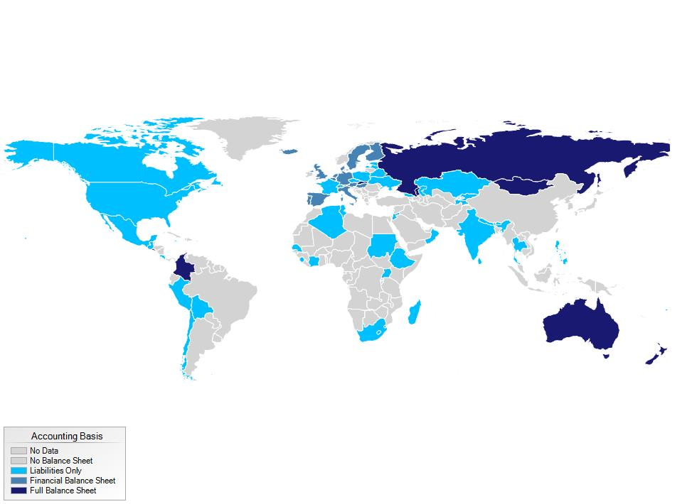
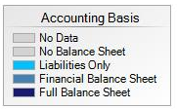
Coverage of Balance Sheet Data (GFS)
Fiscal Risk Analysis
Disclosure of risks has improved...
2003
Source: COFA Database
6

Slide 7
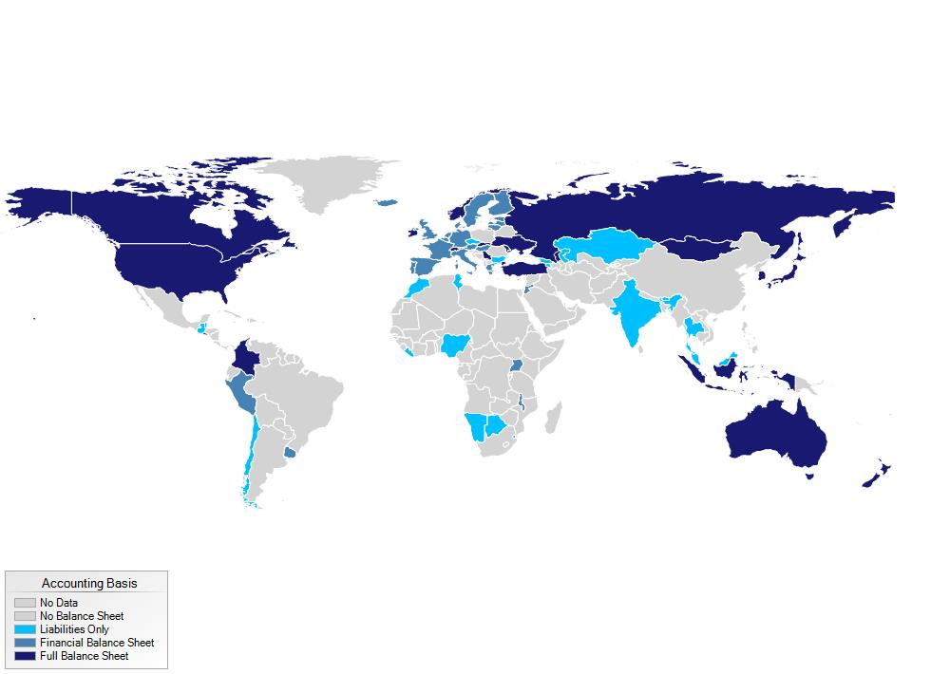
Coverage of Balance Sheet Data (GFS)
Fiscal Risk Analysis
Disclosure of risks has improved...
2013
2003
Source: COFA Database
6

Slide 8
Fiscal Risk Analysis
... but quantification remains limited
Macro-Fiscal Risk
Assets and Liabilities
Source: IMF Staff Estimates
7

Slide 9
Fiscal Risk Analysis
... as well as risk analysis
Specific Fiscal Risks
Long-Term Fiscal Sustainability
Source: IMF Staff Estimates
8

Slide 10
Fiscal Risk Management
Mitigation efforts are undertaken
Direct Controls
Regulations and Other Measures
Source: IMF Staff Estimates
8

Slide 11
Fiscal Risk Management but often ad hoc and fragmented
Risk Transfer/ Sharing Mechanism
Provisioning
Source: IMF Staff Estimates
8

Slide 12
Fiscal Stress Test
More integrated analysis of fiscal risks: Iceland
Public Debt
(Percent of GDP)
Liquidity: Gross Financing
(Percent of GDP)
Stress: Macro + CL
Baseline
Stress
Macro Only
Baseline
Source: IMF Staff Estimates
9

Slide 13
Fiscal Risk Management Toolkit
Guidance on risk mitigation strategies
STEP 1: IDENTIFY AND QUANTIFY
Identify risks
Calculate exposure and likelihood
Weigh costs and benefits of intervention
STEP 2: MITIGATE
Cap Exposure
Regulate
Transfer
STEP 3: PROVISION
Expense
Budget contingencies
Buffer funds
STEP 4: ACCOMMODATE RESIDUAL
Account for in setting fiscal objectives
10

Slide 14
Fiscal Risk Management Toolkit
Risk Matrix

Slide 15
Fiscal Risks and Public Debt Ceilings
Adoption of debt and other fiscal rules
Evolution over time (1990-2014)
Combination of rules (2014)
Number of Countries
Budget Balance +
Expenditure Rules
10
10
58
17
Debt Rule
Debt Rules
Source: IMF Fiscal Rules Database (2015)
11

Slide 16
Fiscal Risks and Public Debt Ceilings
Probabilistic assessment of public debt: Illustration
European Emerging Market Economy
(In percent of GDP)
Median forecast
Source: IMF Staff Estimates
12

Slide 17
Policy Implications
Fiscal risk analysis
All countries should seek to increase their use of probabilistic methods
Low capacity countries should focus on
  macro-fiscal sensitivity analysis
  financial balance sheet
  disclosing explicit contingent liabilities
Intermediate capacity countries should prioritize
  alternative macro-fiscal scenarios
  full balance sheets
  disclosing all contingent liabilities
High capacity countries should concentrate on
  disclosing the size and probability of contingent liability realizations
  periodic fiscal stress tests
13

Slide 18
Policy Implications
Fiscal risk management
All countries should strengthen their institutional frameworks and centrally manage their risks
Low capacity countries should look to strengthen direct controls and centralize approval of explicit contingent liabilities
Intermediate capacity countries should prioritize more effective use of risk mitigation and transfer tools
Advanced capacity countries should build risk exposure into fiscal plans
14

