Slide 1
15 ежегодное совещание руководителей бюджетных ведомств стран ЦВЮВЕ ОЭСР
4-5 июля 2019 г.
Минск, Беларусь
Управление государственными финансами и бюджетом и их приоритизация в поддержку стратегического развития в Словакии
Адресный анализ бюджета
Отдел бюджетирования и государственных расходов
Дирекция по вопросам государственного управления

Slide 2

Цель адресного анализа
Совершенствование инструментов и принципов государственного управления для
  Определения приоритетов национального развития
  Стабильного планирования инвестиций
  Планирования ресурсов для достижения стабильного экономического развития.
→ Вклад в публикацию «Обоснование мер стратегического планирования на уровне центральных государственных ведомств»
Notes:
Contribute to “Developing the Intervention Logic of Strategic Planning by Central Government Authorities” that supports the Slovak Republic in the efficient implementation of its national strategy, and in particular the SDGs.

Slide 3
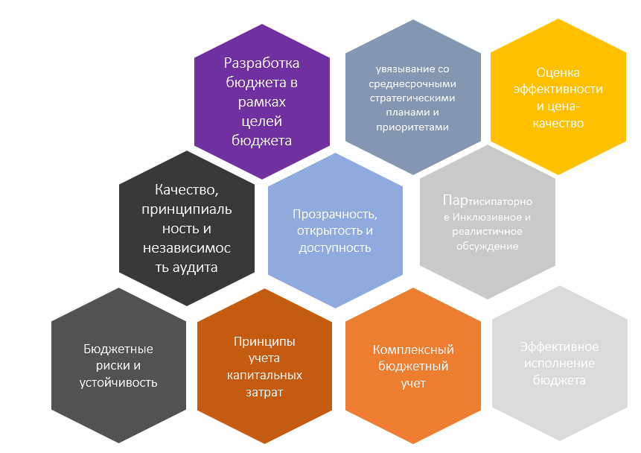
Проводимый ОЭСР адресный анализ бюджета …
→ …поддержка целей стратегического развития в Словакии
Дирекция государственного управления
Рекомендации совета по бюджетному управлению
Увязывание со среднесрочными планами и приоритетами
Принципы учета в бюджете капитальных затрат
Эффективность, оценка и соотношение цена-качество
Notes:
Similar process as full budget reviews
Focus on a sub-set of budget principles that are particularly relevant for the country in a specific point in time
the managing and prioritising processes of public finances
the budget in support of achieving strategic development objectives in the Slovak Republic.
These important dimensions are specifically addressed in the OECD Recommendation on Budgetary Governance (2015). In particular, Principle no. 2 calls on governments to “closely align budgets with the medium-term strategic priorities of government”, and Principle no. 3, “design the capital budgeting framework in order to meet national development needs in a cost-effective and coherent manner”.

Slide 4
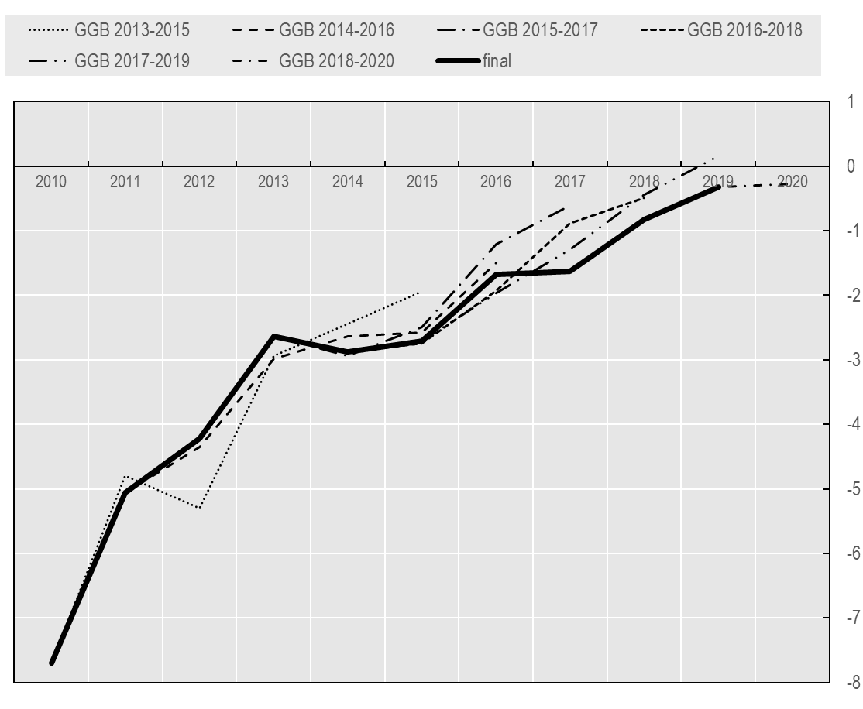
Укрепление принципов бюджетирования и среднесрочного планирования
Непрерывные годовые прогнозы сальдо государственного бюджета
Проводит ли законодательный орган обсуждение или утверждение среднесрочной структуры бюджета?
Источник :Министерство финансов Республики Словакия, БЮДЖЕТА расширенного правительства
Источник: Данные на основании вопроса 3 Обследования деятельности парламента по бюджетной практике.
Notes:
The Slovak stability programme presents indicative objectives for general government revenues, expenditures and balance expressed in nominal terms and as a percentage of GDP for the current year and the three subsequent years. Expenditure targets for the three following years and their composition are indicative and can be and are modified when the draft budget is prepared in autumn (or in subsequent updates of the stability programme in the coming years) (Figure 3.1). There is no legal requirement to explain or justify changes to the target revisions, which underscores the low level of strictness of terms of respecting the plans set out in the medium-term planning documents (Sherwood, 2015_{[10]}).
Parliamentary oversight is mostly limited to the approval process of the current year. As in many OECD countries, parliament approves the state budget only for the first year, while the government approves the medium-term GG budget (Figure 2.4). For the current State budget, there are seven binding indicators formulated on cash basis that are subject to legislative approval: 1) total revenue; 2) total expenditure; 3) co-financing with EU funds 4) revenue and expenditure of EU funds; 5) capital expenditure; 6) wages; and 7) programmes. However, with the MTO set in accrual terms, annual chapter ceilings and binding indicators based on cash limit provide limited accountability for the achievement of the medium-term fiscal target.

Slide 5
Отдельные рекомендации
Внедрение регулярно обновляемых базовых оценок по расходам
Введение в бюджетный цикл практики стратегического обсуждения для усиления коллективной бюджетной ответственности
Введение обязательных максимальных предельных ограничений по государственным расходам
Notes:
Strengthen the Slovak budgeting framework for robust and strategic medium-term planning:
Introduce baseline estimates of expenditures over the three-year medium term to support the information available to set credible expenditure ceilings. The role of baseline estimates is to describe the future budget consequences of current laws and policies at any given point in time. Such information provides rolling estimates of what is required to achieve programme objectives, and can include analysis of the factors that may cause allocations to vary from one year to the next. Estimates should be calculated based on the most recent macroeconomic outlook of the economy and other relevant information, such as the most recent measured expenditures.
Regularly update baseline estimates within a single budget year. Baseline estimates need to be regularly updated for the Government to be able to evaluate actual expenditures against its ceilings. Variations against budget may arise from changing external and internal circumstances. Updates about external circumstances should be done at the start of budget preparation and frequently during budget execution. Baseline estimates must also be amended when new policies or substantive laws are decided or enacted. The role of these updates is to inform political decision making with respect to the medium-term framework and the ceilings.
[Include baselines in the automatised Budget Information System. To ensure agreement between line ministries and the Ministry of Finance, the regularly updated baselines need to be shared between the line ministries and the Ministry of Finance. The BIS seems to be a well-prepared system to do so. The line ministries should be responsible for inputting and updating baselines in the system, while the expenditure divisions of the Budget Directorate should be responsible for the assurance and oversight of the updates.]
[Ensure time and space for political engagement for a baseline discussion. Baseline identification is not a purely technical affair. The Budget Directorate should establish the rules to administer the process and any differences of opinion about the baselines should ultimately be decided between the relevant ministers at cabinet. Baselines should inform, not undermine top-down priority setting. Once reliable baselines are identified, broad policy priorities can be managed by expenditure ceilings.]
Reinforce the medium-term dimension for stable budget planning
Introduce a strategy debate of government into the budget cycle to enhance collective fiscal responsibility and priority setting. A collective approach as discussed in 3.4 to the definition of fiscal targets, medium-term priorities and corresponding expenditure ceilings, and bottom-up baseline projections would strengthen the commitment to annual and multi-annual ceiling and enhance transparency and accountability. As part of this strategic debate, Slovakia should consider developing a designated stand-alone document to frame realistic medium-term expectations for the allocation of resource and which could serve as a strategy document to align broader strategic objectives. Such document should align to the EU-related stability programme. An example of such fiscal statements is given in Box 3.4.
The multi-annual expenditure ceilings for total expenditures and ministerial envelopes should be eventually binding. By their very nature, high-level fiscal ceilings are set in a medium-term context. For the medium-term framework to work effectively, estimates and ceilings need to be reconciled within the context of a forward-looking approach to budgetary planning and policy formulation.
The MTEF may be specified at the level of ministries. Keeping expenditure ceilings at Chapter level allows reaping the benefits of controlling the expenditure growth path, providing and the spending units with predictability in their revenues resources to carry out their policies, while retaining sufficient flexibility.
Expenditure ceilings should include incentives and flexibility to ensure expenditure boundaries are respected, for example by building in a “budget margin” as a buffer amount, which is not allocated in the expenditure ceiling.

Slide 6
Стратегический подход к капитальным инвестициям для достижения среднесрочных приоритетов
Пирамида стратегического планирования
Agenda OSN 2030 and
EU 2020
НИП
отраслевые и межотраслевые стратегии
Международный уровень
Стратегические инфраструктурные приоритеты
методы достижения стратегических целей
определение того, каким видится будущее государство
Стратегия развития общества
Стратегии
Долгосрочное видение развития общества
Источник: система бюджетной информации Министерство финансов Республики Словакия
Notes:
Following a top-down approach, the high-level objectives of the Slovak national long-term vision are envisaged to be derived from United Nations 2030 and the EU 2020 Agenda, followed by a national long-term vision and a strategy of society development. These objectives are further translated into inter-sectoral strategies such as the National Investment Plan (NIP) (Figure 3.2.). However, neither the national long-term strategy nor its linkages to resource allocations are at in place at this time. To ensure that an improved budget planning process that is aligned to the national long-term vision does not only reflect the SDGs by definition, the government will have to ensure that these linkages are clear and verifiable.
EU funds are an essential part of the Slovak budget. In the last seven years (between 2011 and 2017), around 14% of total expenditures, and 57% of capital expenditure were from EU funds (Figure 2.10).Yet, since 2016, operational expenditures have started to become more relevant.
However, the system of planning, allocating resource, disbursing and monitoring EU funds differs from and runs in parallel to the main budget process. The EU funds section at the Ministry of Finance is responsible for coordinating the preparation of the budget. It collects estimates from line ministries (executed resources, carry-overs, etc.) and proposes limits for the individual Chapters during budget formulation. During their operational programme period (which covers 7 years), EU funds can be carried over each year– both capital and operational, for up to two years after operational programme period.
A future transition towards reduced dependency on EU funds will need to take into account the gaps this transition will impose, not only in terms of financing, but also with regard to reporting and evaluation mechanisms.

Slide 7
Отдельные рекомендации
Усиление межведомственного сотрудничества, в т.ч. путем обмена экспертными знаниями
Обеспечение подхода «сверху-вниз» к Национальному инфраструктурному плану с учетом рисков и факторов неопределённости
Введение системы мониторинга реализации Национального инфраструктурного плана
Notes:
Prepare for the transition from EU funding of capital investments :
[Strengthen the governance framework for capital investment. Slovakia’s transition to become less dependent on EU funds may lead to challenges for planning capital investment, as the country has traditionally relied on the EU system for planning, allocating, monitoring and evaluating capital investments. Reduced dependency in EU funds will require the government to improve its framework for capital investment, meaning in particular the strengthening of strategic planning of capital investment (see chapter 4). The OECD framework, Getting Infrastructure Right, highlights 10 successes factors of good infrastructure governance. A full assessment on the implementation of this framework in the Slovak Republic could provide a detailed insights and recommendations on how to move forward with the implementation of each one of the dimensions. ]
Link strategic infrastructure planning to the budget process
Enhance co-operation across Ministries and sharing of expertise. This would entail a well-defined active participation of the Ministry of Finance in the discussion and preparation of the NIP. In particular, the Value for Money Unit can provide expertise on feasibility, impact and prioritisation of relevant investment projects. This will also support the DPMO to define criteria and considerations to prioritise projects within the plan.
Ensure a top-down approach of the NIP to complement the project by project assessment performed by line ministries. A top-down approach maintains the focus on policy objectives rather than projects, and helps form a strategic view on where investments are most needed. This implies a vision for the desired future state, which requires the government to set clear high-level strategic objectives when determining the future infrastructure need. Inter-departmental or ministerial committees could support the design of infrastructure strategies. An effective top-down approach also requires an understanding of present conditions in the form of the current needs of the population and gaps in access to key services. Decisions on what infrastructure to build can be framed as part of a broader strategy for bridging the present and the future.
Take major future risks and uncertainties into account. A useful tool to future-prove infrastructure plans is to use analytical methods such as a scenario-based approach. This type of analysis can be used to test projects flexibility, identify the factors that are essential for the project to deliver its expected outcomes, and provide insight on alternatives to deal with future constraints to infrastructure investment. Scenarios can also help the policy maker develop a list of alternative options for investment depending on the future state of the economy (OECD, 2017).
Implement a system to monitor the implementation of the NIP. To provide the systematic collection of data, ensure that the financial and non-financial information of investments are included in a register of investments within the BIS and reported on annually.
[Clearly link strategic infrastructure planning with fiscal planning. The NIP need to provide information on financing strategies and potential delivery modalities. Infrastructure projects under the NIP should be reflected in the annual and multi-annual budget allocation process. Furthermore, infrastructure plans should include an assessment of implementation costs and a projection on the potential sources of financing. In a fiscally constrained environment, the plan should balance assessed infrastructure needs with medium-term fiscal projections and other potential source of financing. Debt management needs to be assessed within the strategic investment plan. The strategic plan should inform investment decision in the medium and long term. However, it should retain some flexibility and it should be periodically updated in order to respond to emerging challenges and opportunities.]

Slide 8
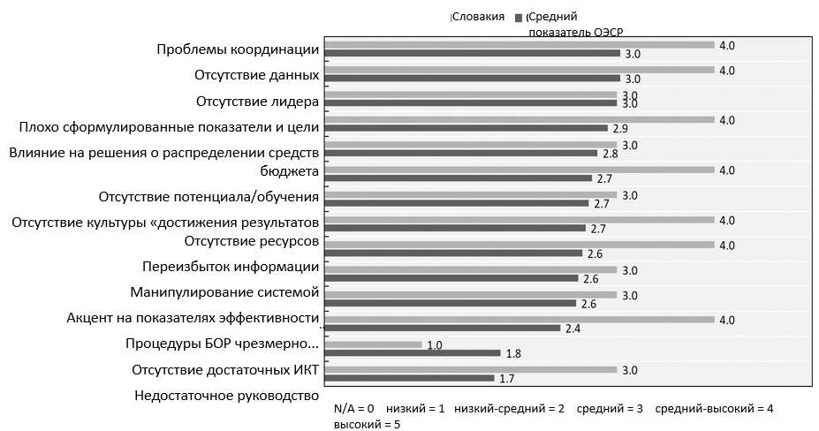
Увязывание результатов и оценки бюджетных ассигнований
основные трудности реализации БОР
Источник: ОЭСР: Обследование практики БОР в 2018
Notes:
According to OECD Performance Budgeting Survey 2018, challenges in most OECD countries when implementing performance budgeting include co-ordination and leadership – challenges that were also identified as major impediments of the Slovak System (Figure 4.1), together with poorly formulated indicators and targets, lack of data capacities, and information overload.
Inter-agency co-ordination becomes particular important in the context of cross-cutting policy priorities. Achieving progress on the SDGs and Slovakia’s national priorities will require evaluation, co-ordination, consultation and collaboration across numerous policy areas. For example, action against climate change and environmental degradation requires multiple coherent actions in areas ranging from infrastructure investments, environmental regulations and tax incentives to public education and awareness. The United States offers an example of institutionalised mechanisms to promote co-ordination around cross-agency performance goals. In order to integrate cross-cutting strategic development goals into the budget process, a sustained partnership between the DPMO and the Ministry of Finance is crucial.
Monitoring and evaluation elements play a secondary role in Slovak’s programme budgeting system. Since 2010, line ministries and agencies are encouraged to monitor and evaluate their programmes on voluntary basis. This includes performance evaluation of programmes during programme formulation (ex-ante) and after budget execution (ex-post). Effective implementation however, is perceived rather low and not relevant for decision processes and increased transparency. In international comparison, Slovakia scores around OECD average in terms of overall quality of ex-ante impact assessment of primary laws, but demonstrates low quality of ex-post evaluation (Figure 4.3). In particular, systematic adoption, oversight and quality control achieve low results. Ex-post evaluation, furthermore, shows a low degree of transparency and lacks a defined methodology.

Slide 9
Отдельные рекомендации
Стремление к повышению качества информации о результатах
Обеспечение достаточного времени и возможностей для стимулирования вовлечения парламента
Создание скоординированной системы мониторинга, оценки и управления качеством
Notes:
Improve the alignment of performance information to strategic goals
Ensure the quality of performance information for the budget formulation process supports parliamentary debates and oversight. Slovakia may facilitate oversight and accountability by (re-) introducing performance information in the budget documentation to inform and provide context for the financial allocations. Doing so, Slovakia should consider to improve the quality of performance information by introducing selected, concise and internationally comparable objectives and indicators. A smaller number of high-level outcome targets that are clearly linked to government priorities can drive policy discussion within government and in parliament. Greater selectivity in presenting performance information can highlight the performance objectives to which the government is holding itself to account, for example through the development of dashboards to provide concise information on budget implementation, and based on internationally comparable benchmarks that align to the EU 2020 and/or the UN Sustainable Development Goals.
Encourage parliamentary engagement to revive the demand for performance information. This requires a participative approach already in the design phase of outcome objectives and indicators; and a strengthened discussion on performance information and evaluation during the budget formulation and approval phase, for example by a dedicated parliamentary committee to report on performance and/or dedicated time to the discussion of performance objectives, indicators and their evaluation during the budget approval sessions in autumn.
Strengthen the evaluation function of the government to demonstrate progress toward strategic objectives
Standardise spending reviews as a tool for performance evaluation and formulation of medium term expenditure ceilings. To maintain a consistent focus on efficiency of public spending, the Ministry of Finance should ensure to regularly and systematically integrate spending review results into budgetary decision-making processes. An option to consider would be to analyse timely results of spending reviews for setting the medium term expenditure ceilings for each chapter, as is done for example in the United Kingdom (see Box 4.7).
Establish a co-ordinated system and the necessary capacities for monitoring, evaluation and quality control by:
A centralised competence for co-ordinating cross-cutting objectives, including quality-control on performance information associated with broader policy priorities, indicator development. Such entity would furthermore be a key player with respect to performance monitoring and evaluation.
Considering focused assessments of the budget’s impact on particular Government priorities such as gender equality or the environment.
Encouraging Supreme Audit Office (SAO) to conduct systematic evaluations of performance information, including an assessment of the coherence of performance-objectives and outcomes within the national strategic plans, the Agenda 2030 and the stability programme; and strengthening the role of the SAO and the CBR by requiring a formal discussion and response by government of the analysis results in parliament.

Slide 10
Следующее шаги
Комментарии в письменном виде до 30 июля 2019 г.
!

Slide 11
Спасибо
Andrew Blazey
Andrew.BLAZEY@oecd.org
Ana Maria Ruiz Rivadeneira
AnaMaria.Ruiz@oecd.org
Juliane Jansen
juliane.jansen@oecd.org
Budgeting and Public Expenditure
Public Governance Directorate, OECD

