Slide 1

OECD Budget Review of Kazakhstan
“A Roadmap for Continuing Budget Reform”
Ronnie Downes
Deputy Head, Budgeting & Public Expenditures
OECD
CESEE SBO, Zagreb, Croatia, 24 May 2018
Notes:
1 - hello

Slide 2
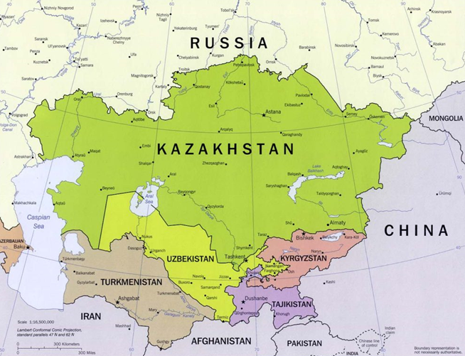
Context

Slide 3

Context
Large and dynamic economy
Oil wealth, plus diversification
Ambition: among 30 most developed nations by 2050
Major reforms

Slide 4
Strengths and recent successes
Strong alignment between plans and budgets
  Institutional alignments: Ministry of National Economy and Ministry of Finance
  Results-based budgeting
Well-managed National Fund
High level of engagement by Parliament
Progress in budget transparency and participation
  Open Budgets portal
  “Public Councils” in each ministry

Slide 5
Suggested themes for continuing reform
Closer sequencing of planning and budgeting processes
Closer focus on quality and relevance of performance indicators
Evidence-based analysis throughout policy cycle
  linkages between performance and evaluation processes…
  … and also Spending Review
  “continuum of evaluative and performance information”
Review of multi-level fiscal governance
  Including alignment of results
Clearer fiscal rules (expenditure growth rule?)

Slide 6
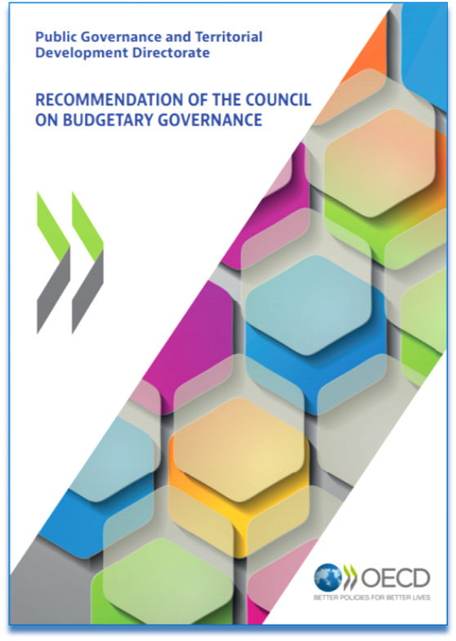
Kazakhstan’s accession to OECD Recommendation on Budgetary Governance
Commitment to OECD budget principles
First country in CESEE SBO to accede
Strong signal of continuing reform
Notes:
3 – we bring together results in these 2 main reference publications
Budget Survey – unique authoritative international reference – continuous data series every 4-5 years – also regional versions
State of Finances – qualitative assessment of country’s fiscal position, budgetary policy responses; links to growth strategy and reform plans

Slide 7
THANK YOU !

