Slide 1

Spending Reviews in OECD Countries
4 July, 2019
Minsk
Wojciech Zielinski
Public Governance Directorate, OECD

Slide 2
Presentation outline
OECD recommendations
Spending reviews in OECD countries – basic comparative information
Different rational and objectives of spending reviews
Types of spending reviews
Roles of different actors in spending reviews
Challenges

Slide 3

OECD Performance Budgeting Survey
Coverage:
45 questions on
    Performance Budgeting
    Spending Review
    Evaluation
  Respondents mainly from central budget authorities
  Response rate: 33 countries (out of 35)

Slide 4
Spending Reviews are one way to operationalise OECD Budgetary Principles
Budgeting within fiscal objectives
Alignment with medium-term strategic plans & priorities
Perfor-mance, evaluation & VfM
Quality, integrity & indepen-dent audit
Transparencyopenness & accessibility
Participative, inclusive & realistic debate
Fiscal risks & Sustaina-bility
Capital budgeting framework
Compre-hensive budget account-ing
Effective budget execution
Performance, Evaluation & VFM

Slide 5
Role of spending review in the budget process
Aligning policy objectives & budget process
  Identifying options for expenditure cuts under aggregate spending limits.
  Creating fiscal space for policy priorities.
Mobilising evidence for budgetary decision-making
  Making use of performance & evaluation information to inform reallocation & budgetary decisions.
  Reviewing baseline expenditures against efficiency & effectiveness criteria.
Leadership, political will & incentives
  A shared view among political leadership, the MoF and the Centre of Government
  An agreed-upon process and governance with Centre of Government, line ministries and other stakeholders.

Slide 6
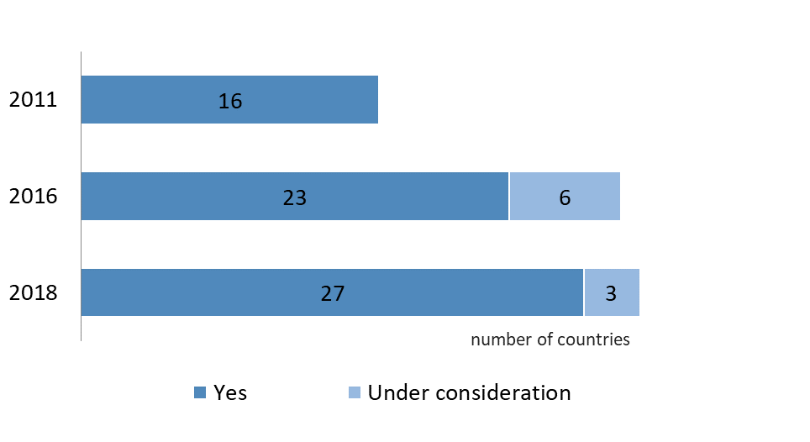
Spending Reviews: survey
Continued increase in number of countries conducting spending reviews
Adoption of spending reviews (2011-2018)

Slide 7
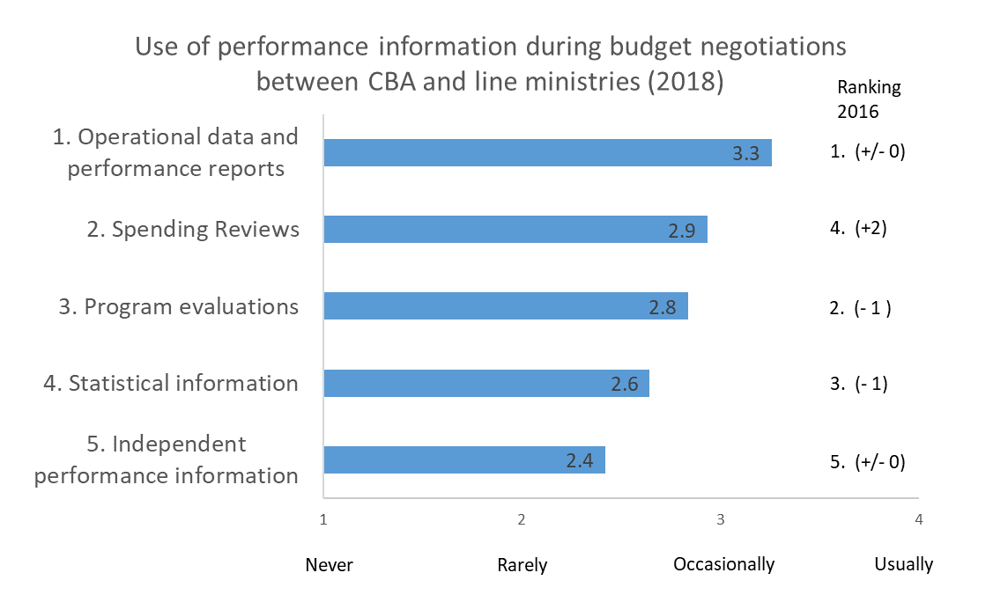
Performance Budgeting: survey
Spending Review information is becoming more important and is more likely to be used during budget negotiations

Slide 8
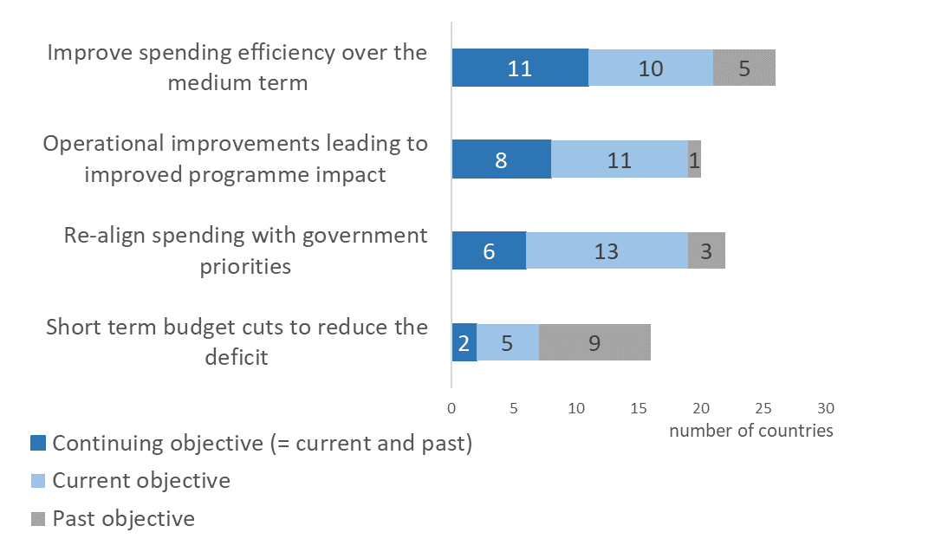
Spending Reviews: survey
Focus is moving away from short-term budget cuts to a more medium-term view on efficiency and an improved programme impact
Main objectives of Spending Reviews over the past 10 years

Slide 9
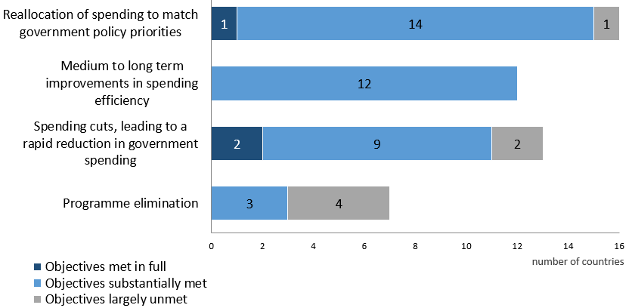
  Spending Reviews: survey
  Key result has been the reallocation of spending to match government priorities
Main results of Spending Reviews over the past 10 years

Slide 10
Rationale of spending reviews differs
Finland Productivity Programme: response to demographic slowdown with identification of efficiency measures, with strong emphasis on use of technology.
Irish 2009 Report of the Special Group on Public Service Numbers and Expenditure : took place in the context of a consolidation path that required 3 B EUR in current spending reductions. The subsequent Comprehensive Expenditure Report (CRE) 2012-14, undertaken in the early phase of the EU/IMF Programme, introduced regular spending reviews.
Croatia
  Spending reviews as a way to respond to the EU Council recommendation to reduce budget deficit
  The target was 10% cuts of spending.
Denmark and Netherlands: spending reviews are linked to political cycle.

Slide 11
Frequently the objective is fiscal consolidation
Canada
  Strategic Review (2007-08 to 2010-11): agencies required to identify savings options totalling at least 5 per cent from their lowest-priority, lowest-performing programme spending.
  Strategic and Operating Review (2011-12): agencies required to present cutting options at 5 per cent and 10 per cent.
France
  Révision Générale des Politiques Publiques 1 (2007-08): review teams asked to identify efficiency savings to ensure that the policy of non-replacement of one in two retiring civil servants would not impact on services.
  RGPP2 (2010-11): an additional target of a ten per cent reduction in non-salary administration costs (to be achieved by 2013) target was set.
Netherlands
  Policy options identified under the Comprehensive Expenditure Review must include at least one option with -20%.

Slide 12
What type of spending review?
Selective Spending Review
Focus on pre-agreed set of topics (programmes,processes,agencies)
Topics chosen on discretionary or cyclical basis
Aligned with budget process (usually annual)
Canadian Strategic Review (2008,2009,2010)
Danish Special Studies
Dutch Spending Reviews
Slovakia
Germany
Comprehensive Spending Review
Open review process focusing on most important savings options
Suitable for quick fiscal consolidation or change in policy direction
Resource intensive
Conducted when required
UK 2010 CSR
2011 Canadian Strategic & Operating Review
French RGPP
Dutch Comprehensive Reviews
Ireland

Slide 13
Spending Reviews: survey
Scope varies greatly
Source: 2018 OECD Performance Budgeting Survey

Slide 14
Spending reviews are a tool that should be adapted to changing needs
Netherlands: 270 Spending Reviews since 1981
In 2016/2017:
Military Readiness
Inability to work
Educational disadvantages
Innovation in health care
Subsidies
Technical committee
health care
Comprehensive spending review
Comprehensive spending review
Number of Spending Reviews, year commencement of reviews
Focus on budget cuts
Focus on increasing efficiency
Focus on increasing effectiveness/efficiency, value for money
Source: adapted from presentation by Lukas van Akker, Dutch Ministry of Finance, based on experience as of 25 November 2016.

Slide 15
Different roles for actors at each stage of the spending review budget process -- Netherlands
Framework stage: deciding key design features
Parameters stage: deciding specific savings targets, scope, procedures, calendar
  TOR: Background and rationale; Scope; Description of what at least one policy option must entail; Composition of the working group, including external experts; Date by which report needs to be completed
Savings option stage: developing options
  Work conducted by independent, non-political working groups, staffed by economic think tanks of the larger ministries, and chaired by senior officials not responsible for the policy at hand but with an understanding of the policy and budgetary environment; no veto authority; report and response are published.
Savings decision stage
  Spending Review Committee chaired by Director-General of the Budget, selects topics, assures quality & arbitrates conflicts.

Slide 16
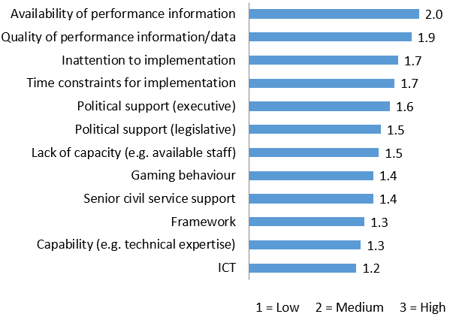
Spending Reviews: survey
Main challenges are the availability and quality of performance information

Slide 17
Spending review trends:
Summary of observations
Continued increase in the number of countries conducting spending reviews
Focus is moving away from short-term budget cuts to:
  a more medium-term view on efficiency
  improved programme impact
  alignment of spending with government priorities
Main challenges are the quality and availability of performance information

Slide 18
THANK YOU
For more information:
wojciech.zielinski@oecd.org

