Slide 1
Spending Reviews in The Netherlands
Best practices and lessons learned from the review on military readiness 2017
Sjoerd Keulen

Slide 2
Outline
Key elements of Spending Reviews in the Netherlands
Governance of Spending Reviews
SR MILITARY READINESS
Motivation
Review Process
Cases
Input & Output
Measuring Readiness
Recommendations

Slide 3
Spending Reviews since 1981, 270 Completed
Comprehensive spending review
Comprehensive spending review
Number of Spending Reviews,
year commencement of review
Focus on budget cuts
Focus on efficient management of agencies
Focus on increasing effectiveness/efficiency

Slide 4
Key elements in the success of spending reviews in the Netherlands
1. Effectiveness and efficiency
Aim of SR´s: increasing efficiency and effectiveness
2. Connected
Ongoing part of budget preparation process
3. Independent
SR topics are picked by civil servants 5-7 per year
Independent working group with non veto principle on policy options
4. Creative
Thinking out of the box
Using different sources and perspectives
Notes:
4

Slide 5
Governance arrangements for Spending Reviews
Independent, non-political working groups
Chaired independent chairman
Report has two parts
Policy description/theory
Policy/Saving options
Non veto principle in Working group
Hard cut between ‘technocratic’ and ‘political decision making’ phase
Report and cabinet respons are public

Slide 6
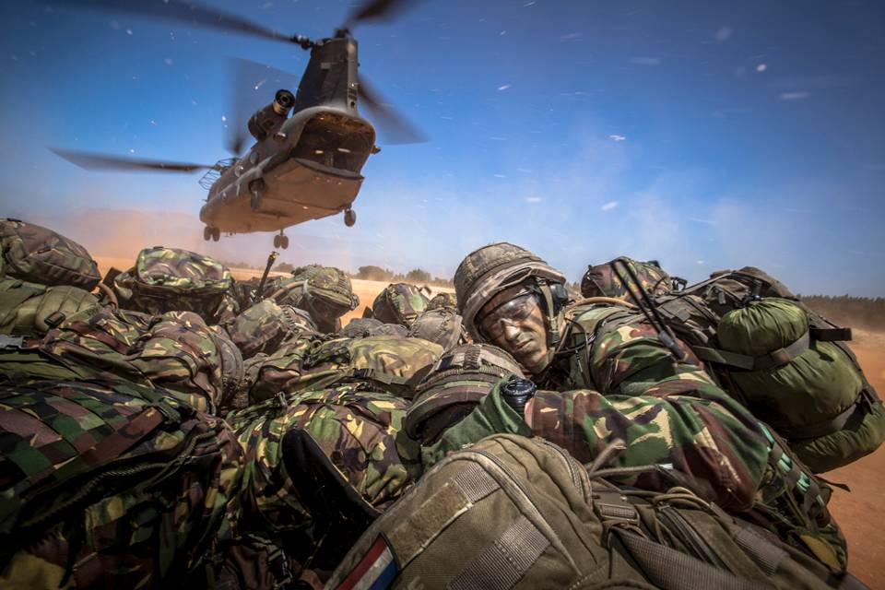
Spending Review on Military Readiness

Slide 7
Motivation of the review
Court of Audit 2016
“the deployability of the Netherlands armed forces had reduced over the past few years and that as the Ministry of Defence continued to make unrealistic demands of itself, the organisation was being run dry. … There is too little materiel available and that increasingly more units could not fully complete the necessary training and instruction programmes.”
Spending Reviews in The Netherlands

Slide 8
Review steps and process
Working Group
Members Defence, Foreign Affairs, Prime Ministers Office, Finance (independent Technology Research)
Chairman: Independent D.J. van den Berg (former SG MoFA, CEO)
Process Steps
Case selection and Data approval
Case studies in Joint Team with McKinsey and civil servants
International Survey to establish benchmark for cases
Working Visits to best practices cost-readiness modeling (UK, DK)
Analysis Phase
Recommendation Phase (“the basket”)
Spending Reviews in The Netherlands

Slide 9
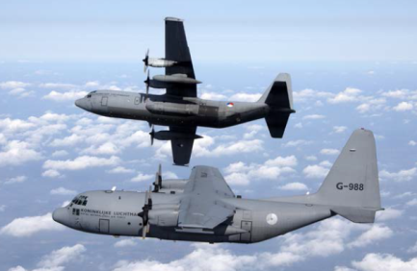
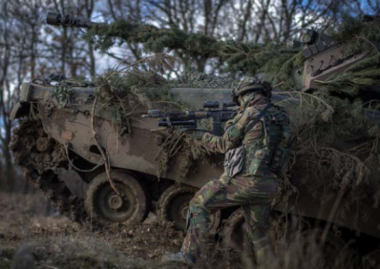
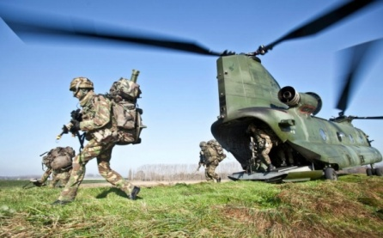
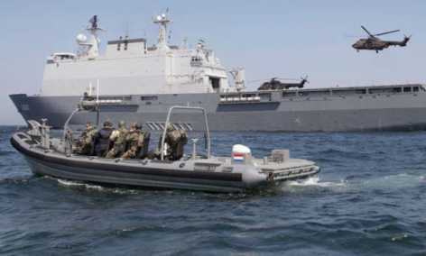
Cases
Spending Reviews in The Netherlands

Slide 10
Input
Budget
Personnel
Output
NAVY: Fitted and Staffed Ships
AIRFORCE: Equipped Staffed Planes
Outcome
Core task 1: Protecting national and allied territory
Material
Training
ARMY: Trained unites (battalions) with material and soldiers
Core task 2: Deployments
Core task 3: Assistance to interior authorities (disaster, police assistance)
=KNOWN=
DATA AVAILABLE
Operational readiness proces
Unstable output
Connection with output unclear
No correlation between input & output
Spending Reviews in The Netherlands

Slide 11
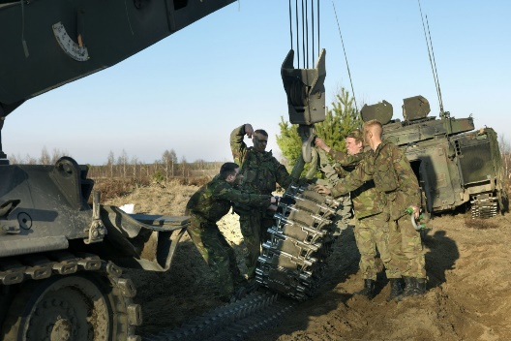
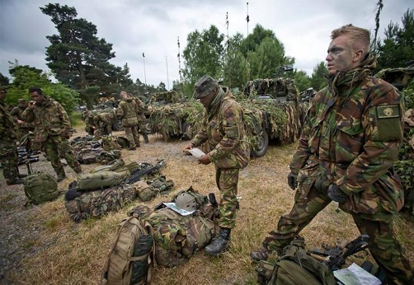
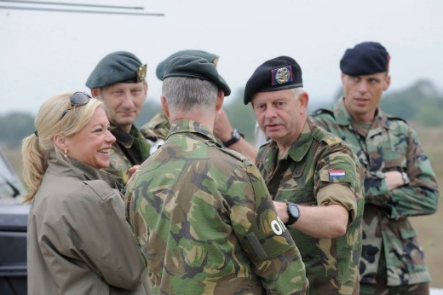
Measuring Operational Readiness
OR = PR + MR + Training
PR = Personal Readiness MR= Material Readiness
Training
+ Judgement Commander
Judgement of the Commander
Spending Reviews in The Netherlands

Slide 12
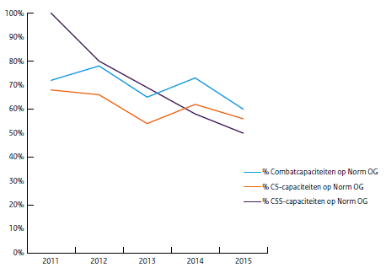
Units/Capacities at norm of Operational Readiness
% Combat units at norm OR
% CS units at norm OR
% CSS units at norm OR
Spending Reviews in The Netherlands

Slide 13
From Core task to Deployment
Core tasks
Example 2015
Usability matrix (connects tasks to capacities)
Sustainability
Norm OR
Expected OR (budget)
Realisation OR
Deployments
Zicht op gereedheid

Slide 14
Reasons for instable output
Norm of OR (PR, MR, TR) varied over years – also on unit level
Focus on deployment (Can Do Mentality)
Swiss Army Knife and Economies of Scale
Spear head focus in budget cuts
“Enablers” CS/CSS (and parts of material) were centralized in pools
Trailing investments
Material and maintenance
Personnel (vacancies and job rotations)
Training (enablers and material)
Spending Reviews in The Netherlands

Slide 15
Tasks and performance measurement
No clear norms for core task 1
Deployment in core task 2 affects readiness for core task 1 and 3
Core task 1
Core task 2
Core task 3
Deployment target 4
Spending Reviews in The Netherlands

Slide 16
From Organic Readiness to Deployment
Bat 1
Company A
Company B
Bat 2
Company A
CS/CSS
Trucks
Company C
Heavy Weapons
Company B
Company C
Heavy Weapons
Helicopters
Artillery
Spending Reviews in The Netherlands

Slide 17
From Organic Readiness to Deployment
Bat 1
Company A
Company B
Bat 2
Company A
CS/CSS
Trucks
Company C
Heavy Weapons
Company B
Company C
Heavy Weapons
Helicopters
Artillery
BACKFILL
Deployed unit
Bat 1
Company A
Company B
Bat 2
Company A
CS/CSS
Trucks
Company C
Heavy Weapons
Company B
Company C
Heavy Weapons
Helicopters
Artillery
Company A
Company B
Company C
Heavy Weapons
Helicopter
Artillery
training
2nd order effects
3rd order effects
Spending Reviews in The Netherlands

Slide 18
Recommendations (selection)
(1) Smaller organic building blocks (‘force elements’).
(2) Improve to SMART Management Performance Reporting
(3) Develop a ‘cost-to-readiness’ model that provides insight into the relationship between costs and readiness
(4) Ringfence operational ready troops to prevent readiness losses
(5) Invest in scale, standardisation, commonality & cots-mots
(6) Improve inter-ministerial cooperation and coordination
(7) Invest in Enablers (CS/CSS/Transport), replace in time
(8) Deployment Cost register (for 2nd and 3rd order effects)
Spending Reviews in The Netherlands

Slide 19
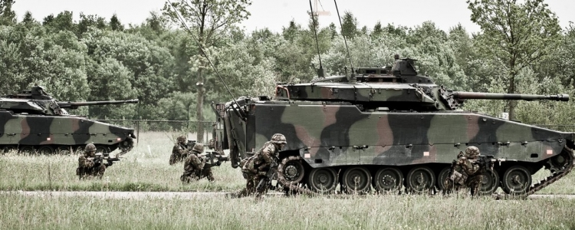
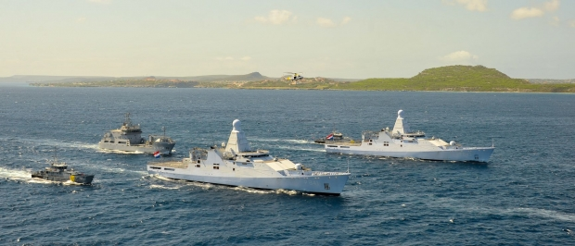
Success factors of the review
Excellent chairman with stature
and diplomatic skills
Trust between the secretaries
Joint team with consultants
Working visits to build team
Clear deadline → elections
One “basket” with
recommendations
Buy in from MoD
Contact international colleagues

Slide 20
Sjoerd Keulen
Questions?

