Slide 1
Current Challenges of Budgetary Governance: Syrian Refugees in Turkey
A. BAHADIR YILDIZ
DEPUTY GENERAL DIRECTOR
DG BUDGET

Slide 2
Outline
Refugee Crisis
Managing the Problem
Challenges of Budgetary Issues

Slide 3
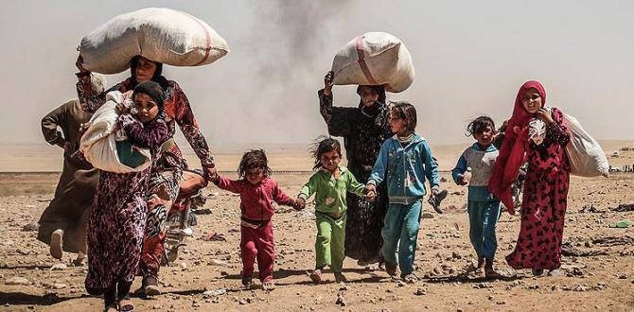
Refugee Crisis
Turkey
Lebnan
1.048.275
Jordan
655.217
Iraq
247.339
Eqypt
117.702
2.739.326 (Number of Refugees)

Slide 4
Refugee Crisis
Turkey had now become the world’s biggest refugee hosting country and had spent more than US$6 billion on direct assistance to refugees.
  UN High Commissioner for Refugees António Guterres (March 2015)
As a donor country, Turkey;
  1st as a percent of GDP (%0.21)
  3rd largest as total amount
  Global Humanitarian Assistance Report 2014

Slide 5
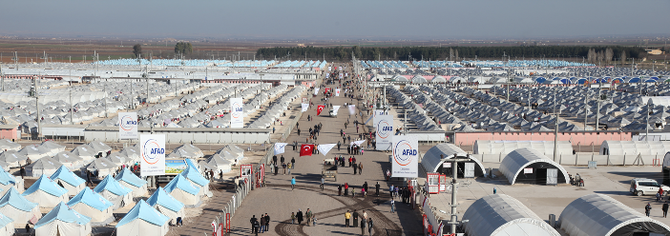
Managing the Problem
Disaster and Emergency Management Authority (AFAD) is a coordinating body for humanitarian needs of Syrians in Turkey

Slide 6
Camps
Most of the Syrian refugees come from the region close to the Syrian-Turkish border.
More than 260 thousand refugees located in 26 camps in 10 cities.

Slide 7
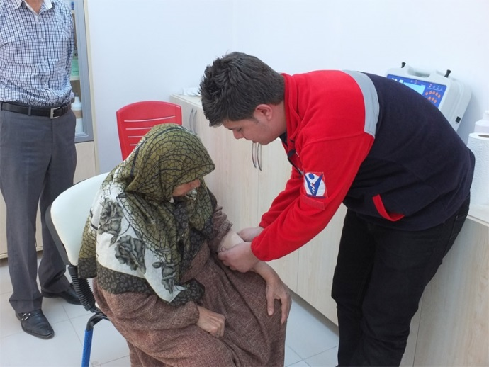
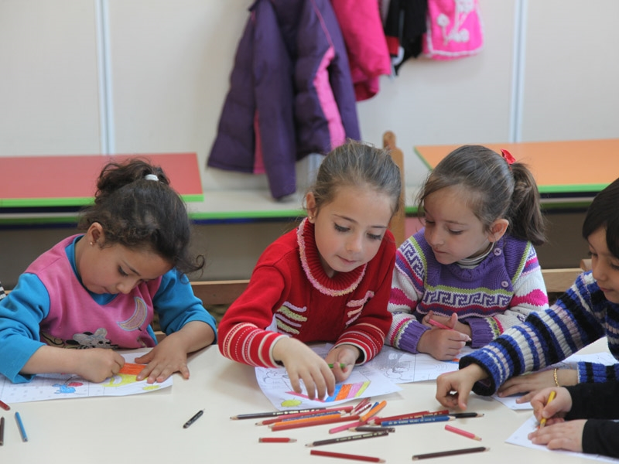
Camp-Based Services
Accommodation
Food
Health Care
Education
Security

Slide 8
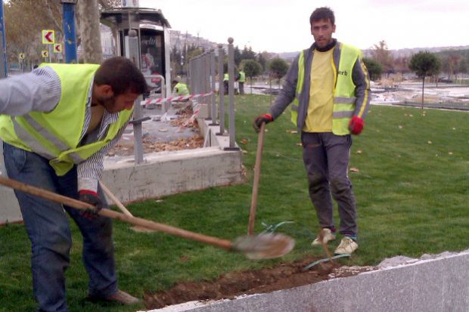
Urban Refugees
More than 2 million refugees are out of the camps,
Living in the cities,
Economic consequences

Slide 9
Impact on Economy
ECONOMY
HOUSING
EMPLOYMENT
GOODS AND SERVİCES

Slide 10
Budgetary Challenges
Turkey has spent over US$10 billion
Foreign contributions US$0.4 billion
US$2 billion per year
% 0.3 GDP

Slide 11
Budgetary Challenges
Refugees
Border Security
Movement of Troops
Hampered Trade

Slide 12
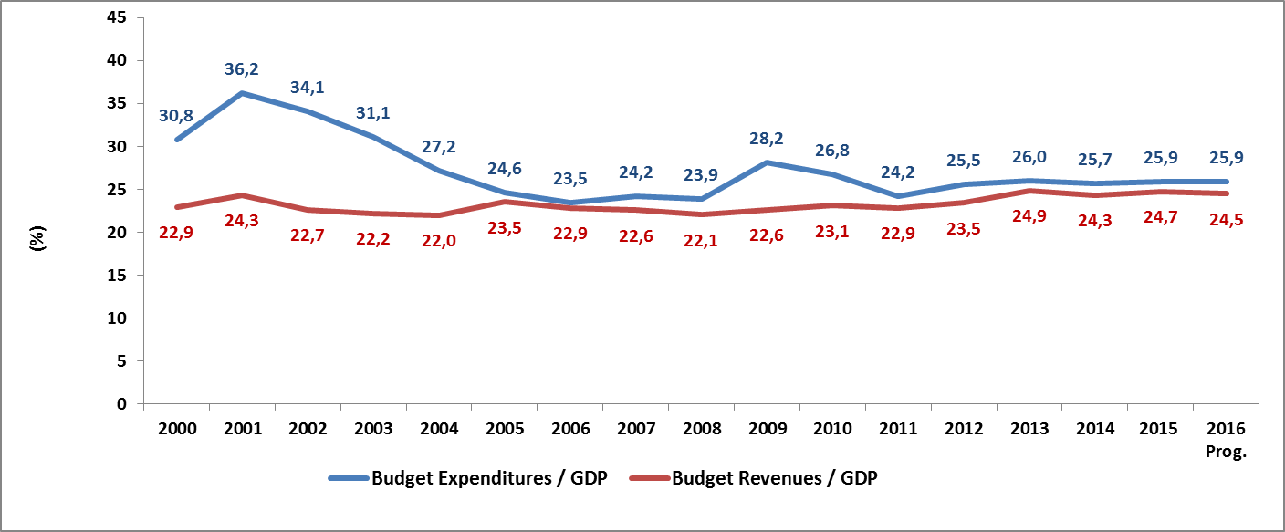
The Development of The Budget Expenditures and
Budget Revenues
2004’ten bu yana Maastricht Kriterini sağladık

Slide 13
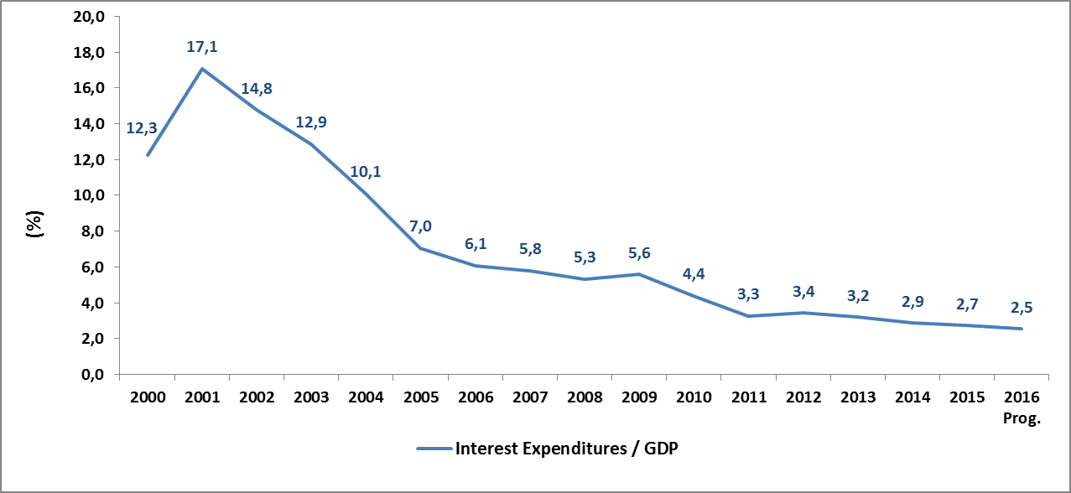
The Development of Interest Expenditures
2004’ten bu yana Maastricht Kriterini sağladık

Slide 14
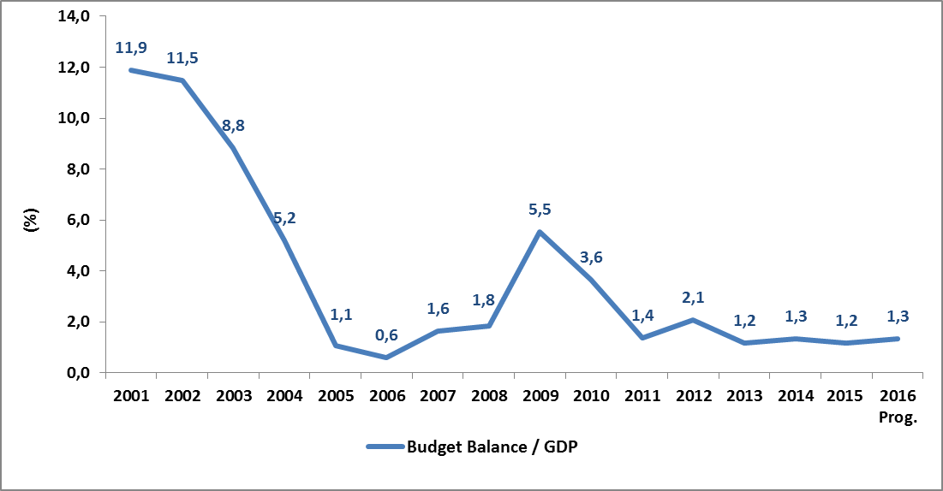
The Development of The Budget Deficit
2004’ten bu yana Maastricht Kriterini sağladık

Slide 15
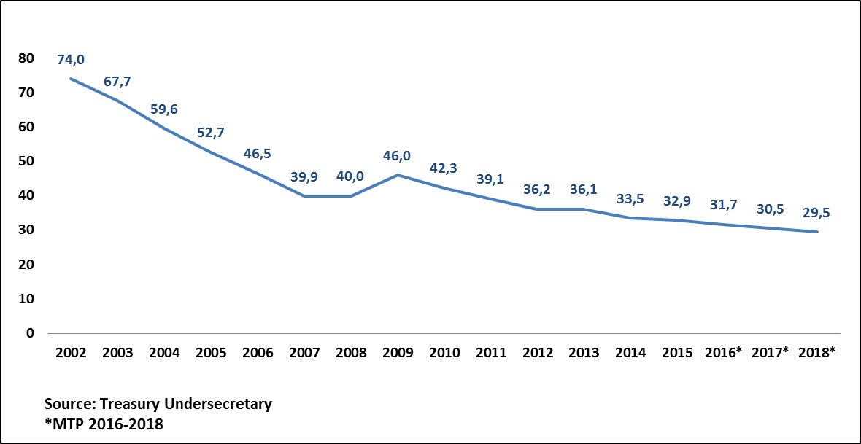
EU Defined General Government Debt / GDP (%)
2004’ten bu yana Maastricht Kriterini sağladık

Slide 16
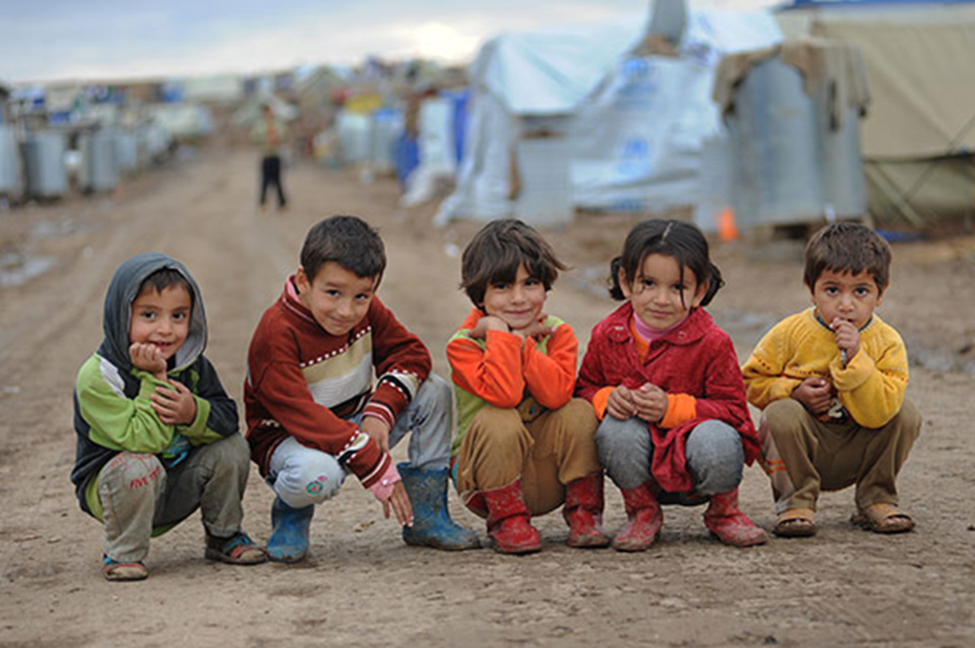
Peace at Home,
Peace in the World

