Slide 1
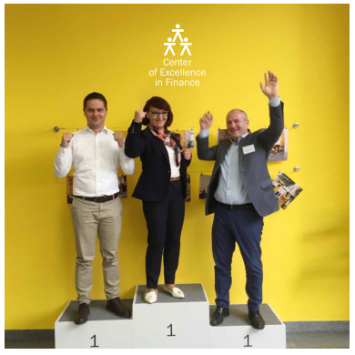
BUILDING
THE INSTITUTIONAL
AND HR CAPACITIES
TO DELIVER PFM REFORM
Jana Repanšek, Deputy Director
Center of Excellence in Finance (CEF)
MANAGEMENT/ FRONT OFFICE

Slide 2
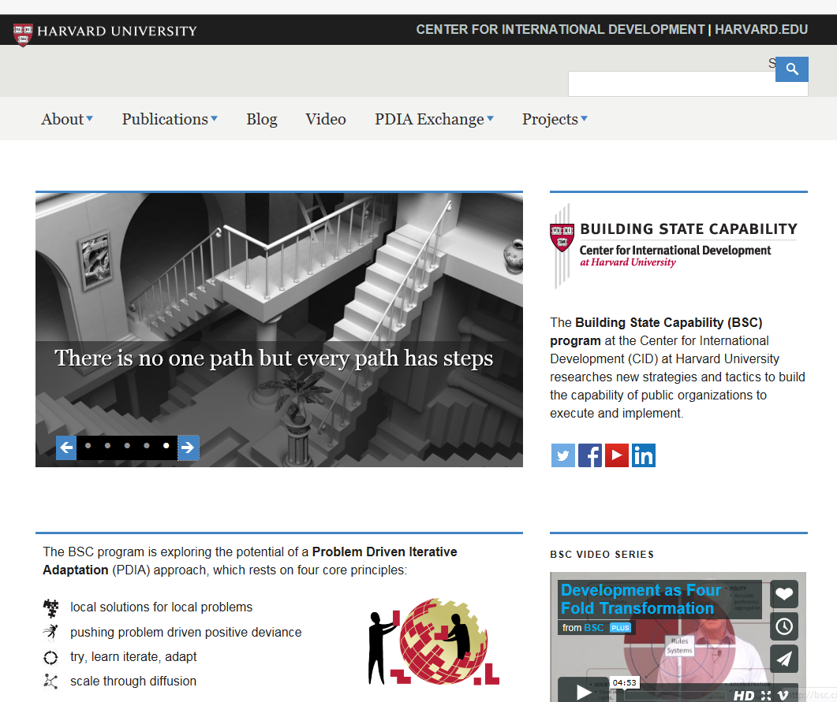

CEF applies
Harvard‘s
Building State Capability
Problem Driven Iterative Adaptation (PDIA) approach
to thematic area of PFM

Slide 3
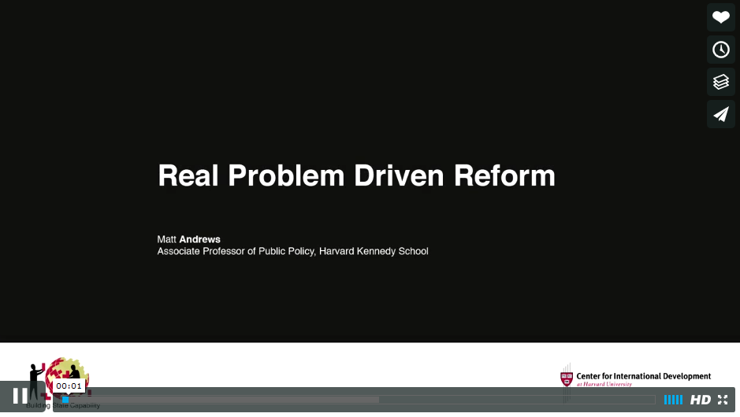
Important questions to ask: (1) What do we mean by lack of capacity; (2) How are we measuring this lack of capacity; (3) Why does it matter at all?
https://vimeo.com/91733932

Slide 4



DECONSTRUCTING COMPLEX PROBLEMS IN ISHIKAWA (FISHBONE) DIAGRAM*
CAUSE 2: ______________________
_______________________________
CAUSE 1: ______________________
_______________________________
PROBLEM
CAUSE 3: ______________________
_______________________________
CAUSE n: ______________________
_______________________________
* from Andrews M., Pritchett L., and Woolcock M. (2015). Doing Problem Driven Work. CID Working Paper 307. Cambridge, MA: Center for International Development at Harvard University.

Slide 5


INSTITUTIONAL AND INDIVIDUAL HR CAPACITIES NOT OPTIMALLY DEVELOPED
REFORMS MOSTLY APPROACHED FROM A TECHNICAL PERSPECTIVE
PFM REFORM PROGRAMS
ARE SUBOPTIMAL
PFM AND PUBLIC ADMINISTRATION REFORMS ARE DISCONNECTED
NOT ENOUGH QUALITY CD*** PROGRAMS FOR PFM EXPERTS
*** CD = capacity development

Slide 6

Building a lot of
REGULATIVE MECHANISMS
one can see and evaluate.
But not building the unseen NORMS and
CULTURAL COGNITIVE MECHANISMS
that form the foundation for the new rules of the game.

Slide 7

Building a lot of
REGULATIVE MECHANISMS
one can see and evaluate.
But not building the unseen NORMS and
CULTURAL COGNITIVE MECHANISMS
that form the foundation for the new rules of the game.

Slide 8
INSTITUTIONAL AND INDIVIDUAL HR CAPACITIES NOT OPTIMALLY DEVELOPED
REFORMS MOSTLY APPROACHED FROM A TECHNICAL PERSPECTIVE
PFM REFORM PROGRAMS
ARE SUBOPTIMAL
PFM AND PUBLIC ADMINISTRATION REFORMS ARE DISCONNECTED
NOT ENOUGH QUALITY CD*** PROGRAMS FOR PFM EXPERTS
*** CD = capacity development

Slide 9
Analyze causes and sub-causes for the problem/challenge that you and your institution face
and
if you or those that need to act have ability, authority, and acceptance to do something about it.
ABILITY
AUTHORITY
MANAGEMENT/ FRONT OFFICE
ACCEPTANCE
NO CHANGE SPACE

Slide 10
Analyze causes and sub-causes for the problem/challenge that you and your institution face
and
if you or those that need to act have ability, authority, and acceptance to do something about it.
ABILITY
AUTHORITY
MANAGEMENT/ FRONT OFFICE
ACCEPTANCE
CHANGE SPACE

Slide 11
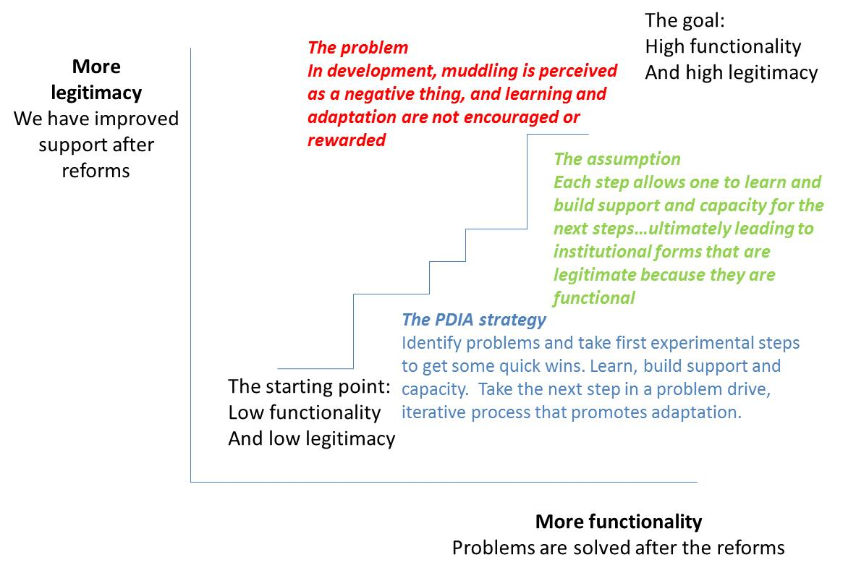
Matt Andrews @ HKS

Slide 12
BUILDING
THE INSTITUTIONAL
AND HR CAPACITIES
TO DELIVER PFM REFORM
Jana Repanšek, Deputy Director
Center of Excellence in Finance (CEF)
jana.repansek@cef-see.org
MANAGEMENT/ FRONT OFFICE

