Slide 1
Developing and Coordinating Key Performance Indicators
Structures – Processes – Challenges
Andreas Fraydenegg
Senior Adviser
DG Budget – Department for General Issues, Coordination and Law
Minsk, July 4th, 2019

Slide 2
Agenda
KPIs in the Austrian system of performance management
Lessons Learned
Future Challenges

Slide 3
The Structure of Austria‘s Performance Management System

Slide 4
KPIs in the Austrian system of performance management
Every performance goal has to include at least one indicator
For sub-goals and measures as well
„what gets measured gets managed“
KPIs can – within a broad range – be defined by line ministries themselves
Availability of data and connection to the desired outcome are key elements
„Soft“ Quality assurance through Federal Performance Management Office and Court of Audit
No single , centralised national system of KPIs from which to choose

Slide 5
Structures and Processes
Definition of performance goals, targets and KPIs falls into the responsibility of every line ministry – high degree of ministerial autonomy
Accountability and Flexibility
Usage of commonly accepted KPIs is encouraged by the MoF
Guidelines and trainings are offered by the Federal Academy of Administration
Political Project: „Austria to the Top“ – Getting better in international Rankings

Slide 6
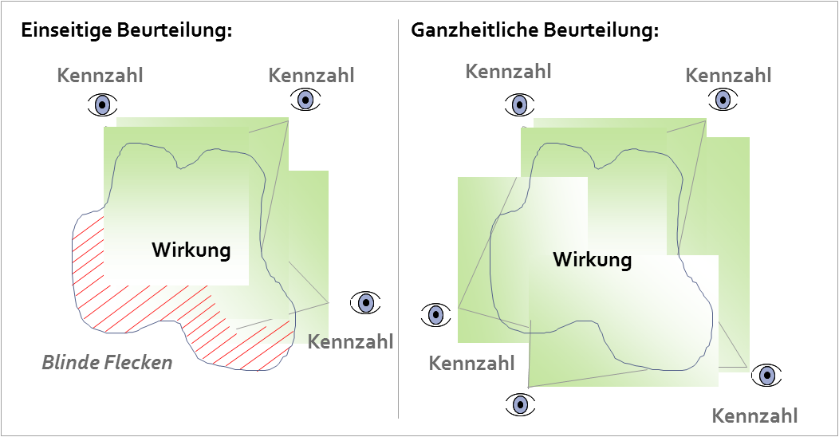
Combining KPIs: Don‘t miss the big picture…
Any social phenomenon may not be judged or managed by a single indicator, but more likely by a combination of different quantitative and qualitative indicators.

Slide 7
Coordination and Quality Assurance
Be SMART
Criteria are well known but difficult to implement
Still substantial resistance to „getting measured“
Consistency is key!
… across departments
… across time
… with international KPI systems (e.g. SDGs, EU 2020)

Slide 8
Lessons Learned
Coordination across Departments is still rather weak
Different, sometimes even conflicting indicators for similar proposed outcomes
KPIs are (still) treated with some suspicion by civil servants and politicians
Alignment with international standards and KPIs could be enhanced
Lack of ambition – triggered by low levels of trust between line ministries and the MoF
Ex post Evaluations often suffer from poor definition of KPIs and/or low quality of data

Slide 9
Future Challenges
Enhancing the culture of performance
Being bolder – setting more ambitious targets
Generally no lack of data – but priorities are sometimes missing
Gender-disaggregated perspective is often lacking
Don‘t get spellbound by KPIs – Data must always be interpreted within its context
Use of KPIs and other data in public policy debate should be furthered
Strengthening the evidence-based perspective in policy formulation
Open Data?

Slide 10
Thank you for your attention!
Andreas Fraydenegg
andreas.fraydenegg@bmf.gv.at

