Slide 1
2018 OECD Performance Budgeting
Wojciech Zieliński
Senior Policy Adviser
OECD/GOV
Minsk, 4 July 2019

Slide 2
Outline of the presentation
Quick presentation of the survey on performance budgeting
OECD good practices on performance budgeting
Developing KPIs

Slide 3
2018 OECD Performance Budgeting Survey
Fifth OECD PB Survey
Coverage:
45 questions on
Performance Budgeting
Spending Review
Evaluation
Respondents mainly from CBAs
Response rate: 33 countries (out of 35)
all 2018 data in this presentation is coming from the
2018 OECD Performance Budgeting Survey

Slide 4
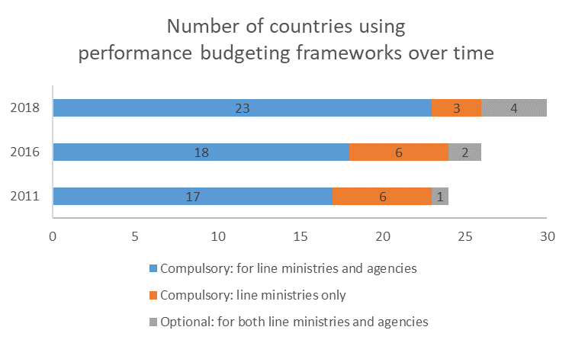
Performance Budgeting survey Use of performance frameworks continues to increase over time and are the norm across the OECD

Slide 5
Performance budgeting survey What kind of performance budgeting?

Slide 6
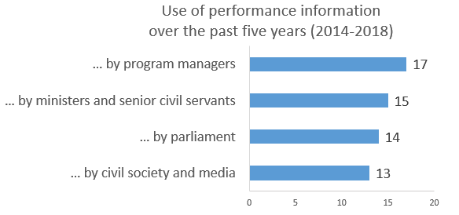
Performance budgeting survey Increased use of performance information - across a broad range of stakeholders – is observed over the last 5 years
Number of countries

Slide 7
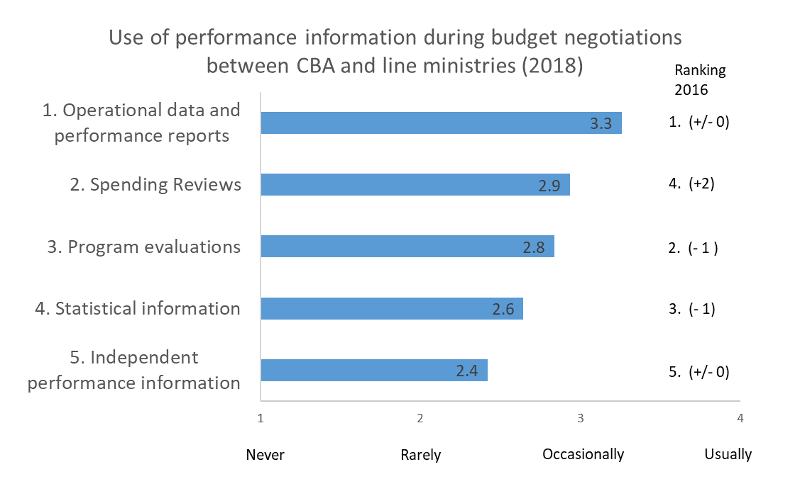
Performance budgeting survey Spending Review information is becoming more important and is more likely to be used during budget negotiations

Slide 8
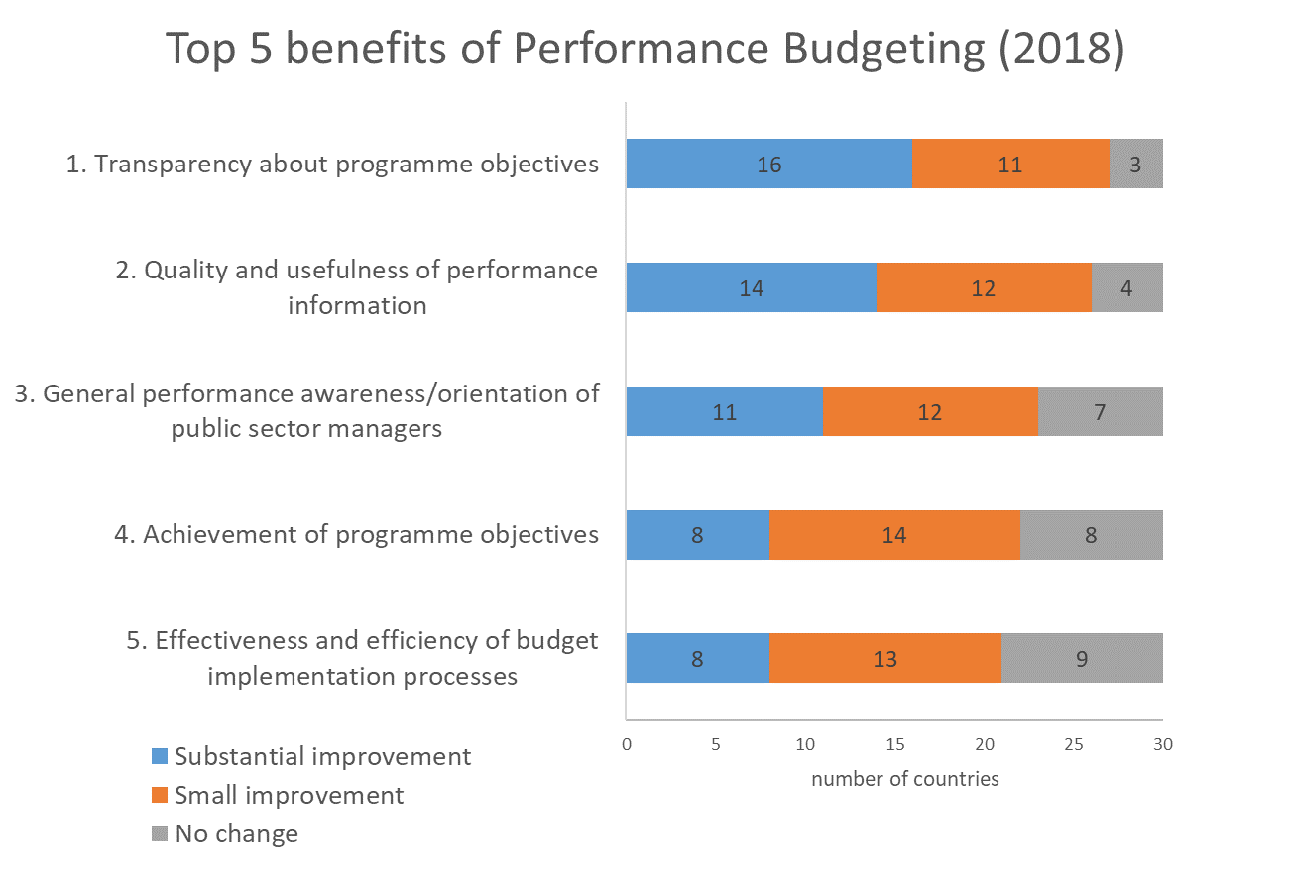
Performance budgeting survey The greatest benefits are increased transparency about objectives, and the quality and usefulness of performance information

Slide 9
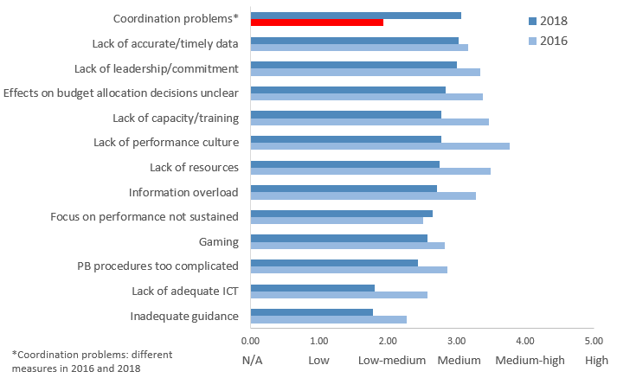
Performance budgeting survey Coordination problems are the biggest challenge
Main challenges for the implementation of performance budgeting (2018)

Slide 10
Good practices for performance budgeting Context II: OECD Framework of Modern Budgeting
Budgeting within fiscal objectives
Alignment with medium-term strategic plans and priorities
Performance, evaluation & VFM
Quality, integrity & independent audit
Transparency, openness & accessibility
Participative, Inclusive & Realistic Debate
Fiscal Risks & Sustainability
Capital budgeting framework
Comprehensive budget accounting
Effective budget execution
Performance, Evaluation & VFM

Slide 11
Good practices for performance budgeting
The rationale and objectives of performance budgeting are clearly documented and reflect the interests of key stakeholders.
Performance budgeting aligns expenditure with the strategic goals and priorities of the government.
The performance budgeting system incorporates flexibility to handle the varied nature of government activities and the complex relationships between spending and outcomes.
Government invests in human resources, data and other infrastructure needed to support performance budgeting.

Slide 12
Good practices for performance budgeting
Performance budgeting facilitates systematic oversight by the legislature and civil society, reinforcing the government’s performance orientation and accountability.
Performance budgeting complements other tools designed to improve performance orientation, including programme evaluation and spending reviews.
Incentives around the performance budgeting system encourage performance-oriented behaviour and learning.

Slide 13
Developing KPIs Dilemmas
Number and type of KPIs – what level of detail is needed?
The institutional set up and procedures for developing KPIs and setting targets
Quality standards in developing indicators
Measuring of horizontal/cross-cutting issues
Monitoring the performance
Accountability for achievements of set targets

Slide 14
Number and type of KPIs – what level of detail is needed? Output or activities` related KPIs are the most commonly used

Slide 15
Developing KPIs Dilemmas
Number and type of KPIs – what level of detail is needed?
The institutional set up and procedures for developing KPIs and setting targets
Quality standards in developing indicators
Measuring of horizontal/cross-cutting issues
Monitoring the performance
Accountability for achievements of set targets

Slide 16
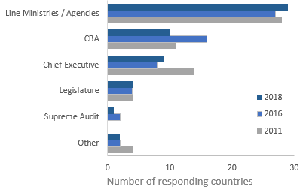
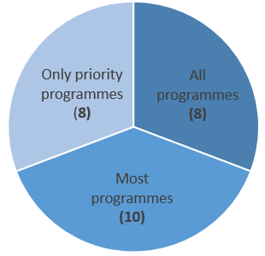
Performance budgeting survey Target setting tends to be done by line ministries, and its coverage varies
Responsibility for
target setting (2018)
Coverage of performance targets (2018)

Slide 17
Developing KPIs Dilemmas
Number and type of KPIs – what level of detail is needed?
The institutional set up and procedures for developing KPIs and setting targets
Quality standards in developing indicators
Measuring of horizontal/cross-cutting issues
Monitoring the performance
Accountability for achievements of set targets

Slide 18
Quality standards in developing indicators Many OECD countries do not implement centrally defined quality standards

Slide 19
Quality criteria important for the development of indicators Consistency with strategies is more important than benchmarking

Slide 20
Developing KPIs Dilemmas
Number and type of KPIs – what level of detail is needed?
The institutional set up and procedures for developing KPIs and setting targets
Quality standards in developing indicators
Measuring of horizontal/cross-cutting issues
Monitoring the performance
Accountability for achievements of set targets

Slide 21
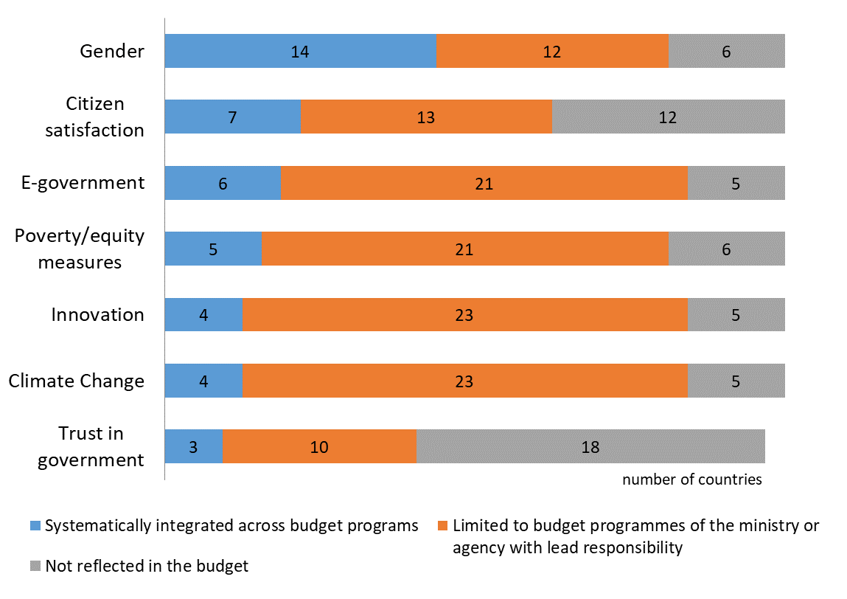
Performance Budgeting Gender is one of the thematic objectives most likely to be systematically integrated into performance frameworks
Indicators of cross cutting or thematic objectives in the budget (2018)

Slide 22
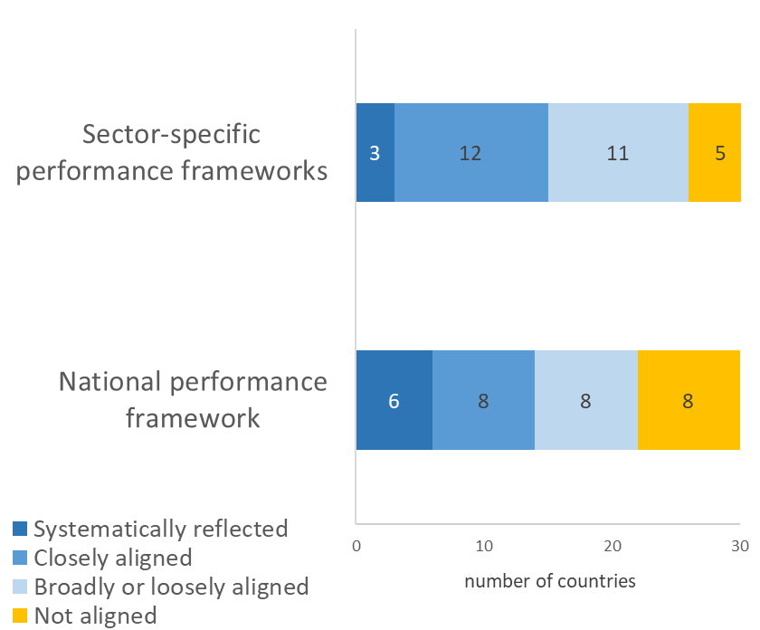
Performance budgeting survey Sustainable Development Goals (SDGs) are not yet systematically reflected in performance frameworks
Reflection of SDG targets and indicators in national frameworks (2018)

Slide 23
Developing KPIs Dilemmas
Number and type of KPIs – what level of detail is needed?
The institutional set up and procedures for developing KPIs and setting targets
Quality standards in developing indicators
Measuring of horizontal/cross-cutting issues
Monitoring the performance
Accountability for achievement of set targets

Slide 24
THANK YOU !

