Slide 1
Paris collaborative on green budgeting: from concept to action
CESEE SBO
23-24 May 2018
Zagreb, Croatia
Ronnie Downes
Budgeting and Public Expenditures Division
Notes:
I’ll be introducing you to a new initiative here at the OECD, being taken forward by a number of teams across the organisation. That initiative is called the Paris Collaborative on Green Budgeting.

Slide 2
“Green Budgeting”
  …using the tools of budgetary policy-making to improve the impact of environmentally sound and sustainable policies
  This includes:-
  assessing the trajectory towards meeting national and international commitments
  identifying “policy gaps” and areas for particular action
  assessing the coherence of policies and resources
  taking stock of environmental relative to other priorities
  contributing to informed, evidence-based debate and discussion on sustainable and inclusive growth
Notes:
Green budgeting offers a range of tools which can help align public policy and public finances with national and international commitments.
- It

Slide 3
“National and international commitments”
  Domestic and international action on environment:
  Air pollution, biodiversity, climate
  International agreements (Paris Agreement, Aichi Biodiversity Targets, related Sustainable Development Goals)
  Imperative to align policy and all financial flows
Implications for public finances?
  Fiscal sustainability
  Perverse incentives and misalignments
  Budgetary process (responses and preparation)
Notes:
So what is the rationale for green budgeting?
We are all aware of the range of international commitments now in place – notably the Paris Agreement and its aim to make financial flows consistent with a long-term, low-emission development pathway, the actions set out at COP23, the Aichi Biodiversity Targets under the Convention on Biodiversity (CBD) and the other related Sustainable Development Goals (SDGs).
There is a recognition that there is a need for financing for climate action, financing for biodiversity, development of resilient infrastructure, for example.
Climate developments have a number of implications for public finances. These financial issues go well beyond mobilising private finance.
Revenue streams will be changing and costs of climate change mitigation will be arising which could very well give rise to issues of long-term fiscal sustainability.
Within the existing policy environment, there are perverse incentives and misalignments between policies. More thought needs to go into policy coherence with the national agenda.

Slide 4
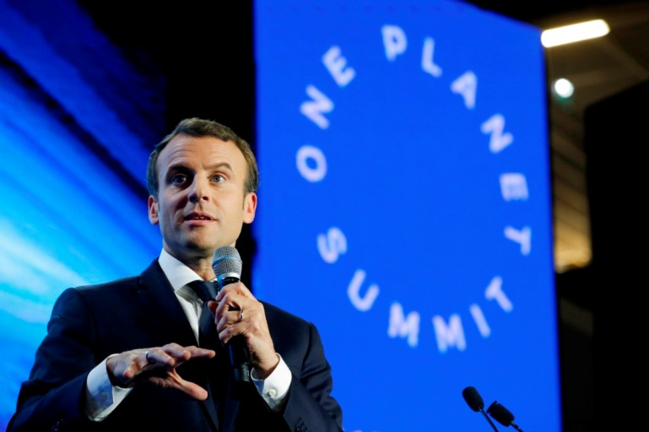
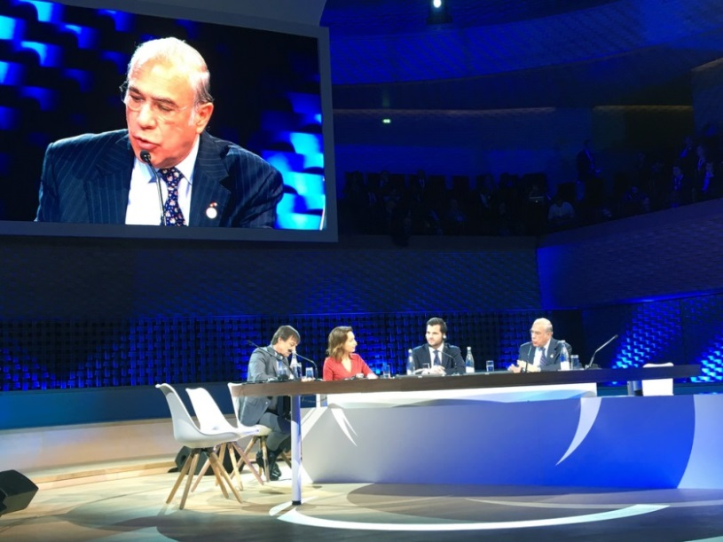
Launch of the Paris Collaborative
Launched at One Planet Summit, 12 Dec 2017 in Paris
Convened by OECD, working in close partnership with governments and experts
Notes:
It was at the One Planet Summit on 12 December in Paris that the OECD Secretary-General Angel Gurría announced the launch of the “Paris Collaborative on Green Budgeting”, a strategic initiative to assess and drive the alignment of national budgetary processes with the Paris Agreement and other environmental goals.
The announcement was endorsed by Environment Ministers Nicolas Hulot of France and Rafael Pacchiano of Mexico, during a panel discussion on the role of public policies in accelerating the ecological and inclusive transition. The announcement was also restated by President Macron in his closing remarks at the summit.
The Paris Collaborative will be convened by the OECD, working in close partnership with a range of governments around the world.

Slide 5

Building on existing OECD work streams
Budgeting for inclusive and sustainable growth
Long-term fiscal sustainability
Environmental cost-benefit assessments
Environmental tax reform
Carbon pricing and reform of harmful subsidies
Notes:
Budgeting for inclusive and sustainable growth:
The OECD is already looking at how budget systems can be used to achieve inclusive and sustainable goals. For example, the OECD is currently working with countries such as Austria and Canada to look at how budgeting systems can be better designed to help achieve overarching gender goals.
In this work we look at the budget, not as a one day event, but as a year round, even multi-year event with multiple windows to apply a gender lens. For example, in the budget development phase policy proposals can be subject to gender impact assessments. When the draft budget is presented, an accompanying gender budget statement can highlight how the new policies presented will contribute in net towards gender goals, drawing on information from the gender impact assessments.
Long-term fiscal sustainability:
LTFS analysis is done as a matter of routine, underpinned by economic and demographic projections, often with stark lessons for policy-makers. However, the OECD is looking at how to do a different multi-dimensional LTFS analysis taking into account environmental projections and shining a spotlight on what needs to be done today to achieve national and international commitments.
Environmental cost-benefit assessments:
The OECD recognises that it is important to consider the full social costs and benefits of all budget measures. As part of this, CBAs should value changes in GHG emissions, but also changes in emissions of local air pollutants. The OECD has a number of activities furthering work in this area, including pioneering work in relation to ex post CBAs of environmentally related taxes and tax provisions being done by the Joint Meetings of Tax and Environmental Experts.
Environmental fiscal reform:
Taxes are one instrument in the environment policy toolbox. For example, we all know taxes can be used to reflect the costs of pollution in prices. This not only reduces pollution, but it also does it in effective and cost-effective ways.
At present, environmentally related taxes are of limited coverage, low and there are volatile rates in most sectors except transport.
The OECD has been preparing comparative analysis of environmentally related taxes as a primer in environmental fiscal reform.
Environmental fiscal reform holds considerable opportunity. This sort of reform could be the cornerstone of cost effective environmental policy, but with few exceptions it does not deliver on that promise yet.
Carbon pricing and reform of harmful subsidies:
At the COP21 Conference on Climate Change in 2015, 195 countries agreed to decarbonise the global economy by the second half of the century. This requires deep change in the structure of modern economies and environmental fiscal reform. The OECD is undertaken comprehensive analysis in this area to help better understand what needs to be done. For example, OECD analysis of 2012 data showed that 60% of CO2-emissions from all energy use in the 41 countries are not subject to an ECR at all, 30% are subject to a rate between zero and EUR 30 per tonne of CO2, and 10% to a rate above EUR 30 per tonne.

Slide 6

A roadmap for the Paris Collaborative
Primer on green budgeting
new Green Budget Statement
Engage working groups for further scoping and refine new green budgeting tools
Develop new methodological approaches
Notes:
Range of existing tools which can inspire work in this area, for example:
Rio markers, which form an important part of the overall OECD monitoring of official development finance.
Climate budget tagging which is being used in some countries to highlight and monitor how money being spent through their budget for the achievement of climate-change goals.
The application of an environmental perspective to spending review, as has been practiced in some countries, such as the UK.
ENV WPBWE 2019-2020 work on Developing national guidance to identify and assess subsidies harmful to biodiversity
(examine and compare existing national level studies undertaken for France, Italy, etc) and develop further..

Slide 7
A roadmap for the Paris Collaborative
Launch at One Planet Summit, 12 Dec 2017 in Paris
20 June 2018
Experts Workshop
22 May 2018 Introductory workshop
September: One Planet Summit progress report
Elaborate on green budgeting definition
Scope potential green budgeting tools
Engage working group for further scoping
Develop new methodological approaches
Pilot and refine new green budgeting tools
Notes:
The Cost-Benefit Analysis and the Environment: Further Developments and Policy Use publication has been completed and the book will be available in June 2018

Slide 8
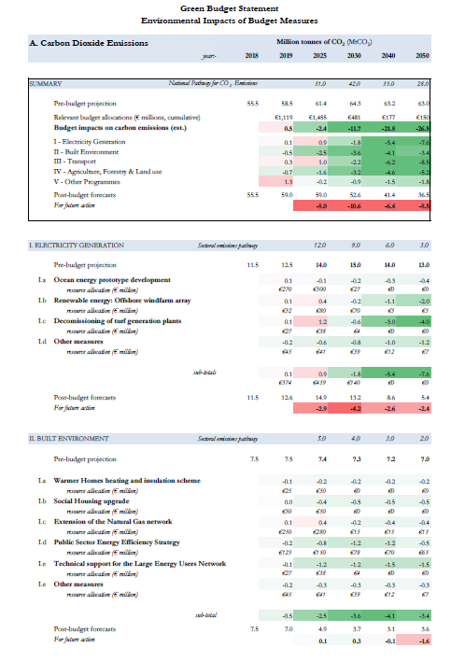
draft output 1:
Green Budget Statement prototype
a voluntary reporting tool to assess:
the environmental impact of key budget measures
contribution of annual budget to reaching environmental objectives
level and aptness of resources associated with policy measures
consistency of budgetary policies
areas for future action

Slide 9
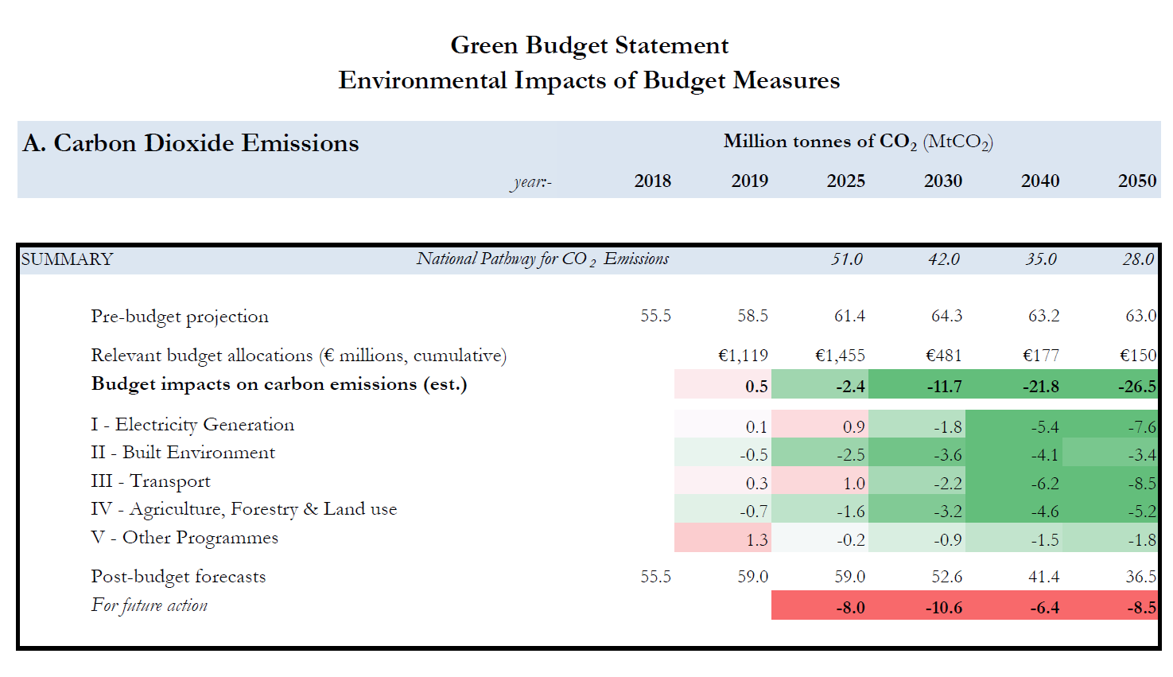

Slide 10
Other potential deliverables
Green Budget Statement – see next slide
Green Budget Baseline Analysis - “heat-map” of the environmental impact of the expenditure and tax-policy baseline
Green Budget Benchmarks to provide cross-national indicators of progress against various international environmental goals
Environmental Cost-Benefit Analysis, a major update of OECD reference publication
Green Budget Sustainability Report – long-term fiscal implications of low carbon, environmentally-sustainable economy
Tax Decarbonisation Country Scan to gauge the impact of carbon pricing and decarbonisation on fossil fuel use and on tax revenues
Green Balance sheet – valuing natural assets and liabilities
Sectoral Profile – practical impact of environmental tools?
Notes:
a Green Budget Sustainability Report which scopes out the revenue and expenditure risks and opportunities on the pathway towards low greenhouse gas emissions and climate-resilient development that are relevant for budgetary sustainability
a Tax Decarbonisation Country Scan to gauge, at the country level, the impact of carbon pricing and decarbonisation on fossil fuel use and on tax revenues, and to assess the potential of alternative tax tools;
a Green Budgeting Toolkit providing core reference and guidance on applying analytical tools and techniques. This will include a new guidance framework on a proportionate and practical approach to Environmental Impact Assessment.

Slide 11
Questions for discussion
How relevant is ‘green budgeting’ for your countries?
Which potential outputs would be most promising, in your view?
How would CESEE SBO network and its members wish to get involved?

Slide 12
Thank you
Contacts:
Juliane.JANSEN@oecd.org
Ronnie.DOWNES@oecd.org
Notes:
If you would like further information, please feel free to download the full report or the policy highlights from our website.
Thank you.

