Slide 1
OECD CESEE SBO 25 May 2018
“Budgets as Bridges”
Insights from the
Open Budget Survey 2017
Notes:
Decisions about how public resources are raised and spent are at the heart of democratic practice and inclusive policymaking

Slide 2
Open Budget Survey: Key Features
Assesses whether three pillars for a well functioning budget accountability system are in place: transparency, public participation, oversight effectiveness
Independent, evidence-based, comparative measure of budget transparency and accountability around the world
Produced by independent budget experts
Questions based on international standards
Measures observable facts using 145 scored indicators
Six rounds completed: 2006, 2008, 2010, 2012, 2015, and 2017
Covers 115 countries, including 13 new countries in 2017
Open Budget Index scores are publicized the most = public availability + comprehensiveness of key budget documents → transparency

Slide 3
OBS: What Does It Evaluate?
109 indicators used to construct the Open Budget Index assess whether governments publish online and in a timely manner eight key budget documents
18 revised questions examine formal oversight institutions
18 new questions examine opportunities for public participation in national budget decision-making and oversight

Slide 4
OBS: Coverage of CESEE+PEMPAL
Countries Assessed in the OBS 2017
10 Countries
Not Assessed
Albania
Azerbaijan
Bosnia-Herzegovina
Bulgaria
Croatia
Czech Republic
Georgia
Hungary
Kazakhstan
Kyrgyz Republic
Macedonia
Moldova
Poland
Romania
Russia
Serbia
Slovakia
Slovenia
Tajikistan
Turkey
Ukraine
Armenia
Belarus
Cyprus
Estonia
Kosovo
Latvia
Lithuania
Montenegro
Turkmenistan
Uzbekistan

Slide 5
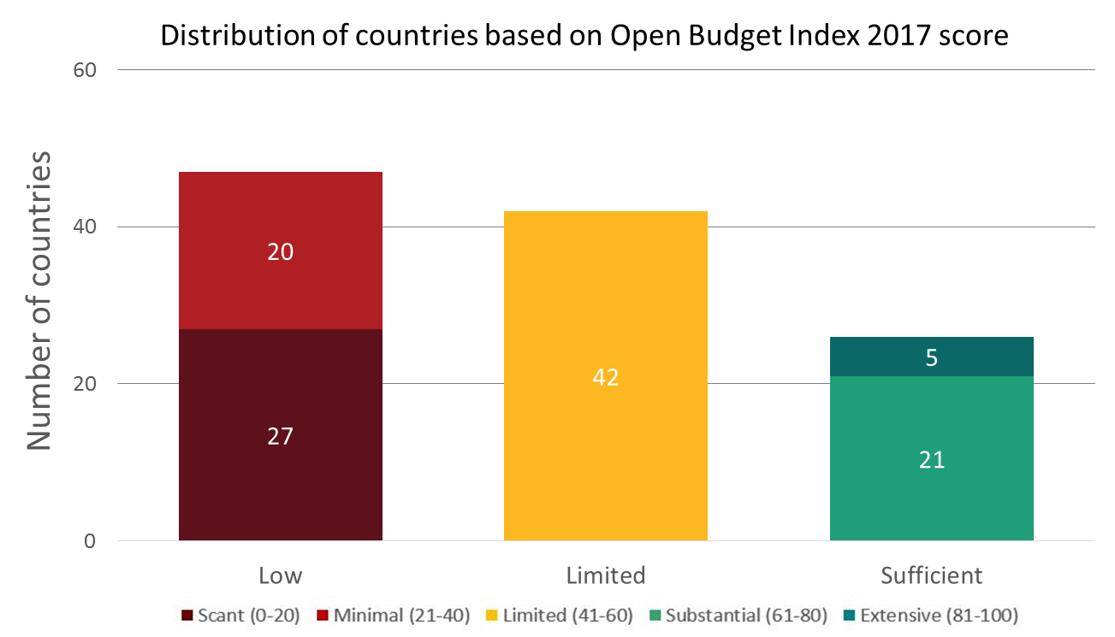
Finding #1: 3 of Every 4 Countries Fall Short on OBI
Average OBI score of the 115 countries surveyed in 2017 is 42 out of 100, → the global state of transparency is limited
89 of 115 countries surveyed fail to provide sufficient information to the public on their national budgets
Notes:
Governments fail to make sufficient information available to the public to understand, debate and participate in budget decisions

Slide 6
CESEE/PEMPAL Results: Countries Provide Limited Budget Information
On average, the CESEE/PEMPAL countries score 55 out of 100 on the OBI
Higher than the global average (42)
Lower than the OECD average (68)
Score > 60 is sufficient
CESEE/PEMPAL
115 countries
21 countries
22 countries

Slide 7
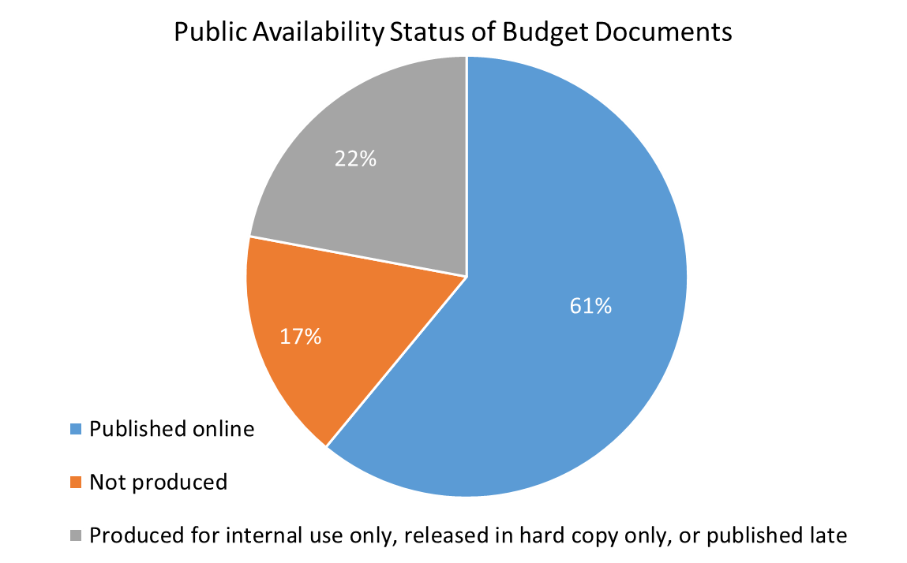
Global: 40% of Key Documents Not Published
Of those documents that are not publicly available, more than half are already produced by governments
Notes:
ECA has a higher rate of document publication, with 79% of the eight documents in the 21 countries available to the public.
Of the remaining documents that are not available, however, 8% are published late, 2% are published for Internal Use only, 1% is published in Hard Copy only, and 10% are not produced at all.

Slide 8
Public Availability of Key Documents: Global vs CESEE/PEMPAL
Global (115 countries)
CESEE/PEMPAL (21 countries)
Documents where performance can improve
Notes:
Percent of countries publishing key budget document in 2017
ECA has above average publication rates for documents such as the EBP, EB, IYRs, YER and Ars, however is closer to the global average with lower publication rates for the PBS, CB, and MYR

Slide 9
Finding # 2: Increases in Transparency Halted btw 2015 & 2017
The average OBI score fell from 45 in 2015 to 43 in 2017 for the 102 countries surveyed in both rounds
But, taking a longer view (2008-2017), we see that:
Transparency has increased→ OBI score went up by 6 points
Documents are, overall, more comprehensive than 10 years ago
Individual country gains, in the region and globally
Notes:
Progress toward greater transparency has stalled for the first time since IBP began measuring it over a decade ago

Slide 10
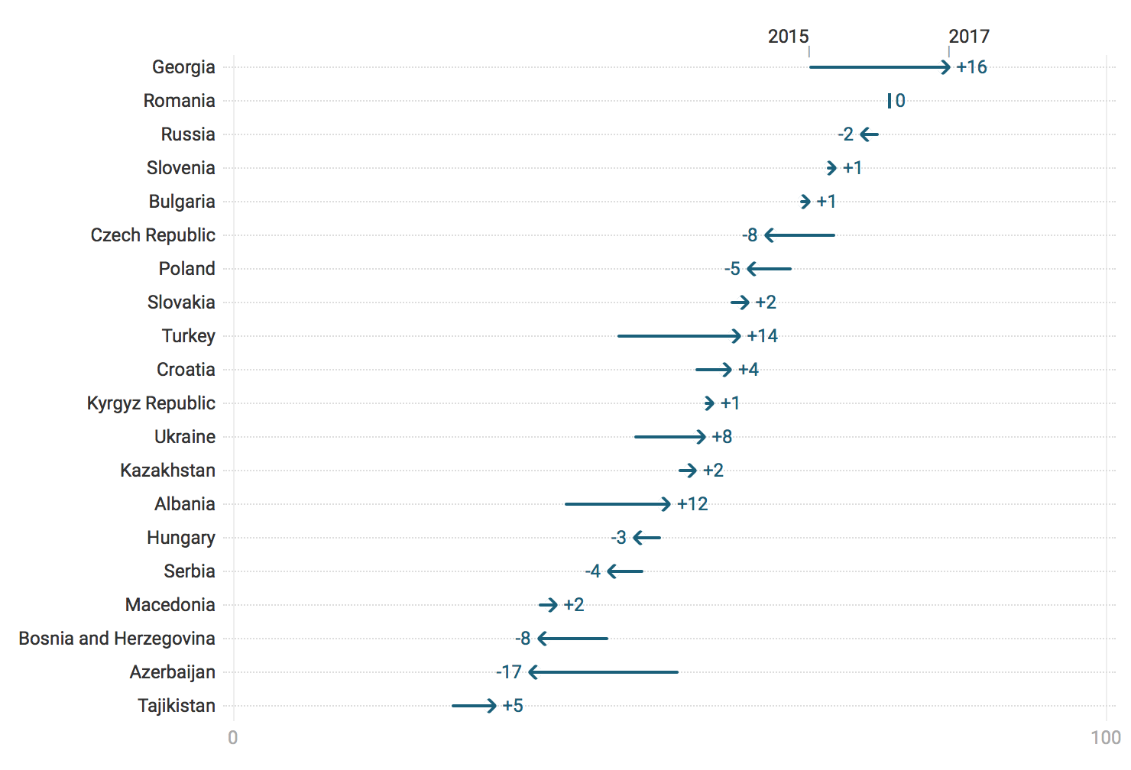
CESEE/PEMPAL: Changes in OBI Scores 2015-2017
Notes:
Overall, +1 change in score for ECA countries, as compared to -2 at the global level
These figures are for 20 countries, excluding Moldova which only started the OBS assessment in 2017
Large gains seen in Georgia (+16), Turkey (+17), and Albania (+12) declines seen in Azerbaijan

Slide 11
Common Challenges, based on the 2017 OBS assessment of budget transparency in the region
Pre-Budget Statements are produced but not published → make them available within the appropriate timeframe & online
Mid-Year Reviews are not produced → discuss with peer countries, what do they include, when do they start preparing it, etc.
Citizens Budgets are not produced → refer to the PEMPAL knowledge product “Breaking Challenges in Constructing Citizens Budgets for PEMPAL Countries”, discuss with peer countries, take inspiration from other countries around the world
Executive’s Budget Proposals lack comprehensiveness → more fine tuned, individual country analysis of what information is missing in the EBP package. Caveat: differs from country to country
Performance information is incomplete throughout the budget process (in both formulation and execution phases) → discuss what is feasible, given each country’s budgeting system

Slide 12
Thank you!

Slide 13
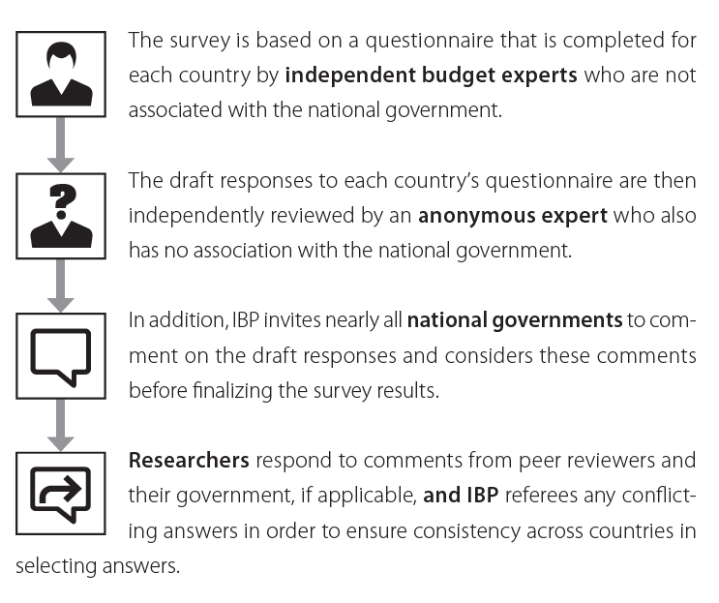
The OBS Research Process

Slide 14
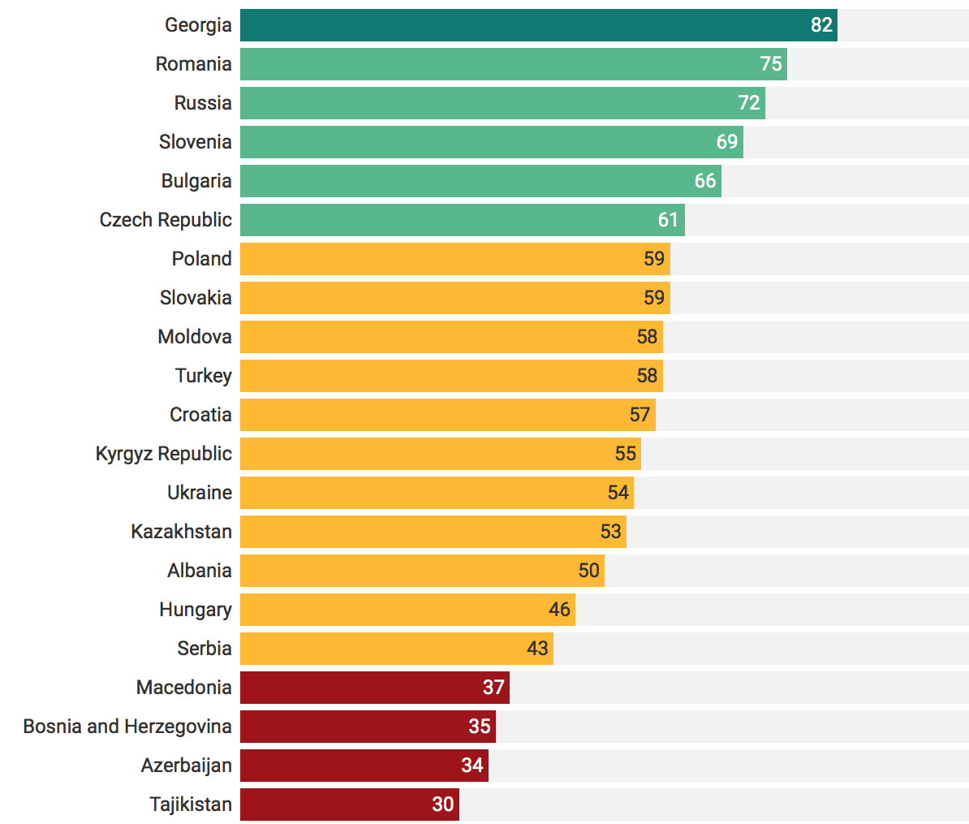
OBS 2017: Results for CESEE+PEMPAL
Of the 21 countries covered in the OBS 2017,
71% fail to provide sufficient budget information
Notes:
Only six countries provide sufficient budget information (>60) – Czech Republic, Bulgaria, Slovenia, Russia, Romania, and Georgia

Slide 15
Global State of Budget Documents
The OBS is anchored on eight key internationally recognized budget documents necessary to inform the four stages of the budget cycle
These include planning documents, execution reports, and the audit findings
Publicly available documents = published online and in a timely manner (the acceptable timeframe varies for each document).
Cutoff date: for the OBS 2017, only documents that should have been published prior to 31 December 2016 have been assessed

Slide 16
Taking a Longer View: 2008 - 2017
The decline in budget transparency in 2017 did not erase all of the gains from previous rounds of the OBS → Between 2008 and 2017, the average OBI score rose by 6 points for comparable countries
Increase in comprehensiveness: available budget documents contain more information than they did in previous years
Individual country gains: substantial improvements in diverse countries like Georgia, Jordan, Mexico, and Senegal → any government can register impressive gains in transparency in a short period of time

