Slide 1
Session 7: fiscal risk management
15th Annual Meeting of
OECD-CESEE Senior Budget Officials
4-5 July 2019
Minsk, Belarus
Andrew Blazey and Delphine Moretti
Budgeting and Public Expenditure Division
Public Governance Directorate

Slide 2
Contents
Fiscal risk management in the OECD
Recent OECD studies on mitigating fiscal risks
    Healthcare
    Natural disasters

Slide 3
Fiscal risk management in the OECD

Slide 4
Fiscal Risk Management
32% of OECD countries have defined criteria for guiding the identification of fiscal risks.
Risks identification
Risks measurement
Forecasting
Disclosure
Prevention
Mitigation
Provision
Reserve
Analysis
Fiscal Policy
Legislation specifies the “government fiscal risk policy” in only one country.

Slide 5
When is a risk a fiscal risk?
Are all potential developments identified?
What is included in the forecast?
What is the time horizon considered?

Slide 6
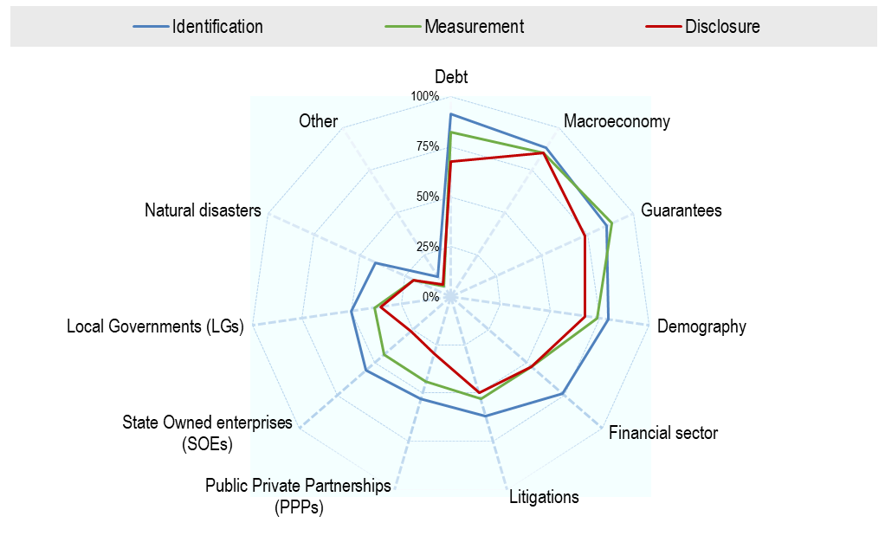
Which fiscal risks are identified by OECD countries?
Source: OECD (2018), OECD Budget Practices and Procedures Survey, Question 77, OECD, Paris.
StatLink 2 http://dx.doi.org/10.1787/888933946704

Slide 7
How to manage fiscal risks?
Prudent fiscal policy
Prevention
Mitigation
No-bail out provisions
Hedging
“Headroom”
Short-Term
Provisions
Long-Term Reserves
Regulation
…
Risk
specific
Source: OECD Recommendations of the Council on Budgetary Governance and Coping with fiscal risks, Journal on Budgeting, 2014).

Slide 8
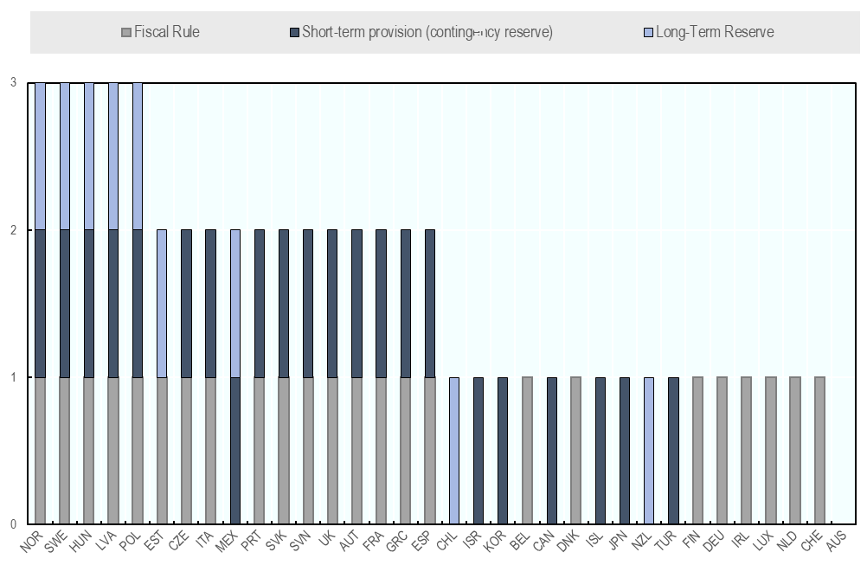
What are the approaches in OECD countries?
Prevention/Mitigation
Source: Adapted from Questions 12a and 79 of the OECD Budget Practices and Procedures Survey.

Slide 9
Recent OECD studies on mitigating fiscal risks

Slide 10
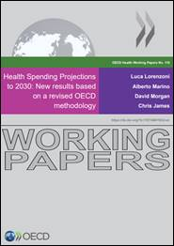
Health spending and natural disasters are short to medium-term fiscal risks…
…likely to increase over the long-term due to ageing and climate change.

Slide 11
Are health spending projections policy relevant?
The OECD proposes scenarios based on key drivers for health spending: enhanced/low productivity; cost control/pressures; life-style policies.
Projections must be devised to be as policy relevant as possible (i.e. estimate the effects of a range of policy options).
OECD projection results show that across all scenarios, health spending will increase in per capita terms and as a share of GDP.
The extent of this increase will depend on the quality of decision-making and the monitoring of risks around health care costs.

Slide 12
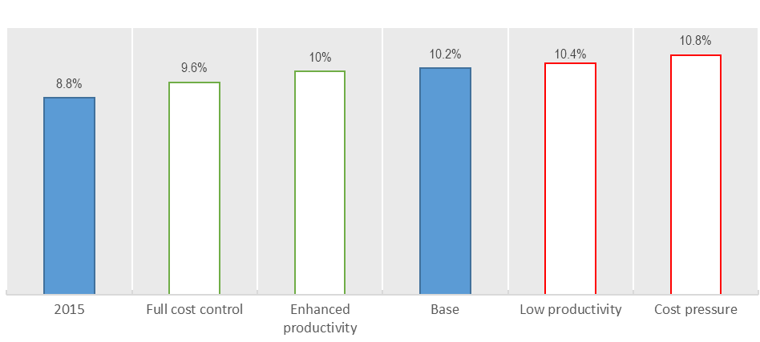
Projections for health spending as a share of GDP
Full range of OECD scenarios, OECD average
Source: OECD (2018), Health Spending Projections to 2030: New results based on a revised OECD methodology, https://dx.doi.org/10.1787/5667f23d-en

Slide 13
Can natural disaster risks be measured comprehensively?
Expenditures
Direct payments to populations
Reconstructions of public infrastructure
Revenue losses
Economic stimulus
Transfers to Hospitals, LGs, SOEs
Reductions in tax bases
Deliberate tax cuts

Slide 14
How to mitigate natural disaster risks?
Analysis of the risks in the fiscal risks statement.
Measurement of the impacts of natural disasters as part of stress tests, to inform the development of the fiscal strategy.
Understanding of the key drivers for cost pressures allows in turn more effective mitigation strategies.
Example of good practices:
Clear cost-sharing mechanisms across levels of government;
Incentives for non-governmental stakeholders to reduce disaster risks ahead of disasters;
Ceiling on disaster recovery costs and development of financial strategies to cover for residual risks.

Slide 15
Concluding thoughts
The measurement of risk is a key component of any mitigation strategy: the method often needs to be tailored to the fiscal risk considered.
When measurement is policy-relevant, (non-fiscal) policy levers can be more easily identified to mitigate specific fiscal risks.
Measuring and mitigating short-term fiscal risks (e.g. natural disasters) is a step towards better managing longer-term sustainability challenges (e.g. climate change).

Slide 16

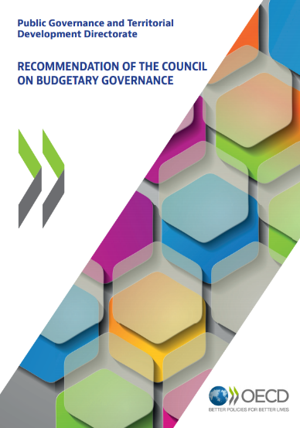
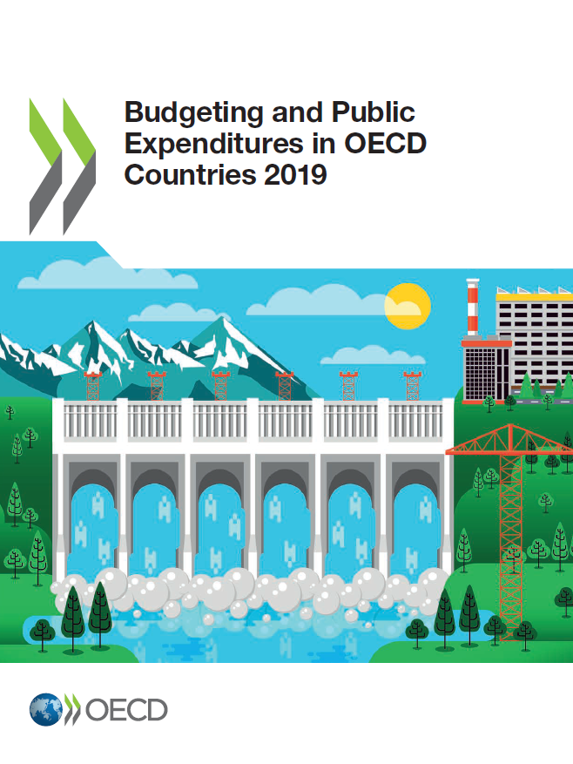
OECD Recommendations and Surveys
OECD recommendations and research:
Disclosing risks of deviations from government economic forecasts as “key fiscal risks” (Best Practices for Budget Transparency, 2002);
Identifying, classifying, quantifying and mitigating fiscal risks (Principles of Budgetary Governance, 2012).
Fiscal risks management in OECD countries:
Fiscal Risks Mini-Survey, 2014;
Budget Practices and Procedures Survey, 2018.

Slide 17
Thank you
http://www.oecd.org/gov/budgeting/
Andrew Blazey
Andrew.BLAZEY@oecd.org
Ana Maria Ruiz Rivadeneira
AnaMaria.Ruiz@oecd.org
Budgeting and Public Expenditure
Public Governance Directorate, OECD

